Slide 1
Notes From the Field & The 1619 Project
Interdisciplinary Unit
English Daily Slides
Week 5

Slide 2
Table of Contents
Workshop: Transcribing Your Oral History
Workshop: Gist Statement and Detail Selection
Workshop: Monologue Writing
Workshop: Monologue Writing and Peer Review
Workshop: Monologue Revision
Workshop: Rationale Preparation
Workshop: Rationale Writing
Monologue Performances and Final Discussion

Slide 3
Workshop: Transcribing Your Oral History

Slide 4
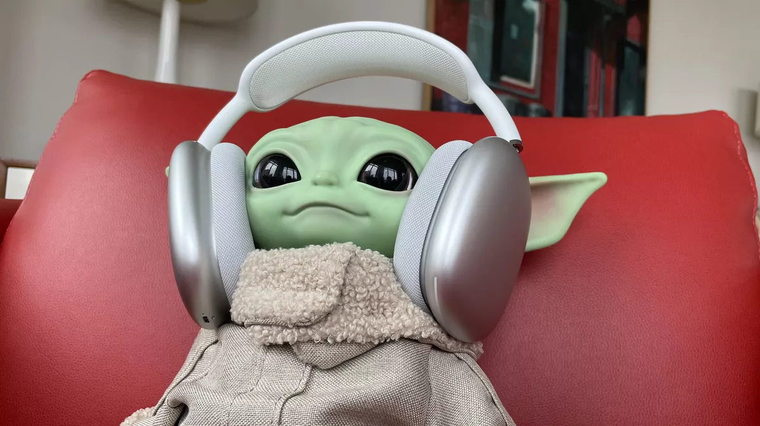
How to transcribe? (Here’s a helpful guide document)
Listen to the full recording all the way through uninterrupted
Select the proper tools (Notebook vs. paper and pencil, headphones, your recording)
Write a first draft
Use shortcuts/abbreviations
Proofread your draft for spelling/formatting errors

Slide 5
Properly formatted transcript sample
Michael Smith: Welcome back, Lincoln. This is the third part of our interview, and I would like to get you through these as efficiently as possible as I know you have another interview later in the day.
Laura Baker: Thank you. I would greatly appreciate that.
MS: It states on your resume that you use to work for JKL Company, in the sales department. What did you do there?
LB: Yes. I worked as a Sales Manager there for two years. I increased sales from $500-000 to $1 million over the course of those two years.
MS: So you increased sales there by $500,000 in only two years?
LB: Yes, and I’m very proud of that.
Notice
- Abbreviations of names after they are first stated
- New line for each change in who is speaking
- Spelling and grammar that reflects the conversation

Slide 6
Components of Summative
Government policy directly and indirectly impacts communities and individuals, which can be discovered through personal narrative.
A rationale (Criterion A, Evaluating):
Explain how you conducted your oral history and how you developed that into a monologue. Explain the policy or inequity that you focused on for your oral history, and why. Then explain which elements of dramatic monologue you want to emphasize, and then explain how you did that. You will have an outline to help you with this process.
An oral history and monologue (Criterion B, Synthesizing)
The oral history
The dramatic monologue will take the oral history as a draft. You will then take the elements of dramatic monologue (diction, characterization, dialogue, perspective, and imagery) to turn
A reflection (Criterion C, Reflecting)
This reflection will use the framework of a Personal Project reflection to determine what students learned from this project as an interdisciplinary endeavor and what students can take away moving forward. The journal entries from English will be a core part of this work, which will be finished after the oral histories are complete.

Slide 7
What is in the monologue?
Government policy directly and indirectly impacts communities and individuals, which can be discovered through personal narrative.
Stage directions showing what the speaker looks like, their attitude, where they are
An inequity, inequality, or some reference to a violation of a right granted by an amendment
A story with a beginning, middle, and end
Devices of dialect, imagery, perspective, characterization, diction, punctuation, and point of view
There is reflection/restoration in the narrative

Slide 8
Formative 6: Adapting your Transcript into a Monologue
*Keep the words of the oral history intact to honor your subject
*Look for the restorative story (acknowledgement of harm but also empowerment through truth and/or validation.)
Use the following literary concepts honor your subject’s story
Diction: Dialect words with strong connotation, denotation
Imagery: Specific details that describe the sensory experience
Perspective: Specific details that establish beliefs or values
Characterization: Stage Directions that establish direct or indirect
Review some of the monologues that we read over the course of this unit.
Notes:
Today’s slides are compliments of Mx. Benner :-)

Slide 9
Feeling Stuck Working with Your Oral History?
Write some follow-up questions to ask your interviewee add to the end of your transcript.
You can tell them that as you’ve started crafting your monologue you’ve realized that you need a little more material.
Ask them “tell me about a time when you or someone you know...”
Ask them “Can you paint a picture of this moment. What did it smell like, feel like, sound like?”
Have you come to terms with this experience? Have you healed from it? Is it something you are still navigating? *Note these questions will help you incorporate a few lines linking to your interviewee’s restorative narrative.
Language from Rubric for Monologue Section

Slide 10
Workshop: Gist Statement and Detail Selection

Slide 11
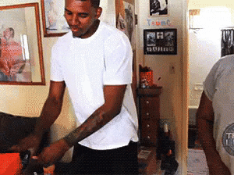
Gist Statement - What are we talking about?
Listen to your entire interview
Determine at its core, what was the story or topic?
Family?
Work?
Love?
Strife?
In a sentence, sum up the story/message of the interview and keep it in mind as you are tackling your monologue adaptation
Think of the gist as the “core” or “root” of the narrative

Slide 12
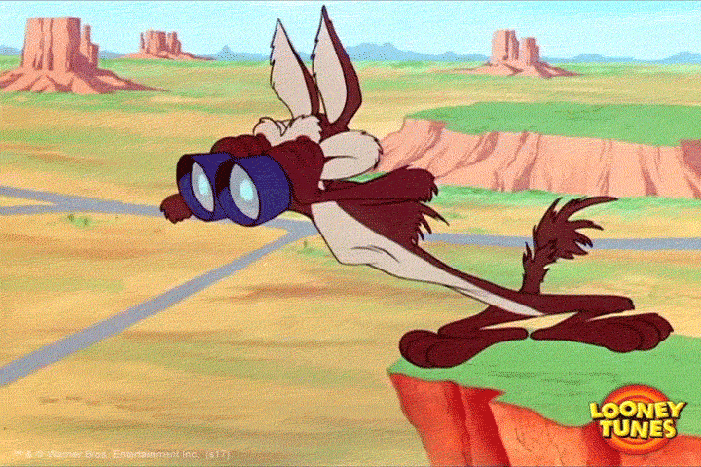
Details...Where do I find them? What am I looking for?
Remember, you are keeping as much of the language of your oral history as possible and adding only what is absolutely necessary to clarify the narrative/message
Highlight details in your transcript that
Tell a story
Give information/help you visualize
Show the speaker’s perspective
Show the speaker’s speech (dialect)

Slide 13
Let’s talk it through
Butler: What did you do during the week for recreation or fun?
Mrs. Royster: Nothing but just play.
Butler: Did you play close to where you lived?
Mrs. Royster: Yeah. Children played together from house to house, you know, like that.
Butler: You were very close with your family? You were the oldest child?
Mrs. Royster: Yeah, I was. Yes.
Butler: Did this cause you to have extra responsibilities?
Mrs. Royster: Yes, it did, because I was the oldest. Yes, indeed.
Butler: What did you have to do? Did you have to more or less take care of the children while
your parents worked?
Mrs. Royster: That’s right. Take care of the children best I could for a little girl growing up.
Let me see, I – [indiscernible] and two younger ones. I took care of all of them.
Butler: You say that you took care of who? I didn’t hear you, Ms. Royster.
Mrs. Royster: I took care of my oldest brother. He – well, Momma had to go out to work, you
know. Because he was the oldest son he thought he was the boss, but she said I – so he had to
help me, you know. He had to help. He wasn’t much help because he was a boy.
Butler: So he didn’t help much?
Mrs. Royster: No.
Butler: Were you responsible for doing household chores?
Mrs. Royster: Yeah. Yes, indeed. Yes indeed, rocking the baby in the old-fashioned cradle.
Butler: You had to take care of the babies?
Mrs. Royster: Yeah.
Butler: As they grew up?
Mrs. Royster: As they grew up.
Butler: And the boy - the oldest boy, what was his name, Ms. Royster?
Mrs. Royster: [Harley] Carrington.
Butler: He wasn’t much help, huh? What was he doing?
Mrs. Royster: No, he wasn’t much help, either. He liked bossing.
Butler: What was he doing?
Mrs. Royster: Playing.
Butler: Playing?
Mrs. Royster: Yeah. Just playing, uh huh. He called me this morning.
Butler: Last time we talked you told me about some parties that you had gone to. Some parties
that you had. Right.
Mrs. Royster: Uh huh. Well, it really wasn’t much like you call them parties now.

Slide 14
Transcribe your oral history and write your monologue
Transcript should look like this (3-5 min is sufficient)
JT: Tell me more about that experience.
BT: Well, um...it’s difficult for me to talk about.
JT: I’m listening.
BT: ...So, I was minding my own business when I heard a knock on the door...
Monologue should look like (300-500 words is sufficient):
Well, um...it’s difficult for me to talk about...I was minding my own business when I heard a knock on the door…

Slide 15
Workshop: Monologue Writing

Slide 16
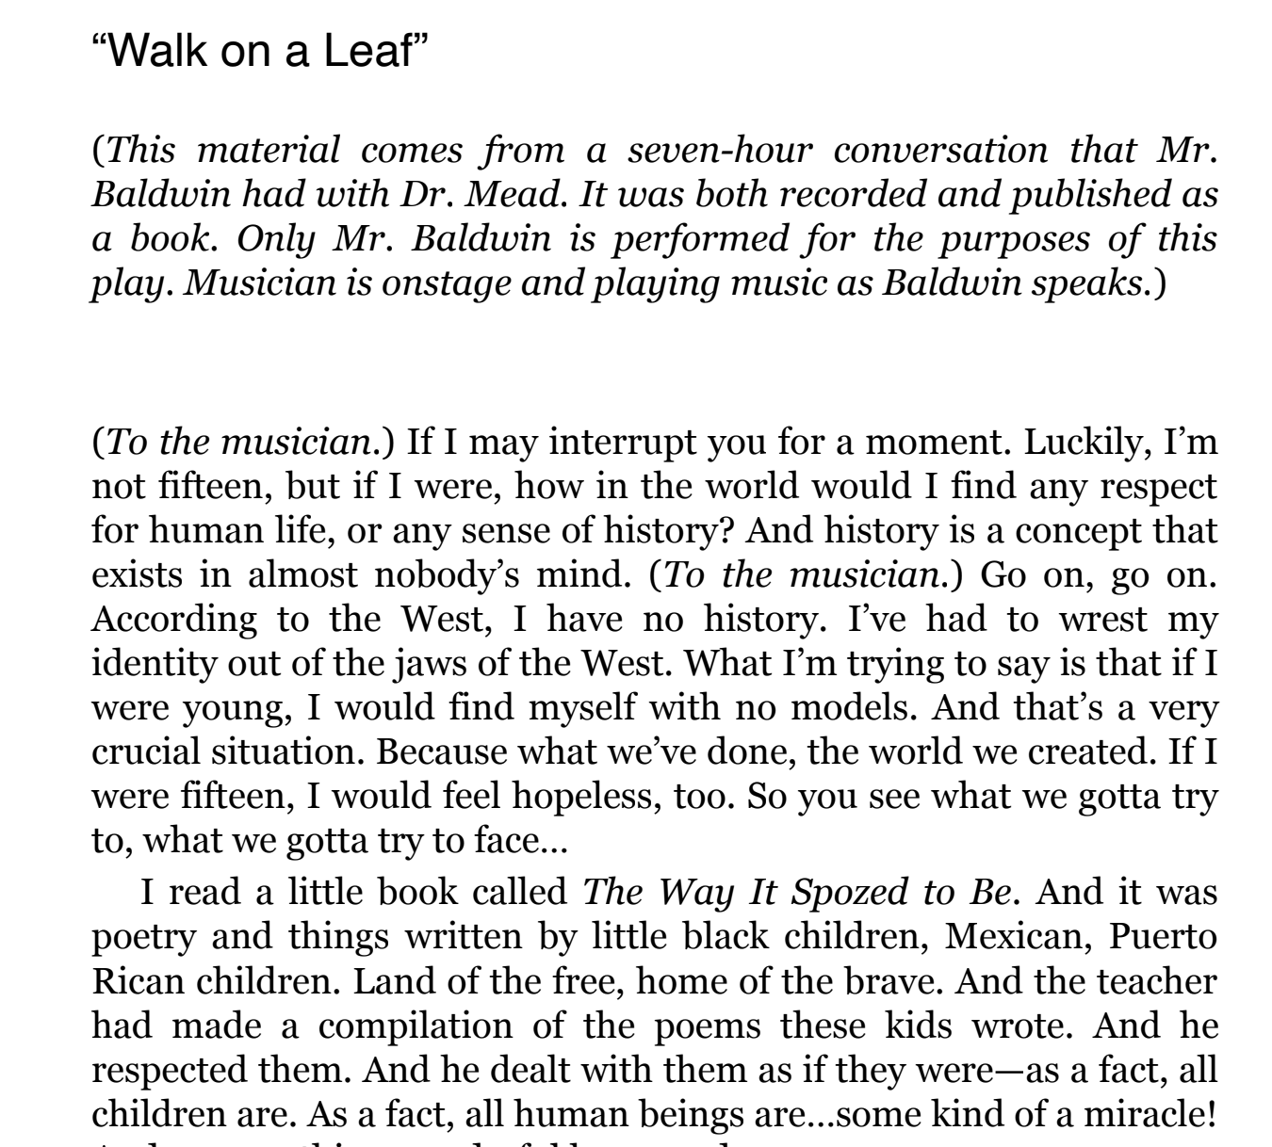
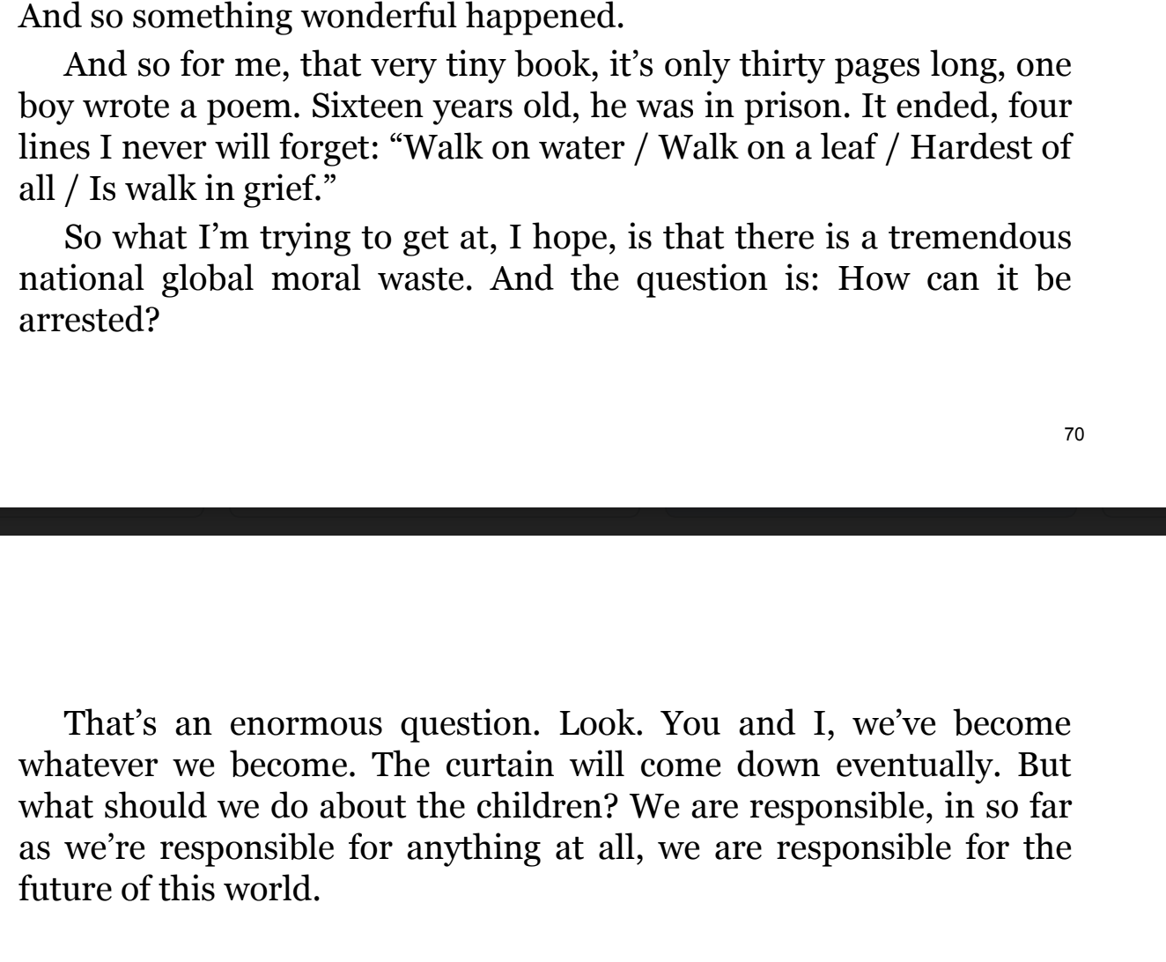
What is a model for your monologue?
James Baldwin’s monologue is the closest in length at around 380 words.

Slide 17
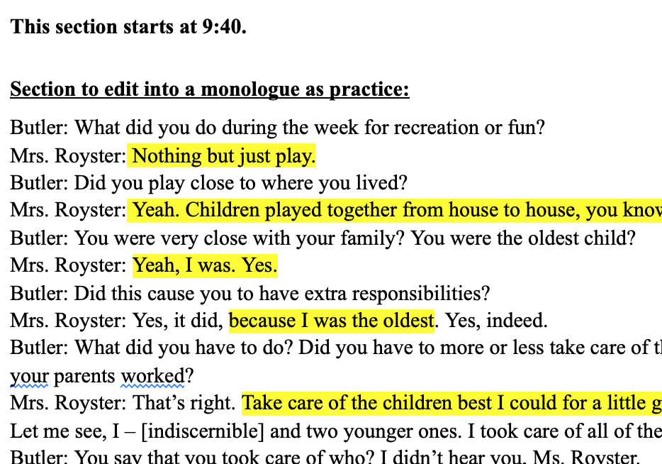
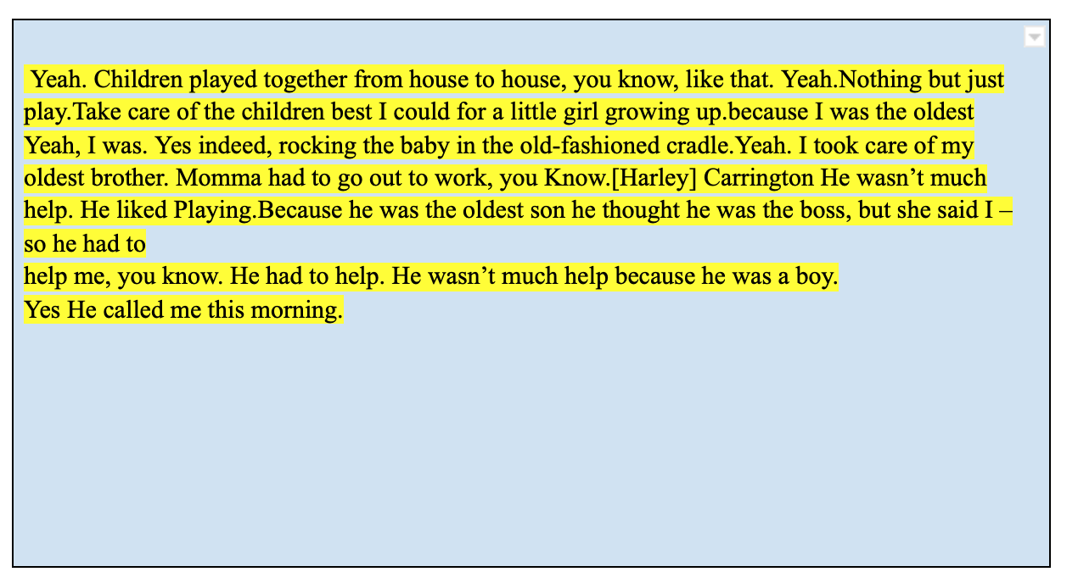
What do you already know about writing a monologue?

Slide 18
What are the steps?
Interview
Transcribe
Draft
Revise
Edit

Slide 19
How will I be evaluated?
Key points:
Purposefully think about diction, characterization, perspective, and imagery as you choose parts of your transcript to include in your monologue. In the Rationale, you will explain these choices.
Purposefully ensure that your monologue touches on issues you discussed in Government, including the amendments.

Slide 20
My 4th amendment was forcefully broken. They came into the house searched the house to look for someone that did not live there...okay they knocked on the door ...after ‘bout not even 5 min before somebody even can't answer they bust through the door and came in and was like we the police I felt violated……(look like she was about to cry)
I was angry very upset------i was hurt because they actually try to take the kids---they just want to try to take the kids and send them to social service i mean the child child service(started reflecting,she took more longer thinking here on out) .they didn't realize I mean I don't know when they realize they had the wrong house all I know is they came in they was asking for this person sat everybody down--was going through everybody room the drawers and dresses everything like that asking about um….who that person is told everybody to pull out their ids they checked everybody identification to make sure they were who they said they were but everybody--(stutters more)but they still lock all of us up even though they knew they didn't have the right person(looking at the ceiling)well they really didn't mess nothing up like downstairs in the living room but they did mess up….the the bedrooms they took all the clothes I don't really know they were looking for cause they took all the clothes off the dresser drawers and looked through the stuff in the closet and this is when with each bedroom they did this to looking for I don't even know they were looking for(she look more confused) they posed to be looking for a person I guess they was doing their job but at the same time they didn't do too much of that they should have done more research to figure out were they at the right house.

Slide 21
What if my interviewee didn’t give me enough material?
Write some more questions you can ask them.
Write some follow-up questions to ask your interviewee and add to the end of your transcript.
You can tell them that as you’ve started crafting your monologue you’ve realized that you need a little more material.
Ask them “tell me about a time when you or someone you know...”

Slide 22
Where are you in the process?
I have an oral history but it’s not transcribed.
I have not done my oral history.
I have transcribed my interview.
Finish your questions and schedule your interview.
Oral History Project Plan [.pdf] [.docx]
Complete Formative #6 to get ahead.
Ensure you are using diction, imagery, characterization, and perspective as you craft your monologue.
Drafting Your Monologue [.pdf] [.docx]
Follow these instructions to transcribe at least 3-4 minutes of your interview.
How To Create An Oral History Transcript [.pdf] [.docx]

Slide 23
Workshop: Monologue Writing and Peer Review

Slide 24
If you DO have your monologue draft, find a partner for peer review and read their monologue.
If you DO NOT have your monologue draft, work on your monologue.

Slide 25
Formatting
SILENT:
Read and take notes: 3 minutes
Swap and answer questions about your peer’s monologue: 3 minutes
TALKING:
Swap back, ask questions, and set a goal in the box at the bottom: 3 minutes
Is the monologue just the words of the interviewee? Yes. | Is the monologue 300-400 words? No. It’s 1200 words. | Is the monologue separated into paragraphs? Yes. .
Based on this feedback, I need to: I need to cut down my monologue. I need to ask some additional questions or add some other parts of my transcript.

Slide 26
Content
SILENT:
Read and take notes during: 3 minutes
Swap and answer questions about your peer’s monologue: 3 minutes
TALKING:
Swap back, ask questions, and set a goal in the box at the bottom: 3 minutes
Does the monologue contain a personal story? Yes, it tells the story of a woman in prison trying to turn her life around. | Does the monologue engage with inequity? Yes, it engages with educational inequity. | Does the monologue contain elements of a restorative narrative? (Does it 1) acknowledge harm?, 2) explore difficult emotional terrain? 3) focus on growth and renewal) Yes
Based on this feedback, I need to: I’m all set with this round.

Slide 27
Craft
SILENT:
Read and take notes: 3 minutes
Swap and answer questions about your peer’s monologue: 3 minutes
TALKING:
Swap back, ask questions, and set a goal in the box at the bottom: 3 minutes
Does the monologue purposefully use diction (word choice)? Yes, the use of italics shows the speaker’s emphasis. | Does the monologue purposefully use imagery (language that appeals to our senses)? Yes, “She’ll jump on me, roll around on the floor, make me play with her” (visual and tactile) -Could be more imagery | Does the monologue purposefully use characterization (speech, actions, thoughts, effects on others, looks that reveal personality)? Yes, especially through her speech and actions... | Does the monologue purposefully use perspective (one’s outlook or lens based on their experiences and values)? Yes, we can see the way Dodson’s experience gave her the outlook on education she has.
Based on this feedback, I need to: No need to add anything here. Maybe some more imagery if it’s in the transcript.

Slide 28
Next Steps
Use your feedback from class to revise your monologue.
Complete Formative 6.

Slide 29
Workshop: Monologue Revision

Slide 30
What do I need for class today?
Today we will do self-review instead of peer review. You will evaluate your own beginning, middle, and end and revise to improve them.
If you have not written your monologue, you will not be able to do today’s lesson.
Priority 1 - Write your monologue.
Priority 2 - Write your journal entries.
Priority 3 - Complete Formative #6.

Slide 31
Beginning
Write the first line of the monologue here: My-m-my parents did many jobs, with no education they just did..um cleaning basically, working on the farm, and so you didn't have much money coming in. | Does the first line draw you in? | Is there a different line or part of the monologue that might be a more powerful opening? I couldn’t even go outside after dark.
Based on this feedback, I need to: I need to move some things around so that I can start with “I couldn’t even go outside after dark.”

Slide 32
Middle
Is the monologue broken up into paragraphs that make sense? Yes. The first paragraph is an overview of her upbringing. The second is more analytical and elaborates on her upbringing. | Is there anything you would take out? Why? No. | Is there anything you would reorder? Why? Not really - just the opening.
Based on this feedback, I need to:

Slide 33
End
Write the last line of the monologue here. We didn’t bother and try to change things. | Does the last line linger and leave an impression on you? Yes. It gets at the heart of the monologue meaning. | Is there a different line or part of the monologue that might be a more powerful ending?
Based on this feedback, I need to:

Slide 34
Next Steps
Finish revising your monologue
Finish Journals 1-5

Slide 35
Workshop: Rationale Preparation

Slide 36
Summative Part II: Rationale
Purpose: to explain to the teacher how you used your oral history to tell a story in monologue form.
You are:
Explaining your creative process
Explaining how your finished product relates to a topic raised in government

Slide 37
Rationale Requirements
How did you address a topic from the 1619 project and/or Bill of Rights?
1 paragraph
What details did you select from your transcript to create your monologue? How did you integrate the idea of restorative narrative?
1 to 2 paragraphs
How did you use tools such as diction, characterization, imagery, perspective, punctuation and point of view? Cite at least 3 creative decisions that you made in your adoption, referring specifically to both the literary device and the language in your monologue.
1 to 2 paragraphs

Slide 38
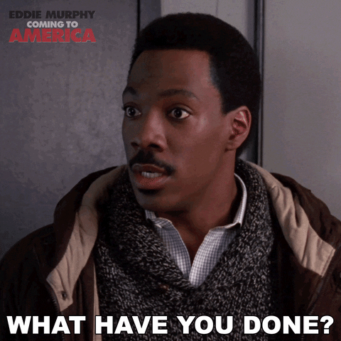
Think of the Rationale as you justifying and explaining what you did in your adaptation!
How did you use tools such as diction, characterization, imagery, perspective, punctuation and point of view?
Did you include stage directions? How? Why?
Did you include italics? How? Why?
Did you include first person point of view? How? Why?
You are spelling out how you transformed your oral history into a monologue as well as how the monologue relates to what you learned in government class

Slide 39
Literary Device Review
Diction = subject’s word choice.
This could include repeated words, catch phrases and filler words like “uhh” and “umm”
Characterization = how the author reveals the character’s personality.
(Direct/ Indirect) What sentences can you include that will get me an understanding of who this person is.
Example : “I would never treat another person as badly as they did. Just because they are different doesn’t mean they are less than human.” ←- This line would be indirect characterization that shows that my subject is compassionate, empathetic, righteous etc.
Imagery = Language that appeals to the readers’/listeners’ senses (smell, touch, taste, sight, hearing, movement, or emotions)
Example: “When I saw the cops’ flashing lights, a pit opened up in my stomach” (visual and organic imagery)

Slide 40
Literary Device Review Pt. 2
Perspective : one’s outlook or lens, usually based on their experiences, values/beliefs, and aspects of identity. Example: “It was in that moment that I knew that I truly believed that all people deserved to feel heard and seen.”
Punctuation :
-If you want to show a pause in their speech, use an ellipsis, example: I wish...I wish I’d stood up for myself.
-If someone cuts themselves off, use an em dash, two dashes together, example: I thought that--that--
-If you want to show emphasis in someone’s speech, use italics, example: It was like whoa, really?
-For stage directions, use parentheses or square brackets, example: [sighs] or (sighs)
Point of view: First person point of view. This mean you are using words like “I” “my” etc. You are becoming the person you are interviewing and writing a monologue as if they were telling it again. This time without the interview structure.
Example : “I remember this moment like it was yesterday…”

Slide 41
Independently read, annotate, and analyze Monologue #1
Directions: The following monologues were written by your peers based on their oral histories. As you read each monologue, annotate for:
· Diction (D), characterization (C), imagery (I), and perspective (P)
· Restorative elements [harm done but an emphasis on resilience and growth] (R)
· Social inequity, amendment violations, or other concepts from Government (G)
After you read, analyze the interdisciplinary ideas and concepts and the disciplinary skills.

Slide 42
With a partner, read, annotate, and analyze Monologue #2
Directions: The following monologues were written by your peers based on their oral histories. As you read each monologue, annotate for:
· Diction (D), characterization (C), imagery (I), and perspective (P)
· Restorative elements [harm done but an emphasis on resilience and growth] (R)
· Social inequity, amendment violations, or other concepts from Government (G)
After you read, analyze the interdisciplinary ideas and concepts and the disciplinary skills.

Slide 43
Monologue #3
Directions: The following monologues were written by your peers based on their oral histories. As you read each monologue, annotate for:
· Diction (D), characterization (C), imagery (I), and perspective (P)
· Restorative elements [harm done but an emphasis on resilience and growth] (R)
· Social inequity, amendment violations, or other concepts from Government (G)
After you read, analyze the interdisciplinary ideas and concepts and the disciplinary skills.

Slide 44
Discuss
Write a question you want to ask your peers about these monologues. You could ask a question about their topics, restorative elements, or their use of any of the literary devices we’ve studied.
Example: Which monologue do you think has the most memorable characterization?

Slide 45
Next Steps
Begin Writing Your Rationale

Slide 46
Workshop: Rationale Writing

Slide 47
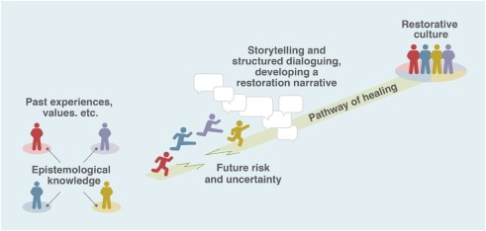
Finish your Rationale
Do you answer all three questions?
Do you cite evidence from your monologue and/or oral history?
Is each paragraph 5-10 sentences long?
Have you proofread your rationale?

Slide 48
Edit
Read back over your writing. Ask, “Does this look right, sound right, and make sense?” Consider trading with a peer, especially if written conventions (grammar, punctuation, spelling, etc.) are not a strength. Proofread for:
Spelling
Punctuation (especially periods and commas)
You have the choice of editing the grammar of your speaker or leaving it in because it reveals dialect/diction and characterization. However, you should definitely edit the grammar in the stage directions and in your Rationale.
Look out for subject-verb agreement (she laugh she laughs)
Capitalization (especially the word “I” [always capitalized] and proper nouns e.g. Baltimore, Maryland, the First Amendment).
Paragraph style (an indent = 5 spaces if your “tab” button isn’t working)

Slide 49
Monologue Performances & Final Discussion

Slide 50
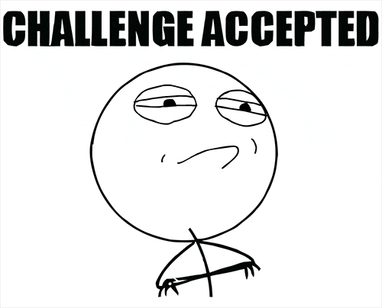
Taking the Stage!
Here is your invitation to perform your monologue for your peers to honor all of your hard work and your interview subject.
Monologues are meant to be heard and shared! Challenge yourself!

Slide 51
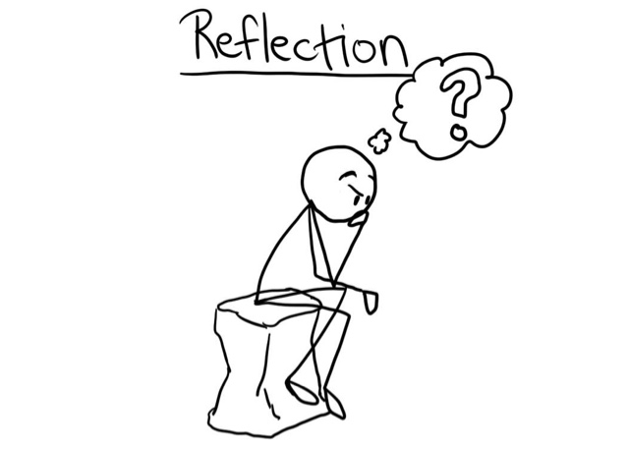
Final Discussion
What did you learn throughout the course of this unit?
What was the experience of an interdisciplinary unity like?
What was something you found particularly interesting this unit? Particularly challenging?
Final thoughts or reflections on The 1619 Project, your monologues, or Notes from the Field?

