Slide 1
Notes From the Field & The 1619 Project
Interdisciplinary Unit
English Daily Slides
Week 4

Slide 2
Table of Contents
01
02
03
Lesson 13
Lesson 14
Lesson 15

Slide 3
Lesson 13

Slide 4
Objective
You will analyze a monologue for diction and perspective through annotation and paired discussion.

Slide 5
Agenda
Government policy directly and indirectly impacts communities and individuals, which can be discovered through personal narrative.
Word of the Day: Consciousness
Introduction to Twilight by Anna Deavere Smith
Twilight Monologue Reading and Discussion
Review of Summative 2
Notes on Diction and Perspective

Slide 6
Agenda Cont.
Government policy directly and indirectly impacts communities and individuals, which can be discovered through personal narrative.
Discussion on the Relationship Between Diction and Perspective
Close Reading of Excerpts of ‘Injury’ for Diction and Perspective
Independent Monologue Reading Exercise
Restorative Narrative Discussion and Debrief

Slide 7
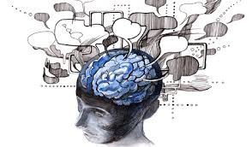
Word of the Day
Government policy directly and indirectly impacts communities and individuals, which can be discovered through personal narrative.
Definition
Noun; the awareness or perception of something by a person.
the state of being awake and aware of one's surroundings.
Consciousness
Example sentence: “But you can’t have a memory like that without it creating a kind of injury. A kind of consciousness of wrongfulness. A consciousness of hurt. That’s what I mean when I say I’m broken, right?” (136)
Notes
Common mistake: conscience is NOT the same as “conscious” or “consciousness.”

Slide 8
Twilight: Los Angeles, 1992
Twilight is a one-woman play written and performed by Anna Deavere Smith. It explores the Rodney King beating in 1991, the violent aftermath of the 1992 verdict, and the enduring impact of these events on Los Angeles and the nation. The play’s monologues are based on oral histories Smith collected from individuals affected by these events.

Slide 9
Who Was Rodney King and What Happened to Him?: A Brief History
Rodney King (1965 - 2012)
Rodney King, a native to Sacramento, California, was a victim of police brutality in 1991.
Overview: In March 1991, Rodney King was involved in a high-speed chase with the Los Angeles Police Department. After being stopped, King was brutally beaten by four officers: Stacey C. Koon, Theodore J. Briseno, Timothy E. Wind, and Laurence Powell. The assault was captured on video by George Holliday, who recorded the incident from his apartment balcony.
Results and Aftermath: The four officers were tried for excessive force, but all were acquitted. This verdict sparked the "Rodney King riots" in Los Angeles, driven by widespread frustration over racial injustice and police misconduct. The riots, which lasted six days, resulted in 63 deaths and over 2,000 injuries, and were quelled only after the California National Guard was deployed.

Slide 10
Monologues from Twilight
Government policy directly and indirectly impacts communities and individuals, which can be discovered through personal narrative.
As you read think about the following questions:
What do you think about this story? Do you have any reactions to it?
How does this monologue compare to the monologues we’ve read in this unit?
Which elements of monologues, including imagery, characterization, perspective, diction, and point of view, do you see here?
Notes:
“A Weird Common Thread in Our Lives” adapted from Reginald Denny’s oral history
“A Badge of Courage” adapted from Captain Lane Haywood’s oral history

Slide 11
The Summative can be found at this link:
A monologue and transcript of interview (Criterion B, Synthesizing): A dramatic monologue of your oral history with original transcript.
A rationale (Criterion A, Evaluating): Explain how you conducted your oral history and how you developed that into a monologue.
A reflection (Criterion C, Reflection): This is process journals #1-5
Notes:
https://docs.google.com/document/d/1Sob6u9Ci410U6RH8M64huI0o3LFDMzdwHURr2QKx1yI/edit?usp=sharing

Slide 12
Diction and Perspective
Government policy directly and indirectly impacts communities and individuals, which can be discovered through personal narrative.
Notes on perspective
is the values, experiences, views, opinions, and aspects of identity that inform how a person sees the world and interprets their experiences.
It’s their lens on the world, as established by their experience of it.
Notes on diction
Word choice
How does word choice work when the creator is adapting an oral history? How is the process different from creating a more traditional piece of creative writing?
How is creating a monologue from an oral history similar to the poem “Fugitive,” which we read last week?
What is the relationship between diction and perspective?

Slide 13
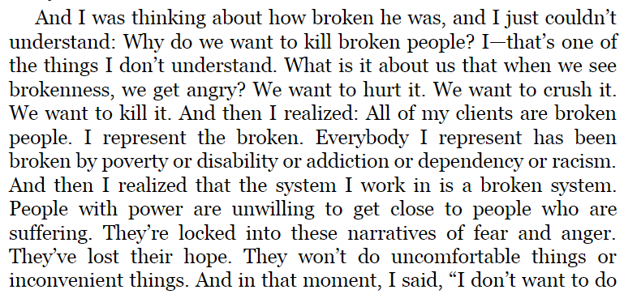
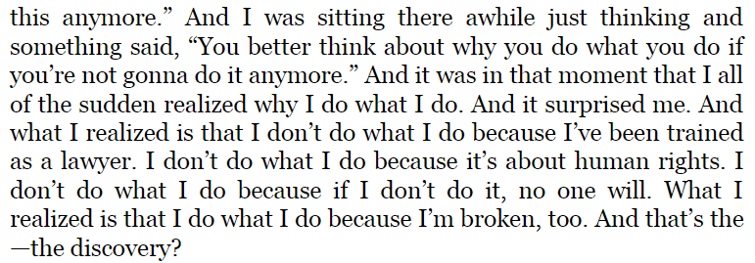
Close Reading #1
Government policy directly and indirectly impacts communities and individuals, which can be discovered through personal narrative.
Excerpt from “Injury,” speaker: Bryan Stevenson. Pages 134-135.
Find a moment where the word choice is powerful. Why?
What are some of the values or experiences revealed in this excerpt, which shapes Stevenson’s experience.
Where does Smith’s diction intersect with perspective?

Slide 14
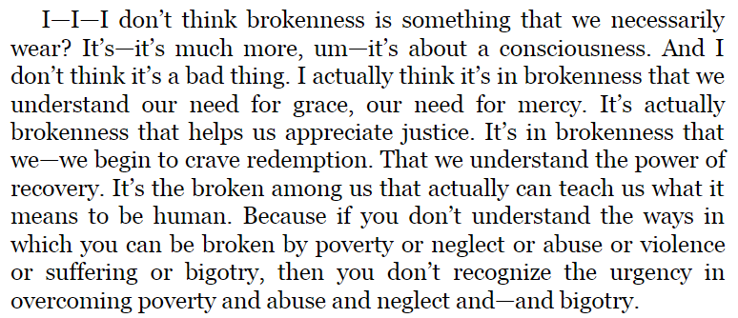
Close Reading #2
Government policy directly and indirectly impacts communities and individuals, which can be discovered through personal narrative.
Excerpt from “Injury,” speaker: Bryan Stevenson. Pg. 135.
Find a moment where the word choice is powerful. Why?
What are some of the values or experiences revealed in this excerpt, which shapes Stevenson’s experience.
Where does Smith’s diction intersect with perspective?

Slide 15
Your Turn
Government policy directly and indirectly impacts communities and individuals, which can be discovered through personal narrative.
Choose one of the monologues from the IU Text that you really enjoyed or found compelling.
Re-read it.
Find a moment where you feel that the character’s perspective is exceptionally clear.
In your notes, explain why that character’s perspective is so clear, and how diction or word choice plays into that clarity.

Slide 16
How does this text function as a restorative narrative?
Government policy directly and indirectly impacts communities and individuals, which can be discovered through personal narrative.
The features of a restorative narrative are:
Acknowledgement of harm
Empowerment through truth and/or validation
“These aren’t positive, happy-go-lucky fluff pieces. They explore the tough emotional terrain of disruptions... But they’re “positive” in the sense that they focus on themes such as growth and renewal” (Tenore).
Do you feel that this text is restorative? Does it create a shared past, meaning, or understanding?

Slide 17
Homework
Government policy directly and indirectly impacts communities and individuals, which can be discovered through personal narrative.
Read:
Read Khalil Gibran Muhammad’s ‘Sugar’ from The 1619 Project.
Write:
No new writing.

Slide 18
Lesson 14

Slide 19
Objective
You will analyze nonfiction texts for narrative and discuss how we would use the elements of dramatic texts to write the nonfiction text as a dramatic monologue.

Slide 20
Agenda
Government policy directly and indirectly impacts communities and individuals, which can be discovered through personal narrative.
Word of the Day: Insuperable
Close Read and Discuss Selected Excerpts from ‘Sugar’ by Khalil Gibran Muhammad
Review the Goals and Elements of Adapting an Oral History into a Monologue
Monologue Writing Activity

Slide 21
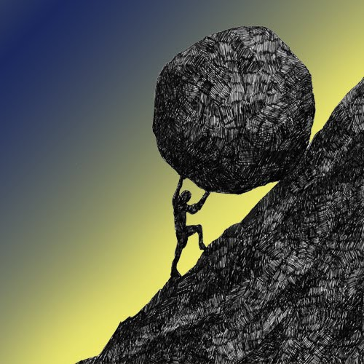
Government policy directly and indirectly impacts communities and individuals, which can be discovered through personal narrative.
Definition
Adjective
Impossible to overcome
Word of the Day
insuperable
“In Europe at that time, refined sugar was a luxury product, the back-breaking toil and dangerous labor required in its manufacture an insuperable barrier to production in anything approaching bulk.” (IU 143)
Notes
“In” as a prefix often means “not”
“Super” as a root means over or more
“Able” as a suffix makes a word an adjective

Slide 22
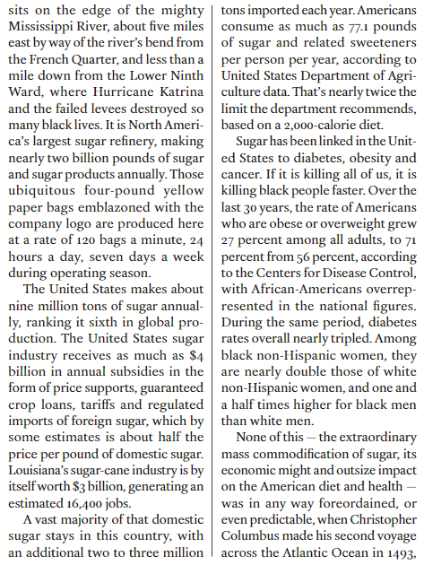
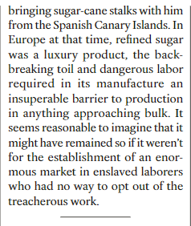
How does this text begin? Where is the hook, the background, and the thesis?

Slide 23
What was reading an informational text like for you?
Government policy directly and indirectly impacts communities and individuals, which can be discovered through personal narrative.
What was your experience of reading?
How did this text differ from the monologues? Consider the opening, the content, and how it tells a story.
Did anything in this article surprise you?

Slide 24
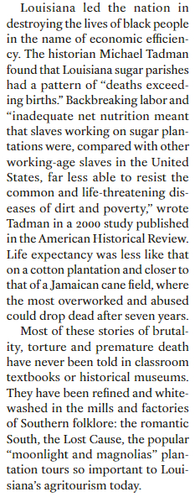
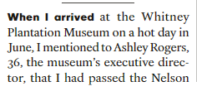
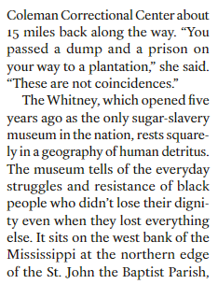
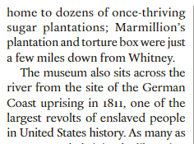
Close read
What is powerful about this section?
Why?
What is the purpose of this section?
How do you know?
How does this nonfiction article use narrative similarly to the monologues and plays we have been reading?

Slide 25
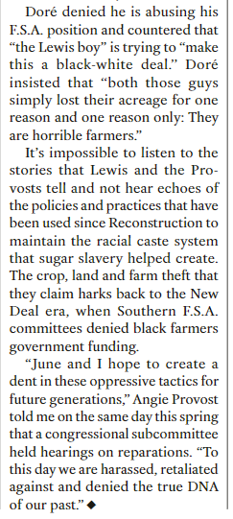
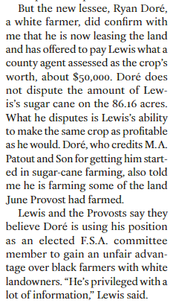
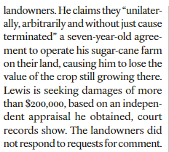
Do you feel that this text is restorative? Does it create a shared past, meaning, or understanding?
(Acknowledgement of harm, or empowerment through truth and/or validation)

Slide 26
Monologue Work Time
Government policy directly and indirectly impacts communities and individuals, which can be discovered through personal narrative.
The main goal of adaptation is keeping the words and spirit of the oral history intact
Elements that can be utilized to achieve said goal
Dialect
Ellipses (...)
Dashes (--)
Stage Directions (Before or during monologue)
Italicized text
Work to create a 300-500 word monologue with a beginning, middle, and end. It should reflect on an event or inequity.

Slide 27
Homework
Government policy directly and indirectly impacts communities and individuals, which can be discovered through personal narrative.
Read:
Read ‘A Tree Out of the Ground’ from Notes From the Field
Write:
Finish writing your monologue.

Slide 28
Lesson 15

Slide 29
Objective
You will learn and practice the process of adapting an oral history interview into a monologue.

Slide 30
Agenda
Government policy directly and indirectly impacts communities and individuals, which can be discovered through personal narrative.
Review the Word of the Day
Discuss the Elements of Adaptation and the Process of Adapting an Oral History into a Monologue
Whole Group Analysis of Anna Deavere Smith’s ‘A Tree Out of the Ground’
Small Group Analysis of Anna Deavere Smith’s ‘Brother’
Formative 5 Revisions
Introduction to Journal Prompt #5

Slide 31
Government policy directly and indirectly impacts communities and individuals, which can be discovered through personal narrative.
Definition
Between two different subject areas; using ideas, concepts, and skills from one area expertise in another
Word of the Day
interdisciplinary
Example sentence
In our interdisciplinary unit, we are using skills and work products from government as the basis for a dramatic monologue in English.
Notes
What skills have you used across disciplines?
What have you used in English from Social Studies?

Slide 32
What goes into adaptation? What decisions have to be made to transform an oral history into a monologue?
Government policy directly and indirectly impacts communities and individuals, which can be discovered through personal narrative.
The main goal of adaptation is keeping the words and spirit of the oral history intact
Elements that can be utilized to achieve said goal
Dialect
Ellipses (...)
Dashes (--)
Stage Directions (Before or during monologue)
Italicized text
What is the effect of each element? Why might you use each while adapting?
Notes:
Today’s slides are compliments of Mx. Benner :-)

Slide 33
Practice adapting this into a monologue, together.
Government policy directly and indirectly impacts communities and individuals, which can be discovered through personal narrative.
Butler: In 1925 – how old were you in 1925? You were twenty years old?
Mrs. Royster: And still going to school.
Butler: And still going to school. How many of your brothers and sister finished school?
Mrs. Royster: I ain’t got but one sister no way, but Ethel and [Harley] finished school. And Lester, he didn’t finish [indiscernible].
Butler: Were you required to finish school in your family? Was that emphasized? Was school an important thing?
Mrs. Royster: Well people then, you know, they stopped their children for - to do different kind of work - jobs, you know. Like – well, if Momma going to wash today she wants you to bring that water up and everything and it just kept you away from school maybe that day. Or maybe two days you might have to do something else. So, you know they did just like they wanted in other words.
Butler: You didn’t have to go to school? Nobody bothered you if you didn’t go?
Mrs. Royster: No, but that came up later though that we had to go to school. It was later that they had to send their children to school. The whites continued, but the coloreds didn’t.
Butler: They continued going to school?
Mrs. Royster: Yeah, white did, never stopped. But they had better conveniences than what we had, you see, for to keep that child in school. We had to stop to do this and do that, you know. Butler: [Indiscernible]?
Mrs. Royster: Which the parents should have been doing - after later years, then they had to do it right on just the same because they made a change in the schools.
Butler: Right.
Mrs. Royster: Uh huh. And so therefore – well, at that time then I was growing older and older and so I had to work.
Butler: You found time for –
Mrs. Royster: Working.
The main goal of adaptation is keeping the words and spirit of the oral history intact
Elements that can be utilized to achieve said goal
Dialect
Ellipses (...)
Dashes (--)
Stage Directions (Before or during monologue)
Italicized text
Notes:
Source: http://archives.ubalt.edu/bnhp/pdfs/R0014_BNHP_S07_B01_002_Royster_Inez.pdf

Slide 34
Let’s return to Deavere Smith’s Notes from the Field to consider creative choices in adaptation
Government policy directly and indirectly impacts communities and individuals, which can be discovered through personal narrative.

Slide 35
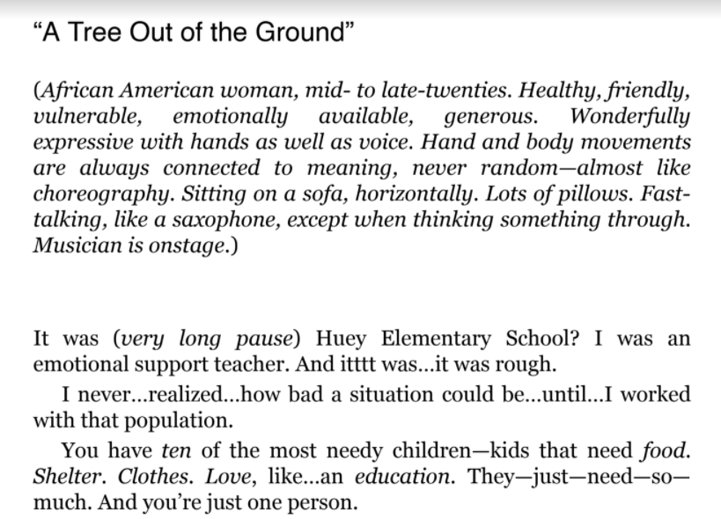
Let’s analyze the choices Deavere Smith made in adaptation
Government policy directly and indirectly impacts communities and individuals, which can be discovered through personal narrative.
How does Deavere Smith use stage directions? Why?
How do you learn about Stephanie Williams directly and indirectly?
What do you notice about the way sentences are constructed? How are you able to figure out Deavere Smith’s delivery? (Remember, the monologue text is a script for performance!)
Notes:
What does the stage direction section give the reader that Smith might have seen in an oral history interview?
Which text features in the monologue itself indicate a possible deletion? Which indicate Williams’ behavior?

Slide 36
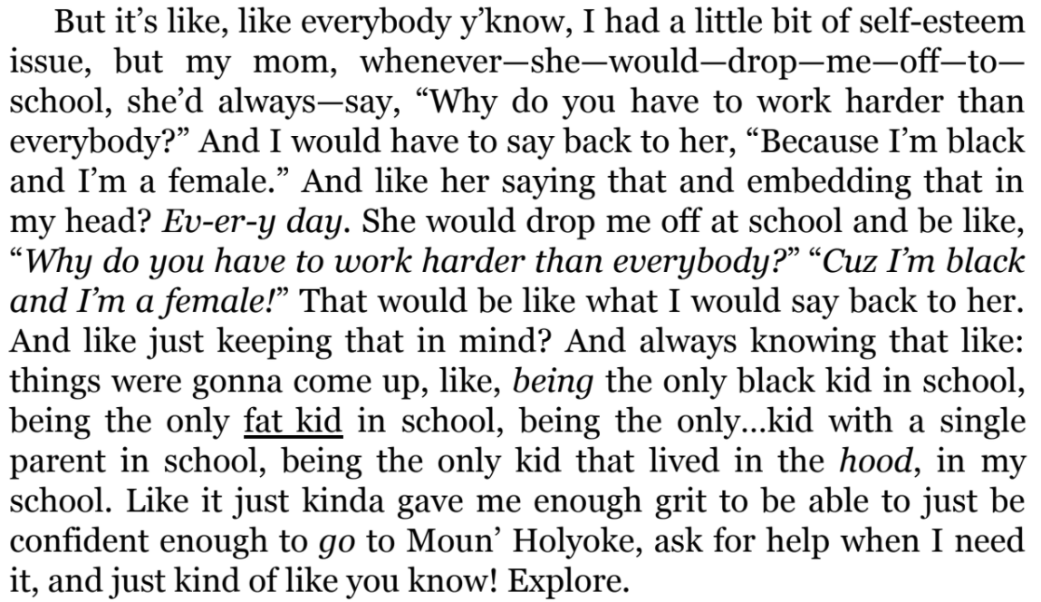
Continue analyzing Deavere Smith’s choices in adaptation
Government policy directly and indirectly impacts communities and individuals, which can be discovered through personal narrative.
How does Deavere Smith use stage directions? Why?
How do you learn about Stephanie Williams directly and indirectly?
What do you notice about the way sentences are constructed? How are you able to figure out Deavere Smith’s delivery? (Remember, the monologue text is a script for performance!)

Slide 37
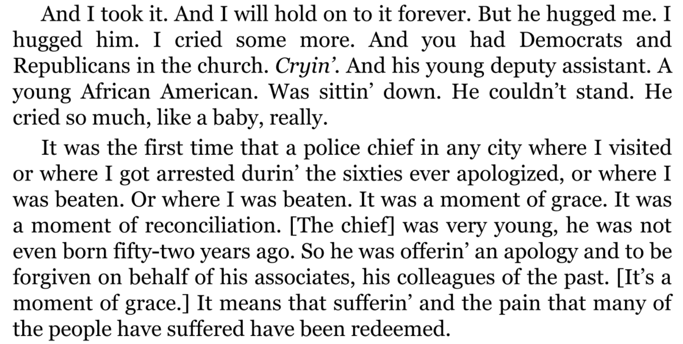
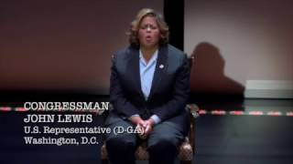
Congressman John Lewis “Brother” from Deavere Smith’s Notes from the Field
Government policy directly and indirectly impacts communities and individuals, which can be discovered through personal narrative.
Watch the clip of Deavere Smith performing this excerpt
How does she utilize the monologue as a script?
How does she follow the choices in adaptation while performing?
Read the excerpt and notice how Deavere Smith adapts an oral history/interview
What specific, textual decisions does she make in her adaptation?
What effect do said decisions have on you, the audience?
Notes:
Instruct students to work in small groups and take notes in their notebook, reading the text and watching the performance, answering the guiding questions.

Slide 38
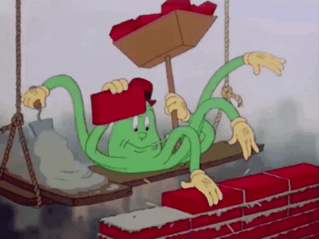
Use what you have learned!
Government policy directly and indirectly impacts communities and individuals, which can be discovered through personal narrative.
Return to Formative 4. If you submitted it, you have received feedback and it has been unsubmitted back to you so that you can continue to work on it.
Add to/edit your work to include specific elements of adaptation that we have discussed.
I will walk around and check in on you!
When we come back together, I will call on you to talk through decisions you are making in your adaptation. Be intentional!

Slide 39
Journal #5
Government policy directly and indirectly impacts communities and individuals, which can be discovered through personal narrative.
What have you already learned in your classes that will help you adapt your oral history into a monologue and make it a restorative narrative? Think about the content and/or the process that you will use or are using to complete your oral history. Name specific class activities, readings, and formatives you’ve done that will help.

Slide 40
Homework
Government policy directly and indirectly impacts communities and individuals, which can be discovered through personal narrative.
Read:
No New Reading
Write:
Complete Journal #5

