Slide 1
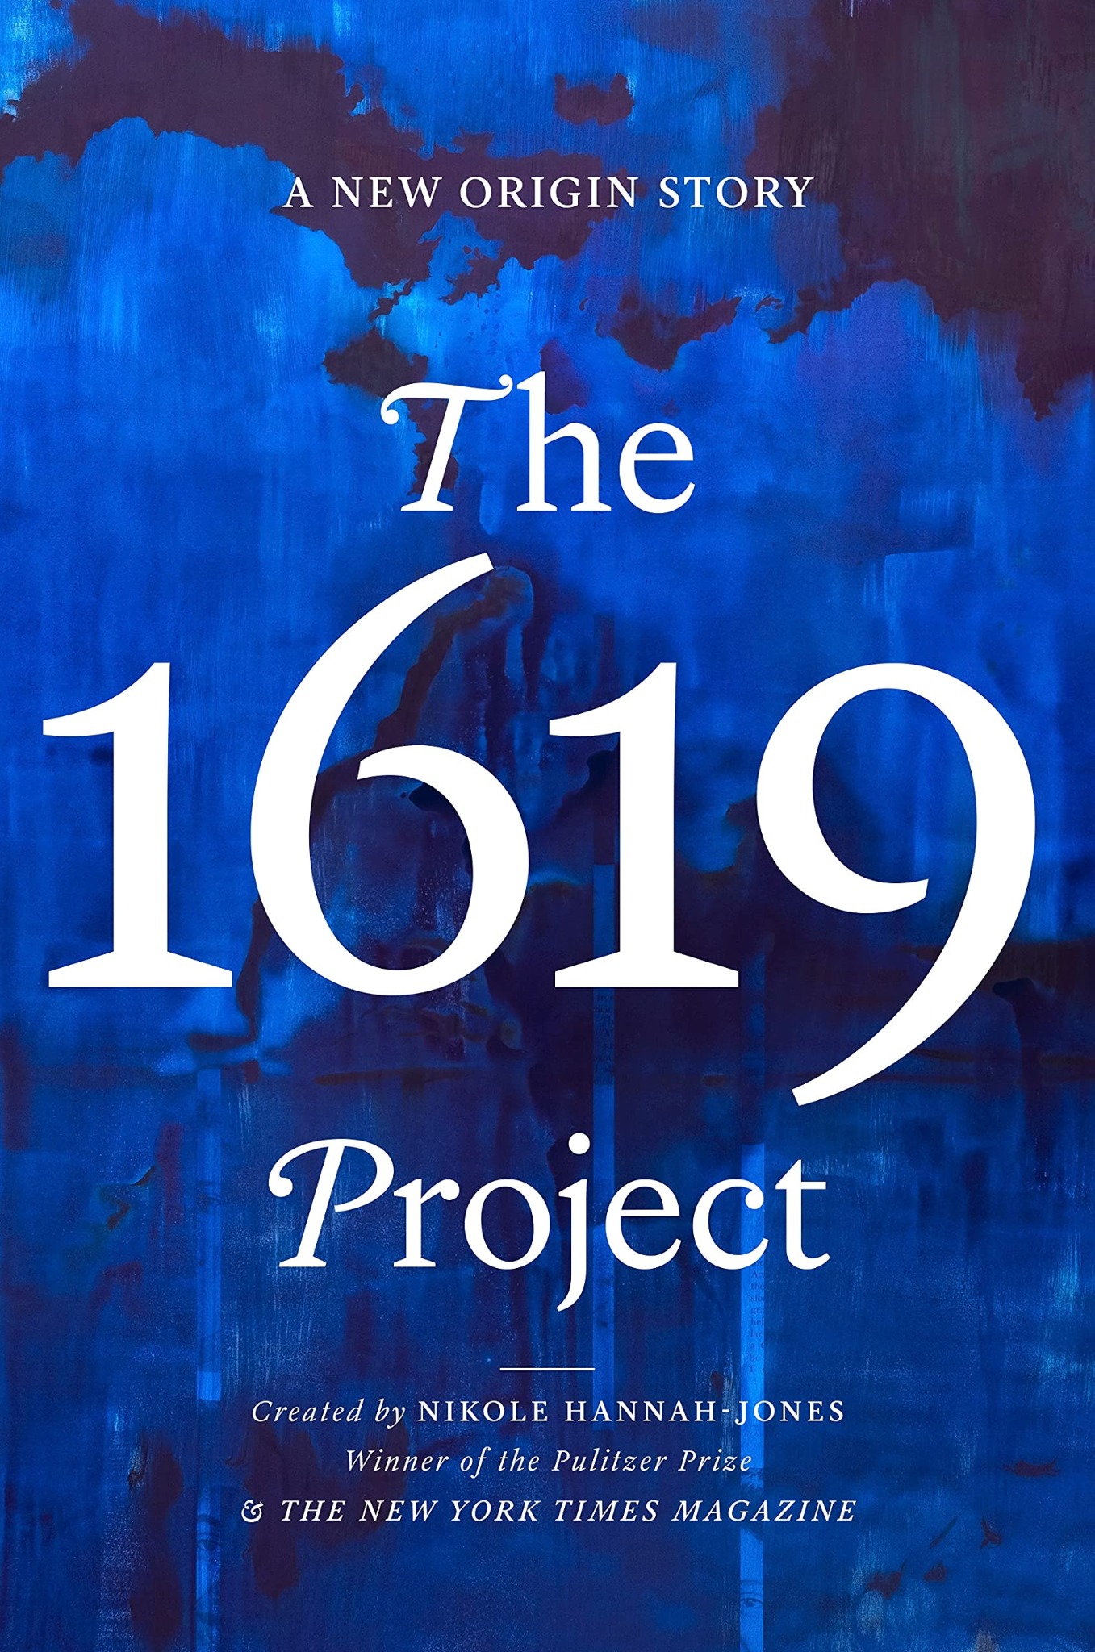
Notes From the Field & The 1619 Project
Interdisciplinary Unit
English Daily Slides
Week 3

Slide 2
Table of Contents
01
02
03
04
Lesson 9
Lesson 10
Lesson 11
Lesson 12

Slide 3
Lesson 9

Slide 4
Objective
You will learn and practice the process of adapting an oral history interview into a monologue.

Slide 5
Agenda
Government policy directly and indirectly impacts communities and individuals, which can be discovered through personal narrative.
Word of the Day: Adapt
Focus Question: React to James Baldwin’s Interview
Discussion of Selected Baldwin Quotes
Review of How to Adapt an Oral History Interview into a Monologue
Practice Formative 5 Assessment

Slide 6
Definition
make (something) suitable for a new use or purpose; modify.
alter (a text) to make it suitable for filming, broadcasting, or the stage.
Word of the Day
Adapt
Example sentence
“The miniseries was adapted from Trevor Noah’s memoir.”
Notes:
You will be adapting your oral history into a dramatic monologue.

Slide 7
Focus Question
Government policy directly and indirectly impacts communities and individuals, which can be discovered through personal narrative.
React to James Baldwin’s Interview with Jordan Elgrably.
Notes:
Access the interview here: https://www.theparisreview.org/interviews/2994/the-art-of-fiction-no-78-james-baldwin

Slide 8
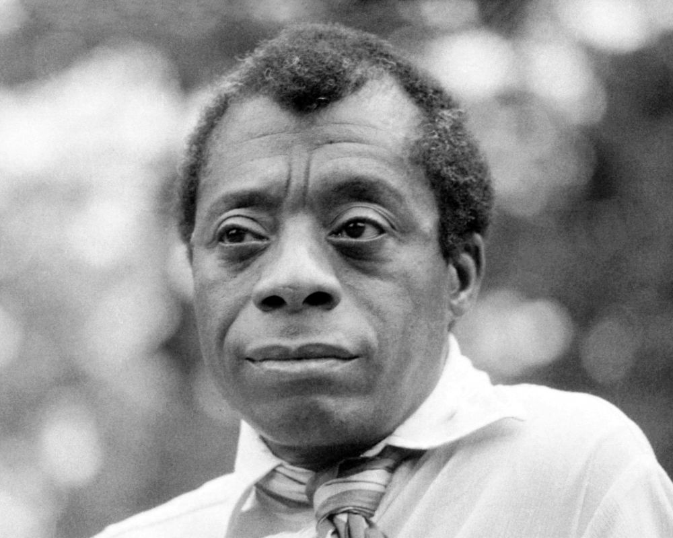
Baldwin on Storytelling and the Art of Writing
“I’ve been compelled in some ways by describing my circumstances to learn to live with them. It’s not the same thing as accepting them.”
“When you’re writing, you’re trying to find out something which you don’t know. The whole language of writing for me is finding out what you don’t want to know, what you don’t want to find out. But something forces you to anyway.”
“INTERVIEWER: What are your first drafts like?
BALDWIN: They are overwritten. Most of the rewrite, then, is cleaning. Don’t describe it, show it. That’s what I try to teach all young writers—take it out! Don’t describe a purple sunset, make me see that it is purple.”
What do you think it means to be a writer and storyteller?
Notes:
Ask students to read these quotations aloud, and ask if they have any reactions. What does it mean to be a writer and storyteller?
Source: https://www.theparisreview.org/interviews/2994/the-art-of-fiction-no-78-james-baldwin

Slide 9
OK, but how I do I turn an oral history into a monologue?
Government policy directly and indirectly impacts communities and individuals, which can be discovered through personal narrative.
Start by identifying any patterns in the diction that you want to emphasize.
Then, highlight the parts you definitely want to keep.
Decide what story you are telling. What societal inequity does this respond to?
You will have to delete parts, especially the interview questions. You will have to be creative with stage directions to cover those gaps, but you are creating a performable monologue, so that is important.
You cannot change the meaning of the oral history. You must make it concise enough to tell a story in no more than three double-spaced pages. You need to preserve the speaker’s perspective.

Slide 10
Check out this adaptation:
Government policy directly and indirectly impacts communities and individuals, which can be discovered through personal narrative.
Oral History Interview:
Butler: Were you allowed to dance?
Mrs. Royster: No.
Butler: No dancing?
Mrs. Royster: Nuh uh.
Butler: No dancing?
Mrs. Royster: Nuh uh. No dancing. Then it would be on the sly.
Butler: In the back behind the barn, huh?
Mrs. Royster: Yes, indeed. And not before the old parents.
Butler: They didn’t let you dance?
Mrs. Royster: Nuh uh. No, we didn’t dance.
Butler: Was there a time – when - what was it – a holiday or a time when it was so special that you could almost dance? I mean, you know, when you could –
Mrs. Royster: Well, we used to go to – you know, school closed in May and holidays probably. And holidays we used to have entertainments at schools. You’d have nice – what you would call a party now but then we didn’t call them parties. We just had school entertainments, they called it. And the parents would go too along with us to school. We carried dinners and put it out on the table, you know, after. [Indiscernible] dialogues at school, you know.
Butler: Recite dialogues?
Mrs. Royster: Yeah. Recite. Recite – more reciting than anything, you know. And some of them had dialogue poems or the Bible. And some had other things, you know, like poems and books.
Butler: Right.
Mrs. Royster: And everything like that.
Butler: Things people had written?
Mrs. Royster: Yeah. And maybe ten or twelve children would get up on the stand and say them dialogues. One would say one thing; one would say another and on and on, you know, like that until they finished like that. It was a lot of fun, though.
Dramatic Monologue excerpt:
There was no dancing... it would be on the sly. And not before the old parents. No, we didn’t dance. Well, we used to go to – you know, school closed in May and holidays probably. And holidays we used to have entertainments at schools. You’d have nice – what you would call a party now but then we didn’t call them parties. We just had school entertainments, they called it. And the parents would go too along with us to school. We carried dinners and put it out on the table, you know, after.
Reciting dialogues at school, you know. Recite – more reciting than anything, you know. And some of them had dialogue poems or the Bible. And some had other things, you know, like poems and books. And everything like that. And maybe ten or twelve children would get up on the stand and say them dialogues. One would say one thing; one would say another and on and on, you know, like that until they finished like that. It was a lot of fun, though.

Slide 11
Let’s Practice
Government policy directly and indirectly impacts communities and individuals, which can be discovered through personal narrative.
Everybody open the practice doc on your screen.
Using headphones, listen once through to the section we are going to edit.
In your monologue practice, please highlight in yellow the sections you would delete, and highlight in green the sections you know you would keep.
Start by identifying any patterns in the diction that you want to emphasize.
Then, highlight the parts you definitely want to keep.
Decide what story you are telling. What societal inequity does this respond to?
You will have to delete parts, especially the interview questions. You will have to be creative with stage directions to cover those gaps, but you are creating a performable monologue, so that is important.
You cannot change the meaning of the oral history. You must make it concise enough to tell a story in no more than 3 single spaced pages.
Notes:
Google doc with oral history practice for whole group (this is in their Formative 4, and you can make a copy of this doc for your class as a teaching material) https://docs.google.com/document/d/1KyXcyR1fp1IC7uhFgH8ONH_0zNXvoC__4g4oRwTLfhI/edit?usp=sharing
Audio: https://archive.org/details/R0014_BNHP_S07_002_Royster_Inez?
Site: https://archivesspace.ubalt.edu/repositories/2/archival_objects/18106

Slide 12
Formative 4: Practice Monologue
Government policy directly and indirectly impacts communities and individuals, which can be discovered through personal narrative.
Use the sample oral history or your own to edit an oral history transcript into a monologue. Use at least two of the principles of dramatic texts that we have discussed so far: characterization, diction, perspective.
If you have already conducted your oral history, you can use this time to turn part of it into a monologue and get formative feedback.
You have the rest of the class period to work. You only need about 100 words for this practice. You should turn this in by the end of the day.

Slide 13
Homework
Government policy directly and indirectly impacts communities and individuals, which can be discovered through personal narrative.
Read:
Read the Photo Essay from The 1619 Project
Write:
Complete Formative 4
Complete Journal 4

Slide 14
Lesson 10

Slide 15
Objective
You will complete an image analysis and discuss the different ideas that images and imagery can communicate.

Slide 16
Agenda
Government policy directly and indirectly impacts communities and individuals, which can be discovered through personal narrative.
Word of the Day: Contrast
Review Elements of Photo Analysis
Photo Analysis Activity
Discussion of Photographic and Literary Imagery

Slide 17
Government policy directly and indirectly impacts communities and individuals, which can be discovered through personal narrative.
In photography, contrast creates "sharpening,” or more a rapid readability of the image.
It can also be understood as juxtaposing two things for a purpose.
Word of the Day
contrast
Contrast of scale: Without this, more time is spent on mentally figuring out what the image is. Viewers seek to create closure out of the available elements.
Also, photographers can create contrast of shape, color, texture, and tone
Contrast in photography is the visual ratio of different tones in an image. This difference is what creates the textures, highlights, shadows, colors and clarity in a photograph.

Slide 18
Photo Analysis
Government policy directly and indirectly impacts communities and individuals, which can be discovered through personal narrative.
An effective photo analysis will look at what you see directly and what you can infer from the image. Look for elements like:
What is happening? What is the activity in the image?
What is the relationship between the elements or figures in the image? What is their relationship with the audience?
Setting
Color
Perspective
What can you infer about the image? What does it mean, and what is it trying to say?

Slide 19
Photo Analysis
Government policy directly and indirectly impacts communities and individuals, which can be discovered through personal narrative.
What is happening? What is the activity in the image?
What is the relationship between the elements or figures in the image? What is their relationship with the audience?
Setting
Color
Perspective
What can you infer about the image? What does it mean, and what is it trying to say?

Slide 20
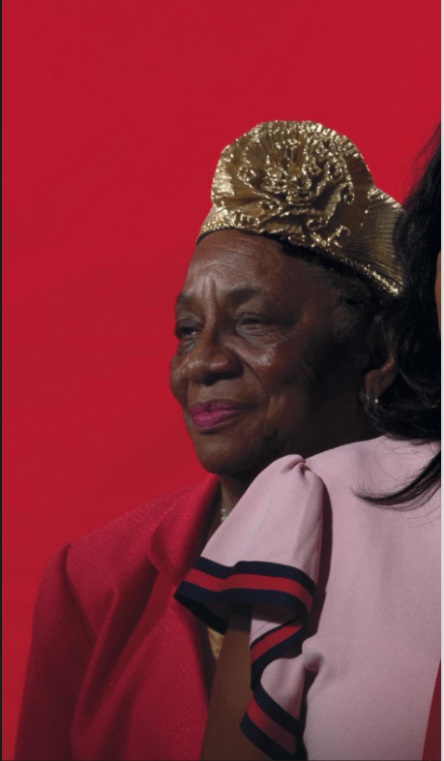
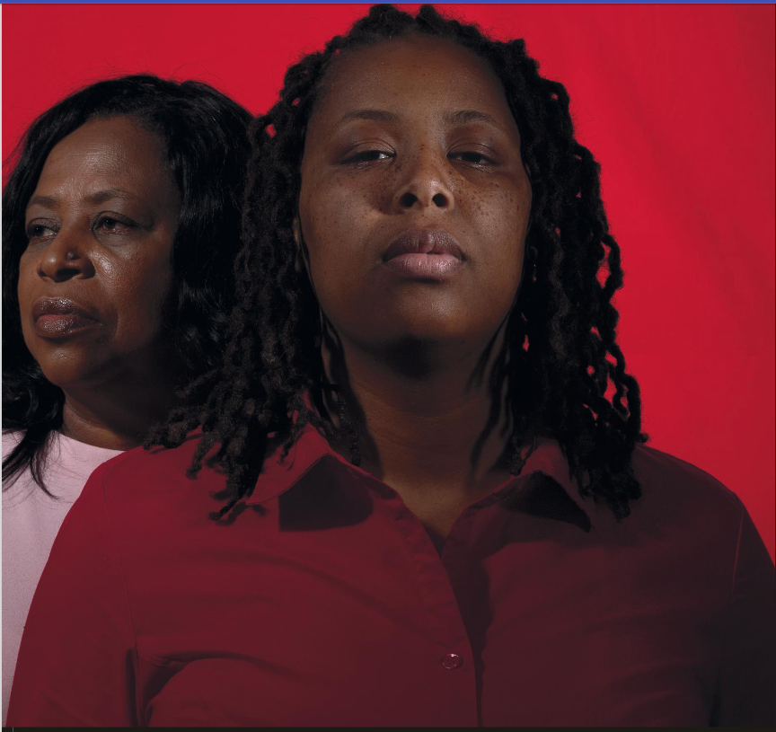
Photo Analysis
Government policy directly and indirectly impacts communities and individuals, which can be discovered through personal narrative.
What is happening? What is the activity in the image?
What is the relationship between the elements or figures in the image? What is their relationship with the audience?
Setting
Color
Perspective
What can you infer about the image? What does it mean, and what is it trying to say?

Slide 21
Photo Analysis
Government policy directly and indirectly impacts communities and individuals, which can be discovered through personal narrative.
What is happening? What is the activity in the image?
What is the relationship between the elements or figures in the image? What is their relationship with the audience?
Setting
Color
Perspective
What can you infer about the image? What does it mean, and what is it trying to say?

Slide 22
Photo Analysis
Government policy directly and indirectly impacts communities and individuals, which can be discovered through personal narrative.
What is happening? What is the activity in the image?
What is the relationship between the elements or figures in the image? What is their relationship with the audience?
Setting
Color
Perspective
What can you infer about the image? What does it mean, and what is it trying to say?

Slide 23
How does photographic imagery differ from literary imagery? Discuss!
Government policy directly and indirectly impacts communities and individuals, which can be discovered through personal narrative.

Slide 24
Homework
Government policy directly and indirectly impacts communities and individuals, which can be discovered through personal narrative.
Read:
Read Reginald Dwayne Betts’ ‘Fugitive Slave Act’ from The 1619 Project.
Write:
No new writing.

Slide 25
Lesson 11

Slide 26
Objective
You will understand how Reginald Dwayne Betts uses erasure as a kind of diction to create a restorative narrative.

Slide 27
Agenda
Government policy directly and indirectly impacts communities and individuals, which can be discovered through personal narrative.
Close Read Reginald Dwayne Betts’ ‘Fugitive Slave Act’ for Erasure
Close Read Selected Excerpts of ‘That, That Was It and That Was All’ for Imagery
Discuss Literary and Photographic Imagery
Discuss How ‘That, That Was It and That Was All’ is a Restorative Narrative

Slide 28
Fugitive Slave Act
How did Reginald Dwayne Betts make this poem?
What makes a poetics of erasure a creative act?
How does he create a refrain?
How has he changed the meaning of the original Fugitive Slave Act?
Do you think this is a restorative narrative? Why? Why not?

Slide 29
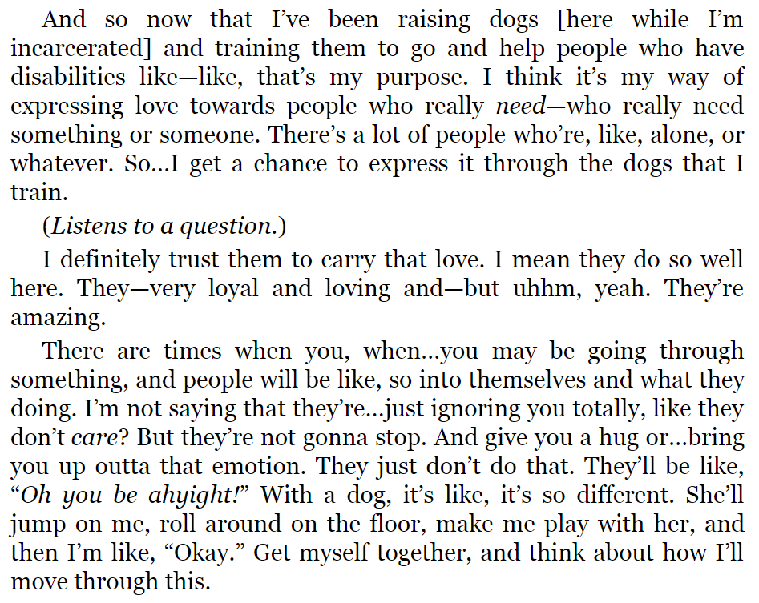
Close Reading Option 1: That, That Was It and That Was All”
Government policy directly and indirectly impacts communities and individuals, which can be discovered through personal narrative.
Identify the imagery.
Which type of imagery is it and why?
Which specific words make this imagery?
How does the imagery work to make meaning? What do you know or learn from it?
Why is it there? Does it characterize? Does it push the conflict?
How is this different from images?

Slide 30
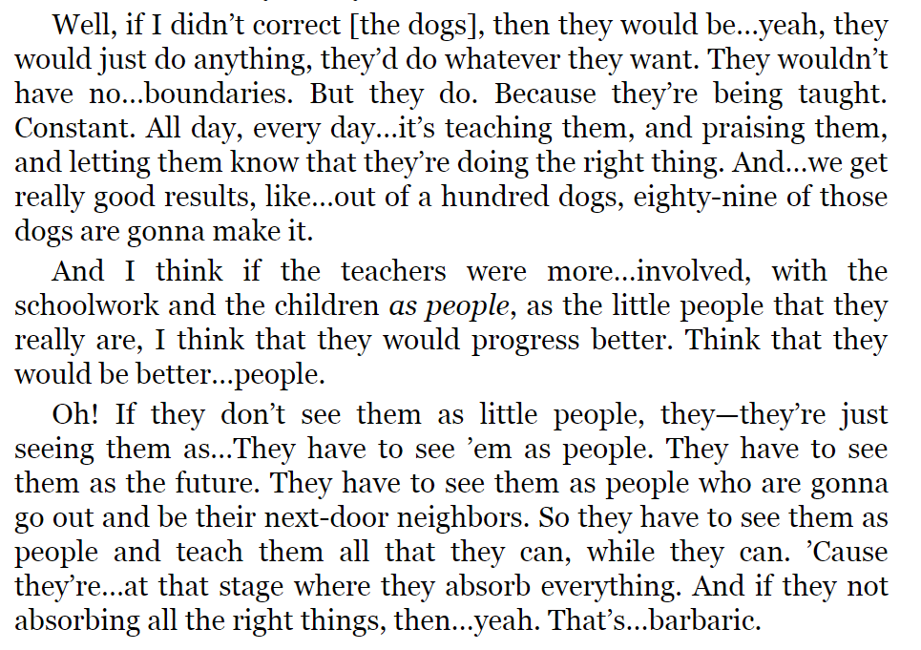
Close Reading Option 2: That, That Was It and That Was All”
Government policy directly and indirectly impacts communities and individuals, which can be discovered through personal narrative.
Identify the imagery.
Which type of imagery is it and why?
Which specific words make this imagery?
How does the imagery work to make meaning? What do you know or learn from it?
Why is it there? Does it characterize? Does it push the conflict?
How is this different from images?

Slide 31
Discussion
Government policy directly and indirectly impacts communities and individuals, which can be discovered through personal narrative.
Why do images communicate different ideas than writing?
How do these ideas differ?
What does an image reveal that words cannot?
What does imagery reveal that pictures do not?
How do they work together?
What argument is each text making?
Compare the photo essay to “That, That Was It and That Was All” and evaluate which is more effective at communicating its theme/message.

Slide 32
How does this text function as a restorative narrative?
Government policy directly and indirectly impacts communities and individuals, which can be discovered through personal narrative.
The features of a restorative narrative are:
Acknowledgement of harm
Empowerment through truth and/or validation
“These aren’t positive, happy-go-lucky fluff pieces. They explore the tough emotional terrain of disruptions... But they’re “positive” in the sense that they focus on themes such as growth and renewal” (Tenore).
Do you feel that this text is restorative? Does it create a shared past, meaning, or understanding?

Slide 33
Homework
Government policy directly and indirectly impacts communities and individuals, which can be discovered through personal narrative.
Read:
Read ‘Brother’ and ‘DNA’ from Notes From the Field
Write:
Prepare for Formative 5, an in-class discussion of how and why we tell restorative narratives, by writing a question about one of the monologues or poems we have read. The conversation will focus on the nature of restorative narratives, but you can diverge from that as long as your question is anchored in something we have read.

Slide 34
Lesson 12

Slide 35
Objective
You will discuss Anna Deavere Smith’s monologues ‘That, That Was It and That Was All,’ ‘Brother,’ and ‘DNA’ in a Socratic Seminar.

Slide 36
Agenda
Government policy directly and indirectly impacts communities and individuals, which can be discovered through personal narrative.
Free Write
Review Socratic Seminar Norms
Review and Prepare for Socratic Seminar
Review Socratic Seminar Rubric
Socratic Seminar
Reflect and Complete Formative 6 Seminar Sheet

Slide 37
Free Write
Government policy directly and indirectly impacts communities and individuals, which can be discovered through personal narrative.
Free write for 5 minutes. Do not stop writing.
If you need an idea, start with, “A restorative narrative is…”
There is no such thing as ‘wrong’ in a free write. Just write everything on your mind.

Slide 38
Socratic Seminar Norms
Government policy directly and indirectly impacts communities and individuals, which can be discovered through personal narrative.
Reference the text: Your opinions are important, but they should be thoughts about the text.
Listen to what others say: Build upon what your classmates say and don’t interrupt. A discussion cannot take place unless you are listening actively and carefully to others.
Speak clearly: For others to respond to your opinions, everyone must be able to hear and understand what you say.
Give others your respect: A discussion is a cooperative exchange of ideas and not an argument or a debate: if you disagree, do so politely. You may become excited and wish to share your ideas, but don’t talk privately to your neighbor. Share your ideas with the whole class instead.
Guidelines:
You do not need to raise your hand to speak. However, do need to wait until whoever is speaking is finished before you speak.
Monitor your airtime. In our discussions, everyone should get a chance to speak. If you’ve spoken multiple times, hold back, and encourage others to speak.
If you have already spoken once, then wait until the timer counts down before you speak. This gives shy students processing time before they speak.
Speak in formal, academic language. We are practicing for college and for professional, academic conversations.

Slide 39
Prior to each step of the discussion, we will watch one of the homework readings: “That, That Was It, and That Was All,” “DNA,” and “Brother”
Government policy directly and indirectly impacts communities and individuals, which can be discovered through personal narrative.
“That, That Was It, and That Was All,” Denise Dodson, 0:52:25 of Notes From the Field
“DNA,” Dr. Victor Carrion, minute 1:03:02 of Notes From the Field
“Brother,” Senator John Lewis, minute 1:18:35 of Notes From the Field

Slide 40
Take five minutes to review/prepare for the Socratic Seminar
0-2 | Does not participate in seminar. Has device out/open.
3-4 | Speaks at least one time, making reference to the text. Shows signs of active listening.
5-6 | Speaks at least two times, making purposeful references to the text. Shows signs of active listening. Encourages others to participate.
7-8 | Speaks at least three times, making insightful references to the text. Shows signs of active listening. Encourages others to participate by presenting alternate lines of inquiry/questioning.
Return to “DNA” and “Brother” from Notes from the Field
Write at least one question to ask your peers about restorative narratives of the content of the monologues.
Remember, you must ask a question to receive a 7 or a 8 this time!

Slide 41
Formative 5: Socratic Seminar
Government policy directly and indirectly impacts communities and individuals, which can be discovered through personal narrative.
This is a required formative.
Participate at least three times with substantive contributions, which can be responses or questions.

Slide 42
How does “That, That Was It and That Was All” use the oral history Smith took from Dodson? How does Smith, as an artist and creator, turn that into a monologue?
Government policy directly and indirectly impacts communities and individuals, which can be discovered through personal narrative.
Notes:
“That, That Was It, and That Was All,” Denise Dodson, 0:52:25 of Notes From the Field

Slide 43
What is the role of education in human development and the development of identity?
Government policy directly and indirectly impacts communities and individuals, which can be discovered through personal narrative.

Slide 44
How does reflection work in a restorative narrative? Why is reflection important?
Government policy directly and indirectly impacts communities and individuals, which can be discovered through personal narrative.

Slide 45
You’ve studied this for a while. In your opinion, what is a restorative narrative?
In your opinion and experience, do they work? If they work, what do they do?
Government policy directly and indirectly impacts communities and individuals, which can be discovered through personal narrative.

Slide 46
How does “DNA” use the oral history Smith took from Carrion? How does Smith, as an artist and creator, turn that into a monologue?
Government policy directly and indirectly impacts communities and individuals, which can be discovered through personal narrative.
Notes:
“DNA,” Dr. Victor Carrion, minute 1:03:02 of Notes From the Field
3 minute video

Slide 47
How do people recover from trauma?
Are there traumas from which people cannot recover?
Government policy directly and indirectly impacts communities and individuals, which can be discovered through personal narrative.

Slide 48
Do you think that PTSD can exist on a societal level? Is it possible to fix that? How?
Government policy directly and indirectly impacts communities and individuals, which can be discovered through personal narrative.

Slide 49
Do you think that the stories we tell about who we are and where we come from can change our identity and our outlook?
Government policy directly and indirectly impacts communities and individuals, which can be discovered through personal narrative.

Slide 50
How does “Brother” use the oral history Smith took from Lewis? How does Smith, as an artist and creator, turn that into a monologue?
Government policy directly and indirectly impacts communities and individuals, which can be discovered through personal narrative.

Slide 51
What do you think about apologies? Do they work to heal historic wounds?
Government policy directly and indirectly impacts communities and individuals, which can be discovered through personal narrative.
Notes:
“That, That Was It, and That Was All,” Denise Dodson, 0:52:25 of Notes From the Field

Slide 52
What kind(s) of apologies work in restorative justice?
Government policy directly and indirectly impacts communities and individuals, which can be discovered through personal narrative.

Slide 53
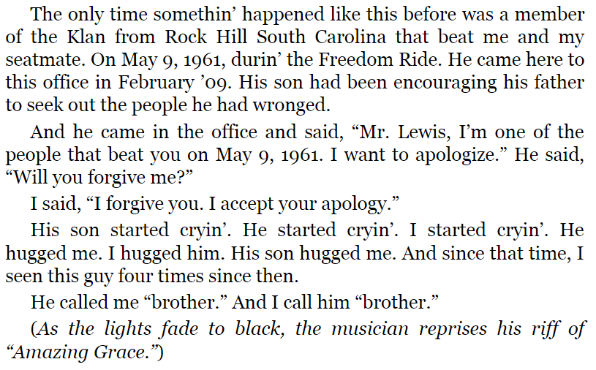
Is forgiveness required for a restorative narrative to work?
Is reconciliation necessary?
Government policy directly and indirectly impacts communities and individuals, which can be discovered through personal narrative.

Slide 54
Which of the monologues, poems, and articles we have read has been the most compelling for you? Why?
Government policy directly and indirectly impacts communities and individuals, which can be discovered through personal narrative.

Slide 55
Which of the monologues, poems, and articles we have read has been the most restorative for you? Why?
Government policy directly and indirectly impacts communities and individuals, which can be discovered through personal narrative.

Slide 56
Do you think restorative narratives are effective?
Government policy directly and indirectly impacts communities and individuals, which can be discovered through personal narrative.

Slide 57
In what context(s) are restorative narratives effective?
Government policy directly and indirectly impacts communities and individuals, which can be discovered through personal narrative.

Slide 58
What is the government’s responsibility in terms of community wide PTSD and creating space for restorative narratives?
Government policy directly and indirectly impacts communities and individuals, which can be discovered through personal narrative.

Slide 59
What are your questions?
Government policy directly and indirectly impacts communities and individuals, which can be discovered through personal narrative.

Slide 60
Reflect and complete Formative 5 Seminar Sheet.

Slide 61
Homework
Government policy directly and indirectly impacts communities and individuals, which can be discovered through personal narrative.
Read:
Read ‘Injury’ from Notes From the Field.
Read any of the monologues you have not yet read. In the next lesson, we will be close reading excerpts from monologues of of your choosing to find the connections between diction and perspective.
Write:
Complete Formative 5 Seminar Sheet.

