Slide 1
Notes From the Field & The 1619 Project
Interdisciplinary Unit
English Daily Slides
Week 2

Slide 2
Table of Contents
01
02
03
04
Lesson 5
Lesson 6
Lesson 7
Lesson 8

Slide 3
Lesson 5

Slide 4
Objective
You will discuss the questions raised by Baldwin in ‘Walk on a Leaf’ from Notes From the Field in a Socratic Seminar.

Slide 5
Agenda
Government policy directly and indirectly impacts communities and individuals, which can be discovered through personal narrative.
Word of the Day: Disenfranchise
Introduction to Socratic Seminar Definition, Roles, and Norms
Review Socratic Seminar Rubric
Watch Clip of Anna Deavere Smith Performing ‘Walk On A Leaf’
Socratic Seminar
Introduction to Prompt for Journal #3 and Begin Writing Response

Slide 6
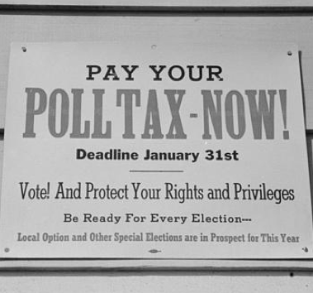
Word of the Day
Government policy directly and indirectly impacts communities and individuals, which can be discovered through personal narrative.
Notes
Also, to deprive (someone) of a right or privilege.
Definition
deprive (someone) of the right to vote.
disenfranchise
Example sentence
Our policy choices as a society and our decisions about where to allocate resources—pouring them
into prisons rather than into mental health or education—have turned our schools into a road to incarceration for too many of our youth. Because this is not only an American issue, we have an opportunity to invite new ideas, new ways of thinking about the disenfranchised.

Slide 7
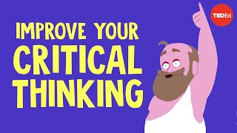
What is a Socratic Seminar?
A classroom discussion based on the implications and themes of a text
Looking at a text critically and making meaning together
The teacher provides you with a series of questions but does not otherwise interfere
Student-led, student-centered
Watch this brief video about the Socratic Method.
How does Socrates view learning?
What is a line of inquiry? How does it involve various people?
How can we apply his thoughts in class discussion?

Slide 8
What is YOUR role in a Socratic Seminar?
Active Listening
Do not just hear, listen to what your peers are sharing.
Side chatter or conversation not on-topic will result in you losing points for the seminar.
Reference the Text
Backup your thoughts and direct your peers to the text.
Active Participation
You do not need to raise your hand, but you must not cut others off.
Monitor your airtime. Are you commanding or making space? If you have spoken a lot, encourage others and step back.
Speak professionally.
Respect
Even if you disagree, explain why and follow up in a response when it is your turn.
Phones or computer screens are prohibited. We are present in the seminar.

Slide 9
Socratic Seminar Norms
Government policy directly and indirectly impacts communities and individuals, which can be discovered through personal narrative.
Reference the text: Your opinions are important, but they should be thoughts about the text.
Listen to what others say: Build upon what your classmates say and don’t interrupt. A discussion cannot take place unless you are listening actively and carefully to what others say.
Speak clearly: For others to respond to your opinions, everyone must be able to hear and understand what you say.
Give others your respect: Always remember our one classroom rule. A discussion is a cooperative exchange of ideas and not an argument or a debate: if you disagree, do so politely. You may become excited and wish to share your ideas, but don’t talk privately to your neighbor. Share your ideas with the whole class instead.
Guidelines:
You do not need to raise your hand to speak. However, do need to wait until whoever is speaking is finished before you speak.
Monitor your airtime. In our discussions, everyone should get a chance to speak. If you’ve spoken multiple times, hold back, and encourage others to speak.
Speak in formal, academic language. We are practicing for college and for professional, academic conversations.

Slide 10
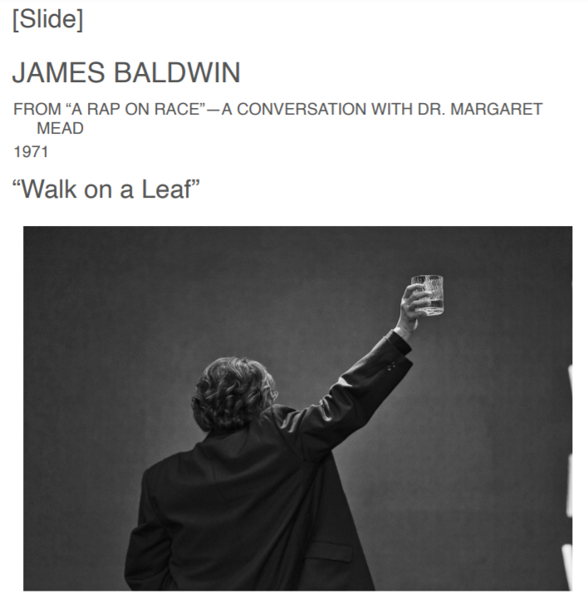
Formative 2: Socratic Seminar
This is a required formative.
Participate at least three times with substantive contributions.

Slide 11
Socratic Seminar Rubric
0-2 | Does not participate in seminar. Has device out/open.
3-4 | Speaks at least one time, making reference to the text. Shows signs of active listening.
5-6 | Speaks at least two times, making purposeful references to the text. Shows signs of active listening. Encourages others to participate.
7-8 | Speaks at least three times, making insightful references to the text. Shows signs of active listening. Encourages others to participate by presenting alternate lines of inquiry/questioning.

Slide 12
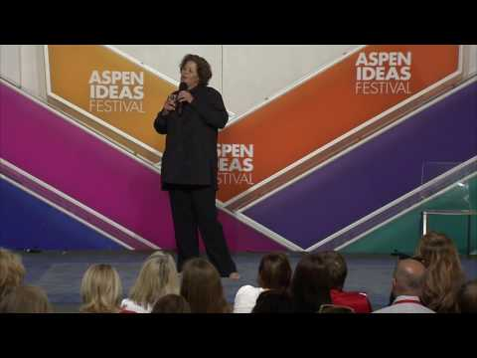

Slide 13
How do people develop a sense of respect for human life and for history?
Source: NFF, 115

Slide 14
What does it mean to have a history? Why is this important?
Source: NFF, 115

Slide 15
Do you have a history? If so, why? If not, why not?
Source: NFF, 115

Slide 16
What happens when we treat people who are often poorly treated with respect? Why?
Source: NFF, 116

Slide 17
Why does respect or dignity change people?
How does it change them?
Source: NFF, 116

Slide 18
What is the “tremendous national global moral waste?”
Source: NFF, 117

Slide 19
Why is this waste happening?
Is it still happening?
Source: NFF, 116

Slide 20
How do we stop it?
Source: NFF, 116

Slide 21
Can restorative narratives “arrest” the “tremendous national global moral waste?”
Source: NFF, 116

Slide 22
Answer Baldwin’s question. What should we do about the children?
Source: NFF, 117

Slide 23
Journal #3
Government policy directly and indirectly impacts communities and individuals, which can be discovered through personal narrative.
Do Baldwin’s questions still apply? He did ask them 50 years ago, after all. If you do not feel these questions still apply, then explain how you believe society has changed since 1971.
Are you part of what society is ‘wasting’ by not respecting you or valuing you enough?
Do you have a history?
What is your personal and social history?
How does that history impact your sense of value in the world? How can you change the way you tell your story?
What should we do about the children?

Slide 24
Homework
Government policy directly and indirectly impacts communities and individuals, which can be discovered through personal narrative.
Read:
Read the following monologues from Notes From the Field: ‘The Baddest,’ ‘Broken,’ and ‘The Geese’
Read ‘August 1619: poem’ by Clint Smith from The 1619 Project
Write:
Complete Journal Entry #3

Slide 25
Lesson 6

Slide 26
Objective
You will write a PEAL paragraph on imagery based on a close reading of your choosing.

Slide 27
Agenda
Government policy directly and indirectly impacts communities and individuals, which can be discovered through personal narrative.
Free Write
Discussion of Responses to Journal Entry #3
Introduction to the Different Types of Imagery
Imagery Example Identification Exercise
Close Read Excerpts of ‘August 1619: poem’ by Clint Smith and ‘The Geese’ and ‘The Baddest’ for Imagery
Discussion of Common PEAL Mistakes
Write Practice PEAL Paragraph
Review Practice PEAL Paragraph

Slide 28
Government policy directly and indirectly impacts communities and individuals, which can be discovered through personal narrative.
Focus Activity: Freewrite
A free write is a sustained writing period where the writer does not censor themselves. Anywhere your mind goes is fine! Start by reading the prompt, and then just WRITE!

Slide 29
Open invitation to share any final reflections from last class.
Government policy directly and indirectly impacts communities and individuals, which can be discovered through personal narrative.
Do Baldwin’s questions still apply? He did ask them 50 years ago, after all. If you do not feel these questions still apply, then explain how you believe society has changed since 1971.
Are you part of what society is “wasting” by not respecting you or valuing you enough?
Do you have a history?
What is your personal and social history?
How does that history impact your sense of value in the world? How can you change the way you tell your story?
What should we do about the children?

Slide 30
Imagery Notes (Imagery is our vocab word instead of WOD)
Figurative language that invites the reader to immerse themselves in a sensory experience with the speaker.
Organic imagery: internal experience or feeling
“my heart dropped into my stomach”
Kinesthetic imagery: movement
“The birds flapped their wings in excitement, the promise of food so close. They sprung out of the tree, one by one, soaring through the branches and swooping down low to the pile of berries beneath the tree.”
Visual imagery: sight
“The deep blue hues of twilight were reflected in the still water.”
Tactile imagery: touch
“Sarah placed her bare hand on the cold snow. It was wet at first, then the frigid cold set in like a thousand needles, all pricking her palm at once.”
Gustatory imagery: taste
“The rich, sweet, sugary taste of chocolate ran over his taste buds as he chewed and swallowed the whole cupcake in less than ten seconds.”
Auditory imagery: sound
“The rooster crowed at early dawn; the clang of pots and pans signaled that breakfast was almost ready.”
Olfactory imagery: smell
“The sweet scent of maple wafted through the room, causing Stephanie to stop what she was doing and sniff the air.”
Steps:
Identify the imagery.
Which type of imagery is it and why?
Which specific words make this imagery?
How does the imagery work to make meaning? What do you know or learn from it?
Why is it there? Does it characterize? Does it push the conflict?
Notes:
Source for all examples: https://blog.udemy.com/imagery-in-literature/

Slide 31
Which type of imagery is which? Identify the examples.
Example | Type of Imagery
“The deep blue hues of twilight were reflected in the still water.”
“The rich, sweet, sugary taste of chocolate ran over his taste buds as he chewed and swallowed the whole cupcake in less than ten seconds.”
“Sarah placed her bare hand on the cold snow. It was wet at first, then the frigid cold set in like a thousand needles, all pricking her palm at once.”
“My heart dropped into my stomach”
“The birds flapped their wings in excitement, the promise of food so close. They sprung out of the tree, one by one, soaring through the branches and swooping down low to the pile of berries beneath the tree.”

Slide 32
Which type of imagery is which? Identify the examples.
Example | Type of Imagery
The rooster crowed at early dawn; the clang of pots and pans signaled that breakfast was almost ready.”
“The sweet scent of maple wafted through the room, causing Stephanie to stop what she was doing and sniff the air.”

Slide 33
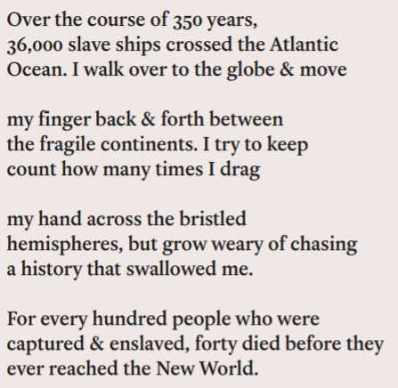
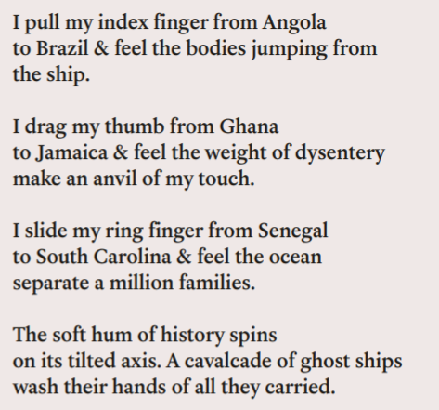
Examine this passage from Clint Smith’s poem
Government policy directly and indirectly impacts communities and individuals, which can be discovered through personal narrative.
Identify the imagery.
Which type of imagery is it and why?
Which specific words make this imagery?
How does the imagery work to make meaning? What do you know or learn from it?
Why is it there? Does it characterize? Does it push the conflict?
Notes:
Connection to the maroons

Slide 34
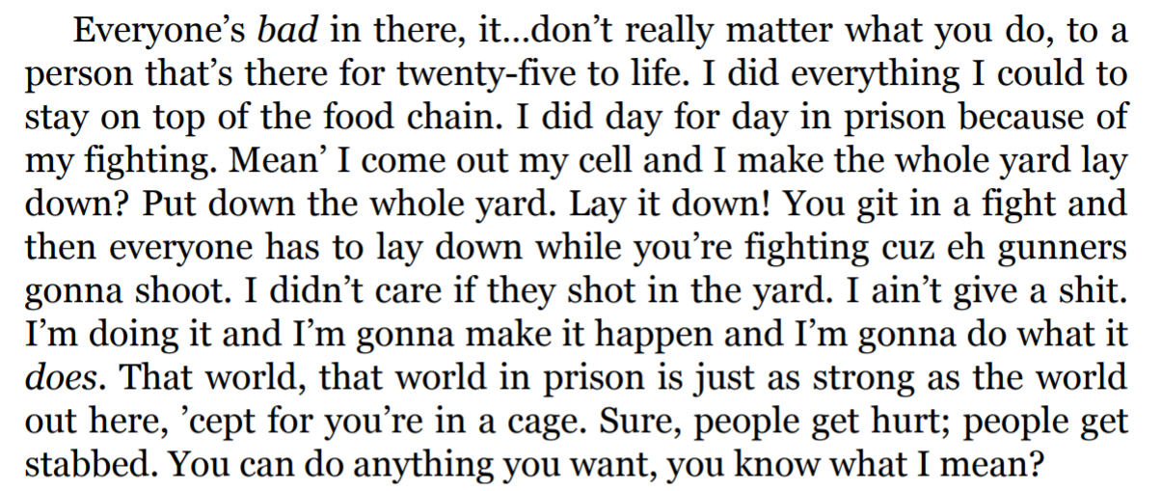
Examine this passage from ‘The Baddest’
Government policy directly and indirectly impacts communities and individuals, which can be discovered through personal narrative.
Identify the imagery.
Which type of imagery is it and why?
Which specific words make this imagery?
How does the imagery work to make meaning? What do you know or learn from it?
Why is it there? Does it characterize? Does it push the conflict?

Slide 35
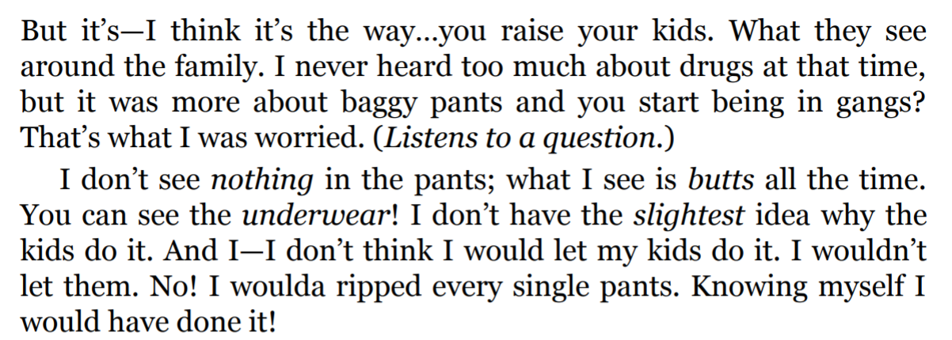
Examine this passage from ‘The Geese’
Government policy directly and indirectly impacts communities and individuals, which can be discovered through personal narrative.
Identify the imagery.
Which type of imagery is it and why?
Which specific words make this imagery?
How does the imagery work to make meaning? What do you know or learn from it?
Why is it there? Does it characterize? Does it push the conflict?

Slide 36
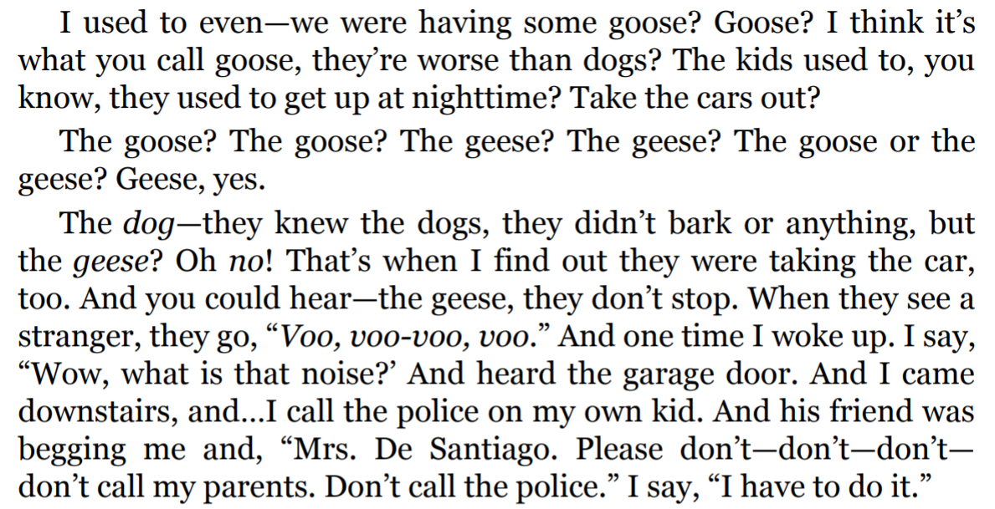
Examine this passage from ‘The Geese’
Government policy directly and indirectly impacts communities and individuals, which can be discovered through personal narrative.
Identify the imagery.
Which type of imagery is it and why?
Which specific words make this imagery?
How does the imagery work to make meaning? What do you know or learn from it?
Why is it there? Does it characterize? Does it push the conflict?

Slide 37
Which is the best example for a paragraph about imagery? Why?
Government policy directly and indirectly impacts communities and individuals, which can be discovered through personal narrative.
“The biggest expense in Medicaid in this county—in this state [of California], is for psychotropic drugs for foster children! All they do is jack these kids up on medicine. We’re using drugs to control children.” (Notes From the Field, 81)
“If…if you have children who are suffering to the extent that they act out in schools and do things they should not do… that could include hitting another child, hitting a teacher, having some kind of fit—and then they get expelled from school, then they get mad at somebody or they attack a school resource officer, then they get handcuffed, then they go to jail or probation or juvenile hall, and then it just goes from there and it—it just keeps going!” (Notes From the Field, 80)
“I was in a fistfight and somebody clobbered me. And they were saying, “Say ‘I give up,’ or say ‘Uncle.’ ” And this other person walked by and said, “You may as well kill her, ’cause she’ll never say it.” And it’s true!” (Notes From the Field, 80)

Slide 38
Common PEAL mistakes
Government policy directly and indirectly impacts communities and individuals, which can be discovered through personal narrative.
Arguing by assertion instead of analyzing the implications of a quotation
Long quotations
Your Point needs to be in OELi format
Analysis:
WHY did you pick the evidence?
HOW is it show a literary device?
How does it link to your thesis?
Pull the evidence apart: use a word or phrase from the quotation in the analysis and then explain what it is doing.
Use specific language; don’t say “this shows,” that’s not clear enough

Slide 39
Formative 3: Peer-reviewed PEAL paragraph
Government policy directly and indirectly impacts communities and individuals, which can be discovered through personal narrative.
Directions: Choose to write about one of the monologues you have read. Select a strong example of imagery. Why is it powerful, and what is its purpose?
Write a PEAL paragraph with an OELi point. You may use the sentence starters included.
You may start with the OELi point/thesis, or you may start with the evidence. It’s entirely up to you.
You may use the graphic organizer or the linear outline, or you may choose to just start writing in the blue box.
Your grade here is going to be based on whether you COMPLETED the paragraph, RECEIVED peer feedback, and REFLECTED on the basis of that peer feedback.
Peer Feedback (partner writes here) | Your Reflection
What are two things that the writer of the paragraph above did well? | How can you make this strength happen more often in your writing?
What are two things that the writer of the paragraph needs to work on? Write about something that was unclear or a part that is missing. | What can you do to improve in this area?
Notes:
30 minutes?

Slide 40
Homework
Government policy directly and indirectly impacts communities and individuals, which can be discovered through personal narrative.
Read:
Read ‘The Shakara Story’ from Notes From the Field
Make sure you are caught up on all the readings you have been assigned thus far.
Write:
Complete Formative 3

Slide 41
Lesson 7

Slide 42
Objective
You will close read for perspective and narrator so that you can explain the difference between the two as well as why an author would choose specific perspectives or narrative lenses.

Slide 43
Agenda
Government policy directly and indirectly impacts communities and individuals, which can be discovered through personal narrative.
Word of the Day: Perspective
Notes on Perspective and Point of View
Discussion of Reactions to ‘The Shakara Story’
Close Read Excerpts of ‘The Shakara Story’ for Perspective
Debrief
Writing Prompt

Slide 44
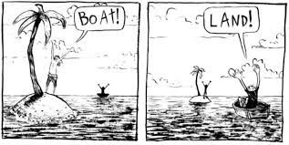
Government policy directly and indirectly impacts communities and individuals, which can be discovered through personal narrative.
Definition: is the values, experiences, views, opinions, and aspects of identity that inform how a person sees the world and interprets their experiences.
Word of the Day
perspective
Example sentence
Notes
Literary term
Different from POV

Slide 45
Perspective and Point of View
Government policy directly and indirectly impacts communities and individuals, which can be discovered through personal narrative.
Point of View is the relationship between the narrator and the story.
1st person: the narrator is telling their story, with the “I” voice.
3rd person: the narrator is outside of the story, telling a story they are not a part of.
The monologues are in ___ person, while the poems are in ___ person.
Perspective is the values, experiences, views, opinions, and aspects of identity that inform how a person sees the world and interprets their experiences. It’s their lens on the world, as established by their experience of it. All the characters and writers in this unit are speaking from different perspectives.
Notes:
Further resources: https://nybookeditors.com/2016/02/whats-the-difference-between-perspective-and-point-of-view/

Slide 46
Open ‘The Shakara Story’

Slide 47
Discussion: what did you think of ‘The Shakara Story?’
Government policy directly and indirectly impacts communities and individuals, which can be discovered through personal narrative.
Was any part of this story particularly challenging or familiar for you?
Which parts of the text jumped out at you? Please share, if you feel comfortable.
Does this text function as a restorative narrative?
Acknowledgement of harm
Empowerment through truth and/or validation
“These aren’t positive, happy-go-lucky fluff pieces. They explore the tough emotional terrain of disruptions... But they’re “positive” in the sense that they focus on themes such as growth and renewal” (Tenore).
Opportunity for growth, new understandings, or way to move forward with a new shared past
Are there any other takeaways you want to share?

Slide 48
When reading difficult texts, what should I do?
Government policy directly and indirectly impacts communities and individuals, which can be discovered through personal narrative.
Pay attention to your body
(signs of stress are heart rate going up, sweating, shaking or jittering, feeling cold in your extremities and hot, flushed cheeks or chest, unexplained crying)
stop and think about what you are feeling (Are you remembering something sad, scary or an angry memory? Are you not sure (that’s also okay)?
Acceptance: Stress is a form of suffering. Many religions have their own versions of this, but Buddhists explain it best in my opinion:
“welcome suffering as a mother welcomes a sad child.” Your suffering is a part of you that is feeling sad or afraid - it is good to accept that part without judgement, nurture it and let it feel safe.
Listen to your suffering: You may need another person to help you figure those feelings out. I am definitely here for you as well as your classmates.
Continue until both you and your suffering are okay to do so.
TAKE TIME if you are not able to continue. Use the time to nurture and understand your suffering so you can return to learning.
Notes:
Resources on this slide compliments of Ms. Rogers.

Slide 49
We are going to read together, quietly, then talk.
Who are these people? What are their perspectives?
Government policy directly and indirectly impacts communities and individuals, which can be discovered through personal narrative.
What do we know about Amanda Ripley’s perspective? Can you describe her lens?
What do we know about Niya Kenny’s perspective? Can you describe her lens?
How has Niya’s personal experience made her who she is?
Can you make any inferences about Shakara’s perspective?
Can you make any connections to “All Because Of Your Mouth,” which you read in Government?
Why does perspective matter?

Slide 50
Reading For Perspective
Government policy directly and indirectly impacts communities and individuals, which can be discovered through personal narrative.
We can’t close read all of these sections as a class. We will need to select some, and you will have the chance to read some others with your partner.
Please take a few minutes to read over which sections are cut into the following slides, and select two that you want to do as a class. We will choose 2-3 of the most popular to close read together, and then you will read the remaining as you can with your partner.

Slide 51
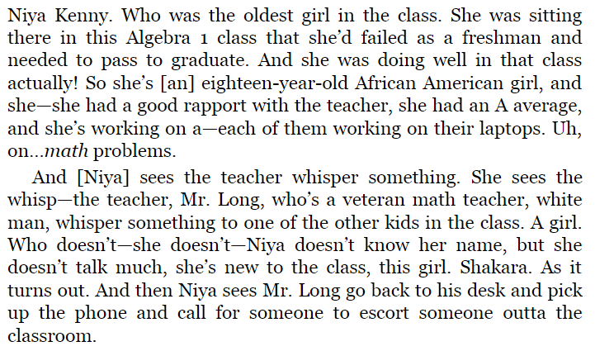
Examine Different Perspectives: Amanda Ripley
Government policy directly and indirectly impacts communities and individuals, which can be discovered through personal narrative.
Identify phrases that reveal the character’s perspective.
What is the speaker’s perspective? (their lens, seen from their values, experiences, views).
Why do you think Smith is putting these perspectives together?

Slide 52
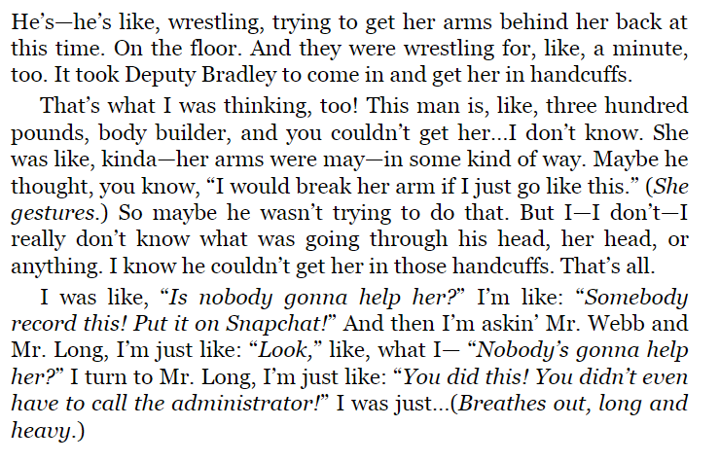
Examine Different Perspectives: Niya Kenny
Government policy directly and indirectly impacts communities and individuals, which can be discovered through personal narrative.
Identify phrases that reveal the character’s perspective.
What is the speaker’s perspective? (their lens, seen from their values, experiences, views).
Why do you think Smith is putting these perspectives together?

Slide 53
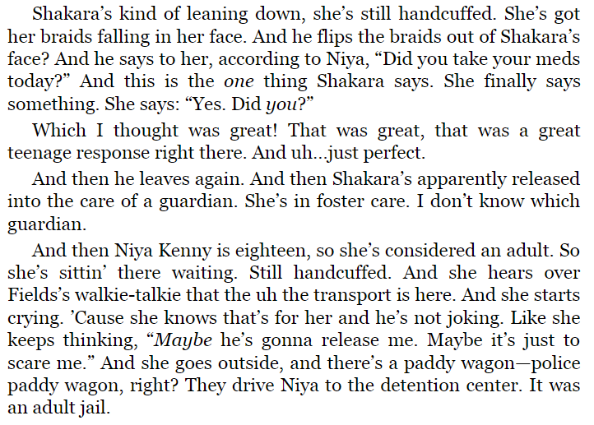
Examine Different Perspectives: Amanda Ripley
Government policy directly and indirectly impacts communities and individuals, which can be discovered through personal narrative.
Identify phrases that reveal the character’s perspective.
What is the speaker’s perspective? (their lens, seen from their values, experiences, views).
Why do you think Smith is putting these perspectives together?

Slide 54
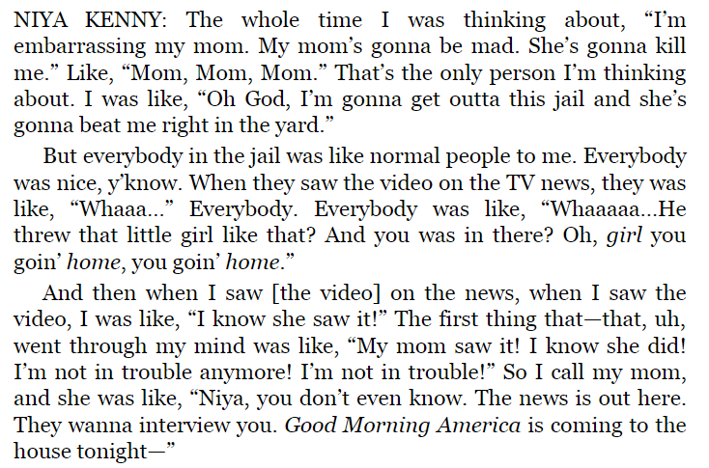
Examine Different Perspectives: Niya Kenny
Government policy directly and indirectly impacts communities and individuals, which can be discovered through personal narrative.
Identify phrases that reveal the character’s perspective.
What is the speaker’s perspective? (their lens, seen from their values, experiences, views).
Why do you think Smith is putting these perspectives together?

Slide 55
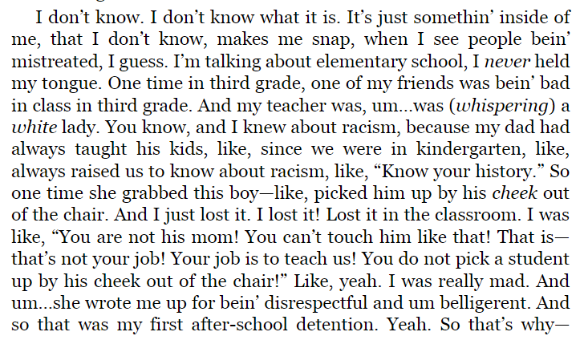
Examine Different Perspectives: Niya Kenny
Government policy directly and indirectly impacts communities and individuals, which can be discovered through personal narrative.
Identify phrases that reveal the character’s perspective.
What is the speaker’s perspective? (their lens, seen from their values, experiences, views).
Why do you think Smith is putting these perspectives together?

Slide 56
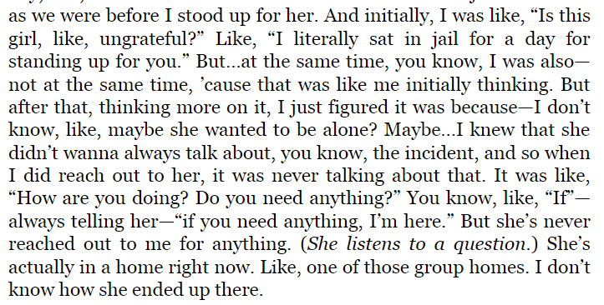
Examine Different Perspectives: Niya Kenny
Government policy directly and indirectly impacts communities and individuals, which can be discovered through personal narrative.
Identify phrases that reveal the character’s perspective.
What is the speaker’s perspective? (their lens, seen from their values, experiences, views).
Why do you think Smith is putting these perspectives together?

Slide 57
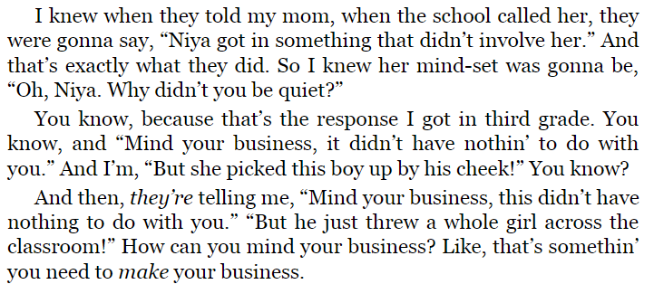
Examine Different Perspectives: Niya Kenny
Government policy directly and indirectly impacts communities and individuals, which can be discovered through personal narrative.
Identify phrases that reveal the character’s perspective.
What is the speaker’s perspective? (their lens, seen from their values, experiences, views).
Why do you think Smith is putting these perspectives together?

Slide 58
How does this text function as a restorative narrative?
Government policy directly and indirectly impacts communities and individuals, which can be discovered through personal narrative.
The features of a restorative narrative are:
Acknowledgement of harm
Empowerment through truth and/or validation
“These aren’t positive, happy-go-lucky fluff pieces. They explore the tough emotional terrain of disruptions... But they’re “positive” in the sense that they focus on themes such as growth and renewal” (Tenore).
Do you feel that this text is restorative? Does it create a shared past, meaning, or understanding?

Slide 59
Write Your Truth
Prompt: Writing from a first and/or second person point of view, write a brief explanation of your perspective on the world. What is it that you believe? What issues does society face? How do you traverse through this society and life?
Aim to write 1-3 paragraphs. The practice is for you, but I will encourage you to share with one another.

Slide 60
Lesson 8

Slide 61
Objective
You will close read blues songs for characterization, diction, perspective, and point of view.

Slide 62
Agenda
Government policy directly and indirectly impacts communities and individuals, which can be discovered through personal narrative.
Turn and Talk: Reflections on ‘The Birth of American Music’
Watch ‘Is Blues the Mother of All Modern Music?’ Clip
Review History of Minstrelsy and the Blues
Small Group Close Readings of Blues Songs
Whole Group Debrief

Slide 63
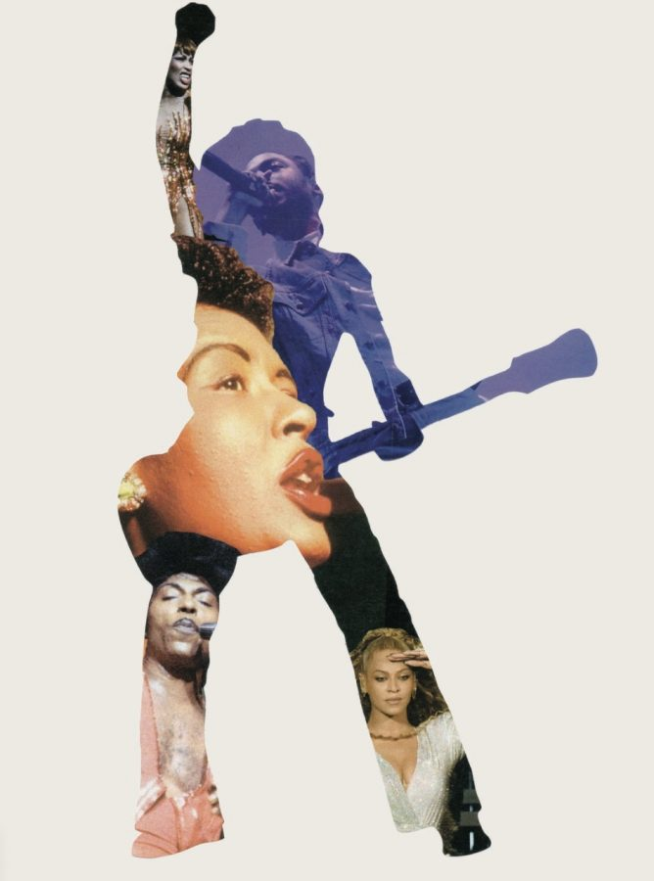
“Our first most original art form arose from our original sin” (Morris)
Turn and talk:
What did you learn about the history and origins of American music from this reading or from the podcast?
Were you aware of this history?
What is your response?
Notes:
PROVIDE DISCLAIMER THAT SOME TROUBLING/RACIST IMAGES FOLLOW IN THE NEXT SLIDE

Slide 64
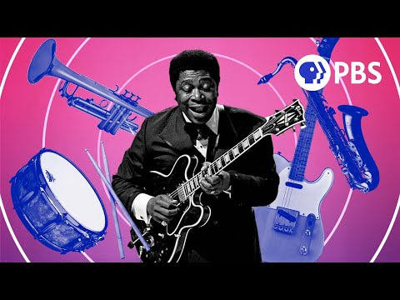

Slide 65
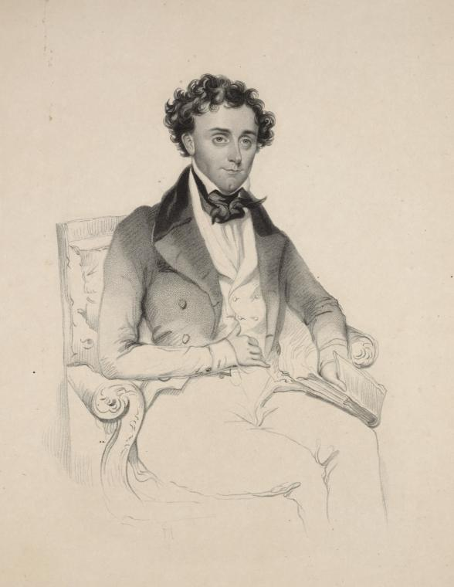
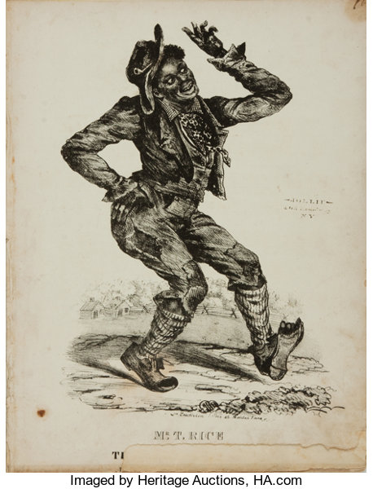
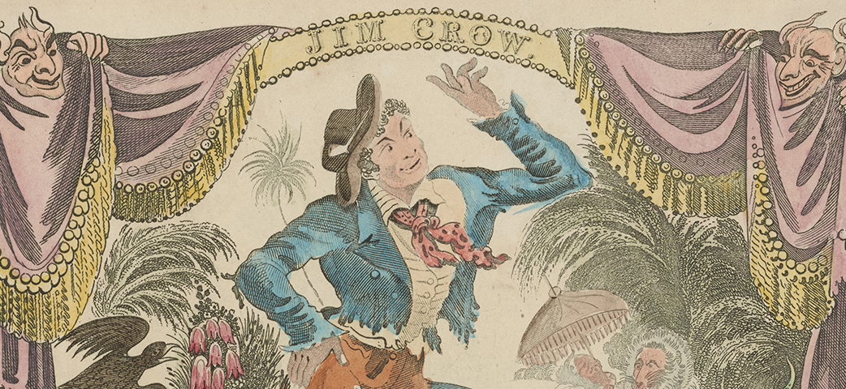
It begins with a man named T.D. Rice...
Weel about and turn about jus so/ Ebery time I weel about, I jump Jim Crow
Notes:
In 1830s, Rice was touring in Cincinnati or Louisville and saw a decrepit, possibly disfigured old black man singing while grooming a horse on the property of a white man whose last name was crow.
Rice took in the tune and movements and created the song. Dressed up as man and performed on stage, adopting a gibberish dialect and donning blackface. Audience reportedly cheered and called for 20 encores.
Americana/popular culture was born, distinct from Italian operas and European theater productions. Resolutely American and resolutely racist. Jim Crow would come to emblemize American racism

Slide 66
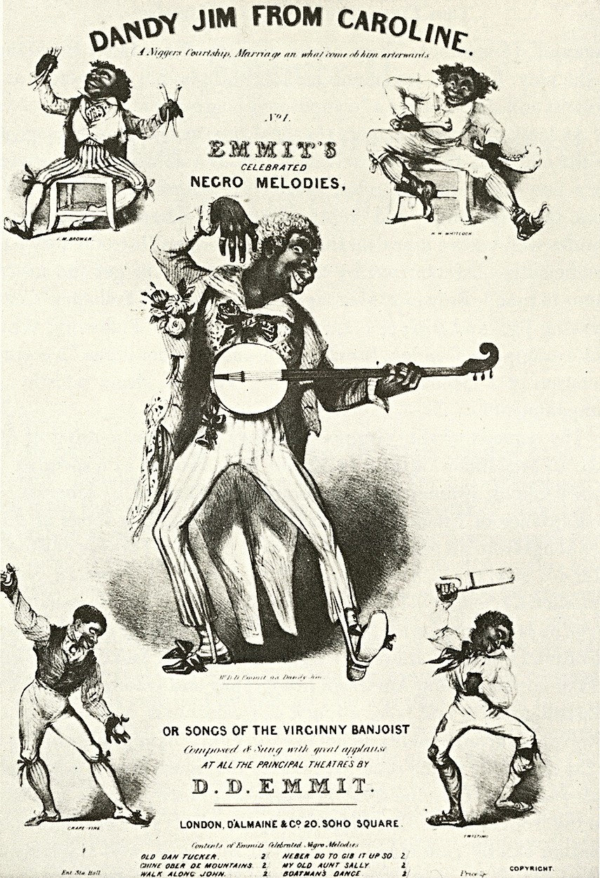
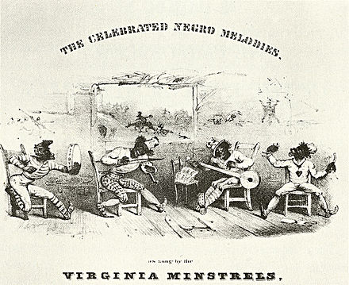
The Minstrel Show
Traveling performance that went from city to city
Featured “minstrels” -- performers in blackface who sang, danced, played music, and performed in skits
Instrumentation included banjo, fiddle, bone castanets, tambourine -- the foundation of American popular music
Minstrel shows were THE form of entertainment in America from 1830s-1870s
Important Note
Performances were ALL conjecture, as most white performers in blackface had never meaningfully met or interacted with black people.
Notes:
Minstrels spoke in gibberish dialect and over exaggerated body movements. Extreme problem as most audiences, like the minstrels, had never meaningfully interacted with black people (enslaved Africans at the time).
How does the representation of conjectured depiction affect the audience’s understanding of blackness and contort reality? Remember, minstrelsy was THE form of popular entertainment and plays a role in the first American recorded music and talking films.

Slide 67
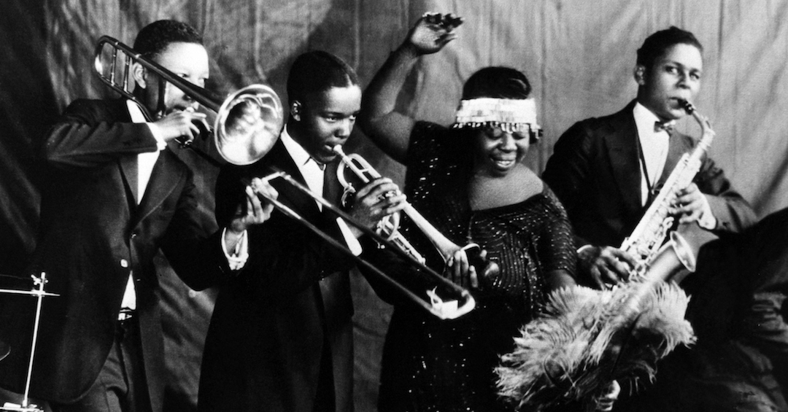
Birth of the Blues in the 1920s
Following the end of slavery, a new audience emerged with a desire for real black performers
Tradition of traveling tent show spectacles upheld, performing in predominantly black, Southern, working-class spaces
A new tradition -- the blues.
Music that addressed the true social and emotional lives of black performers and audiences
Humorous, aggressive, ironic, and straight-forward all at once
Tackled tough topics -- depression, sexuality, domestic violence, migration, work, racial injustice

Slide 68
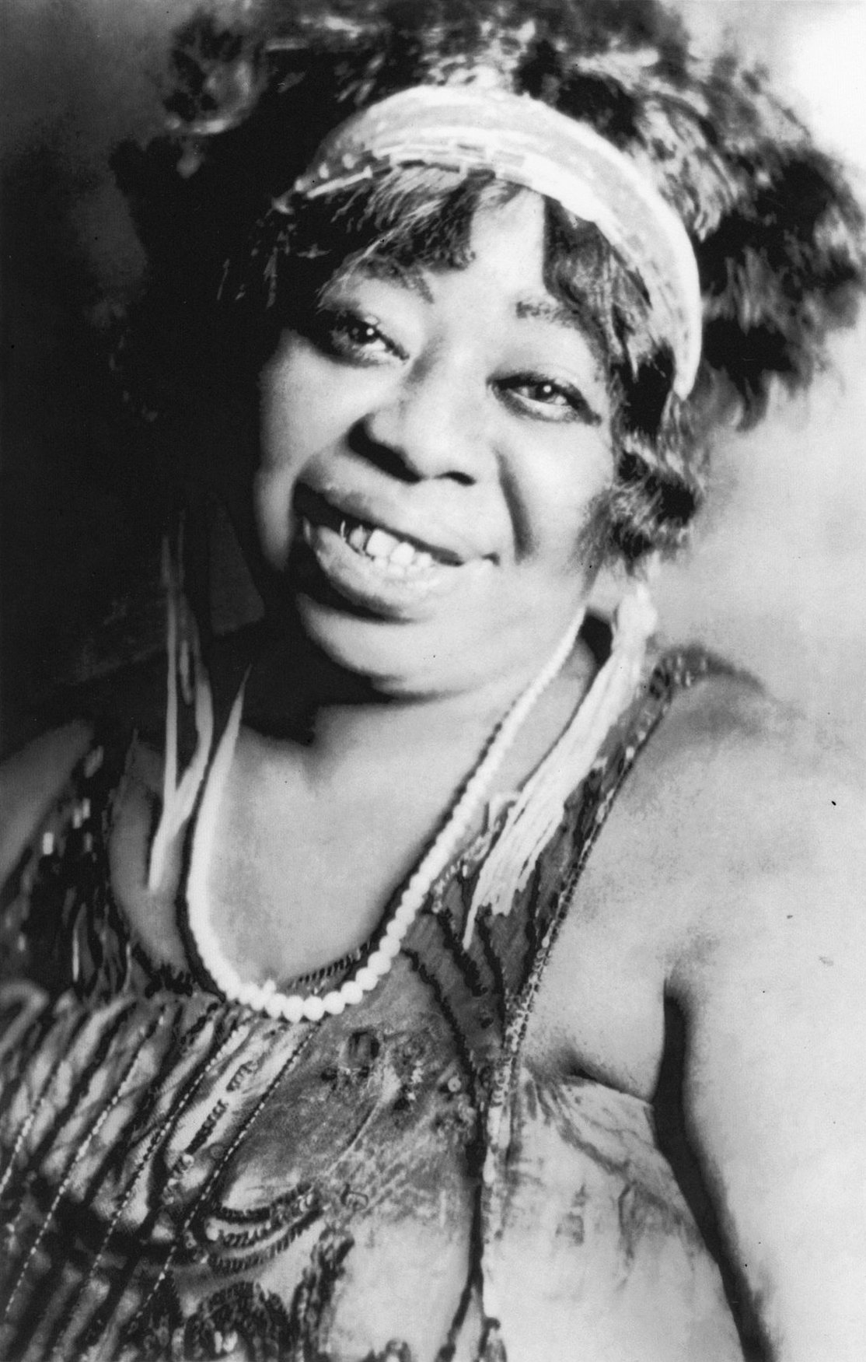
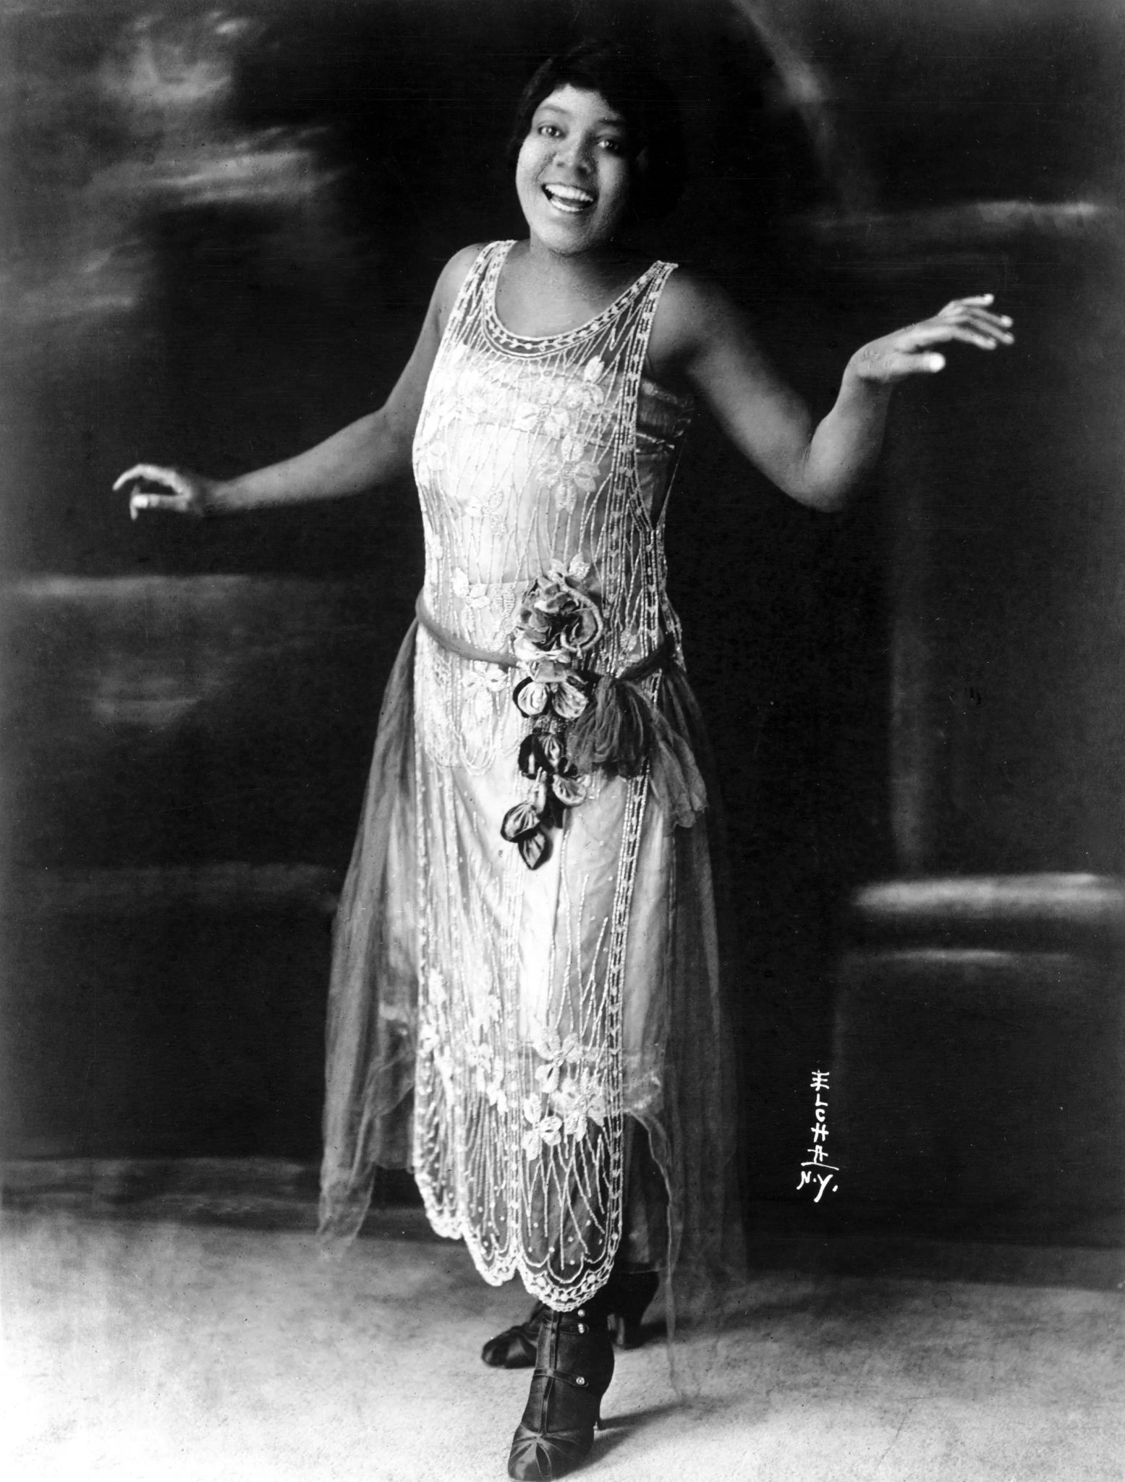
Meet “Mother of the Blues” and “Empress of the Blues”
Gertrude ‘Ma’ Rainey Bessie Smith
Both artists embodied characters and portrayed narratives in their songs rooted in their identities as Black women

Slide 69
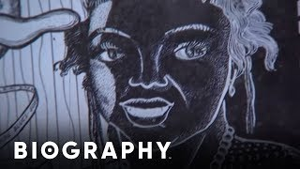
Who is Ma Rainey? (1886–1939)
Ma Rainey ,born Gertrude Pridgett, is a blues singer from Georgia.
She is known as the “Mother of Blues”.
Her music and influence was popular in 1920’s America.
Her music explored her life as an “independent, openly bisexual African-American woman.” (Women’s History )

Slide 70
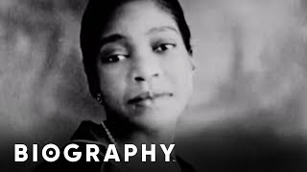
Who is Bessie Smith? (1894- 1937)
Born in Chattanooga, Tennessee Bessie Smith was a famous blues singer of 1920’s and 1930’s .
She was known as the “Empress of Blues”
She often worked with Ma Rainey during this time period in music.
She was one of the best selling blues singers of that time.

Slide 71
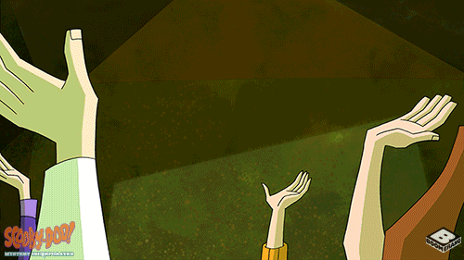
Small Group Close Read
Work with a group assigned to you
Choose one of the songs on the following slides, listen to it together, and read along with the lyrics.
Then, close read together and take notes:
What is the narrative being told in the song? Is it restorative?
What is the narrator’s point of view?
What is the narrator’s perspective?
How can you describe the character? Direct or indirect characterization? What are their traits?
What words/phrases are interesting/stand out to you? Analyze this diction.

Slide 72
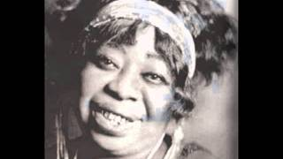
“Black Eye Blues” by Ma Rainey
What is the narrative being told in the song? Is it restorative?
What is the narrator’s point of view?
What is the narrator’s perspective?
How can you describe the character? Direct or indirect characterization? What are their traits?
What words/phrases are interesting/stand out to you? Analyze this diction.
Down in Hogan’s Alley lived Miss Nancy Ann
Always fussin’, squabbling with her man
Then I heard Miss Nancy say
“Why do you treat your gal that way?”
I went down the alley, other night
Nancy and her man had just had a fight
He hit Miss Nancy ‘cross the head
When she rose to her feet, she said
“You low down alligator, just watch me
Sooner or later gonna catch you with your britches down
You ‘buse me and you cheat me, you dog around and beat me
Still I’m gonna hang around
“Take all my money, blacken both of my eyes
Give it to another woman, come how and tell me lies
You low down allligator, just watch me
Sooner or later gonna catch you with your britches down
I mean, gonna catch you with your britches down.”

Slide 73
“Black Eye Blues” by Ma Rainey Group Notes
Put the names of your group members below and add your response to this slide.
Group Members:
Close Read Notes:
Group Members:
Close Read Notes:
Group Members:
Close Read Notes:
Group Members:
Close Read Notes:

Slide 74
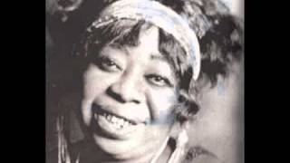
“Trust No Man” by Ma Rainey
What is the narrative being told in the song? Is it restorative?
What is the narrator’s point of view?
What is the narrator’s perspective?
How can you describe the character? Direct or indirect characterization? What are their traits?
What words/phrases are interesting/stand out to you? Analyze this diction.
I want all you women to listen to me
Don't trust your man no further’n your eyes can see
I trusted mine with my best friend
But that was the bad part in the end
Trust no man, trust no man, no further than your eyes can see
I said, trust no man, no further than your eyes can see
He’ll tell you that he loves you and swear it is true
The very next minute he’ll turn his back on you
Ah, trust no man, no further than your eyes can see
Just feed your daddy with a long-handled spoon
Be sure to love him, morning, night, and noon
Sometimes your heart will ache and almost bust
That’s why there’s no daddy good enough to trust
Trust no man

Slide 75
“Trust No Man” by Ma Rainey
Put the names of your group members below and add your response to this slide.
Group Members:
Close Read Notes:
Group Members:
Close Read Notes:
Group Members:
Close Read Notes:
Group Members:
Close Read Notes:

Slide 76
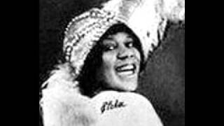
“In the House Blues” by Bessie Smith
What is the narrative being told in the song? Is it restorative?
What is the narrator’s point of view?
What is the narrator’s perspective?
How can you describe the character? Direct or indirect characterization? What are their traits?
What words/phrases are interesting/stand out to you? Analyze this diction.
Settin’ in the house with everything on my mind
Settin’ in the house with everything on my mind
Lookin’ at the clock and can’t even tell the time
Walkin’ to my window, and lookin’ out of my door
Walkin’ to my window, and lookin’ out of my door
Wishin’ that my man would come home once more
Can’t eat, can’t sleep, so weak I can’t walk my floor
Can’t eat, can’t sleep, so weak I can’t walk my floor
Feel like hollerin’ murder, let the police squad get me once more
They woke me up before day with trouble on my mind
They woke me up before day with trouble on my mind
Wringin’ my hands and screamin’, walkin’ the floor hollerin’ and cryin’
Catch ‘em, don’t let them blues in here
Catch ‘em, don’t let them blues in here
They shakes me in bed, can’t set down in my chair
Oh, the blues has got me on the go
Oh, they’ve got me on the go
They runs around my house, in and out of my front door.

Slide 77
“In the House Blues” by Bessie Smith Group Notes
Put the names of your group members below and add your response to this slide.
Group Members:
Close Read Notes:
Group Members:
Close Read Notes:
Group Members:
Close Read Notes:
Group Members:
Close Read Notes:

Slide 78
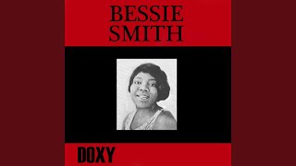
“Please Help Me Get Him Off My Mind” by Bessie Smith
What is the narrative being told in the song? Is it restorative?
What is the narrator’s point of view?
What is the narrator’s perspective?
How can you describe the character? Direct or indirect characterization? What are their traits?
What words/phrases are interesting/stand out to you? Analyze this diction.
I’ve cried and worried, all night I’ve laid and groaned
I’ve cried and worried, all night I’ve laid and groaned
I used to weight two hundred, now I’m down to skin and bones
It’s all about a man who always kicked and dogged me ‘round
It’s all about a man who always kicked and dogged me ‘round
And when I try to kill him that’s when my love for him comes down
I’ve come to see you, gypsy, beggin’ on my bended knees
I’ve come to see you, gypsy, beggin’ on my bended knees
That man put something on me, oh, take it off of me, please
It starts at my forehead and goes clean down to my toes
It starts at my forehead and goes clean down to my toes
Oh, how I’m sufferin’, gypsy, fix him for me one more time
Just make him love me, but please, ma’am, take him off my mind

Slide 79
“Please Help Me Get Him Off My Mind” by Bessie Smith
Put the names of your group members below and add your response to this slide.
Group Members:
Close Read Notes:
Group Members:
Close Read Notes:
Group Members:
Close Read Notes:
Group Members:
Close Read Notes:

Slide 80
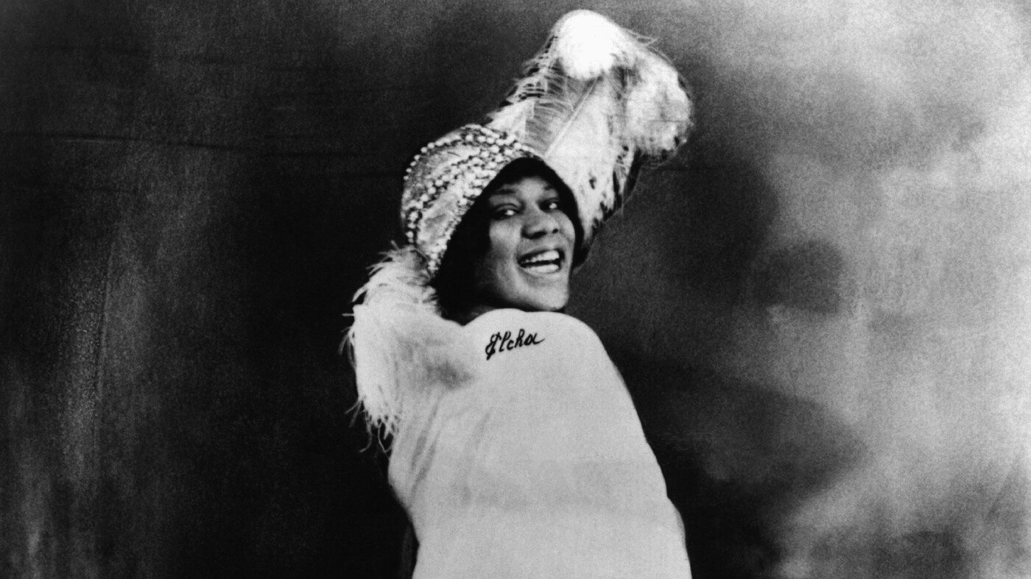
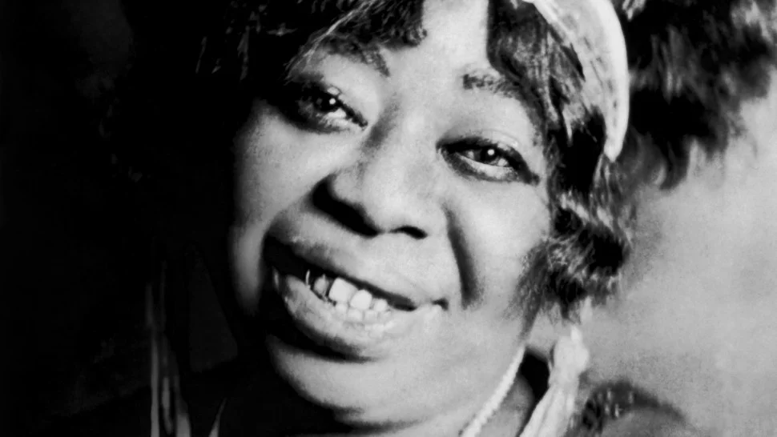
The Women of the Blues
What song did your group choose? What was it about? What was your reaction to it?
Was the narrative restorative? Why or why not?
What is the POV and perspective of the song?
Who is the character? How are they characterized?
What words/phrases did you analyze?

Slide 81
Homework
Government policy directly and indirectly impacts communities and individuals, which can be discovered through personal narrative.
Read:
Read James Baldwin’s Interview with Jordan Elgrably
Write:
No new writing

