Slide 1
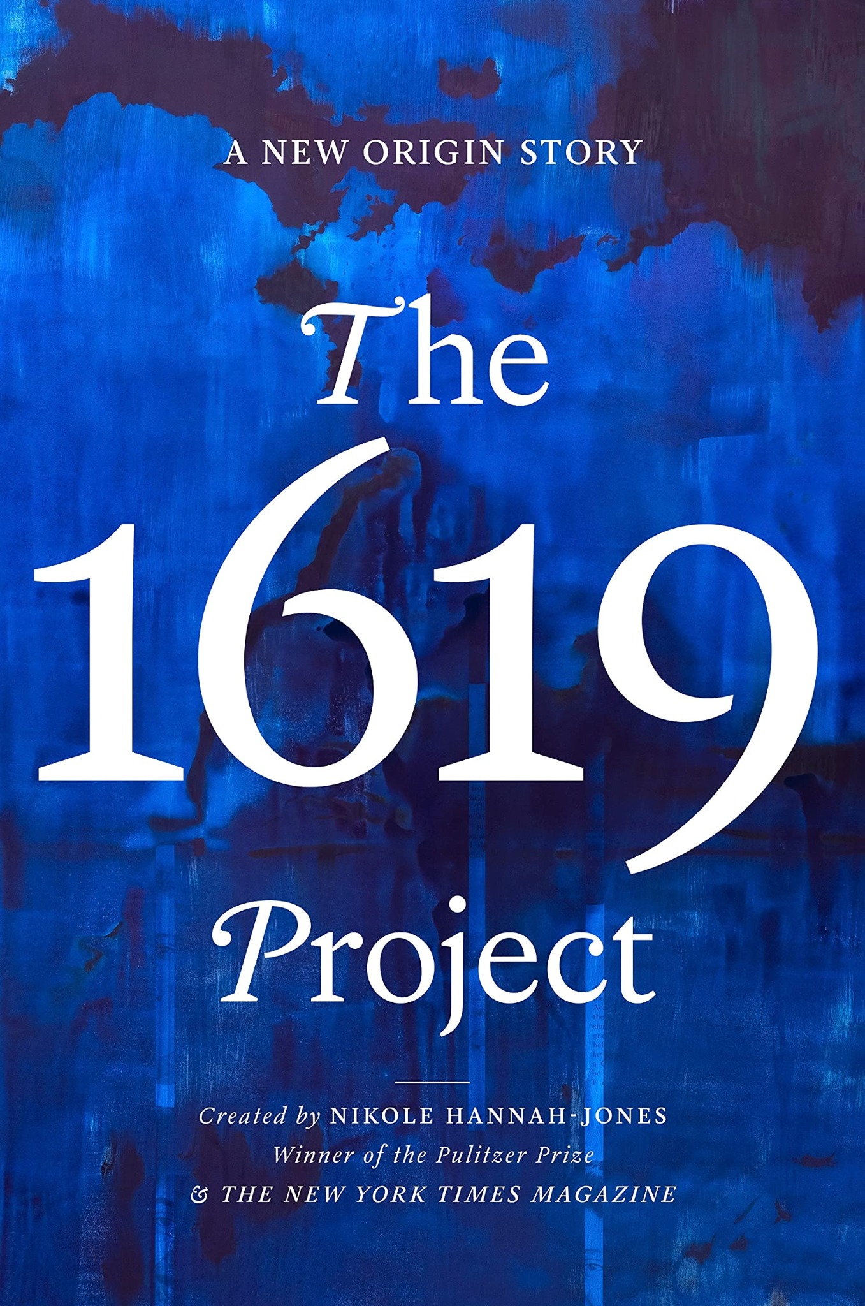
Notes From the Field & The 1619 Project
Interdisciplinary Unit
English Daily Slides
Week 1

Slide 2
Table of Contents
01
02
03
04
Lesson 1
Lesson 2
Lesson 3
Lesson 4

Slide 3
Lesson 1

Slide 4
Objective
You will understand the purpose of restorative narratives, The 1619 Project, and Notes From the Field.

Slide 5
Agenda
Government policy directly and indirectly impacts communities and individuals, which can be discovered through personal narrative.
Focus Question
Word of the Day: Dialect
Anticipating Issues in the Text
Unit Introduction & Overview
Close Reading of “Introduction” from Notes From the Field
Restorative Narrative Discussion
Poetry Reading

Slide 6
A reminder of community norms
Be present.
Be prepared.
Be respectful.
In this unit, we will learn about and discuss many topics that are challenging, upsetting, and emotional. As a community, we must actively listen to one another and be present, prepared, and respectful while engaged in this work.

Slide 7
Focus Question
Government policy directly and indirectly impacts communities and individuals, which can be discovered through personal narrative.
Journal Prompt: Tell a nonfiction story from your life. The story should include a fleshed out beginning, middle, and end.

Slide 8
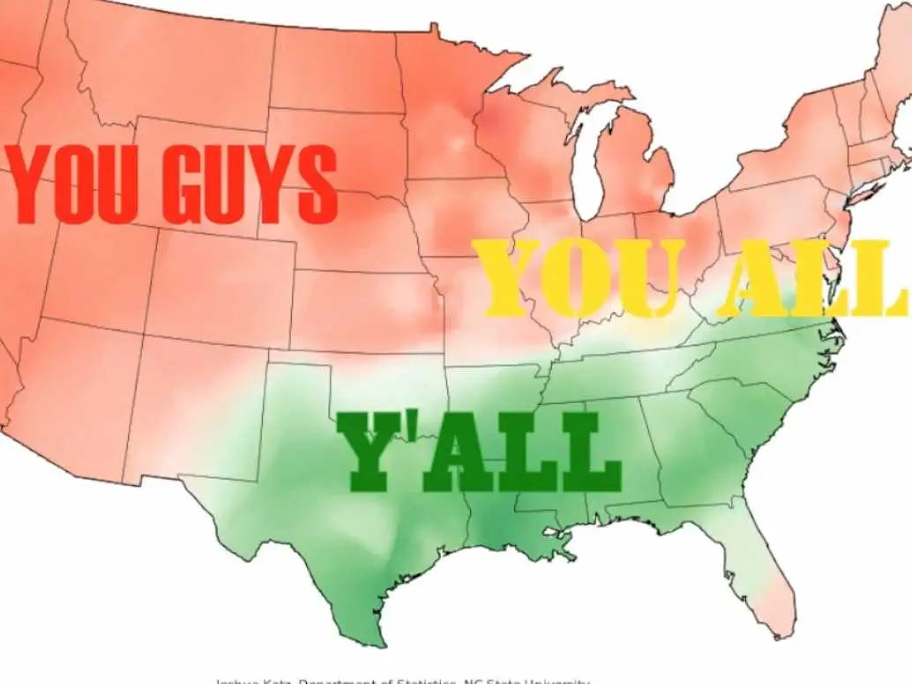
Word of the Day
Government policy directly and indirectly impacts communities and individuals, which can be discovered through personal narrative.
Definition: the way someone speaks based on regional or cultural speech patterns, pronunciation, or idioms. It is often revealed through phonetic spelling.
Dialect
Notes:
Dialect can be used to establish a character’s location, social group, and level of education
Be careful of falling into stereotypes with dialect analysis; highly educated people often use their native dialect (Ex: Ms. Kain says y’all).
“Gotta keep climbing. You gotta keep fightin’. You gotta keep climbing. You gotta keep praying. You gotta keep doing all’v the things that you know can make you stronger,” (IU Text 37)

Slide 9
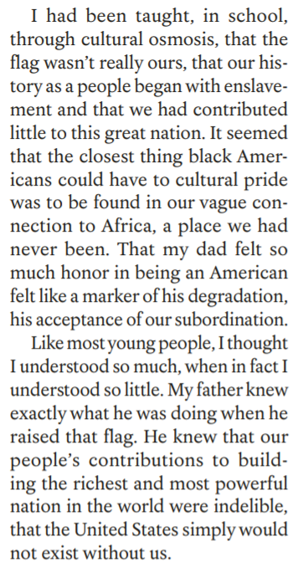
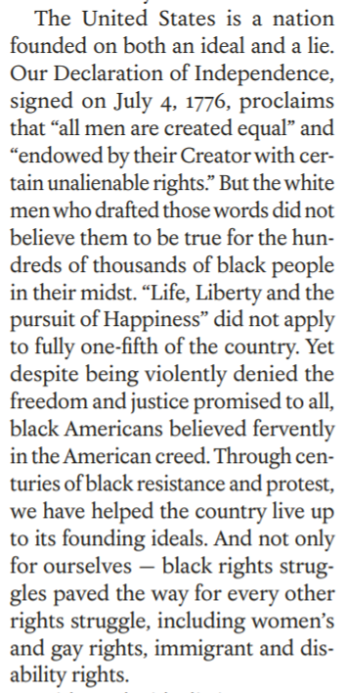
Anticipating the Issues in the Text:
Read these excerpts from The 1619 Project.
What do you think we will be doing this unit?
Government policy directly and indirectly impacts communities and individuals, which can be discovered through personal narrative.

Slide 10
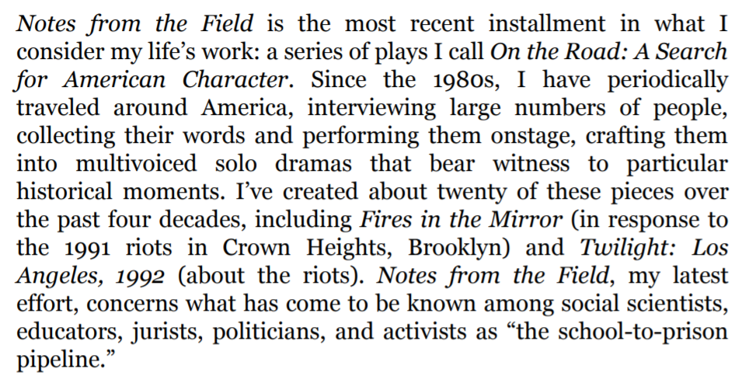
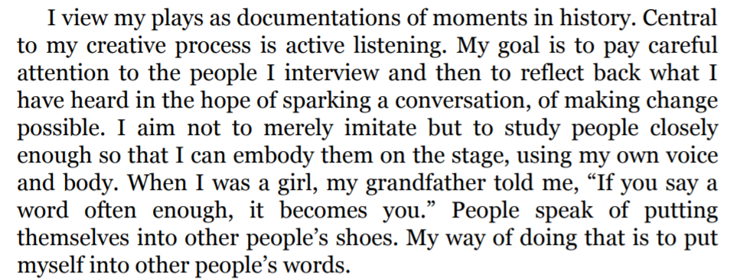
Anticipating the Issues in the Text:
Read these excerpts from Notes From the Field.
What do you think we will be doing this unit?
Notes:
Poll the students to see who has read the intro to Notes From the Field in Government. Chances are, they have, and you do not need to use this slide much.

Slide 11
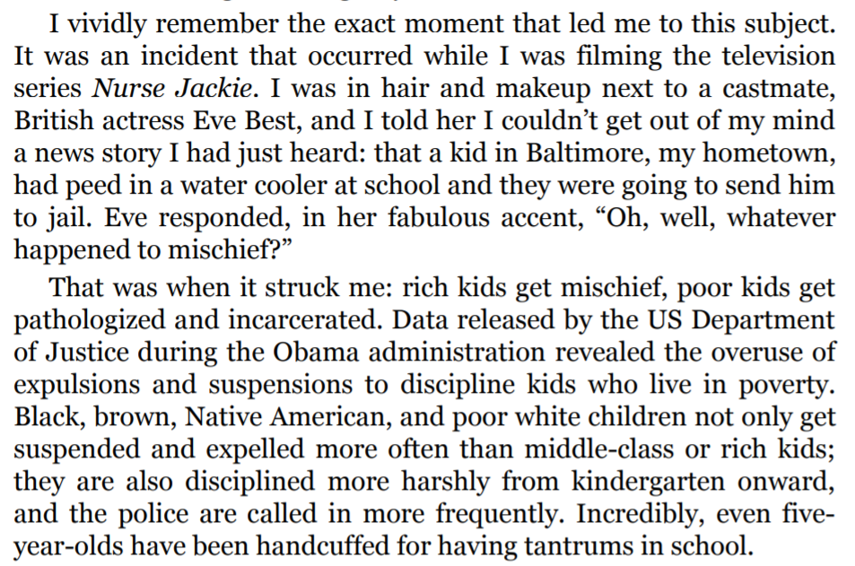
Anticipating the Issues in the Text:
Read these excerpts from Notes From the Field.
What do you think we will be doing this unit?

Slide 12
“Storytelling changes how we understand our past.”
Government policy directly and indirectly impacts communities and individuals, which can be discovered through personal narrative.
Raise your hand with a number, 1-5, to express your opinion.
Strongly Agree - 5
Agree - 4
Neutral - 3
Disagree - 2
Strongly Disagree - 1
I will invite some students to share their opinions in this discussion.

Slide 13
“Storytelling creates a shared past.”
Government policy directly and indirectly impacts communities and individuals, which can be discovered through personal narrative.
Raise your hand with a number, 1-5, to express your opinion.
Strongly Agree - 5
Agree - 4
Neutral - 3
Disagree - 2
Strongly Disagree - 1
I will invite some students to share their opinions in this discussion.

Slide 14
“Newsrooms should put as much emphasis on recovery and restoration as they do on tragedy and devastation.”
Government policy directly and indirectly impacts communities and individuals, which can be discovered through personal narrative.
Raise your hand with a number, 1-5, to express your opinion.
Strongly Agree - 5
Agree - 4
Neutral - 3
Disagree - 2
Strongly Disagree - 1
I will invite some students to share their opinions in this discussion.

Slide 15
“People can find meaning in even the darkest circumstances.”
Government policy directly and indirectly impacts communities and individuals, which can be discovered through personal narrative.
Raise your hand with a number, 1-5, to express your opinion.
Strongly Agree - 5
Agree - 4
Neutral - 3
Disagree - 2
Strongly Disagree - 1
I will invite some students to share their opinions in this discussion.

Slide 16
“What is to give light must endure burning.”
Viktor Frankl, Man’s Search for Meaning
Government policy directly and indirectly impacts communities and individuals, which can be discovered through personal narrative.
Raise your hand with a number, 1-5, to express your opinion.
Strongly Agree - 5
Agree - 4
Neutral - 3
Disagree - 2
Strongly Disagree - 1
I will invite some students to share their opinions in this discussion.

Slide 17
“Everything can be taken from a man but one thing: the last of the human freedoms—to choose one’s attitude in any given set of circumstances, to choose one’s own way.”
Viktor Frankl, Man’s Search for Meaning
Government policy directly and indirectly impacts communities and individuals, which can be discovered through personal narrative.
Raise your hand with a number, 1-5, to express your opinion.
Strongly Agree - 5
Agree - 4
Neutral - 3
Disagree - 2
Strongly Disagree - 1
I will invite some students to share their opinions in this discussion.

Slide 18
“Stories are the way we domesticate the world’s disorder.”
-- Bruce Jackson, The Story is True
Government policy directly and indirectly impacts communities and individuals, which can be discovered through personal narrative.
Raise your hand with a number, 1-5, to express your opinion.
Strongly Agree - 5
Agree - 4
Neutral - 3
Disagree - 2
Strongly Disagree - 1
I will invite some students to share their opinions in this discussion.

Slide 19
Interdisciplinary Unit: Notes From the Field by Anna Deavere Smith, in collaboration with The 1619 Project
Government policy directly and indirectly impacts communities and individuals, which can be discovered through personal narrative.
Overview: this Interdisciplinary Unit is a collaboration between Government and English. The goal is to help students use the tools of narrative and storytelling to interrogate, consider, and critique the role and function of the US legal system. This unit starts in Government on September 27, and in English on October 4. It is a collaboration between the MYP English I, Government, and the 1619 Project from the Pulitzer Center.

Slide 20
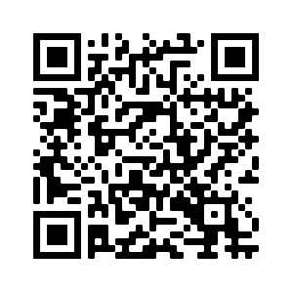
Notes From the Field
Government policy directly and indirectly impacts communities and individuals, which can be discovered through personal narrative.
Title : Notes from the Field (2015)
Author : Anna Deavere Smith
Text Type: Play
Description: A play that explores the flaws in the American justice system and the effects of the school-to-prison pipeline.
Notes From the Field
Notes From the Field
To learn more about the school to prison pipeline, scan the QR code.
17
Notes:
“school-to-prison pipeline,” a disturbing national trend wherein children are funneled out of public schools and into the juvenile and criminal justice systems. Many of these children have learning disabilities or histories of poverty, abuse, or neglect, and would benefit from additional educational and counseling services. Instead, they are isolated, punished, and pushed out. ←- ACLU Article

Slide 21
The 1619 Project
Government policy directly and indirectly impacts communities and individuals, which can be discovered through personal narrative.
Title : The 1619 Project
Author : Nikole Hannah-Jones
Text Type: Long Form Journalism Project
Description: A collection of writing that follows the story of the first group of enslaved Africans to arrive to Virginia in 1619. Much of this work follows the stories of these people, their impact, and the larger implications of this event for US history.
Long form journalism = Larger articles with larger amounts of content. This particular piece was a magazine sized project with lots of different articles building on the same theme.
The 1619 Project
18

Slide 22
Objective & SOI
Government policy directly and indirectly impacts communities and individuals, which can be discovered through personal narrative.
Students will be able to implement their understanding of the features of dramatic monologue (imagery, characterization, diction, and point of view) built in their analysis of Notes From the Field in order to craft individual dramatic monologues which highlight and explore issues raised by the 1619 Project and the oral history developed in Government.

Slide 23
Restorative Narratives
Government policy directly and indirectly impacts communities and individuals, which can be discovered through personal narrative.
Mallory Tenore, a scholar in the field, says that “These are stories that show how communities and people are learning to become resilient after periods of disruption. In doing so, they express empowerment, possibilities and revitalization.”
She continues, “These aren’t positive, happy-go-lucky fluff pieces. They explore the tough emotional terrain of disruptions like the Newtown shooting and the Boston Marathon bombings. But they’re “positive” in the sense that they focus on themes such as growth and renewal — themes that, at some point in our lives, we can all relate to.”

Slide 24
Restorative Narratives
Government policy directly and indirectly impacts communities and individuals, which can be discovered through personal narrative.
“Retributive theory believes that pain will vindicate, but in practice that is often counterproductive for both victim and offender. Restorative justice theory, on the other hand, argues that what truly vindicates is acknowledgment of victims’ harms and needs, combined with an active effort to encourage offenders to take responsibility, make right the wrongs, and address the causes of their behavior. By addressing this need for vindication in a positive way, restorative justice has the potential to affirm both victim and offender and to help them transform their lives.”
― Howard Zehr, The Little Book of Restorative Justice
What is the difference between retributive and restorative vindication?
This unit, we will seek out oral histories to help us tell restorative narratives about inequities produced through government policies in the US.

Slide 25
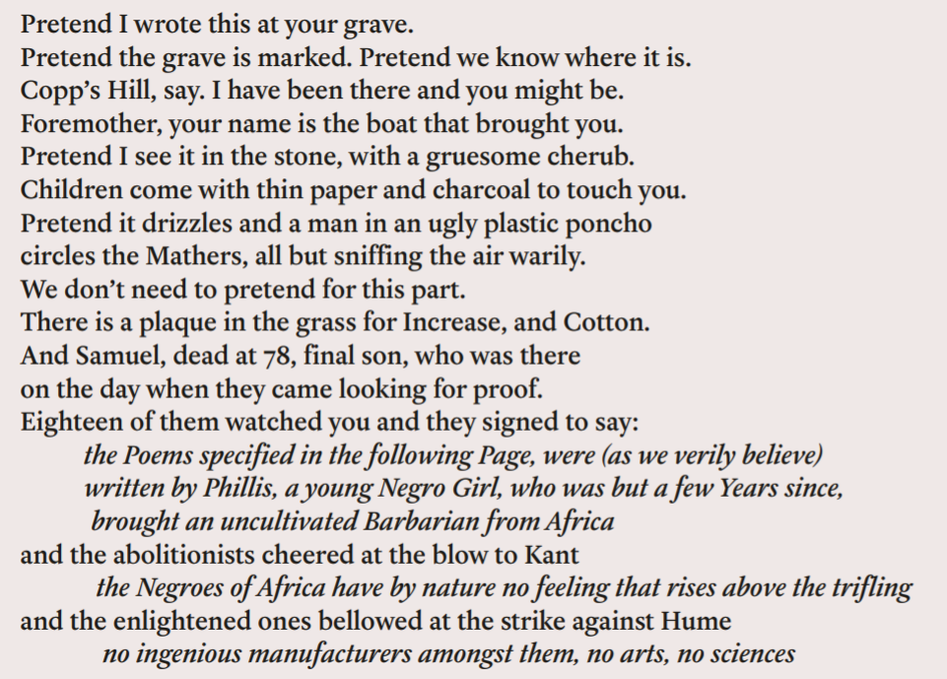
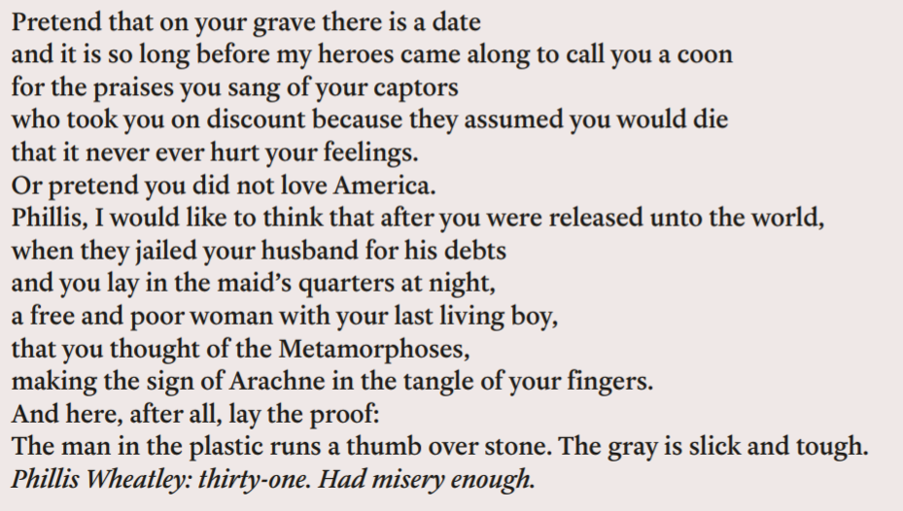
What do you think of this poem by Eve Ewing? Is it a restorative narrative? What does it restore or vindicate?
Notes:
Pg. 15 of IU Text

Slide 26
Homework
Government policy directly and indirectly impacts communities and individuals, which can be discovered through personal narrative.
Read:
Read ‘Just A Glance’ from Notes From the Field
Write:
Journal #1: What do you already know that will help you in this unit? Read the clarifying prompts beneath the journal to get you started writing.
Notes:
Show students how to navigate the text

Slide 27
Lesson 2

Slide 28
Objective
You will be able to analyze a monologue from Notes From the Field for diction through discussion and annotation.

Slide 29
Agenda
Government policy directly and indirectly impacts communities and individuals, which can be discovered through personal narrative.
Word of the Day: Diction
Discussion of ‘Late 1773: poem’ by Eve Ewing from The 1619 Project
Close Reading of ‘Just A Glance’ by Anna Deavere Smith from Notes From the Field
Debrief of Close Reading
Discussion of Smith’s Use of Diction in ‘Just A Glance’

Slide 30
Government policy directly and indirectly impacts communities and individuals, which can be discovered through personal narrative.
Definition
patterns of word choice which rely on a word’s connotation in order to reveal something about the text or character
Word of the Day
Diction
Example sentence with clear diction which creates a direct tone:
“Our founding ideals of liberty and equality were false when they were written. Black Americans fought to make them true. Without this struggle, America would have no democracy at all.”
Notes
Related to tone
Related to other literary devices

Slide 31
What do you think of this poem by Eve Ewing? Is it a restorative narrative? What does it restore or vindicate?
Notes:
Pg. 15 of IU Text

Slide 32
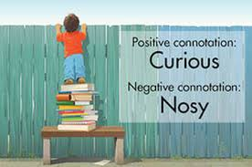
Diction: patterns of word choice which reveal tone, but also character, values, purpose, style, social status/class
Government policy directly and indirectly impacts communities and individuals, which can be discovered through personal narrative.
Word Choice: why an author chooses one word over another. Considerations:
Dialect
Characterization
Connotation: the emotional or social associations with a word; the feelings a word evokes
Denotation: the technical or dictionary definitions of a word
Notes:
We’ve talked about tone already; this lesson expands upon diction to show how else it can be used in conversations about language and authorial choices
Ms. Abban found this excellent video: https://www.youtube.com/watch?v=gg4QfUfihro

Slide 33
Place these words based on their connotation
Government policy directly and indirectly impacts communities and individuals, which can be discovered through personal narrative.
positive
Skinny
Bony
Angular
Emaciated
Gaunt
Malnourished
Scrawny
Slender
Thin
Anorexic
informal
formal
negative

Slide 34
What are we looking for when we look for diction?
Government policy directly and indirectly impacts communities and individuals, which can be discovered through personal narrative.
Patterns: are there repetitions in connotation? What about structure, like repeating a type of sentence? What about repeating a particular word?
Values: connotations and associations
Analyze specific words or phrases, not the complete sentence
Shifts in diction, which can reveal emotion, traits, values, and conflicts
Attitude or tone
Diction vs. dialect
Diction is about speech patterns in word choice and is related to meaning
Dialect is about regional or cultural vocabulary, idioms, or pronunciation and is related to identity

Slide 35
Terminology
Slang: Slang is time- and region-dependent. For example, something might be groovy, rad, or dank depending on when you grew up. Someone might make you wicked nervous or hella nervous depending on whether you’re from Boston or California.
Phraseology: One character might use davenport to describe a piece of living room furniture. Another might say sofa. A third might say couch. Each choice reveals another aspect of who your character is and how they view the world.
Rhythm: A nervous character might speak quickly or run several sentences together while a depressed character might speak slowly and or use frequent pauses.
Idioms or Personal Phrases: An idiom is a figure of speech that means something different than a literal translation of the words would lead one to believe. Many popular clichés are also idioms. Think “piece of cake,” “wear my heart on my sleeve,” and “live off the fat of the land.” While you don’t want to fill your work with clichés, see if there’s a way to create some fresh idioms for your dialogue. A great way to find fresh idioms is to pay attention to the phrases used by people around you. For example, my brother is a fan of saying, “You’re risking a scab” anytime someone engages in risky behavior or makes a smart-aleck remark.
Notes:
Slang: Slang is time- and region-dependent. For example, something might be groovy, rad, or dank depending on when you grew up. Someone might make you wicked nervous or hella nervous depending on whether you’re from Boston or California.
Phraseology: One character might use davenport to describe a piece of living room furniture. Another might say sofa. A third might say couch. Each choice reveals another aspect of who your character is and how they view the world.
Rhythm: A nervous character might speak quickly or run several sentences together while a depressed character might speak slowly and or use frequent pauses.
Idioms or Personal Phrases: An idiom is a figure of speech that means something different than a literal translation of the words would lead one to believe. Many popular clichés are also idioms. Think “piece of cake,” “wear my heart on my sleeve,” and “live off the fat of the land.” While you don’t want to fill your work with clichés, see if there’s a way to create some fresh idioms for your dialogue. A great way to find fresh idioms is to pay attention to the phrases used by people around you. For example, my brother is a fan of saying, “You’re risking a scab” anytime someone engages in risky behavior or makes a smart-aleck remark.

Slide 36
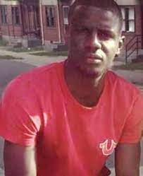
“Just a Glance”
“Just a Glance” is an oral history from a person who videotaped the beating of Freddie Gray. The author of Notes from a Field, Anna Deavere Smith, collected this oral history wrote it down and re-presented it in the form a play.
An excerpt from a Rolling Stone article about the case :
“On April 12th, 2015, a 25-year-old black man from the west side of Baltimore named Freddie Gray was arrested for possession of a “switchblade,” put inside a Baltimore Police Department (BPD) transport van, and then, 45 minutes later, was found unconscious and not breathing, his spinal cord nearly severed. Following a seven-day coma, Gray died on April 19th; his untimely death and citizen video of his arrest, which showed Gray screaming in pain, prompted both the peaceful protests and headline-grabbing riots. The subsequent two-week police investigation ultimately concluded that Gray’s injury happened sometime during the van’s route – over six stops, with two prisoner checks, and another passenger pick-up.”
Notes:
Resources -Freddie Gray https://www.rollingstone.com/culture/culture-features/death-of-freddie-gray-5-things-you-didnt-know-129327/
More context -

Slide 37
Let’s Enter the Text
What is this text? How was it written? How was it performed?
Open the text.
Review the stage directions.
Do you want to read excerpts or just go over the whole thing?

Slide 38
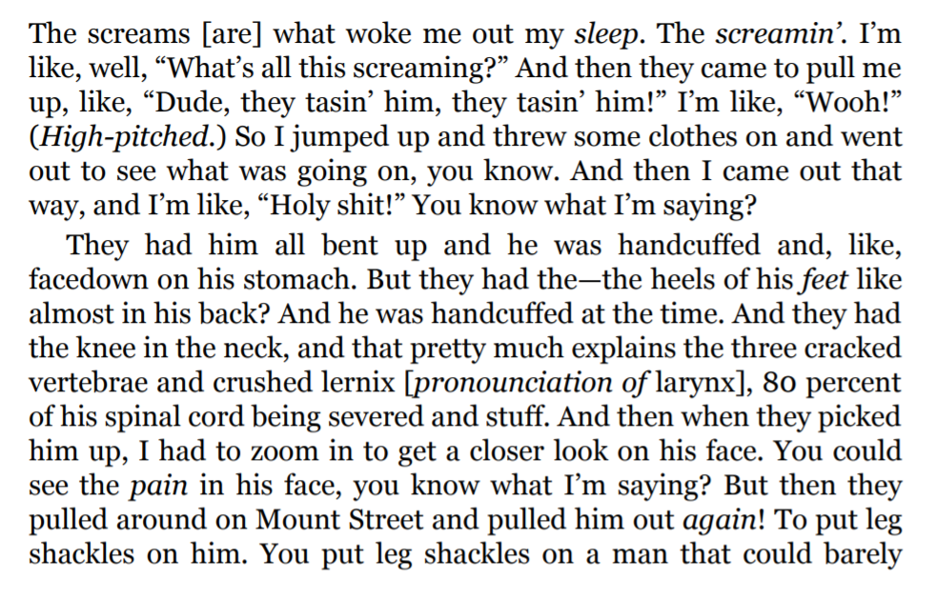
Close Read
Government policy directly and indirectly impacts communities and individuals, which can be discovered through personal narrative.
What words hold the most meaning in this passage?
What are their connotations?
What patterns do you see here? What about patterns of spelling or pronunciation?
What is the speaker’s tone?
Notes:
Consider the differences between diction and dialect

Slide 39
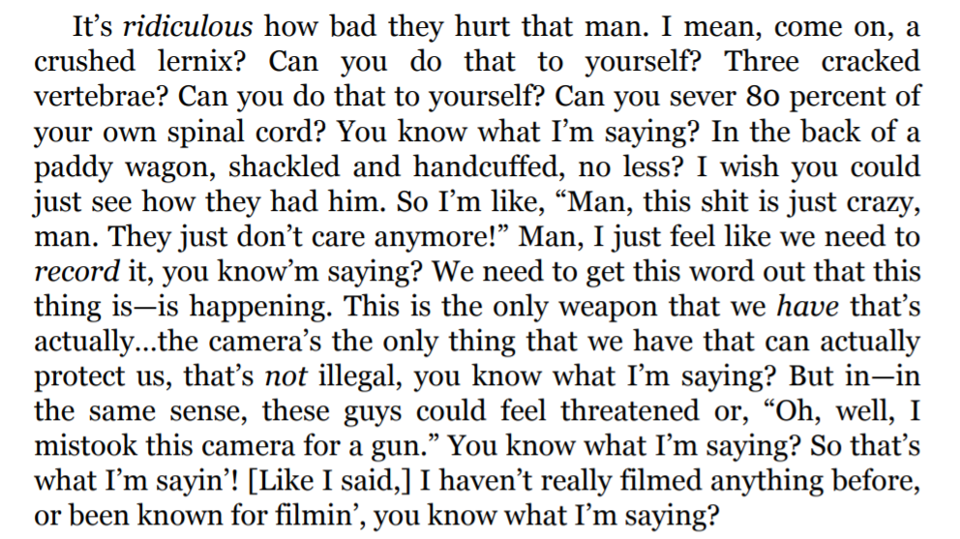
Close Read
Government policy directly and indirectly impacts communities and individuals, which can be discovered through personal narrative.
What words hold the most meaning in this passage?
What are their connotations?
What patterns do you see here? What about patterns of spelling or pronunciation?
What is the speaker’s tone?

Slide 40
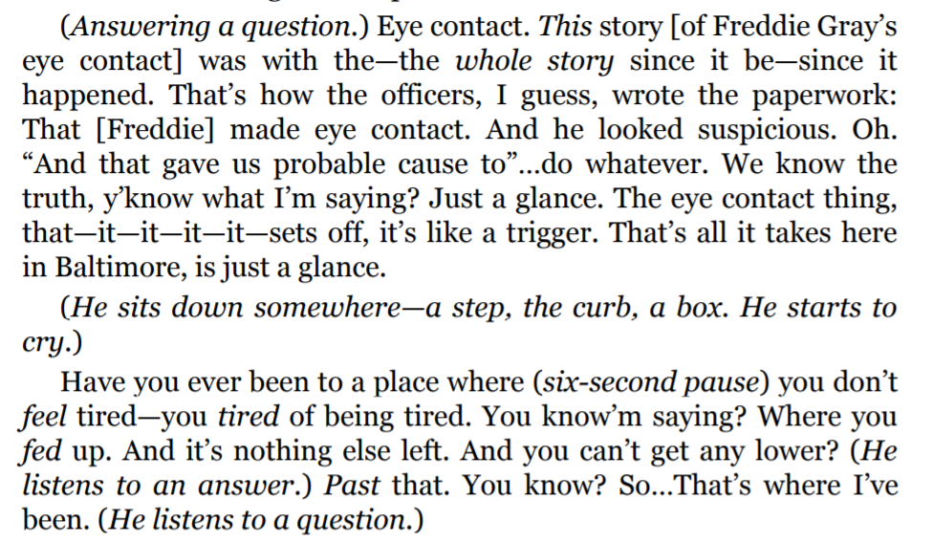
Close read in pairs; answer these questions in your notes
Government policy directly and indirectly impacts communities and individuals, which can be discovered through personal narrative.
What words hold the most meaning in this passage?
What are their connotations?
What patterns do you see here? What about patterns of spelling or pronunciation?
What is the speaker’s tone?

Slide 41
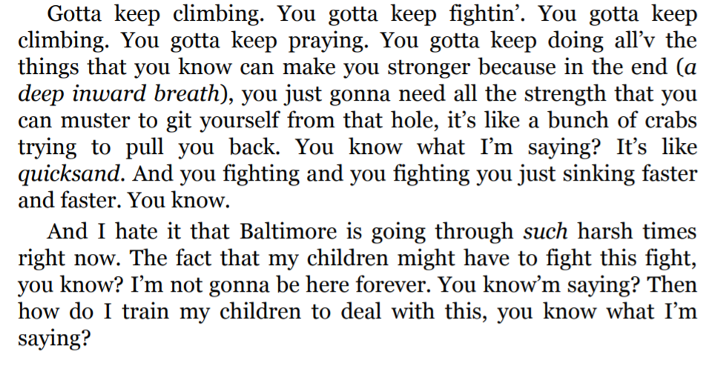
Close read in pairs; answer these questions in your notes
Government policy directly and indirectly impacts communities and individuals, which can be discovered through personal narrative.
What words hold the most meaning in this passage?
What are their connotations?
What patterns do you see here? What about patterns of spelling or pronunciation?
What is the speaker’s tone?

Slide 42
Debrief
Government policy directly and indirectly impacts communities and individuals, which can be discovered through personal narrative.
Quotation | Keywords | Connotation | Denotation | Analysis and conclusions

Slide 43
Discussion
Government policy directly and indirectly impacts communities and individuals, which can be discovered through personal narrative.
What does diction offer the reader?
What can we learn through diction?
In this play, Smith has taken words spoken by a person (in this case, Kevin Moore) and she is embodying them in her written record and performance. She describes her process this way: “I have periodically traveled around America, interviewing large numbers of people, collecting their words and performing them onstage, crafting them into multi voiced solo dramas that bear witness to particular historical moments.”
When she says crafting here, what do you think she means? How did she edit with diction in mind? What could she have taken out?

Slide 44
How does this text function as a restorative narrative?
Government policy directly and indirectly impacts communities and individuals, which can be discovered through personal narrative.
The features of a restorative narrative are:
Acknowledgement of harm
Empowerment through truth and/or validation
“These aren’t positive, happy-go-lucky fluff pieces. They explore the tough emotional terrain of disruptions... But they’re “positive” in the sense that they focus on themes such as growth and renewal” (Tenore).
Do you feel that this text is restorative? Does it create a shared past, meaning, or understanding?

Slide 45
Homework
Government policy directly and indirectly impacts communities and individuals, which can be discovered through personal narrative.
Read:
Read ‘Runnin’ from ‘Em’ and ‘Breaking the Box’ from Notes From the Field
Write:
No New Writing

Slide 46
Lesson 3

Slide 47
Objective
You will analyze a monologue for direct and indirect characterization using annotation, discussion, and inferencing so that you can understand how to craft your own character traits in your monologue.

Slide 48
Agenda
Government policy directly and indirectly impacts communities and individuals, which can be discovered through personal narrative.
Word of the Day: Monologue
Review ‘Breaking the Box’
Watch, Listen, and Respond to Anna Deavere Smith’s Performance of a segment of ‘Breaking the Box’
Respond to Free Write Prompt
Review of How to Read a Dramatic Text
Review of Characterization

Slide 49
Agenda (Cont.)
Government policy directly and indirectly impacts communities and individuals, which can be discovered through personal narrative.
Close Reading of ‘Runnin’ from ‘Em’ for Characterization
Close Reading of ‘Breaking the Box’ for Characterization
Whole Group Debrief
Review the Steps for Writing a PEAL Paragraph on Diction and Characterization

Slide 50
Government policy directly and indirectly impacts communities and individuals, which can be discovered through personal narrative.
Definition:
Noun, a long speech by one actor in a play or movie, or as part of a theatrical or broadcast program.
Word of the Day
Monologue
Example sentence:
“It’s a bit of a
verbal feat to keep the monologue moving along quickly.”
Notes
Common dramatic form
This is the whole text of Notes From the Field
Notes:
2 min

Slide 51
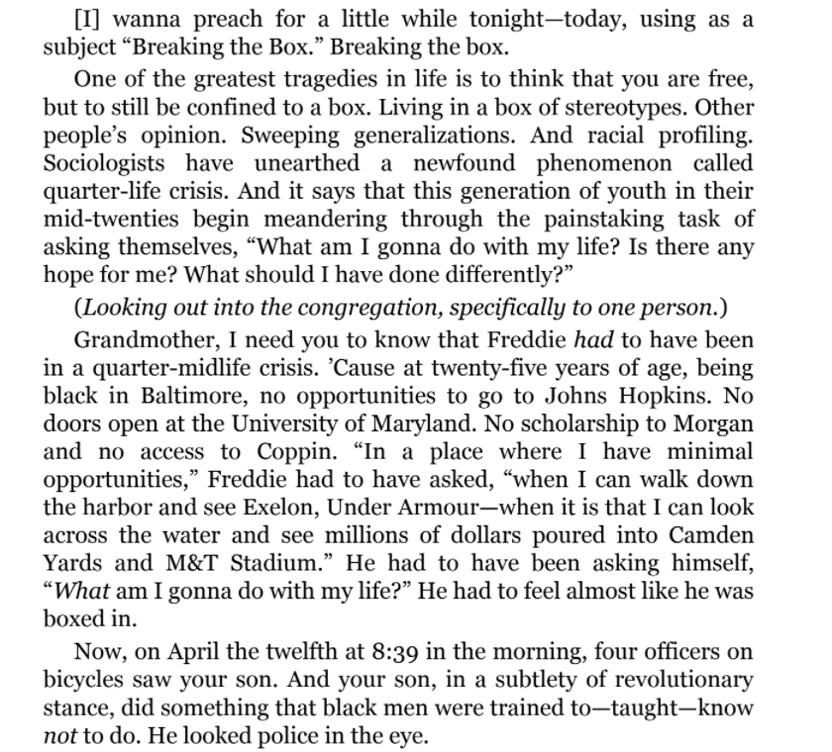
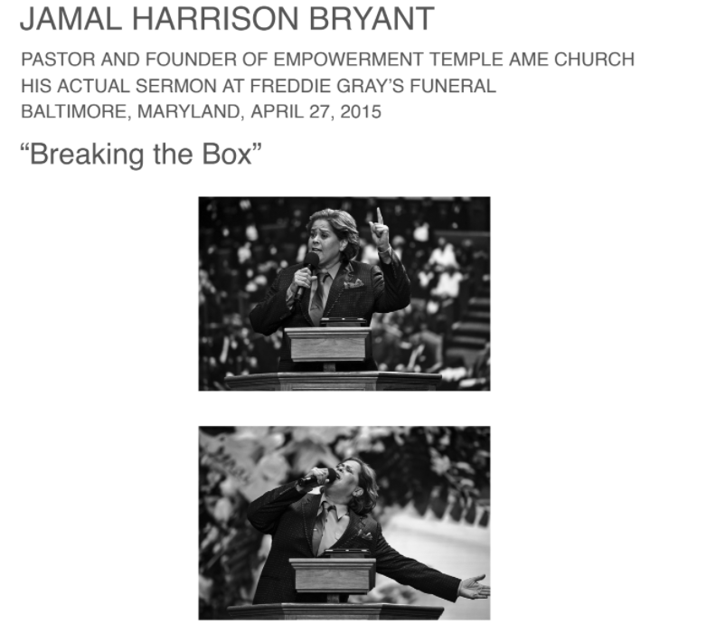
In preparation for our free write let’s re-read a piece from yesterday’s homework.

Slide 52
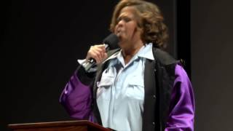
Restorative Narratives
Capture hard truths
Show meaningful progression - how someone got to where they are
Tell stories about people and communities exhibiting resilience
Are authentic
Highlight strength and possibility
Watch and Listen to Deavere Smith perform a segment from “Breaking the Box”
Think and Write in your notebook. How is this an example of a restorative narrative?

Slide 53
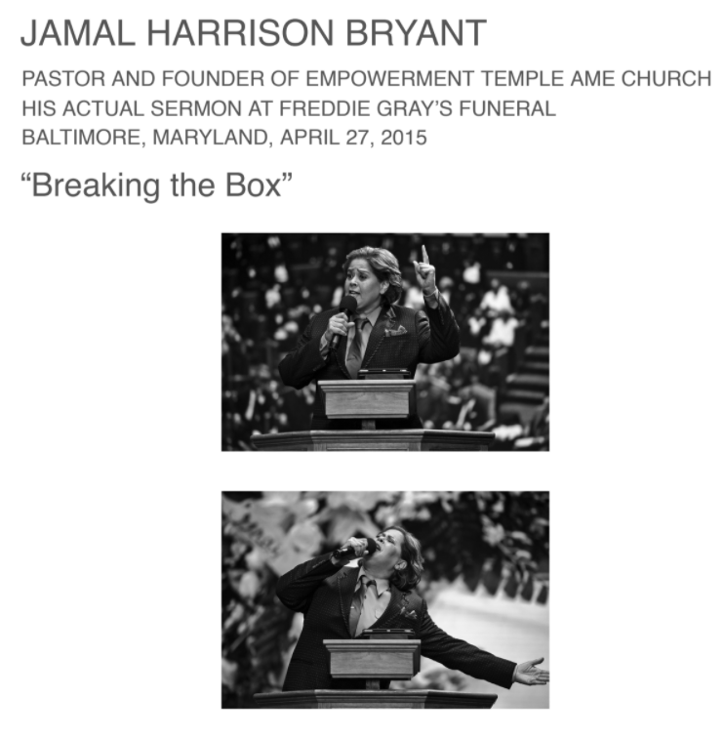
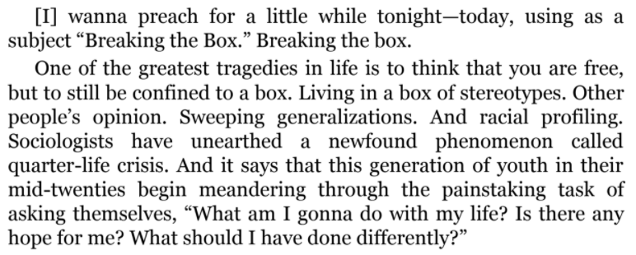
Write Your Truth
Prompt : Write about a time when someone put you a box. In other words, what was a time when someone in your life or society at large told you who you are and who you are going to be?
Your response :
The event/situation that occurred
How you felt
What box/limit they put around your personhood.
This free write is for your eyes only.
Sharing out is welcome, but not mandatory! I’ll be doing this free write with you as well.

Slide 54
How to read a dramatic text
Government policy directly and indirectly impacts communities and individuals, which can be discovered through personal narrative.
Dialogue tags: the names or labels of characters
Stage directions: the playwright’s directions to the actors and director
Monologue: a long speech by one actor in a play or movie, or as part of a theatrical or broadcast program.
Blocking: the actor’s movements across the stage
Vocalization: the way the actors speak
Diction: in the world of drama, it’s how the actor speaks and the words the playwright chooses
Playwright: author
Notes:
3-5 min

Slide 55
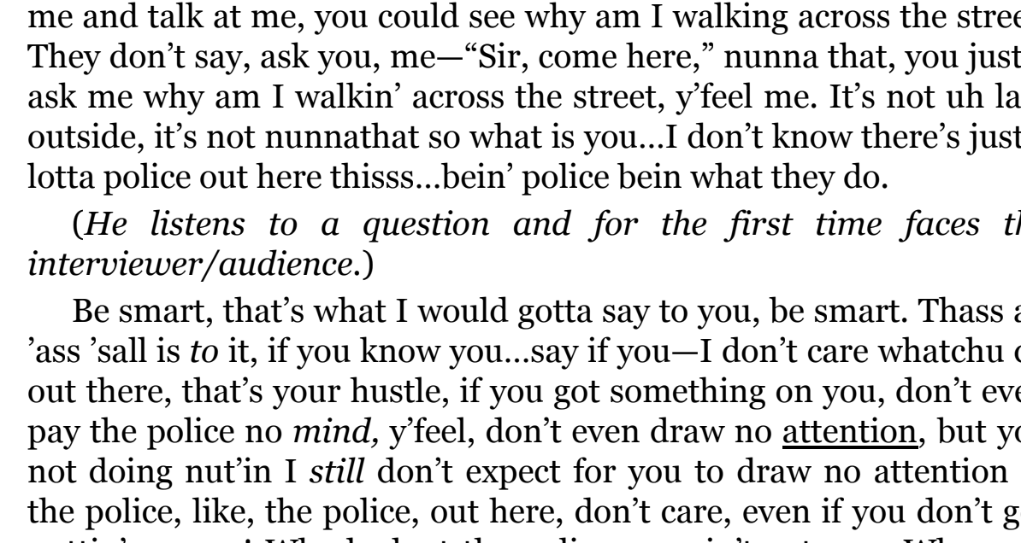
How to read a dramatic text
Government policy directly and indirectly impacts communities and individuals, which can be discovered through personal narrative.
Stage directions: the playwright’s directions to the actors and director
Blocking: the actor’s movements across the stage (in the screen directions)
Playwright: author

Slide 56
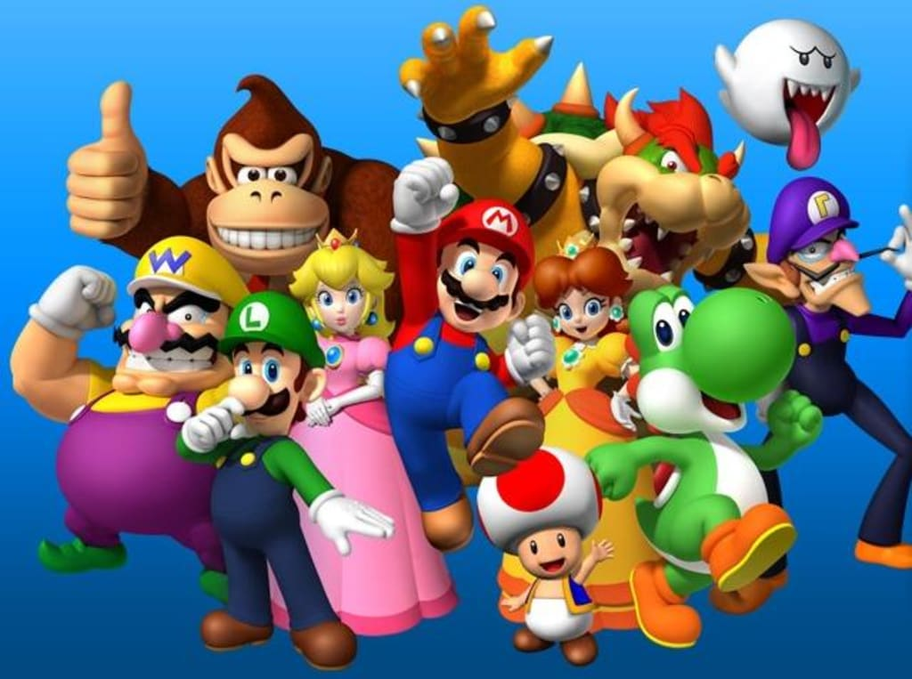
Let’s get acquainted.
As you watch a movie, play a video game, read a book, or see a play, how do you learn about the characters?
How do you know what a character is like?
What do you look for to begin to understand a character?

Slide 57
Characterization
Government policy directly and indirectly impacts communities and individuals, which can be discovered through personal narrative.
Characterization is the process by which the writer reveals the personality or traits of a character, which happens through direct characterization and indirect characterization.
Direct characterization tells the audience what the personality of the character is. In a pay, this happens in stage directions.
Example from “Big Bets”: Ms. Ifill is a public figure. Really good with a crowd, could run for office. African American, late forties. Brightly colored jacket, simple slacks.
Explanation: The trait we see here is _______.
Indirect characterization shows things that reveal the personality of a character.
There are 5 different methods of indirect characterization:
Speech
Thoughts or beliefs
Effects on Others
Actions
Looks
Notes:
5 min

Slide 58
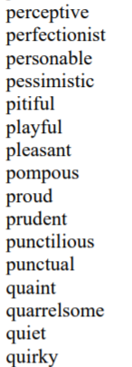
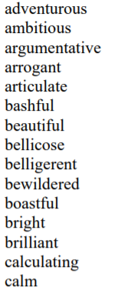
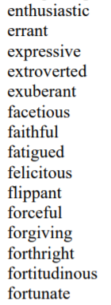
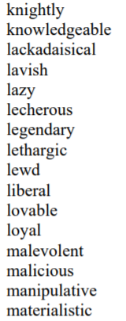
Character Traits
Government policy directly and indirectly impacts communities and individuals, which can be discovered through personal narrative.
Traits are true things about a character over time, not moods or feelings. If someone consistently behaves in a way, that way is a trait.
Notes:
Do you have any of these traits?
2 min

Slide 59
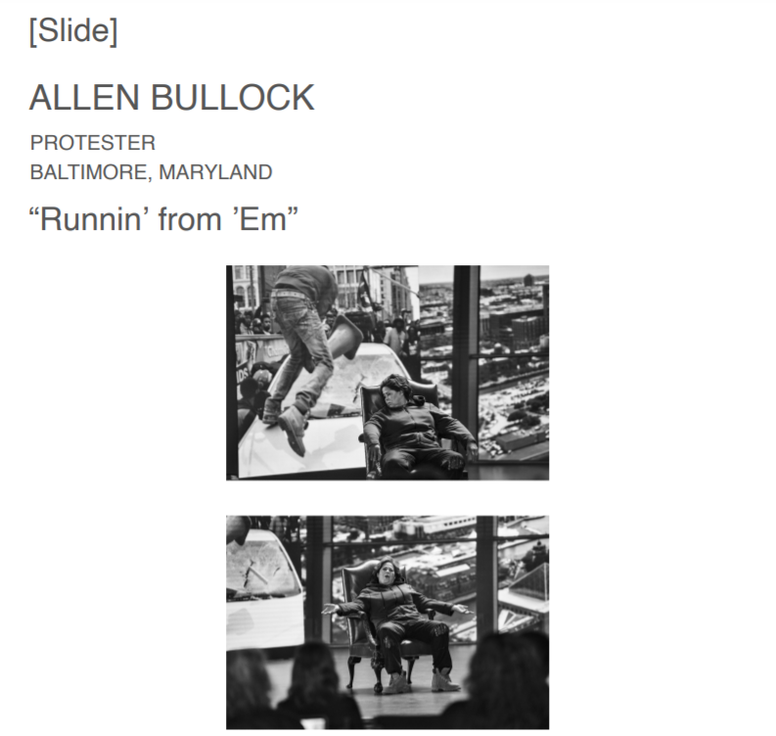
Open to ‘Runnin’ From ‘Em’
Government policy directly and indirectly impacts communities and individuals, which can be discovered through personal narrative.
‘Runnin’ from ‘Em’
Monologue about Allen Bullock -- the subject of the famous picture on the front page of The Baltimore Sun from 2015. With his raised traffic cone, he became the “face” of the Baltimore riots, including the fervent media backlash.

Slide 60
Government policy directly and indirectly impacts communities and individuals, which can be discovered through personal narrative.
Why start the monologues with these slides?
Do you have any memories of this?
For those of us who were living and in the public school system at the time, what what this like?
When you read this last night, did it work as a restorative narrative for you?
Notes:
5 min

Slide 61
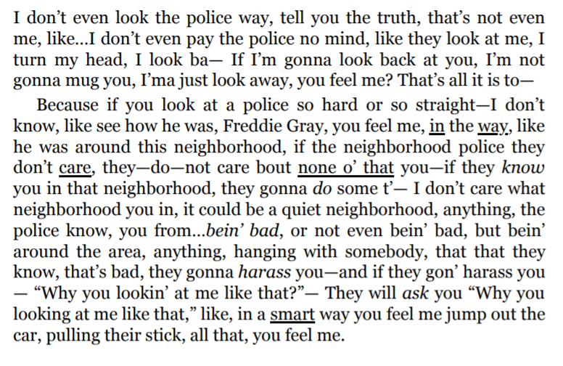
Close read for characterization
Government policy directly and indirectly impacts communities and individuals, which can be discovered through personal narrative.
Consider Allen Bullock’s dialect. What can you infer about him?
Consider his diction. Are there any words with heavy connotative value? What do they tell you?
Find a phrase or sentence which reveals a trait. What is the trait?
Find an example of a thought/belief. What trait does this reveal?
Notes:
5
Whole group activity
Consider Allen Bullock’s dialect. What can you infer about him? Emphasis on “way,” “care,” “harass,” and “smart;” phrases like “look the police way,” “tell you the truth,” and “jump out the car” without prepositions is a common dialectical feature of West Baltimore; “I’ma” is a common feature of Black English/AAVE; Allen Bullock is likely native to West Baltimore
Consider his diction. Are there any words with heavy connotative value? What do they tell you? “No mind” has strong connotative value of superiority and separateness; “harass,” “smart,” “care” all hold strong connotations -- ask students to expand upon this
Find a phrase or sentence which reveals a trait. What is the trait? “I don’t even look the police way” seems defensive bordering on afraid, but almost an aggressive response to fear; “anything, hanging with somebody,” shows earnestness
Find an example of a thought/belief. What trait does this reveal? He believes he will be harassed by police, which tells me that he has seen or experienced police harassment; it also shows some paranoia, anxiety

Slide 62
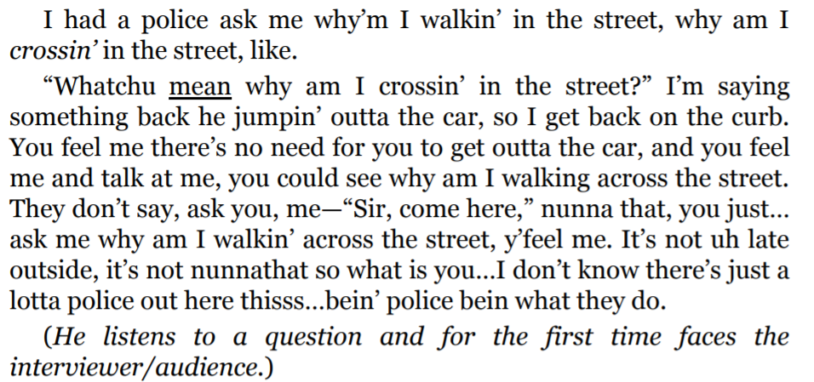
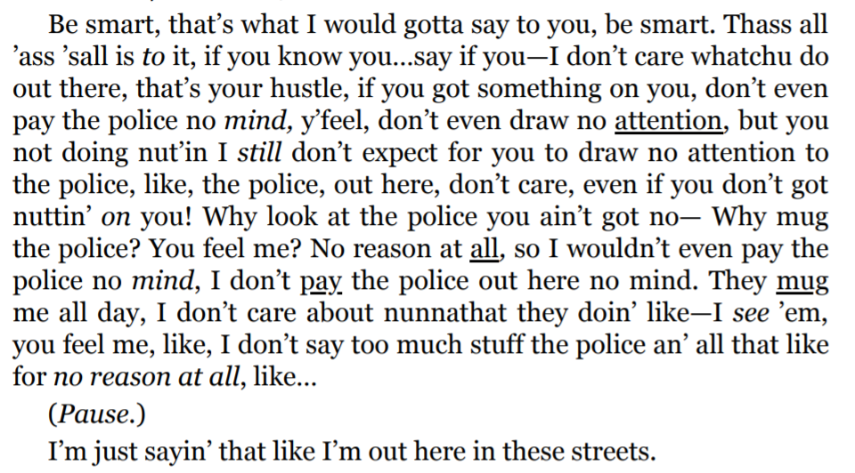
Close read for characterization
Government policy directly and indirectly impacts communities and individuals, which can be discovered through personal narrative.
Are there any patterns in his diction? What can you infer about him from these?
Are there any words with heavy connotative value? What do they tell you?
Find a phrase or sentence which reveals a trait. What is the trait?
Find an example of a thought/belief. What trait does this reveal?
Find an example of an action, what trait does this reveal?
Notes:
5
Are there any patterns in his diction? What can you infer about him from these? He uses rhetorical questions repeatedly; he is an engaging and engaged speaker
Are there any words with heavy connotative value? What do they tell you? “Whatchu mean,” “nunna that,” “mug,” “no mind” all show that he holds himself with pride and defends his self worth, but it also shows that he is reactive and impulsive
Find a phrase or sentence which reveals a trait. What is the trait? “Be smart” shows that he is a critical thinker
Find an example of a thought/belief. What trait does this reveal?
Find an example of an action, what trait does this reveal?

Slide 63
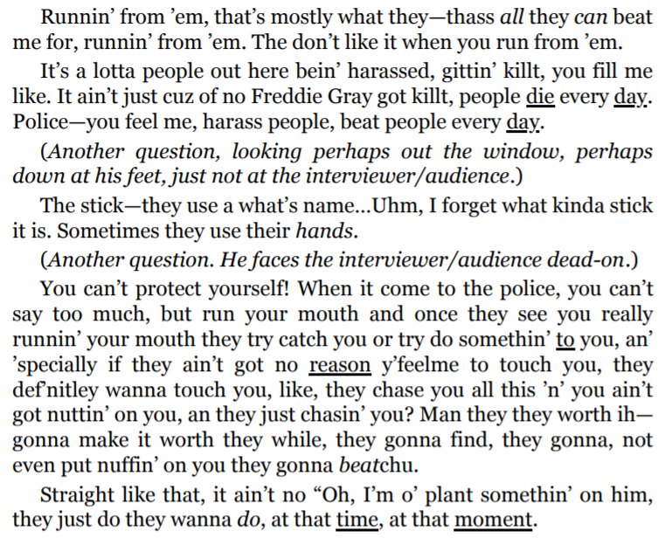
Close read for characterization
Government policy directly and indirectly impacts communities and individuals, which can be discovered through personal narrative.
Are there any patterns in his diction? What can you infer about him from these?
Are there any words with heavy connotative value? What do they tell you?
Find a phrase or sentence which reveals a trait. What is the trait?
Find an example of a thought/belief. What trait does this reveal?
Find an example of an action, what trait does this reveal?

Slide 64
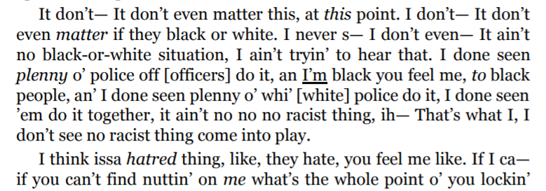
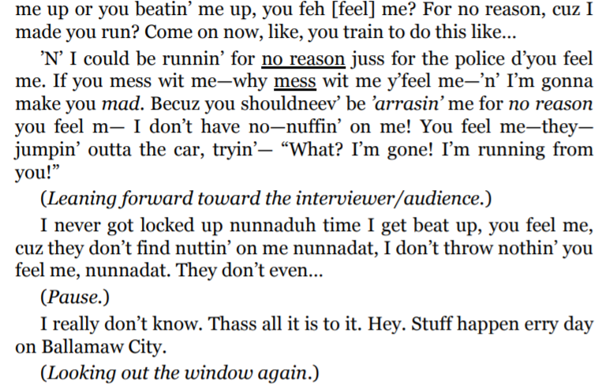
Close read for characterization
Government policy directly and indirectly impacts communities and individuals, which can be discovered through personal narrative.
Are there any patterns in his diction? What can you infer about him from these?
Are there any words with heavy connotative value? What do they tell you?
Find a phrase or sentence which reveals a trait. What is the trait?
Find an example of a thought/belief. What trait does this reveal?
Find an example of an action, what trait does this reveal?

Slide 65
Close read for characterization
Government policy directly and indirectly impacts communities and individuals, which can be discovered through personal narrative.
Turn to ‘Breaking the Box’
Re-read with your partner until you find a section that has good characterization evidence.
Examine the passage for these questions:
Are there any patterns in his diction? What can you infer about him from these?
Are there any words with heavy connotative value? What do they tell you?
Find a phrase or sentence which reveals a trait. What is the trait?
Find an example of a thought/belief. What trait does this reveal?
Find an example of an action, what trait does this reveal?
Notes:
15

Slide 66
How does this text function as a restorative narrative?
Government policy directly and indirectly impacts communities and individuals, which can be discovered through personal narrative.
The features of a restorative narrative are:
Acknowledgement of harm
Empowerment through truth and/or validation
“These aren’t positive, happy-go-lucky fluff pieces. They explore the tough emotional terrain of disruptions... But they’re “positive” in the sense that they focus on themes such as growth and renewal” (Tenore).
Do you feel that this text is restorative? Does it create a shared past, meaning, or understanding?
Notes:
5

Slide 67
Writing a PEAL paragraph on diction or characterization
Pick which monologue you want to write about. Decide whether you want to write about diction or characterization. (3 minutes)
Find the best evidence. (5 minutes)
Think about what the larger implication could be for this evidence. (3 minutes)
Write your Point. (2 minutes)
(Optional) Outline.
Write your paragraph, making sure you ANALYZE your evidence.
Analysis of diction discusses connotation.
Analysis of characterization discusses character traits.
Don’t forget to link your analysis back to your thesis/point.

Slide 68
Homework
Government policy directly and indirectly impacts communities and individuals, which can be discovered through personal narrative.
Read:
Read ‘Tupac’ from Notes From the Field
Read ‘July 27, 1816: poem’ by Tyehimba Jess from The 1619 Project
Write:
Formative #1: Write a PEAL paragraph. You may choose to write about one of the monologues you have read, and choose whether you want to write about diction or characterization. What is the purpose of one of the examples of diction or characterization? Write a PEAL paragraph with an OELi point.

Slide 69
Lesson 4

Slide 70
Objective
You will discuss how Jess and Smith use diction and characterization differently and demonstrate their understanding through a close reading and discussion.

Slide 71
Agenda
Government policy directly and indirectly impacts communities and individuals, which can be discovered through personal narrative.
Review of Diction and Characterization
Word of the Day: Maroon
Maroon As A Metaphor Activity
Respond to Writing Prompt
Close Reading of ‘Tupac’ from Notes From the Field
Guided, Paired Reading of ‘July 27, 1816: poem’ by Tyehimba Jess from The 1619 Project
Discussion of Jess and Smith’s Use of Diction and Characterization
Complete Journal #2

Slide 72
Just to review
What is diction?
What do we look for when analyzing diction?
What is characterization?
What are the two types of characterization?
What are the elements of the types of characterization?

Slide 73
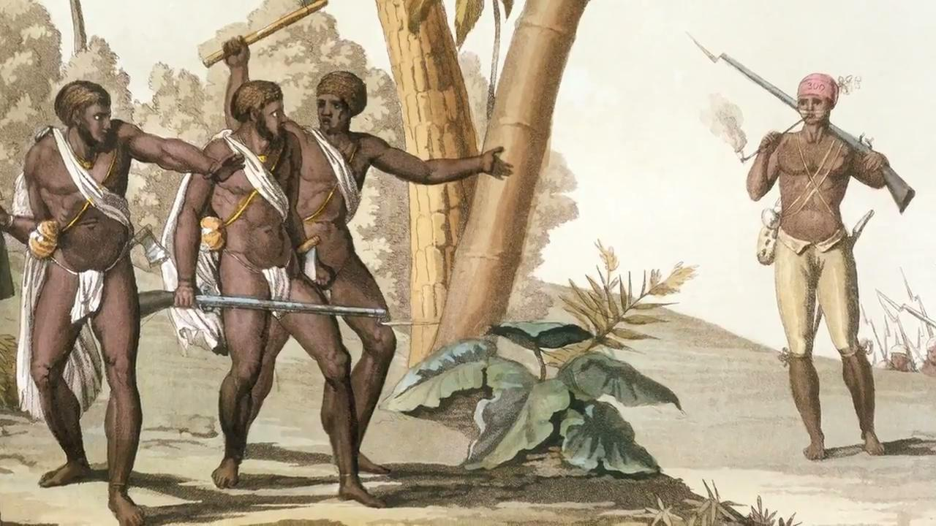
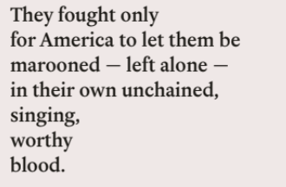
Government policy directly and indirectly impacts communities and individuals, which can be discovered through personal narrative.
Definition
Adj., having a dark brown-red color:
Verb, to leave someone in a place from which they cannot escape
Word of the Day
maroon
Taken from the French word marron, which translates to “runaway black slave,” or the American/Spanish cimarrón, which means “wild runaway slave,” “the beast who cannot be tamed,”
Maroons are descendants of Africans in the Americas who formed settlements away from slavery.
https://en.wikipedia.org/wiki/Maroons
Notes:
Teachers will have to buy Notes From the Field on Amazon or HBO unless someone finds another way to get the file. If you would like to watch any associated resources, interviews, or clips, check this out: https://www.hbo.com/movies/notes-from-the-field

Slide 74
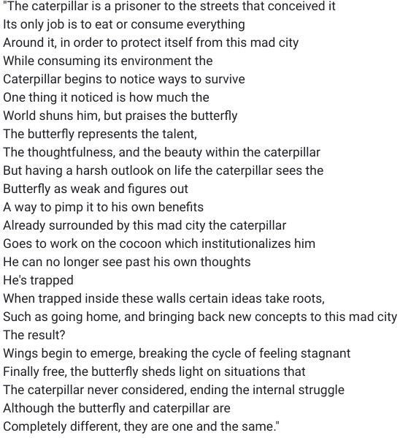
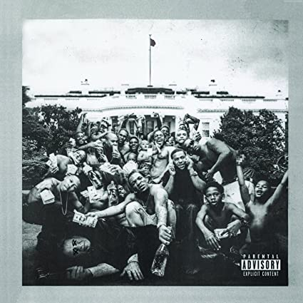
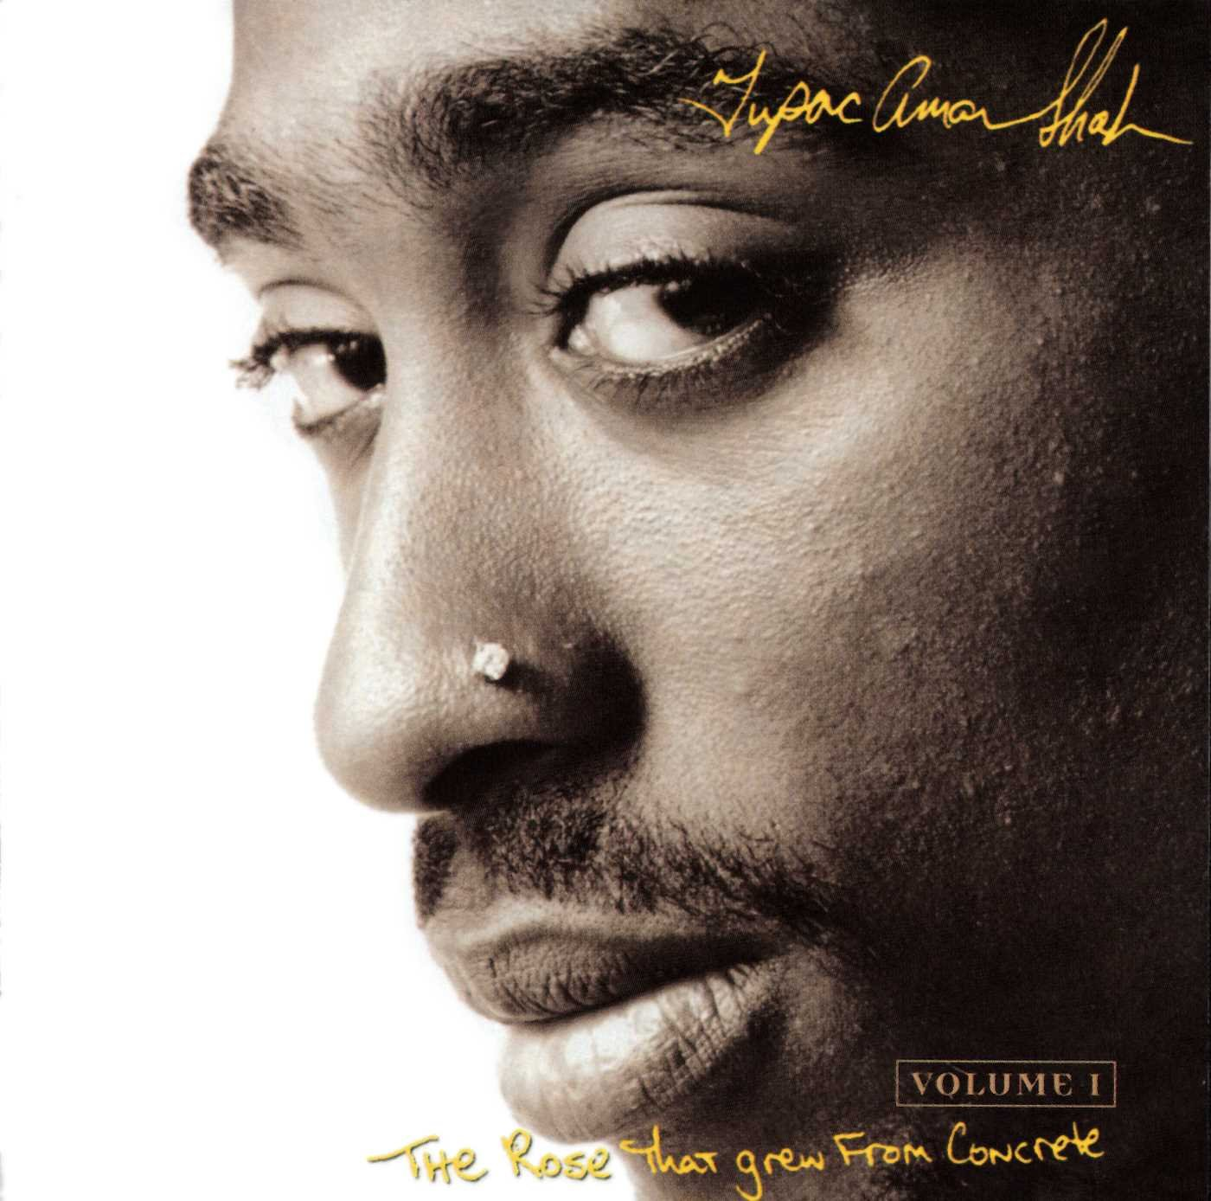
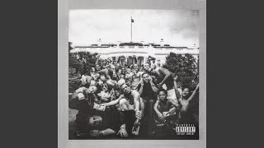
Maroon as a Metaphor
Are there common themes/messages in the two poems?
Who has been marooned in these poems?
What words stand out to you while reading? What is their connotation?
“Mortal Man” by Kendrick Lamar
“The Rose That Grew from Concrete” by Tupac Shakur
https://www.youtube.com/watch?v=axwpgn3GRMs
Notes:
Play “Mortal Man” by Kendrick Lamar from 10:30 to end

Slide 75
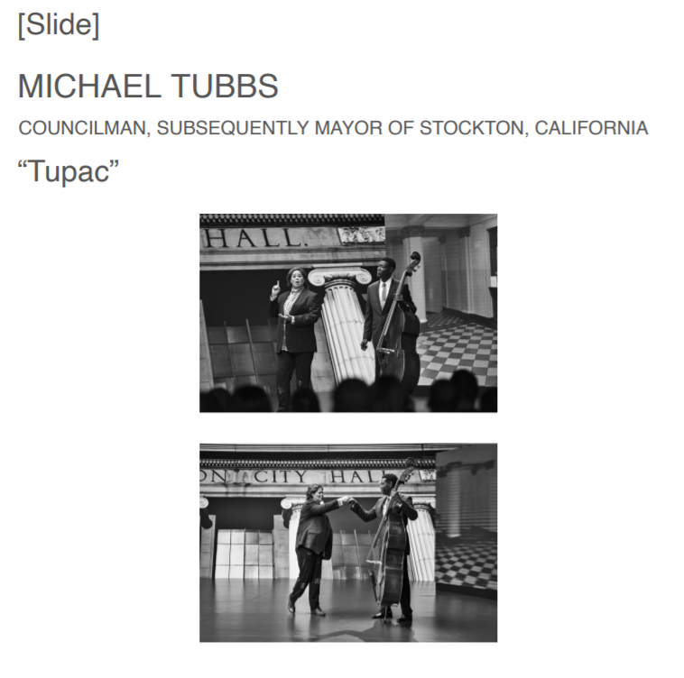
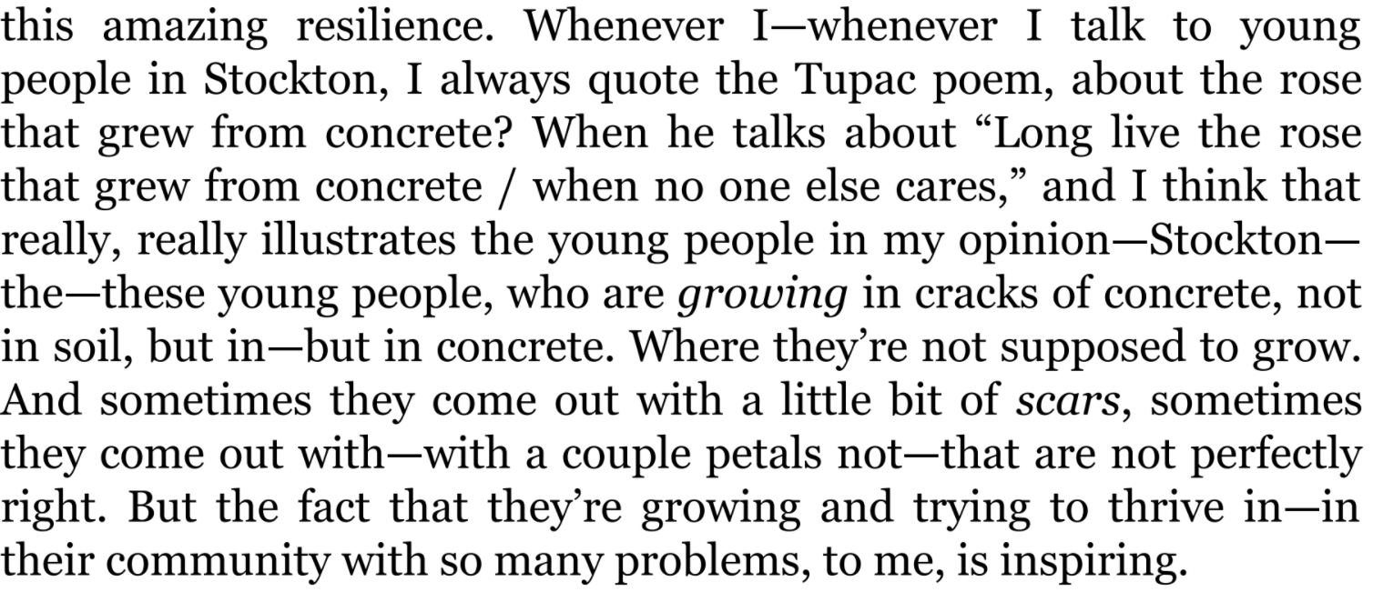
Write Your Truth
Prompt : Do you see any similarities between your own experiences and Tupac’s “rose” or Lamar’s “butterfly?” Write about a time when you defied odds, challenged expectations, and/or found strength in resilience.
This free write is for your eyes only.
Sharing out is welcome, but not mandatory! I’ll be doing this free write with you as well.

Slide 76
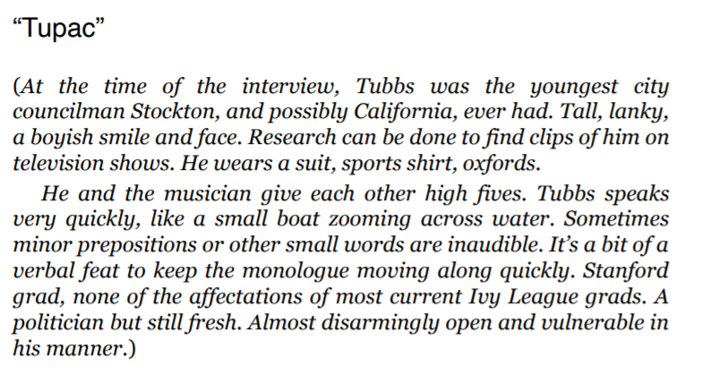
‘Tupac’
Government policy directly and indirectly impacts communities and individuals, which can be discovered through personal narrative.
Michael Tubb’s was one of the nation’s youngest mayors at 26, running on a platform for universal basic income.
We will examine this monologue for characterization and diction. Where is the direct characterization?

Slide 77
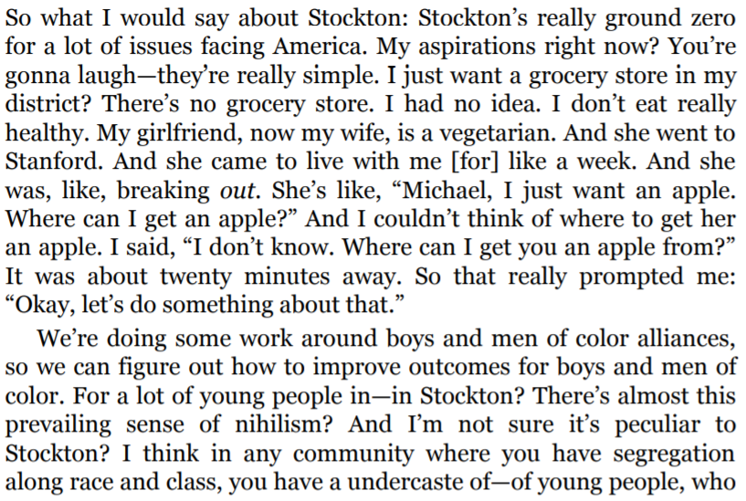
‘Tupac’ - beginning
Government policy directly and indirectly impacts communities and individuals, which can be discovered through personal narrative.
Are there any patterns in his diction? What can you infer about him from these?
Are there any words with heavy connotative value? What do they tell you?
Find a phrase or sentence which reveals a trait. What is the trait?
Find an example of a thought/belief. What trait does this reveal?
Find an example of an action, what trait does this reveal?
Notes:
There are three options for close readings here

Slide 78
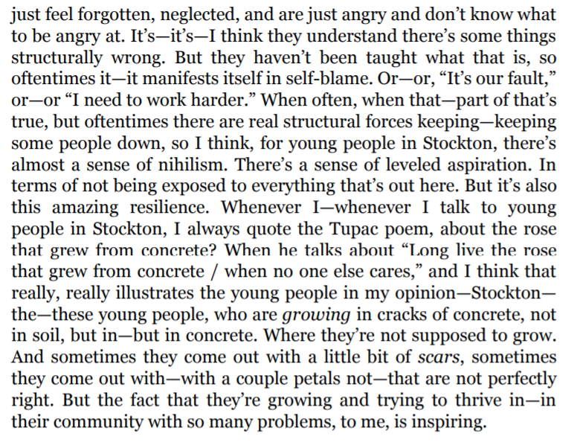
‘Tupac’ - middle
Government policy directly and indirectly impacts communities and individuals, which can be discovered through personal narrative.
Are there any patterns in his diction? What can you infer about him from these?
Are there any words with heavy connotative value? What do they tell you?
Find a phrase or sentence which reveals a trait. What is the trait?
Find an example of a thought/belief. What trait does this reveal?
Find an example of an action, what trait does this reveal?

Slide 79
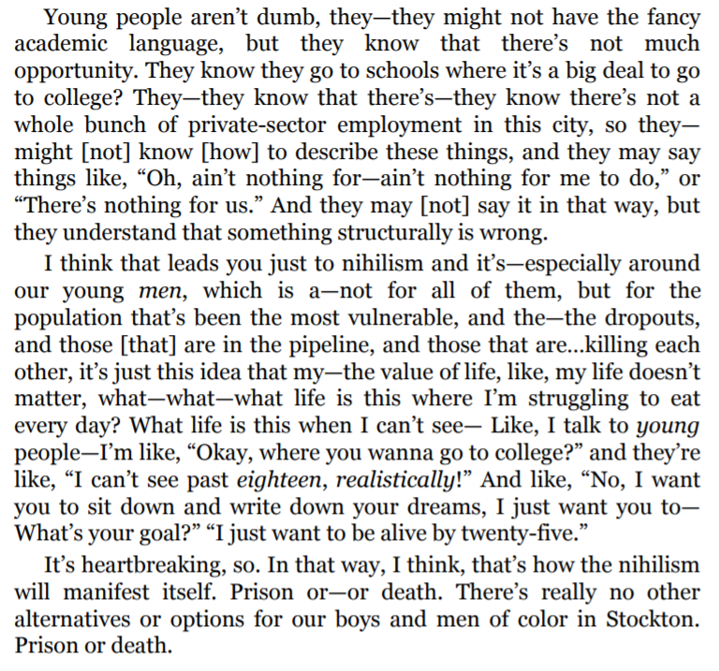
‘Tupac’ - ending
Government policy directly and indirectly impacts communities and individuals, which can be discovered through personal narrative.
Are there any patterns in his diction? What can you infer about him from these?
Are there any words with heavy connotative value? What do they tell you?
Find a phrase or sentence which reveals a trait. What is the trait?
Find an example of a thought/belief. What trait does this reveal?
Find an example of an action, what trait does this reveal?

Slide 80
How does this text function as a restorative narrative?
Government policy directly and indirectly impacts communities and individuals, which can be discovered through personal narrative.
The features of a restorative narrative are:
Acknowledgement of harm
Empowerment through truth and/or validation
“These aren’t positive, happy-go-lucky fluff pieces. They explore the tough emotional terrain of disruptions... But they’re “positive” in the sense that they focus on themes such as growth and renewal” (Tenore).
Do you feel that this text is restorative? Does it create a shared past, meaning, or understanding?

Slide 81
Prose vs. Poetry
Government policy directly and indirectly impacts communities and individuals, which can be discovered through personal narrative.
How do we think about diction in poetry and prose differently?
Fewer words to choose in poetry, because there is less space; they need to be “meatier” words
We see less filler language in poetry than in dramatic monologues

Slide 82
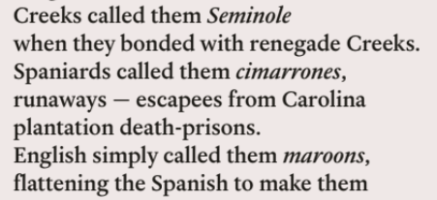
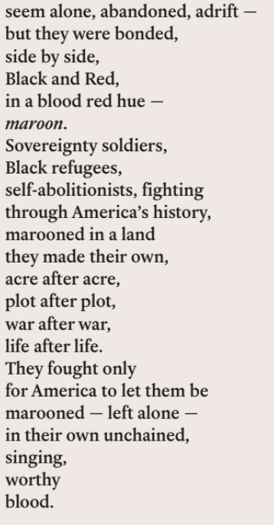
Tyehimba Jess
Government policy directly and indirectly impacts communities and individuals, which can be discovered through personal narrative.
Are there any patterns in Jess’s diction? What can you infer from these?
Are there any words with heavy connotative value? What do they tell you?
Find an example of a thought/belief. What trait does this reveal?
Find an example of an action. What trait does this reveal?

Slide 83
Discussion Questions
Government policy directly and indirectly impacts communities and individuals, which can be discovered through personal narrative.
How does Smith use diction differently from Jess?
How do they both use diction differently from Trevor Noah, our last author?
How does Smith use dialect for character development? How does Jess? Do you think this tool is effective?
How is characterization different in dramatic texts compared to narrative nonfiction or fiction?
Which character has been the most compelling for you, thus far? Why?
Which of these pieces best fits the definition of a “restorative narrative” and why?

Slide 84
How does this text function as a restorative narrative?
Government policy directly and indirectly impacts communities and individuals, which can be discovered through personal narrative.
The features of a restorative narrative are:
Acknowledgement of harm
Empowerment through truth and/or validation
“These aren’t positive, happy-go-lucky fluff pieces. They explore the tough emotional terrain of disruptions... But they’re “positive” in the sense that they focus on themes such as growth and renewal” (Tenore).
Do you feel that this text is restorative? Does it create a shared past, meaning, or understanding?

Slide 85
Journal #2
Government policy directly and indirectly impacts communities and individuals, which can be discovered through personal narrative.
What is challenging about reading thematically related texts of different genres in two different classes?
We have read monologues, articles, poems, and narratives. How are these genres different, and how are they similar?
How does reading all of this together help you?
Are there ways in which this Interdisciplinary Unit is confusing?
Reflect on one way that what you are learning in Government is helping you with English, and one way that something you have learned in English is helping you in Government.

Slide 86
Homework:
Government policy directly and indirectly impacts communities and individuals, which can be discovered through personal narrative.
Read:
Read ‘Walk On A Leaf’ from Notes From the Field
Write:
Journal Entry: Come up with at least one question to ask in our Socratic Seminar. It must be about the theme of this or any other text we have read this unit.
Remember: a theme is a lesson or moral the reader can take away from the text.

