Slide 1
African American History 400+ years of Resistance, Resilience, Power, and Pride
Today you will become smarter about slave revolts led by women.
Notes:
Introduction:
In this slide deck, students will be introduced to slave revolts led by women. It will be very important to continuously come back to the idea of resistance; that in every time and place, enslave people sought freedom, as stated in the Teaching Hard History standards. Dr. Rebecca Hall, the author of Wake, shares her challenge of finding documentation about women led slave revolts, as it would have potentially been an embarrassment to the enslavers if others knew that women took control of the ship or even attempted to do so. Throughout this study, the students will listen to excerpts of interview with her, watch a video of her book and read some pages from her graphic novel.
This slide deck is to provide background and build a foundation for the learning that will take place throughout this study. The slides take the students through experiences of viewing images, watching videos and reading text in order to build background knowledge. They will also build foundational skills throughout the slides while learning the content.
Joy is included at the end of every slide deck to celebrate the foundation of food, song, dance, etc, brought to the United States by Africans forced from their homes.
To prepare for this study, the students should be provided with a blank journal or journal pages in a folder, as they will be writing a full page at the end of each slide deck, possibly more. Also, the slide decks were originally designed to be completed in one class period, but I have found that it usually takes two to three class periods. If that is the same for you, you might have the students at least write a sentence or two at the end of each period so they remember what they learned throughout the study.

Slide 2
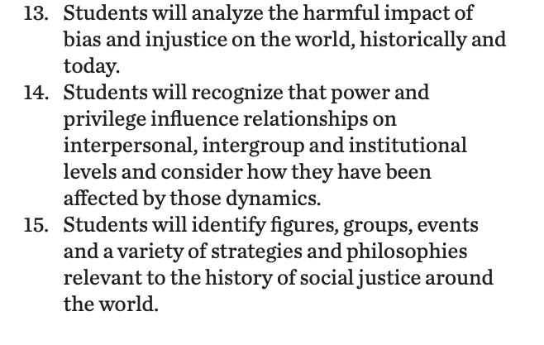
Standards/SJ Standards
Social Justice Standards
History Social Science Standards CA
Teaching Hard History Standards
Notes:
Standards:
Included here are the standards addressed throughout this study. They all in one place so as to keep the study focused on the goals written in the standards. We introduce one standard at a time, starting with the Teaching Hard History Standard, “In every place and time, enslaved people sought freedom”, as this is the main focus of the entire study.

Slide 3
A,E,I,O,U,1,2 Use this approach to help read words with multiple syllables.
Place an X under each A, E, I, O, U
Count the letters between the X’s
Split between:
(X and X) example: jo/vi/al
(X and 1) example: te/na/cious
(1 and 2) example: bal/lad
Do not separate blends or word groupings that need each other.
ous, qu, bi, cl, dr, pr, cial, tion
Dehumanization
Historian
Manufactured
Statistically
Notes:
Word Work:
On this slide, students are introduced to four multisyllabic words that they will encounter in the texts below. The strategy is to first place an X under each vowel. Then the students will split the word into syllables and then they blend the syllables to put the word together.
If your students are familiar with syllable types, here is another strategy you can teach your students to decode multisyllabic words.
After decoding the words, you can use the GLAD strategy of Cognitive Content Dictionary (background information linked). These words are key to understanding the text on these slides.

Slide 4
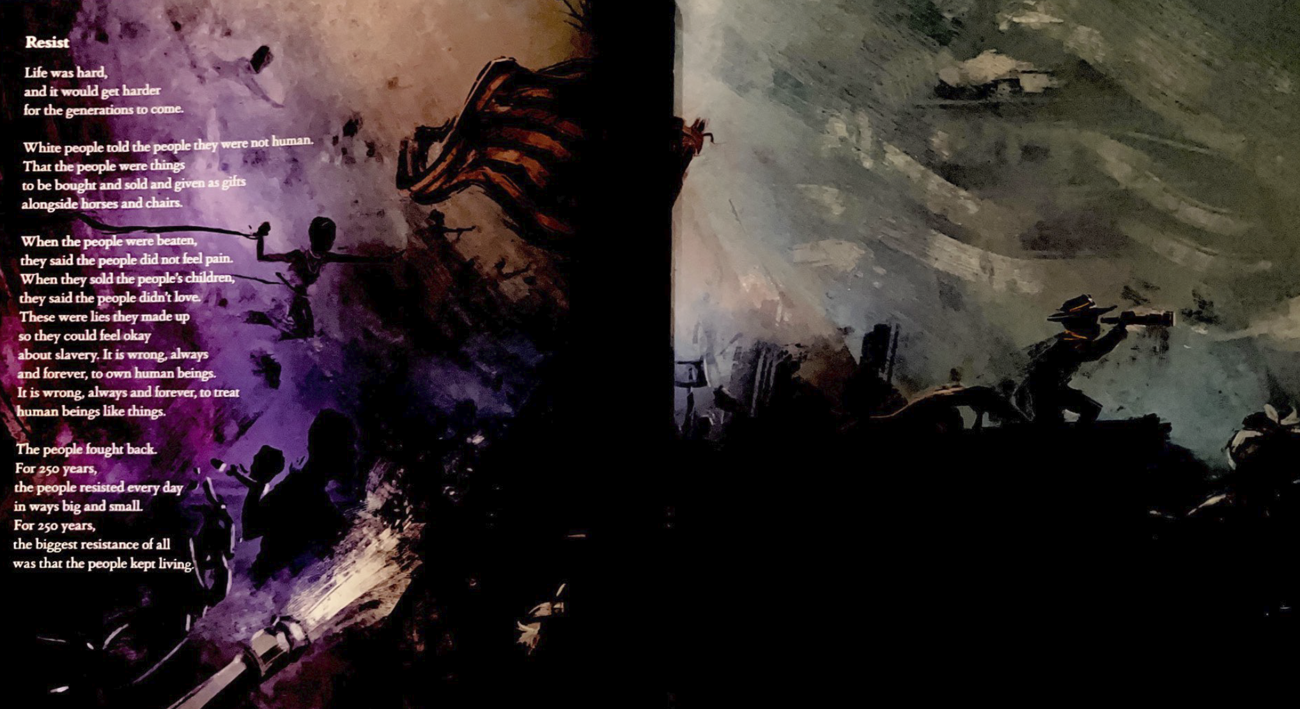
Notes:
Building Background through text
We will be building more background/knowledge using text to build on the slidedeck topic. Students will have printed copies of these slides. Complete a close read of the information spending time for students to highlight their copies and annotate. Another option is having students complete a close read in small groups or partners first and then bringing class together to read through discussing important information. This is also a good time to have students ask any questions about the text.
Key understandings of this text:
On this slide, students can read or listen to the text being read to them from the anchor text, Born on the Water, in the section titled Resist.

Slide 5
“When quantitative historians used statistical analysis to try to determine why slave revolts happened on some ships, and not others, they found one clear pattern: that the more women there were aboard a slave ship, the more likely it was that a revolt would happen, although they dismissed the finding as coincidence.”
https://www.unsunghistorypodcast.com/slave-revolts/#transcript
Notes:
Building Background through text
We will be building more background/knowledge using text to build on the slidedeck topic. Students will have printed copies of these slides. Complete a close read of the information spending time for students to highlight their copies and annotate. Another option is having students complete a close read in small groups or partners first and then bringing class together to read through discussing important information. This is also a good time to have students ask any questions about the text.
Key understandings of this text:
This is a quote from Dr. Rebecca Hall, summing up so much of her research on women-led slave revolts. The big message is that if women were aboard a ship, it was more likely that a revolt would happen.

Slide 6
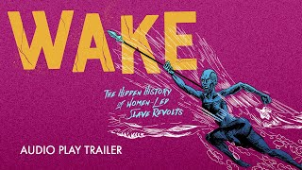
Notes:
Building background through media
Students will build background knowledge, vocabulary, and build towards a deep understanding of the concept through images and/or multi/media presentations and discussion.Students engage in discussion/turn and talks/ and/or whole class discussion. An optional scaffold to add to the class discussion after viewing is writing important discussion points on a white board or chart paper in order to assist students in their journal writing later.
Key understandings for this background media:

Slide 7
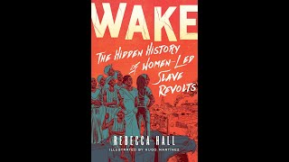
Interview with Dr. Rebecca Hall
Notes:
11:22-13:10
Building background through media
Students will build background knowledge, vocabulary, and build towards a deep understanding of the concept through images and/or multi/media presentations and discussion.Students engage in discussion/turn and talks/ and/or whole class discussion. An optional scaffold to add to the class discussion after viewing is writing important discussion points on a white board or chart paper in order to assist students in their journal writing later.
Key understandings for this background media:

Slide 8
Unsung Heros Podcast
5:18-8:04
Slave revolts during the Middle Passage were so dangerous as to basically be suicidal. On the first leg of the triangular slave trade, ships left Europe and sailed to Africa with manufactured goods. These goods were traded for slaves. And in the second arm, the enslaved Africans were forcibly transported across the Atlantic to the Americas. On the final arm, sugar, tobacco and other products were transported from the Americas to Europe. The conditions on the Middle Passage were wretched, and mortality in the slave ships was high. As many as 15% of the enslaved Africans died at sea, equaling 2 million people. The ships were designed to thwart revolts. The enslaved Africans were chained and manacled below decks, although women usually had more freedom of movement. Despite the impediments, one in ten slave ships experienced some form of African resistance, ranging from usually fatal attempts to leap overboard to major revolts. Occasionally, rebellion sank ships from major explosion or fire, killing both the enslaved and their captors. More often the insurrection was violently beaten back by the crew, and the rebels were punished or executed. When quantitative historians used statistical analysis to try to determine why slave revolts happened on some ships, and not others, they found one clear pattern: that the more women there were aboard a slave ship, the more likely it was that a revolt would happen, although they dismissed the finding as coincidence. To help us understand more about these revolts, and the challenges of understanding the historical record, I'm joined now by Dr. Rebecca Hall. Dr. Hall is a scholar, activist and educator who writes and speaks on the history of race, gender, law, and resistance, as well as on climate justice, and intersectional feminist theory. Her recent, highly acclaimed graphic novel, "Wake: The Hidden History of Women-Led Slave Revolts," weaves history and memoir that focuses on slave revolts in the Middle Passage and in New York City, and her own quest to uncover this unwritten history. Hello, Dr. Hall, thank you so much for joining me.
Notes:
Building Background through text
We will be building more background/knowledge using text to build on the slidedeck topic. Students will have printed copies of these slides. Complete a close read of the information spending time for students to highlight their copies and annotate. Another option is having students complete a close read in small groups or partners first and then bringing class together to read through discussing important information. This is also a good time to have students ask any questions about the text.
Key understandings of this text:

Slide 9
Unsung Heros Podcast
41:26-42:44
But like the historiography, you know, of slave ship revolt, having this sort of myopia about women not being involved in it just messed up the whole history. You know, I mean, I talked about it in the book, where, you know, after these historians put together this, like, incredible database of over 36,000, slave ship voyages, and, you know, they're quantitative historians who make databases and query them. And, you know, they found out that like, there was a revolt on one in 10 ships, which shocked everybody because, you know, revolts on ships were just so basically suicidal, you know. And then when they were trying to look at, well, what's the difference between the ships that had revolts and the ships that didn't have revolts, they saw that the ship, the only difference, statistical difference, statistically significant difference is that the more women on the ship, the more likely a revolt, and these historians immediately dismiss this. And it's like, this is just some kind of fluke, because we know that women weren't, you know, involved in this type of resistance. So then they completely overlook the fact that women, you know, once the ship left the coast of Africa, women were brought on deck and unchained, and that's where the weapons were. And it all makes sense, you know, like, yeah.
Notes:
Building Background through text
We will be building more background/knowledge using text to build on the slidedeck topic. Students will have printed copies of these slides. Complete a close read of the information spending time for students to highlight their copies and annotate. Another option is having students complete a close read in small groups or partners first and then bringing class together to read through discussing important information. This is also a good time to have students ask any questions about the text.
Key understandings of this text:

Slide 10
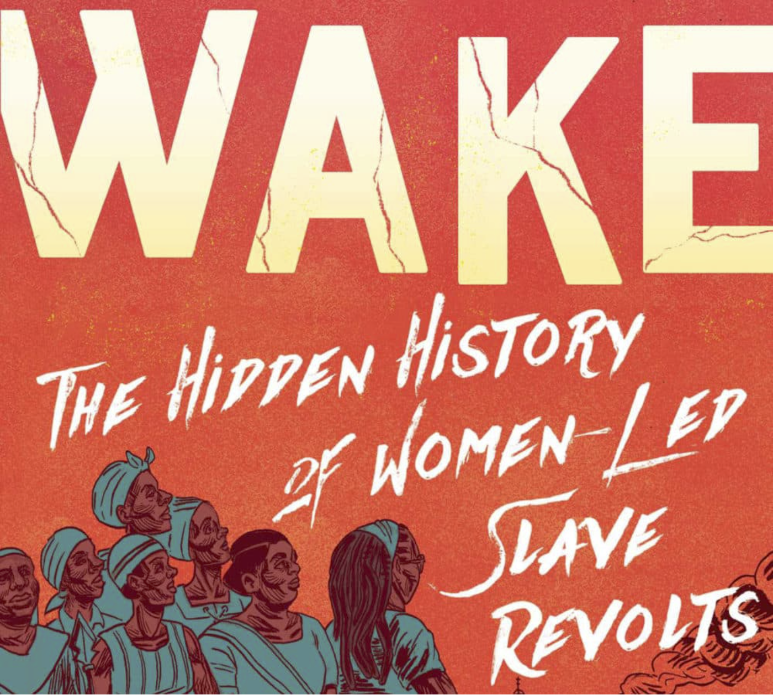
The following eight slides have images from Dr. Rebecca Hall’s graphic novel, Wake: The Hidden History of Women-Led Slave Revolts.
What do you see?
What images are missing?
What story do the images tell?
Notes:
Building Background through text
We will be building more background/knowledge using text to build on the slidedeck topic. Students will have printed copies of these slides. Complete a close read of the information spending time for students to highlight their copies and annotate. Another option is having students complete a close read in small groups or partners first and then bringing class together to read through discussing important information. This is also a good time to have students ask any questions about the text.
Key understandings of this text:
In the next eight slides, there are images from Wake. This will take some time but will be worth the discussion. You can either keep the images only on the slides and discuss as a group, print the images and post them on paper around the room for students to view, discuss and write notes about, or have students view them on their own computers to write notes about and then come together to discuss.

Slide 11
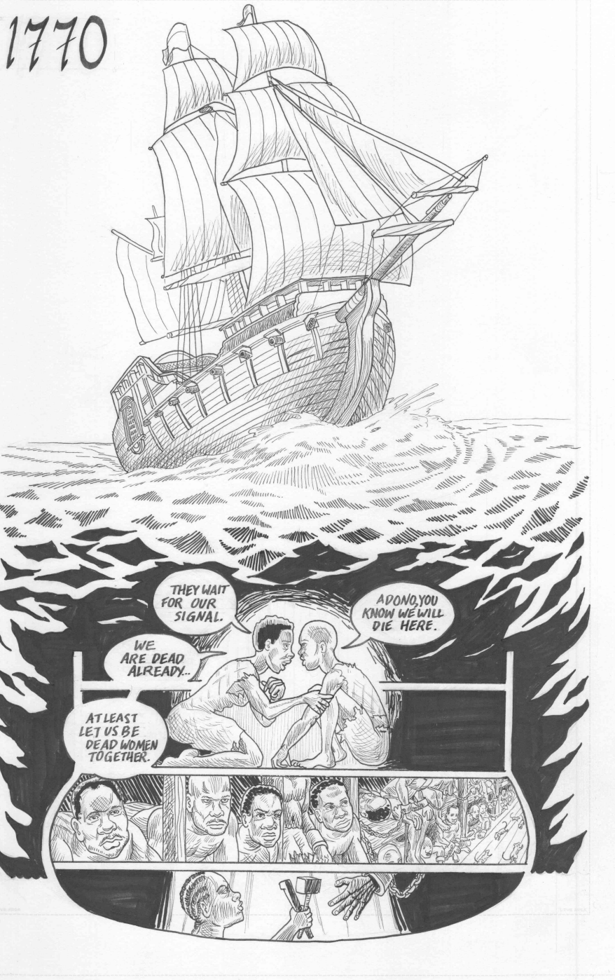
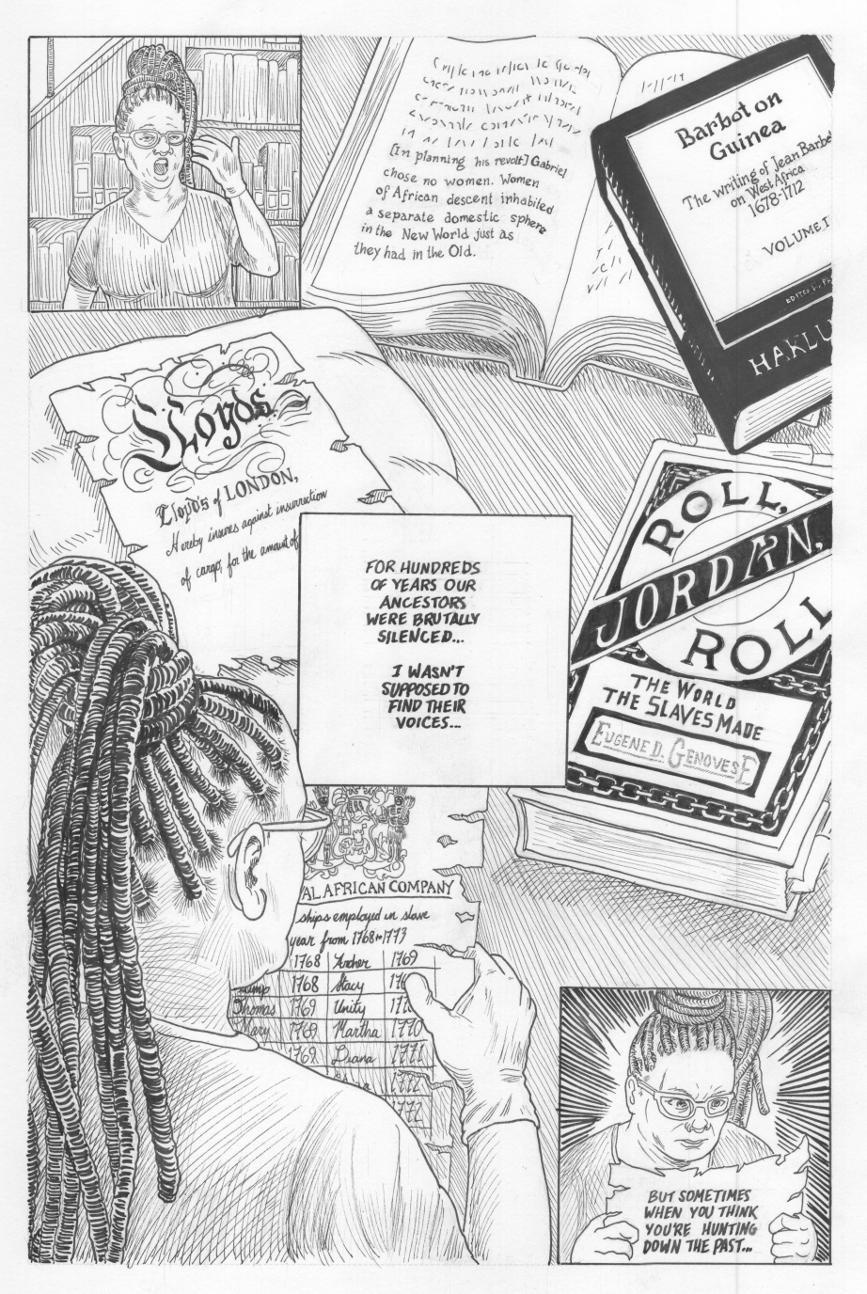
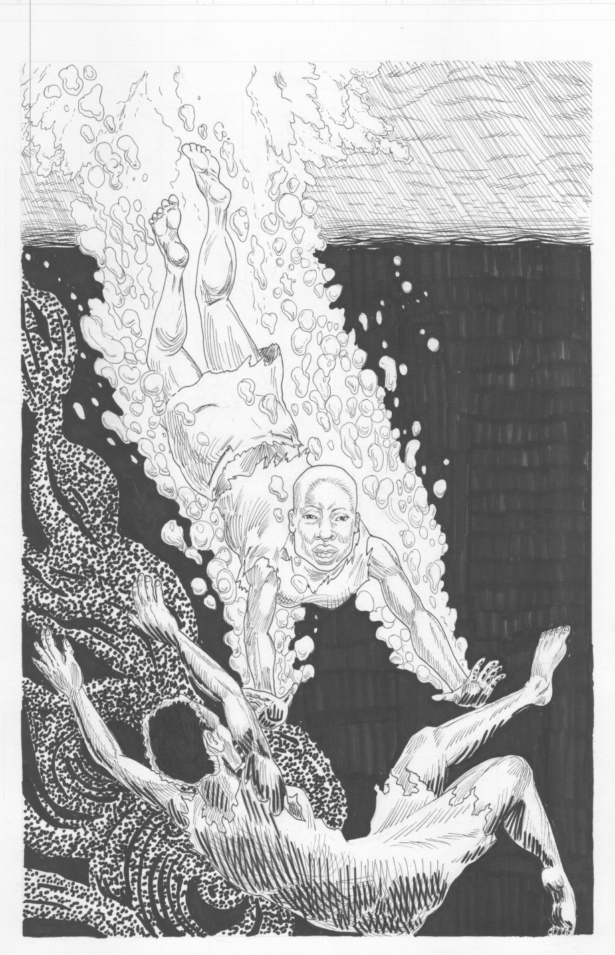
Notes:
https://hyperallergic.com/437361/wake-rebecca-hall-women-slave-revolts/

Slide 12
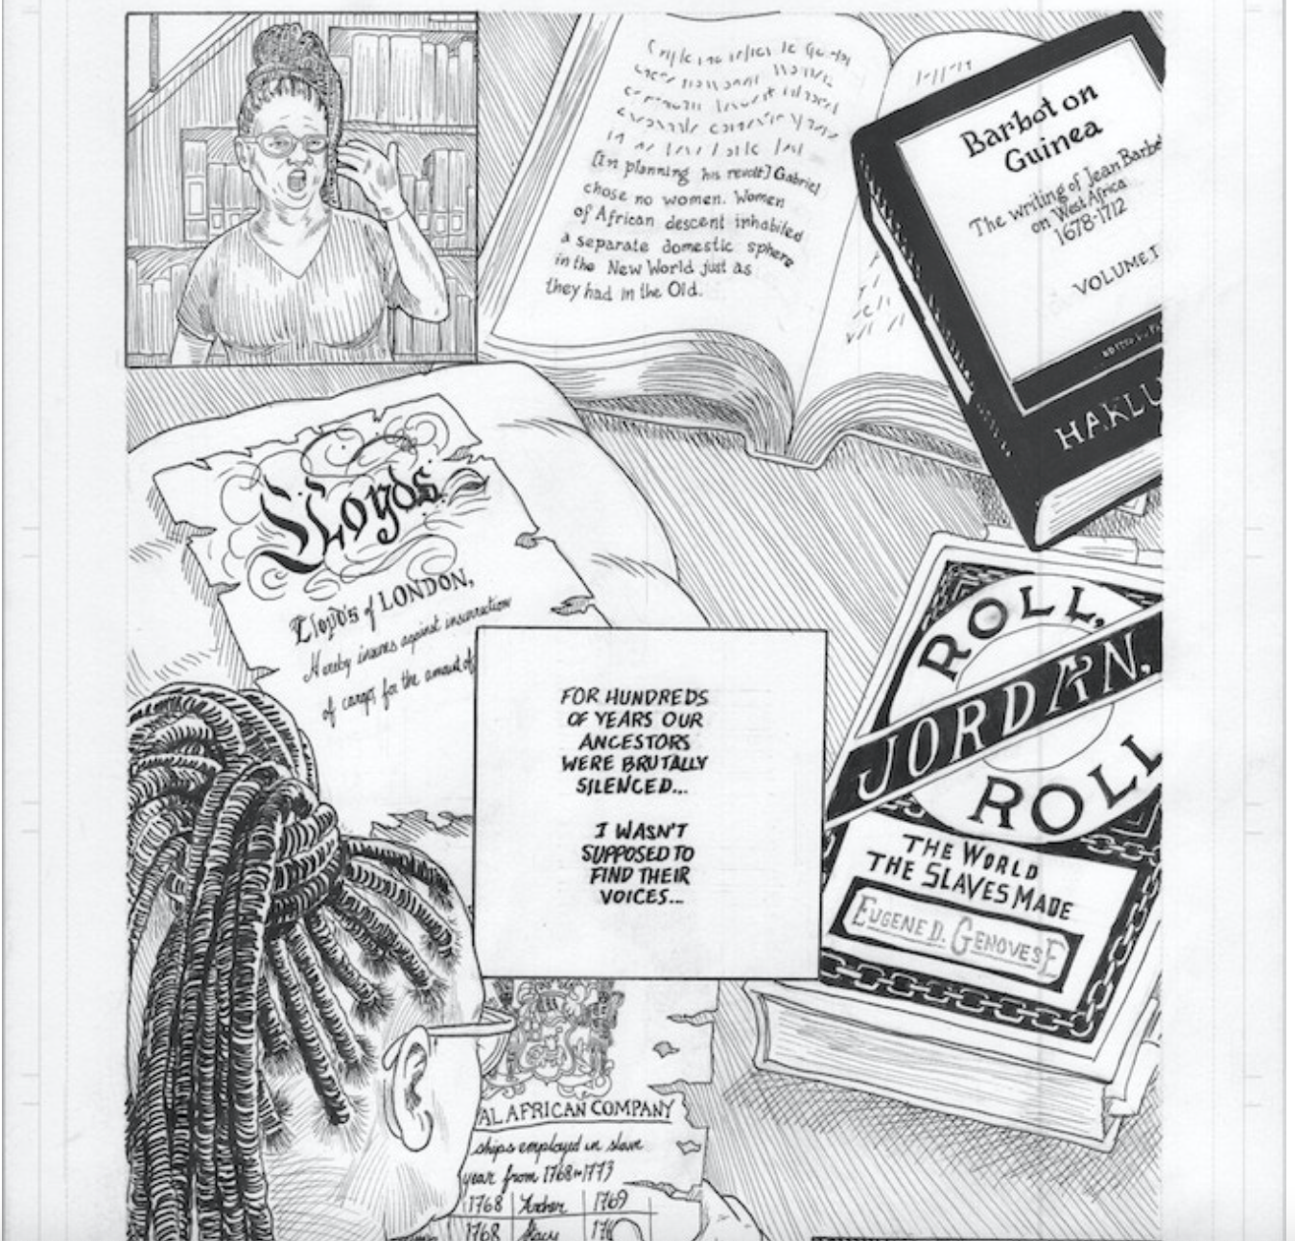
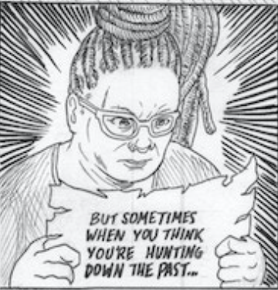
Notes:
https://www.kickstarter.com/projects/694426471/wake-the-hidden-history-of-women-led-slave-revolts

Slide 13
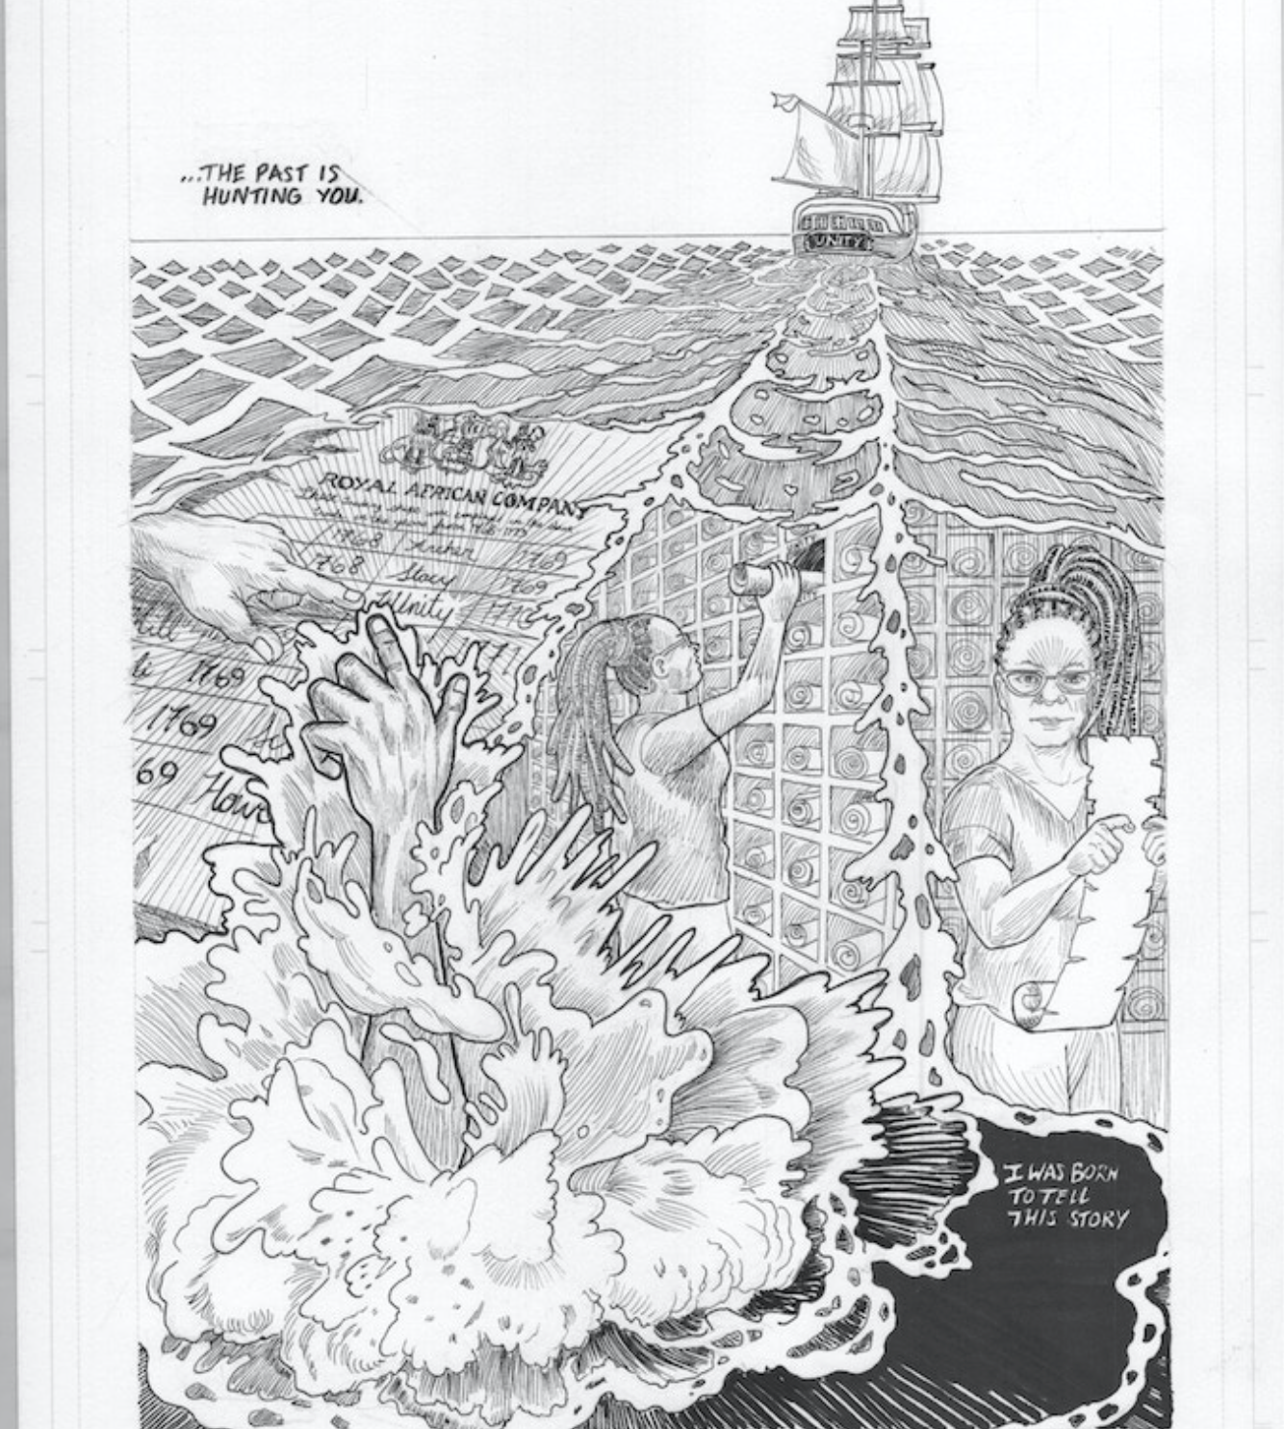
Notes:
https://www.kickstarter.com/projects/694426471/wake-the-hidden-history-of-women-led-slave-revolts

Slide 14
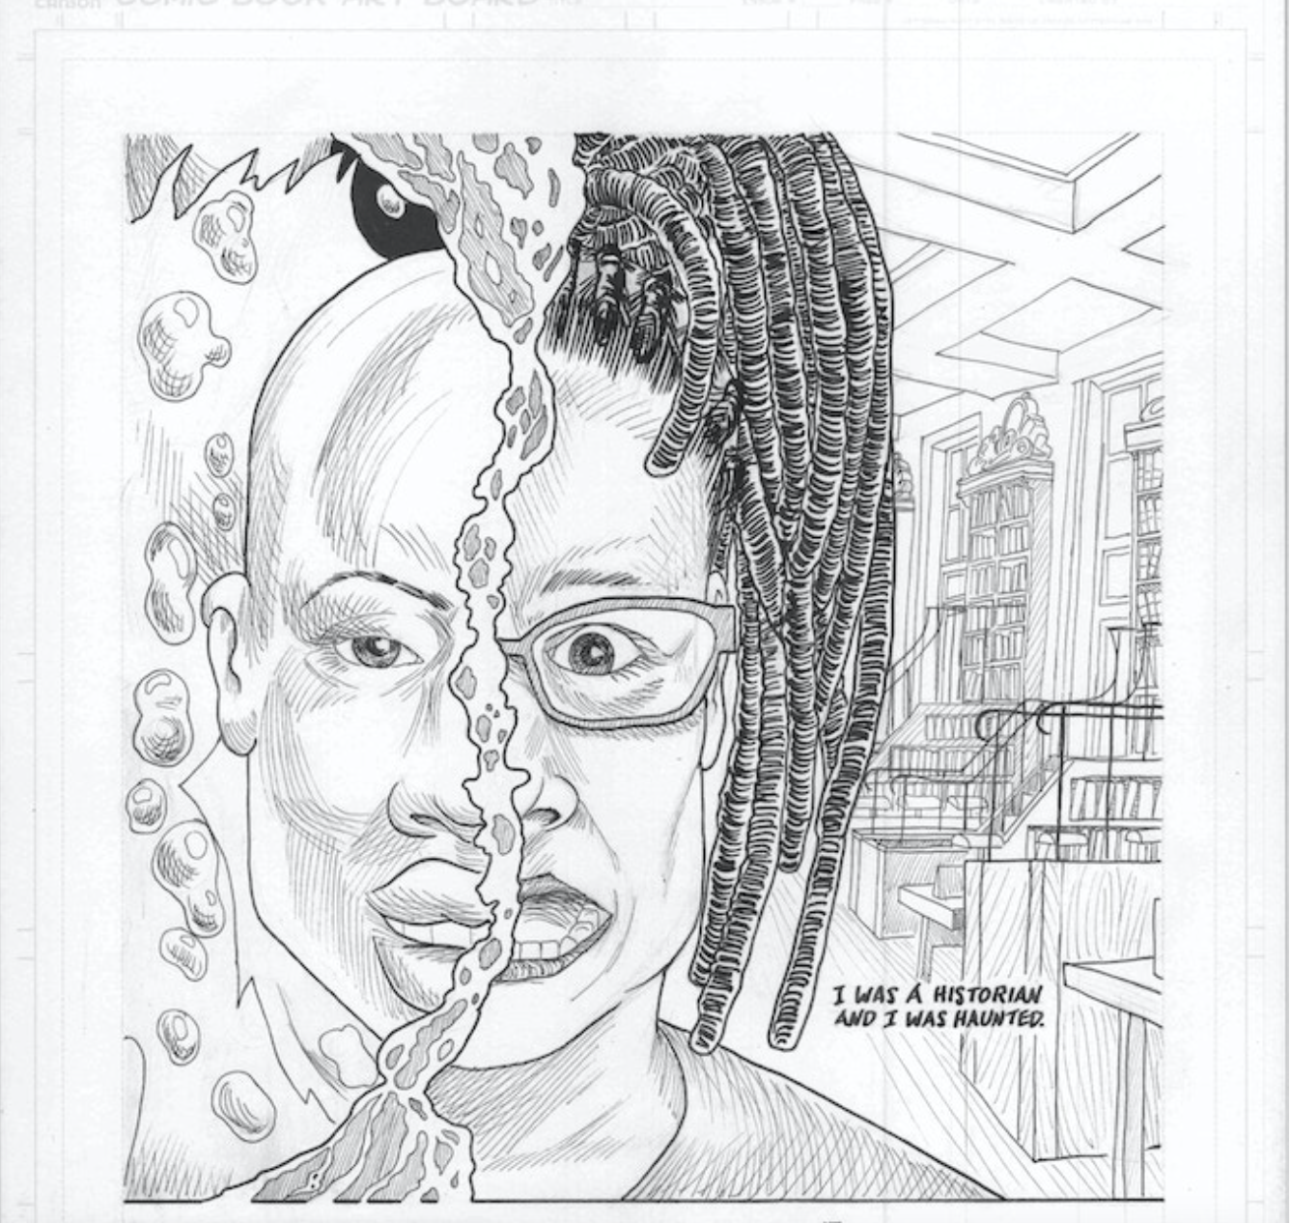
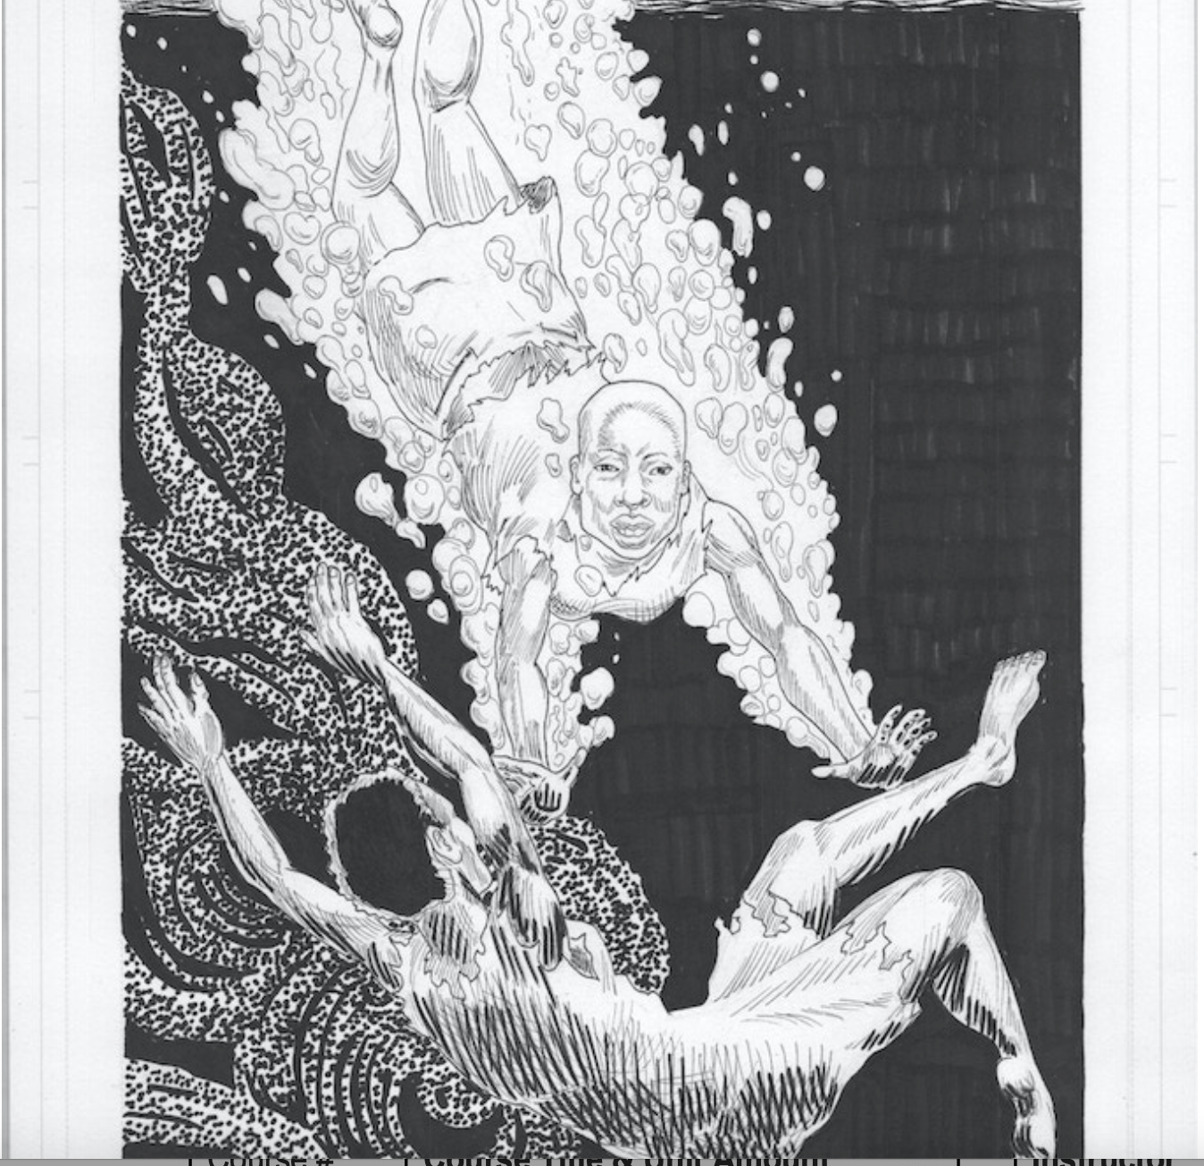
Notes:
https://www.kickstarter.com/projects/694426471/wake-the-hidden-history-of-women-led-slave-revolts

Slide 15
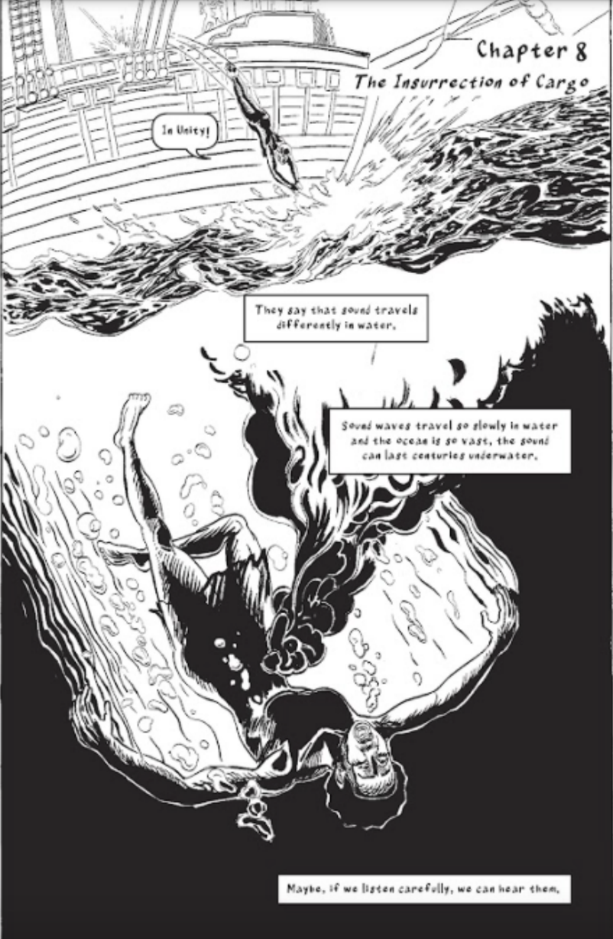
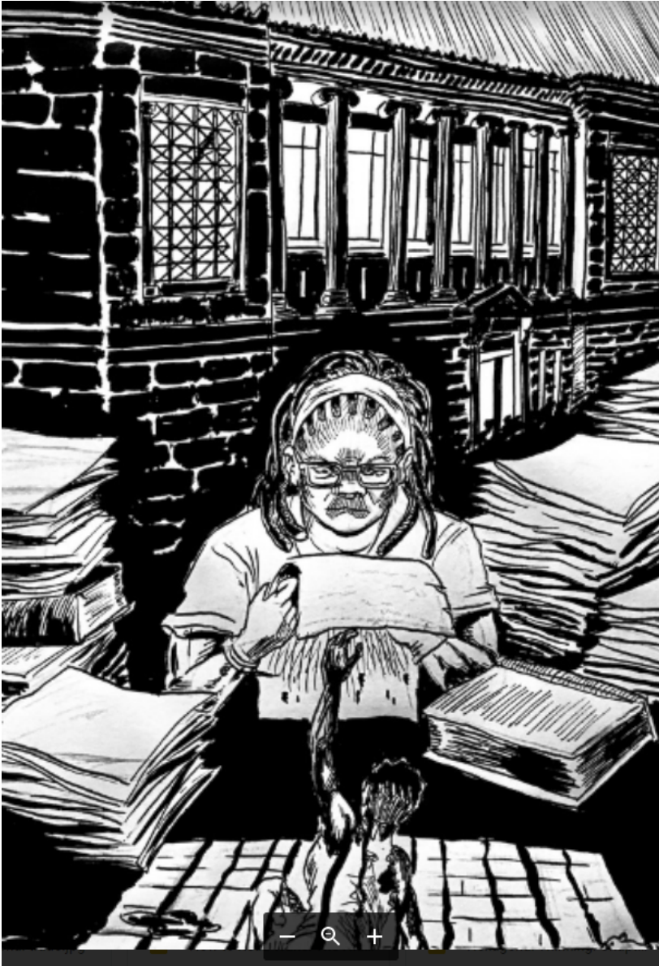

Slide 16
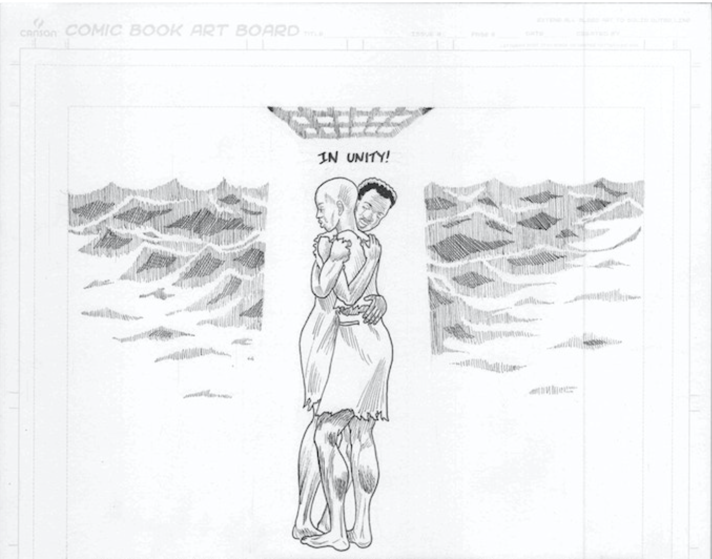
Notes:
https://www.kickstarter.com/projects/694426471/wake-the-hidden-history-of-women-led-slave-revolts

Slide 17
Notes:
https://www.kickstarter.com/projects/694426471/wake-the-hidden-history-of-women-led-slave-revolts

Slide 18
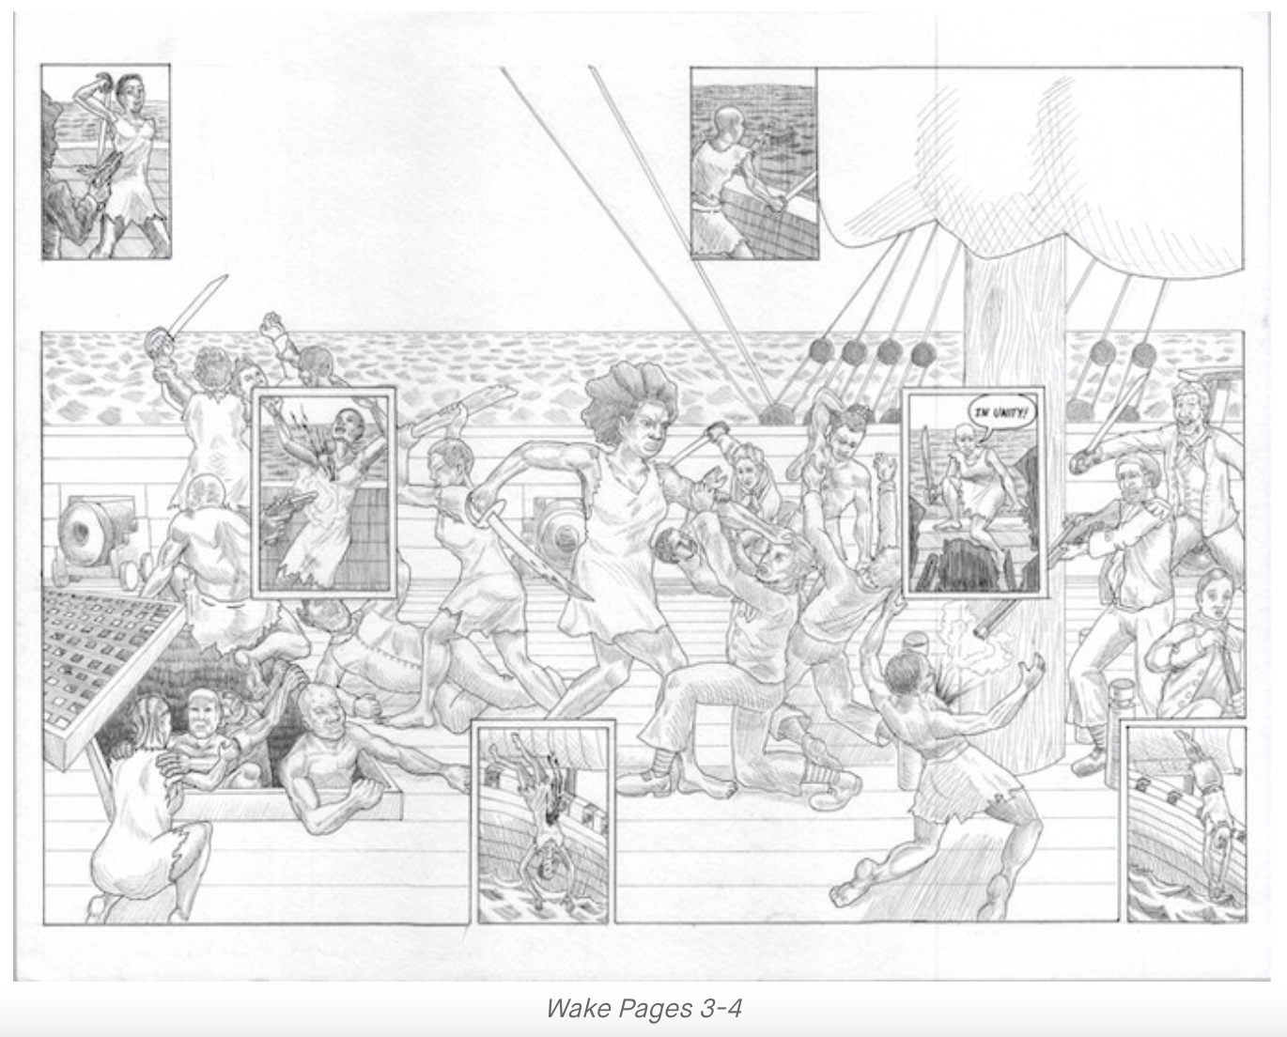
Notes:
https://www.kickstarter.com/projects/694426471/wake-the-hidden-history-of-women-led-slave-revolts

Slide 19
Cloze Passage to Build Comprehension
abandoned, explosion, African, captives
Some of the __________ made a bomb out of gunpowder pressed into a bottle, which they threatened to ignite. Recognizing that the _________would have damaged and perhaps sunk the ship, the crew surrendered to the African captives. Without any sailing or navigation experience, the Africans, now in control of the ship, were able to turn it around and sail it back to the _________ continent. After a few days, the Little George reached the mouth of the Sierra Leone River where both the Africans and the British crew the ___________ship. Later rescued by another slave ship, Captain George Scott, described in detail the revolt, thus leaving a record for later generations.
Notes:
Cloze passage
In this section, students read a text from the previous slide deck using “cloze passage” method. The cloze passage is pulled from previous reading and helps build reading fluency. In the previous reading there are key vocabulary words (non sight words) missing. There are a few options with different scaffolds. One way to complete this passage is to read chorally with all students while the vocabulary are listed above the passage. Students choose which words to fill into the passage while reading chorally. Students can also complete this independently or with a partner. After identifying the words, the next step would be talking about the importance and meaning of the words. It could be a reminder for them from the previous text, but multiple exposures will support their understanding.
Here is an article about using cloze passages and about fluency, which is the work on slide 19, if you’d like to read more.

Slide 20
Discussion Questions:
Why was it so difficult for the author to obtain information about women led slave revolts?
“... the more women there were aboard a slave ship, the more likely it was that a revolt would happen, although they dismissed the finding as coincidence.”
Why do you think this was true and why was it written off as a coincidence?
Notes:
Class Discussion:
In this section, students discuss what they have learned in a whole group discussion. Use these questions as a guideline to the discussion, but also feel free to follow what the students have gleaned from the learning so far in this slide deck. This discussion will support them in the writing section, where each student will be expected to write a page about what they learned. This will be very helpful for them to make connections, ask questions and build an understanding of the content.

Slide 21
Fluency Practice Practice reading the text below with a partner. The goal is to read the text with 100% accuracy. The words in red are from the A, E, I, O, U, 1, 2 List.
The Little George Ship Revolt took place on the British ship Little George in June 1730. The little-known revolt was one of the most successful uprisings of captured Africans on the high seas in history. The revolt occurred five days after the Little George had sailed from the Coast of Guinea to bring captured Africans to the British North American colony of Rhode Island. The revolt began as several Africans were able to slip out of their iron chains, overpower the crew, and sail the ship back to the continent of Africa and specifically to the Sierra Leone River where they abandoned the ship.
On June 1, 1730, Captain George Scott sailed his ship, the Little George, carrying ninety-six captured Africans from the Bonnana Islands off the Coast of Guinea (West Africa) to Rhode Island. There the captured Africans were to be sold as slaves. Five days into the Atlantic crossing, the captives, already mistreated by the ship’s crew and packed and chained down in heavy shackles in the dark and poorly ventilated lower deck of the ship, rose in revolt. On June 6, 1730, around 4:00 a.m. several captives freed themselves from their iron shackles and broke through the bulkhead of the ship. Getting on the ship’s deck, they seized weapons and killed three of the crew’s watchmen who were attempting to alert other crew members and Captain Scott.
Notes:
Fluency
Each day, students should be working on fluency. They can either pair up with a partner, or practice by themselves in this first reading. The ultimate goal would be that they have a fluency partner, each reading to the other for one minute. I have the first reader identify themself and place their finger on the first word, and the listener does the same, but be ready to listen. After one minute, I tell them to stop and switch roles.
If you print this text for them, the only change would be that the listener has a pencil ready to make the text with words missed from the reader. That is not to highlight mistakes, but to support one another in building towards fluency.

Slide 22
Writing Tips Use the following tips to complete your writing using the texts and the videos. Remember to include what you learned about the topic. Also, share your thinking about what you learned.
Using the texts and videos, write what you learned about women led slave revolts.
Write what you learned about (topic) from the examples, the reading and the videos.
Write what you will do with what you have learned.
What thoughts or questions do you have after today’s lesson?
Writing Structure- summary sentences
Notes:
Writing
Each student should be prepared to write an entire page about what they learned today. You can either provide a blank journal or print and copy journal pages for them. The expectation is that they fill a page, and though they might struggle initially, they will get used to the format.
Possible scaffold for writing-To help emergent bilingual students you may pull a small group and give a paragraph frame or complete a guided writing.
For students who need more support, some sentence starters could be:
Today I learned about…
One thing I connected with was …
This helped me understand ….
An example of resistance was …..

Slide 23
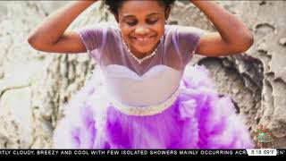
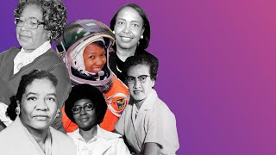
Black Girl Magic
Notes:
Joy: How will my instruction advance students’ happiness through the use of beautiful and truthful images, representations, and narratives about themselves and/or others? This portion can be included during the lesson or at a separate time depending on time availability.
Key understandings of this section:
These are videos that teach students about the hashtag Black Girl Magic and the driving message behind the hashtag. The connection for the students can be the legacy of the strength and power of Black women and girls.

Slide 24
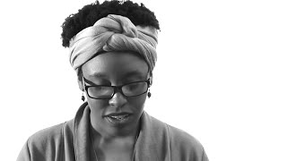
Joy! Black Girl Scientist
Poem by Taylor
Notes:
Joy: How will my instruction advance students’ happiness through the use of beautiful and truthful images, representations, and narratives about themselves and/or others? This portion can be included during the lesson or at a separate time depending on time availability.
Key understandings of this section:
This is a poem written and read by a woman by Taylor. This…

