Slide 1
African American History 400+ years of Resistance, Resilience, Power, and Pride
Today you will become smarter in the Little George ship revolt and Bisa Butler, an artist activist.
Notes:
Introduction:
In this slide deck, students will learn about the Little George ship revolt. This was a successful revolt on the ship headed for Rhode Island. The students will start off by reading a couple pages from the anchor book, Born on the Water, in the section titled: Stolen. This will give students context, again, about the experience of African mothers, fathers, sisters, brothers, and so on being stolen from their homes by they white people who kidnapped them. They will then watch a video and read text about the revolt. They will also build foundational skills throughout the slides. Although there is one specific slide for a discussion, we discuss throughout the learning.
Joy is included at the end of every slide deck to celebrate the foundation of food, song, dance, etc, brought to the United States by Africans forced from their homes.
To prepare for this study, the students should be provided with a blank journal or journal pages in a folder, as they will be writing a full page at the end of each slide deck, possibly more. Also, the slide decks were originally designed to be completed in one class period, but I have found that it usually takes two to three class periods. If that is the same for you, you might have the students at least write a sentence or two at the end of each period so they remember what they learned throughout the study.

Slide 2
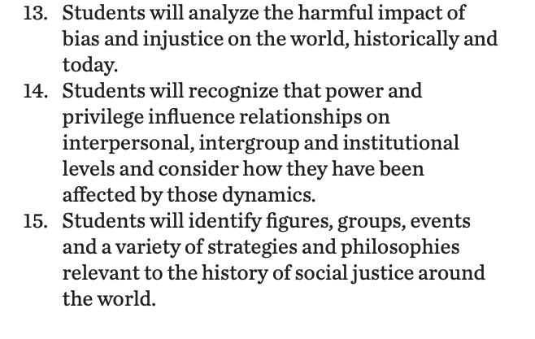
Standards/SJ Standards
Social Justice Standards
History Social Science Standards CA
Teaching Hard History Standards
Notes:
Standards:
Included here are the standards addressed throughout this study. They all in one place so as to keep the study focused on the goals written in the standards. We introduce one standard at a time, starting with the Teaching Hard History Standard, “In every place and time, enslaved people sought freedom”, as this is the main focus of the entire study.

Slide 4
A,E,I,O,U,1,2 Use this approach to help read words with multiple syllables.
Place an X under each A, E, I, O, U
Count the letters between the X’s
Split between:
(X and X) example: jo/vi/al
(X and 1) example: te/na/cious
(1 and 2) example: bal/lad
Do not separate blends or word groupings that need each other.
ous, qu, bi, cl, dr, pr, cial, tion
Abandoned
Generations
Uprisings
Ventilated
Notes:
Word Work:
On this slide, students are introduced to four multisyllabic words that they will encounter in the texts below. The strategy is to first place an X under each vowel. Then the students will split the word into syllables and then they blend the syllables to put the word together.
If your students are familiar with syllable types, here is another strategy you can teach your students to decode multisyllabic words.
After decoding the words, you can use the GLAD strategy of Cognitive Content Dictionary (background information linked). These words are key to understanding the text on these slides.

Slide 5
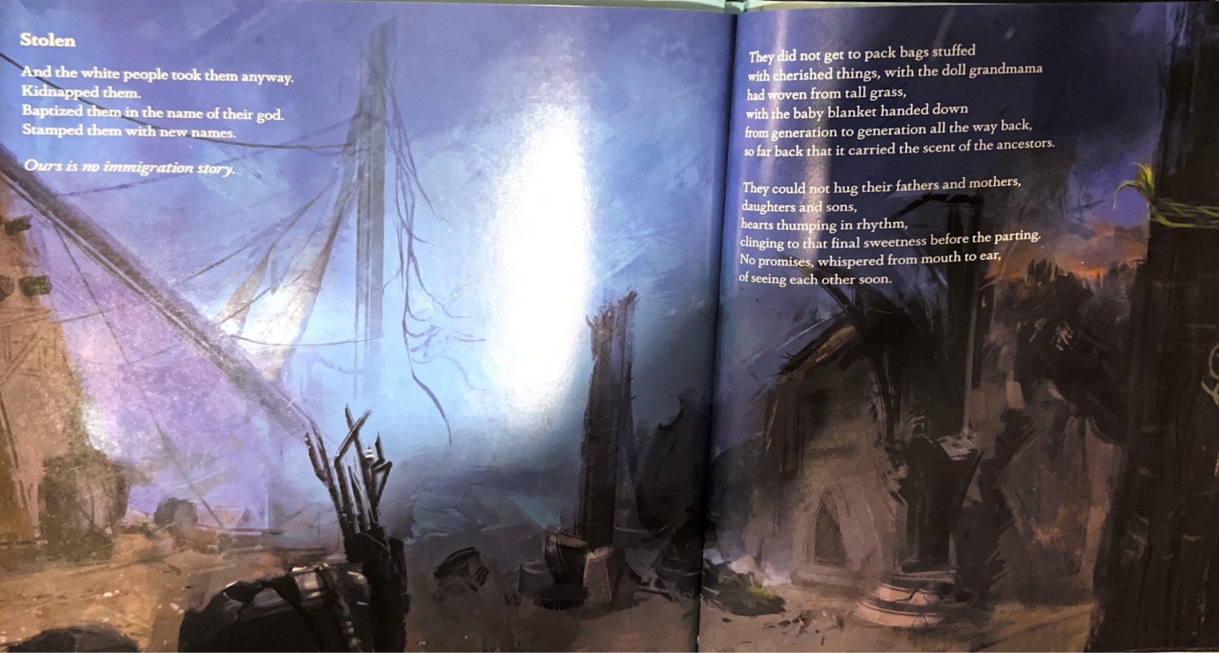
Notes:
I’ll get a better scan…
Building Background through text
We will be building more background/knowledge using text to build on the slidedeck topic. Students will have printed copies of these slides. Complete a close read of the information spending time for students to highlight their copies and annotate. Another option is having students complete a close read in small groups or partners first and then bringing class together to read through discussing important information. This is also a good time to have students ask any questions about the text.
Key understandings of this text:
This slide and the next are to have students hear the human experience of being stolen from their homes without knowing anything about their futures. You can either read this outloud to the students or they can read individually and then discuss.

Slide 6
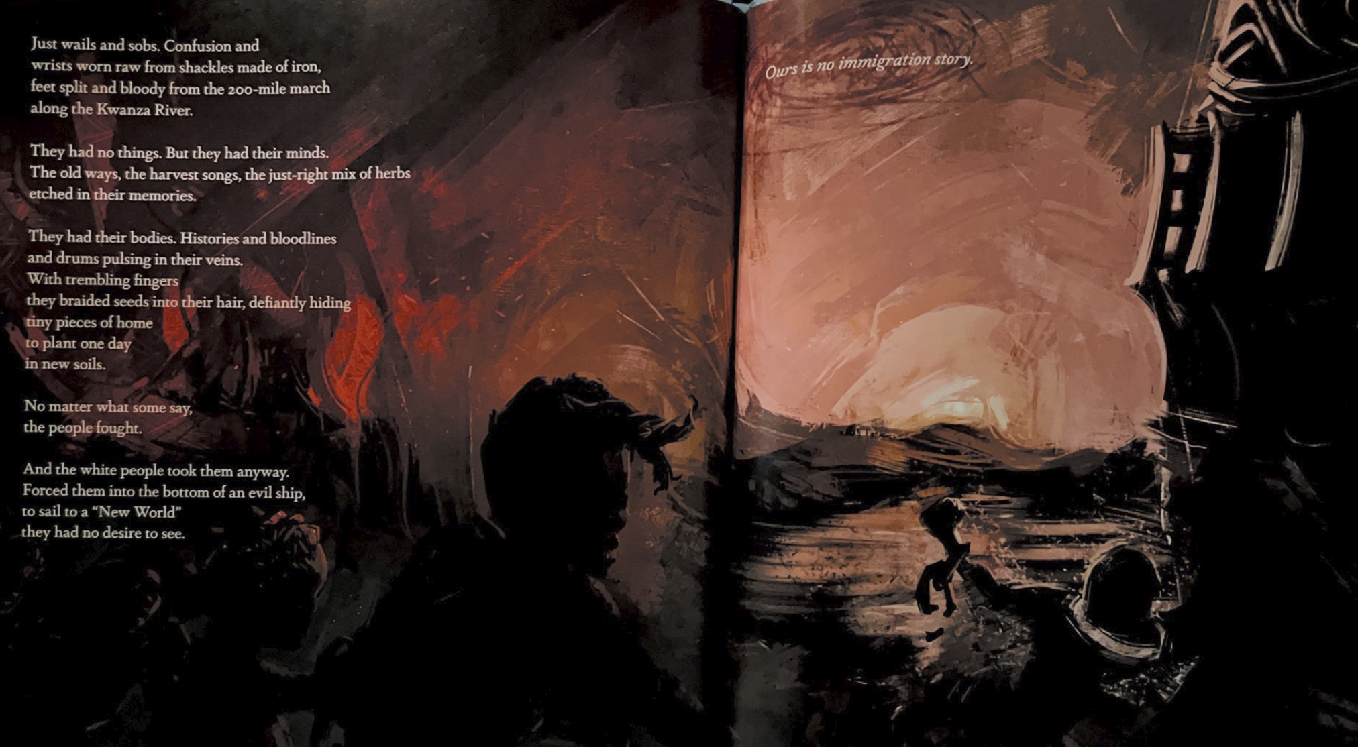
Notes:
Building Background through text
We will be building more background/knowledge using text to build on the slidedeck topic. Students will have printed copies of these slides. Complete a close read of the information spending time for students to highlight their copies and annotate. Another option is having students complete a close read in small groups or partners first and then bringing class together to read through discussing important information. This is also a good time to have students ask any questions about the text.
Key understandings of this text:
This slide and the previous are to have students hear the human experience of being stolen from their homes without knowing anything about their futures. You can either read this outloud to the students or they can read individually and then discuss.

Slide 7
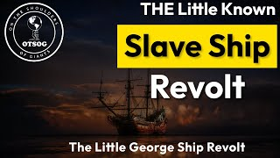
The Little George Ship Revolt
Notes:
Building background through media
Students will build background knowledge, vocabulary, and build towards a deep understanding of the concept through images and/or multi/media presentations and discussion.Students engage in discussion/turn and talks/ and/or whole class discussion. An optional scaffold to add to the class discussion after viewing is writing important discussion points on a white board or chart paper in order to assist students in their journal writing later.
Key understandings for this background media:
This is a video that will introduce the students to the Little George Ship Revolt, a revolt that occurred 5 days after the ship left the Coast of Guinea to go to Rhode Island. The…
On The Shoulders of Giants (linked here)

Slide 8
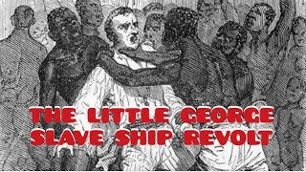
The Little George Slave Ship Revolt
Notes:
Building background through media
Students will build background knowledge, vocabulary, and build towards a deep understanding of the concept through images and/or multi/media presentations and discussion.Students engage in discussion/turn and talks/ and/or whole class discussion. An optional scaffold to add to the class discussion after viewing is writing important discussion points on a white board or chart paper in order to assist students in their journal writing later.
Key understandings for this background media:

Slide 9
The Little George Ship Revolt took place on the British ship Little George in June 1730. The little-known revolt was one of the most successful uprisings of captured Africans on the high seas in history. The revolt occurred five days after the Little George had sailed from the Coast of Guinea to bring captured Africans to the British North American colony of Rhode Island. The revolt began as several Africans were able to slip out of their iron chains, overpower the crew, and sail the ship back to the continent of Africa and specifically to the Sierra Leone River where they abandoned the ship.
On June 1, 1730, Captain George Scott sailed his ship, the Little George, carrying ninety-six captured Africans from the Bonnana Islands off the Coast of Guinea (West Africa) to Rhode Island. There the captured Africans were to be sold as slaves. Five days into the Atlantic crossing, the captives, already mistreated by the ship’s crew and packed and chained down in heavy shackles in the dark and poorly ventilated lower deck of the ship, rose in revolt. On June 6, 1730, around 4:00 a.m. several captives freed themselves from their iron shackles and broke through the bulkhead of the ship. Getting on the ship’s deck, they seized weapons and killed three of the crew’s watchmen who were attempting to alert other crew members and Captain Scott.
Momodu, S. (2020, August 23). Little George Ship Revolt (1730). BlackPast.org. https://www.blackpast.org/global-african-history/little-george-ship-revolt-1730/
Notes:
Building Background through text
We will be building more background/knowledge using text to build on the slidedeck topic. Students will have printed copies of these slides. Complete a close read of the information spending time for students to highlight their copies and annotate. Another option is having students complete a close read in small groups or partners first and then bringing class together to read through discussing important information. This is also a good time to have students ask any questions about the text.
Key understandings of this text:

Slide 10
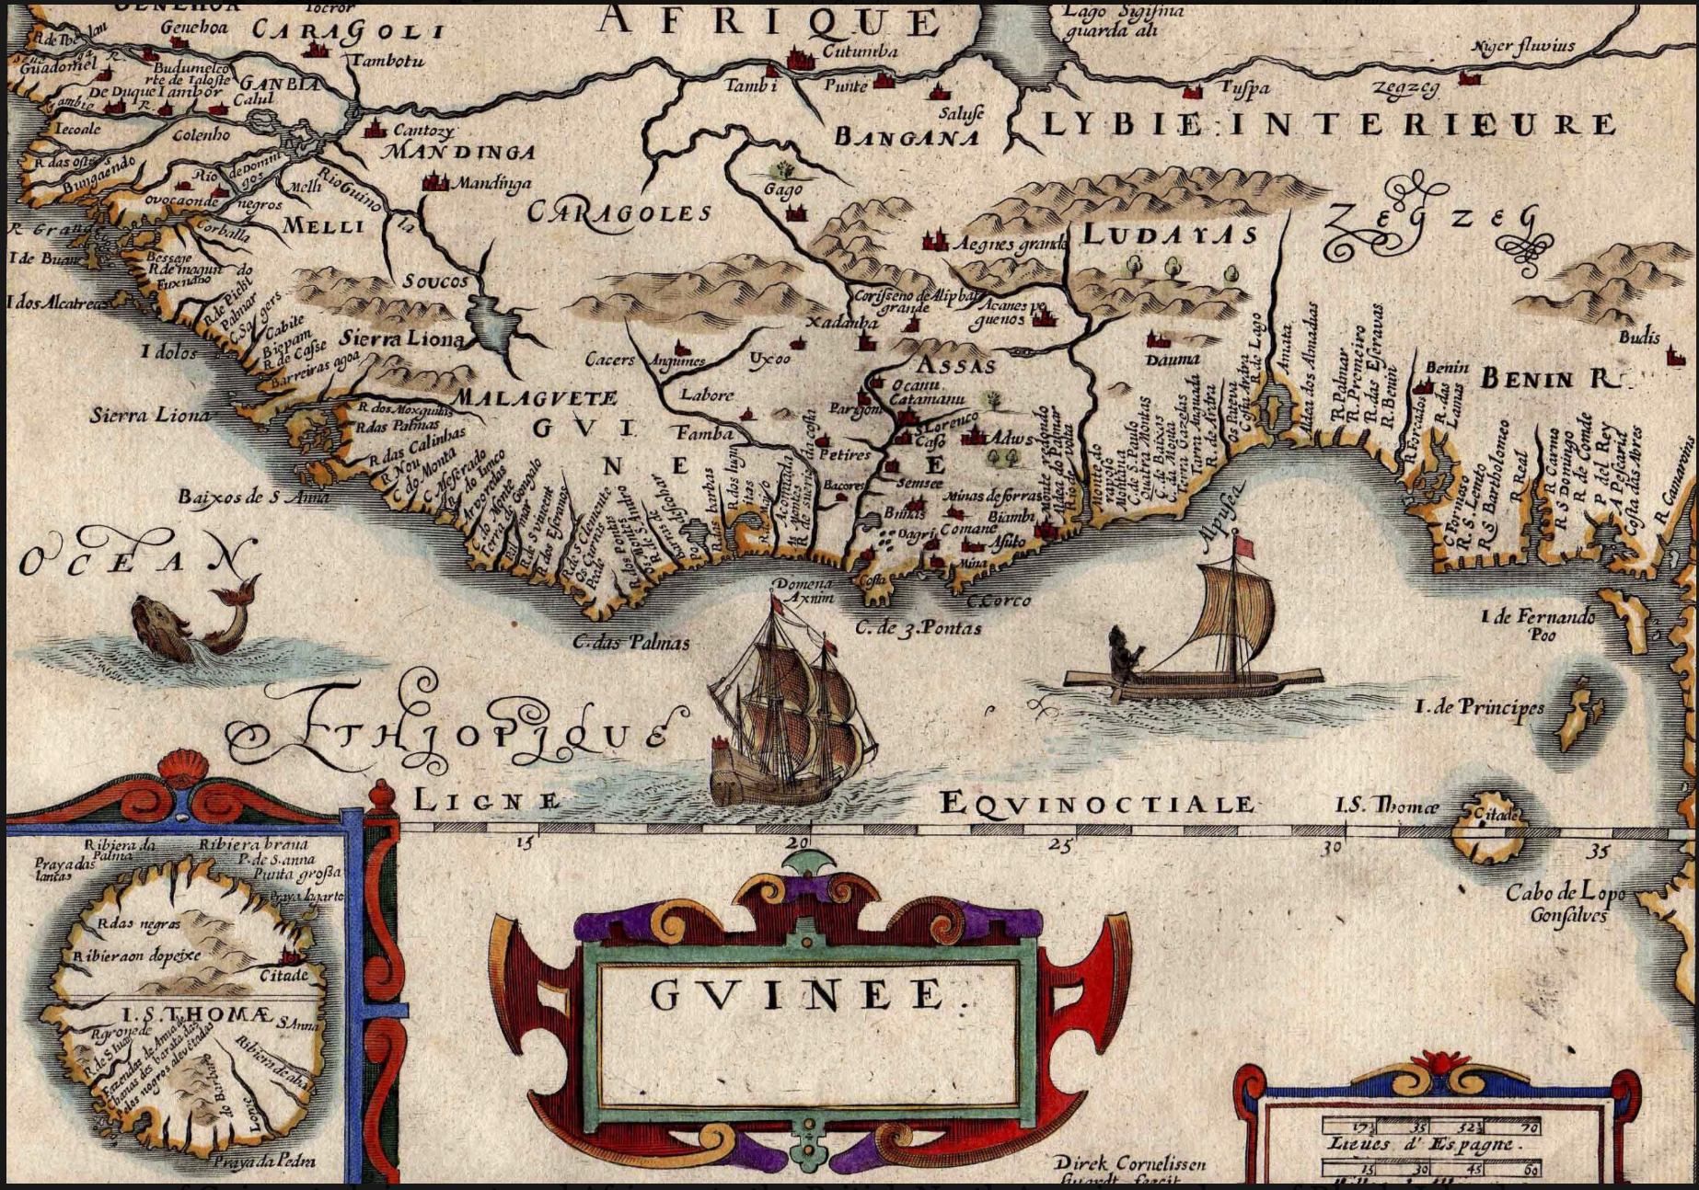
Some of the captives made a bomb out of gunpowder pressed into a bottle, which they threatened to ignite. Recognizing that the explosion would have damaged and perhaps sunk the ship, the crew surrendered to the African captives. Without any sailing or navigation experience, the Africans, now in control of the ship, were able to turn it around and sail it back to the African continent. After a few days, the Little George reached the mouth of the Sierra Leone River where both the Africans and the British crew abandoned the ship. Later rescued by another slave ship, Captain George Scott, described in detail the revolt, thus leaving a record for later generations.
Momodu, S. (2020, August 23). Little George Ship Revolt (1730). BlackPast.org. https://www.blackpast.org/global-african-history/little-george-ship-revolt-1730/
Notes:
Building Background through text
We will be building more background/knowledge using text to build on the slidedeck topic. Students will have printed copies of these slides. Complete a close read of the information spending time for students to highlight their copies and annotate. Another option is having students complete a close read in small groups or partners first and then bringing class together to read through discussing important information. This is also a good time to have students ask any questions about the text.
Key understandings of this text:
Here is another article you can print for your students if you would like them to read more about the revolt.

Slide 11
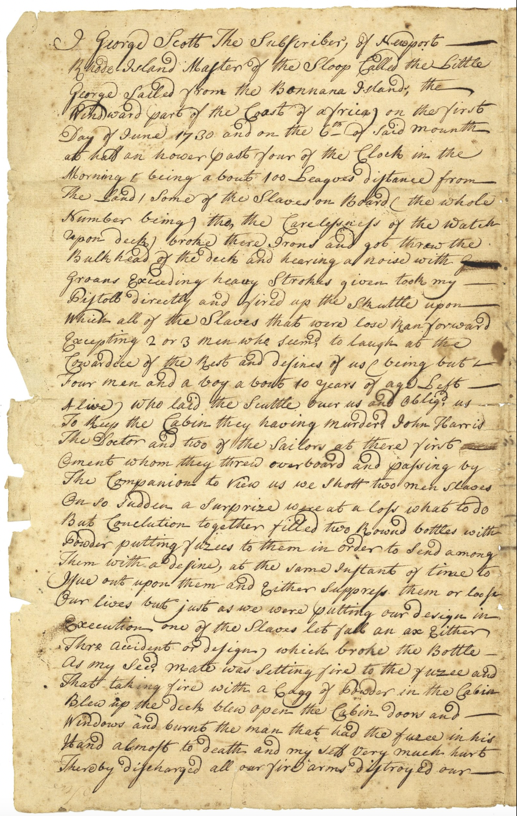
Notes:
Building Background through text
We will be building more background/knowledge using text to build on the slidedeck topic. Students will have printed copies of these slides. Complete a close read of the information spending time for students to highlight their copies and annotate. Another option is having students complete a close read in small groups or partners first and then bringing class together to read through discussing important information. This is also a good time to have students ask any questions about the text.
Key understandings of this text:

Slide 12
Cloze Passage for Comprehension: Fill in the blanks to make the poem make sense.
ocean, land, resignation, water
They say our people were born on the _____________.
When it occurred, no one can say for certain. Perhaps it was in the second week, or the third, but surely by the fourth, when they had not seen their ______ or any land for so many days that they lost count. It was after the fear had turned to despair and the despair to _____________and the resignation gave way, finally, to resolve.
They knew then that they would not hug their grandmothers again, or share a laugh with a cousin during his nuptials, or sing their baby softly to sleep with the same lullabies that their mothers had once sung to them.
The teal eternity of the Atlantic ________ had severed them so completely that it was as if nothing had ever existed before, that everything they ever knew had simply vanished from the earth.
Notes:
Cloze passage
In this section, students read a text from the previous slide deck using “cloze passage” method. The cloze passage is pulled from previous reading and helps build reading fluency. In the previous reading there are key vocabulary words (non sight words) missing. There are a few options with different scaffolds. One way to complete this passage is to read chorally with all students while the vocabulary are listed above the passage. Students choose which words to fill into the passage while reading chorally. Students can also complete this independently or with a partner. After identifying the words, the next step would be talking about the importance and meaning of the words. It could be a reminder for them from the previous text, but multiple exposures will support their understanding.
Here is an article about using cloze passages and about fluency, which is the work on slide 19, if you’d like to read more.

Slide 13
Discussion Questions
What is a revolt and what makes a successful one?
What made the Little George revolt so successful?
Notes:
Class Discussion:
In this section, students discuss what they have learned in a whole group discussion. Use these questions as a guideline to the discussion, but also feel free to follow what the students have gleaned from the learning so far in this slide deck. This discussion will support them in the writing section, where each student will be expected to write a page about what they learned. This will be very helpful for them to make connections, ask questions and build an understanding of the content.

Slide 14
Fluency Practice Practice reading the text below with a partner. The goal is to read the text with 100% accuracy. The words in red are from the A, E, I, O, U, 1, 2 List.
In 1776, the nation was founded on the ideal of democracy. In 1619, when enslaved Africans first arrived in what would become the United States, black people began the fight to make that ideal a reality. Released on Aug. 23, 2019.
Nikole Hannah-Jones
They say our people were born on the water.
When it occurred, no one can say for certain. Perhaps it was in the second week, or the third, but surely by the fourth, when they had not seen their land or any land for so many days that they lost count. It was after the fear had turned to despair and the despair to resignation and the resignation gave way, finally, to resolve.
They knew then that they would not hug their grandmothers again, or share a laugh with a cousin during his nuptials, or sing their baby softly to sleep with the same lullabies that their mothers had once sung to them.
The teal eternity of the Atlantic Ocean had severed them so completely that it was as if nothing had ever existed before, that everything they ever knew had simply vanished from the earth.
Notes:
Fluency Practice:
Each day, students should be working on fluency. They can either pair up with a partner, or practice by themselves in this first reading. The ultimate goal would be that they have a fluency partner, each reading to the other for one minute. I have the first reader identify themself and place their finger on the first word, and the listener do the same, but be ready to listen. After one minute, I tell them to stop and switch roles.
If you print this text for them, the only change would be that the listener has a pencil ready to make the text with words missed from the reader. That is not to highlight mistakes, but to support one another in building towards fluency.

Slide 15
Writing Tips Use the following tips to complete your writing using the texts and the videos. Remember to include what you learned about the topic. Also, share your thinking about what you learned.
Using the texts and videos, write about the Little George Slave Revolt.
Write what you learned about (topic) from the examples, the reading and the videos.
Write what you will do with what you have learned.
What thoughts or questions do you have after today’s lesson?
Writing Structure- summary sentences
Notes:
Writing
Each student should be prepared to write an entire page about what they learned today. You can either provide a blank journal or print and copy journal pages for them. The expectation is that they fill a page, and though they might struggle initially, they will get used to the format.
Possible scaffold for writing-To help emergent bilingual students you may pull a small group and give a paragraph frame or complete a guided writing.
For students who need more support, some sentence starters could be:
Today I learned about…
One thing I connected with was …
This helped me understand ….
An example of resistance was …..

Slide 16
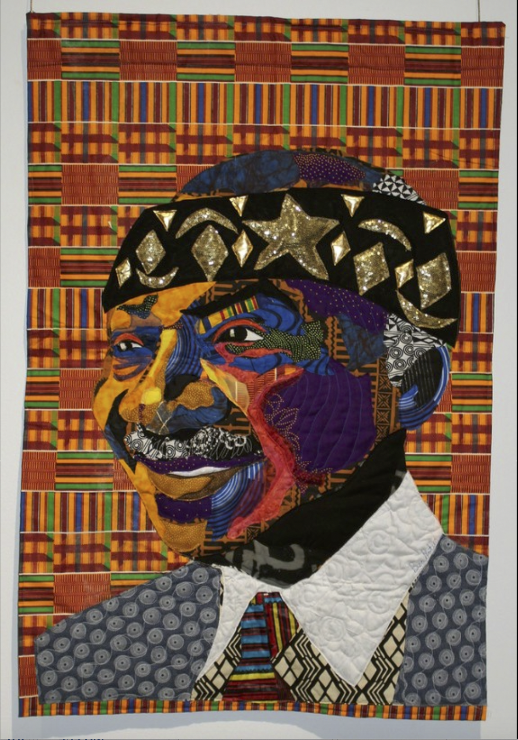
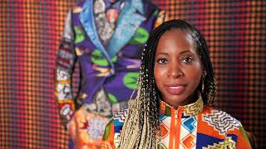
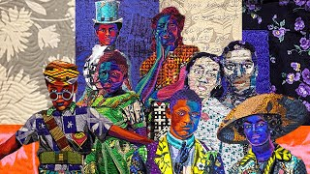
Joy: Artist Activist Bisa Butler
“This is a portrait of my father Dr. A. Zachary Yamba. He was born in Ghana in 1938 in the days when the country was still known as The Gold Coast. When he was a boy first registering for school the Catholic missionaries made all the little African children choose western names. From that day on my father was known as Zachary Yamba, not Zakani Yamba. He is royalty to me as all Fathers are to their daughters. He was born in Ghana and came to the US on an academic scholarship. His roots are humble and as a boy he played soccer barefoot, and with a tennis ball. He worked very hard and became the president of a community college for 30 years. Now he is retired and is one of the biggest influences on my life. I have him here with his Kente cloth behind him and woven through him. On his head is the crown of a Ghanian King.” -Bisa Butler
Bisa Butler: Quilting for Culture
REVIEW: Bisa Butler-Portraits
Notes:
Joy: How will my instruction advance students’ happiness through the use of beautiful and truthful images, representations, and narratives about themselves and/or others? This portion can be included during the lesson or at a separate time depending on time availability.
Key understandings of this section:

