Slide 1
African American History 400+ years of Resistance, Resilience, Power, and Pride
Today you will become smarter in learning how African American Ancestors were stolen by European enslavers and brought to what is now the United States.
Notes:
Introduction:
In this slide deck, we are building upon the information presented in the introduction slides. Students will first learn about the White Lion, a Dutch ship whose passengers kidnapped the families from from a Portuguese ship who had stolen families from Ndongo from their homes. The White Lion aimed for the United States with now enslaved Africans and landed in Port Comfort, an event that is recorded to have started enslavement in the colonies. The students will first view a 3-dimensional video of what a slave ship might have looked like to give context for when they listen to the poem, the White Lion, ready by author Claudia Rankine on the following slide. The slides after take the students through experiences of viewing images, watching videos and reading text in order to build background knowledge about the roots of enslavement in the history of the United States. They will also build foundational skills throughout the slides.
Joy is included at the end of every slide deck to celebrate the foundation of food, song, dance, etc, brought to the United States by Africans forced from their homes.
https://hampton.gov/3580/The-1619-Landing-Report-FAQs#:~:text=In%20late%20August%2C%201619%2C%2020,traded%20in%20exchange%20for%20supplies.
To prepare for this study, the students should be provided with a blank journal or journal pages in a folder, as they will be writing a full page at the end of each slide deck, possibly more. Also, the slide decks were originally designed to be completed in one class period, but I have found that it usually takes two to three class periods. If that is the same for you, you might have the students at least write a sentence or two at the end of each period so they remember what they learned throughout the study.

Slide 2
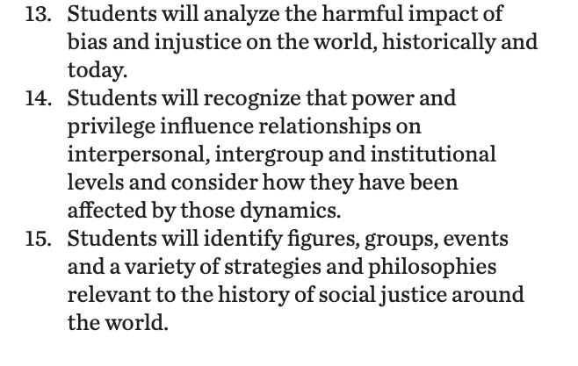
Standards/SJ Standards
Social Justice Standards
History Social Science Standards CA
Teaching Hard History Standards
Notes:
Standards:
Included here are the standards addressed throughout this study. They all in one place so as to keep the study focused on the goals written in the standards. We introduce one standard at a time, starting with the Teaching Hard History Standard, “In every place and time, enslaved people sought freedom”, as this is the main focus of the entire study.

Slide 3
A,E,I,O,U,1,2 Use this approach to help read words with multiple syllables.
Place an X under each A, E, I, O, U
Count the letters between the X’s
Split between:
(X and X) example: jo/vi/al
(X and 1) example: te/na/cious
(1 and 2) example: bal/lad
Do not separate blends or word groupings that need each other.
ous, qu, bi, cl, dr, pr, cial, tion
Descendent
Resignation
Ancestors
Transatlantic
Notes:
Word Work: On this slide, students are introduced to four multisyllabic words that they will encounter in the texts below. The strategy is to first place an X under each vowel. Then the students will split the word into syllables and then they blend the syllables to put the word together.
If your students are familiar with syllable types, here is another strategy you can teach your students to decode multisyllabic words.
After decoding the words, you can use the GLAD strategy of Cognitive Content Dictionary (background information linked). These words are key to understanding the text on these slides.

Slide 4
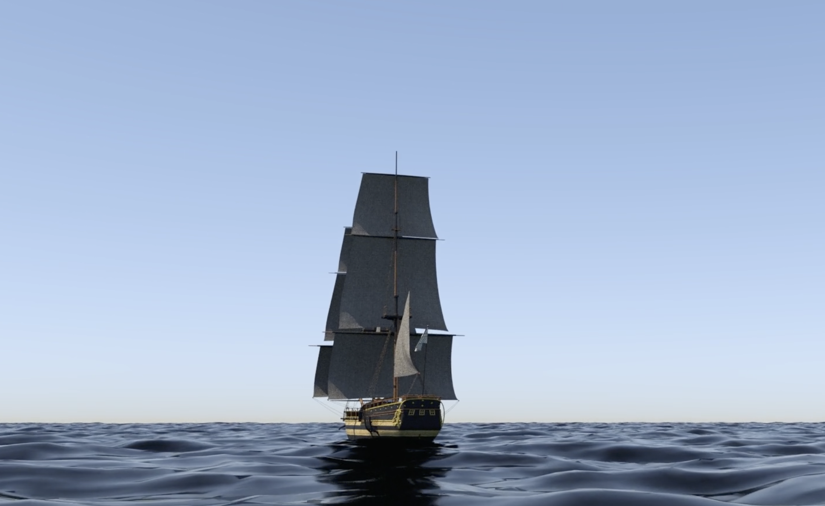
Trans-Atlantic Slave Trade 3-D Video
Notes:
Building background through media
Students will build background knowledge, vocabulary, and build towards a deep understanding of the concept through images and/or multi/media presentations and discussion.Students engage in discussion/turn and talks/ and/or whole class discussion. An optional scaffold to add to the class discussion after viewing is writing important discussion points on a white board or chart paper in order to assist students in their journal writing later.
Key understandings for this background media:
Although this is not a video of the White Lion, it will give students context the inside of a slave ship and a deeper understanding about what it was like to have been forced to go across the Atlantic Ocean on the ship. The intention will be to show the students prior to listening to the White Lion. The video is not directly linked on the slides because it is not on youtube, but can be accessed from the title or the link below. It will help to have that preloaded prior to showing students.
https://www.slavevoyages.org/voyage/ship#3dmodel/0/en/

Slide 5
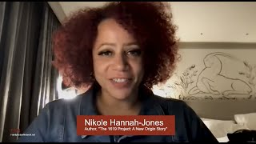
Even dawn begins before its beginning
And still, in the tale of the beginning
That forestalls an end, let’s agree-
A long way from the Kingdom of Ndongo,
Two English ships pirate a third,
The Portuguese Sao Joao Bautista,
And split up its human cargo. The first
Vessel to land at Point Comfort
On the James River enters history,
And thus history enters Virginia
As twenty and odd Negros
Are off loaded from the White Lion,
The man-of war carrying movables,
Blacks stripped to Christian names.
The White Lion, carrying
A man-made fate, makes landfall,
While Virginia, beginning
Its system of land grants, whitens
White indentured servants
By bestowing on them property,
Whitens whites who, through
The act of trading victuals
For the stolen renamed unfree
Transatlantic labor (their griefs
Transient, in reason much inferior),
Are inaugurated master as if
The White Lion
Claudia Rankine
Any Black would, as if
Anyone could, surrender
Their value, human,
To tobacco, sugar, and cotton,
The yield of Powhatan lands;
While Virginia writes itself colonial,
Filing its first property
Ledger with twenty and odd
Of the uprooted twelve million,
Including Anthony and Isabella,
Who, out of the White Lion’s hold,
Step into the whole of history
To give birth to the first child
To take the first steps, provisionally,
Toward African American
In Virginia-William, so called,
Born free, they say, though
All the while Virginia’s wiles
Still sail across centuries,
Leaving a wake with each
Recurring swell, drowning out
What Anthony and Isabella said
To William about love, in love,
In Kimbundu or Kikongo, as if
We could stop knowing
How to know what we know.
Notes:
Building Background through text
We will be building more background/knowledge using text to build on the slidedeck topic. Students will have printed copies of these slides. Complete a close read of the information spending time for students to highlight their copies and annotate. Another option is having students complete a close read in small groups or partners first and then bringing class together to read through discussing important information. This is also a good time to have students ask any questions about the text.
Key understandings of this text:
On this slide, the students listen to the White Lion read by Claudia Rankine, the author of the poem. Depending on how much time you’d like to spend on the poem, there is an optional, additional piece added below that is specific support for English Language Learners, but can help any student understand the text. Also, if you’d like the students to have a copy of the text, I have that linked as well. The two slides following this one are images that connect to the text to give more background knowledge.
If you decide to do a narrative input chart, I have linked a video to watch as an example of how it works. Feel free to modify to fit the needs of your students. Linked here is the text along with images you can include in your chart for the students.

Slide 6
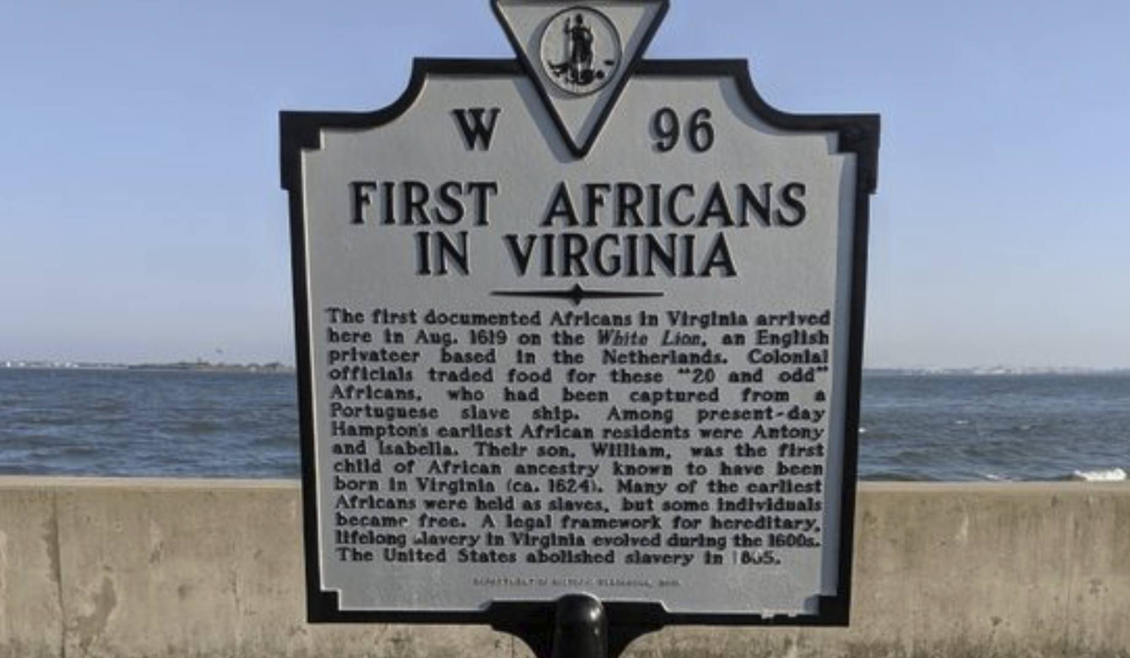
Notes:
Building Background through text
We will be building more background/knowledge using text to build on the slidedeck topic. Students will have printed copies of these slides. Complete a close read of the information spending time for students to highlight their copies and annotate. Another option is having students complete a close read in small groups or partners first and then bringing class together to read through discussing important information. This is also a good time to have students ask any questions about the text.
Key understandings of this text:
This is an image that is still in Virginia, marking the first documented enslaved Africans to reach the colonies.

Slide 7
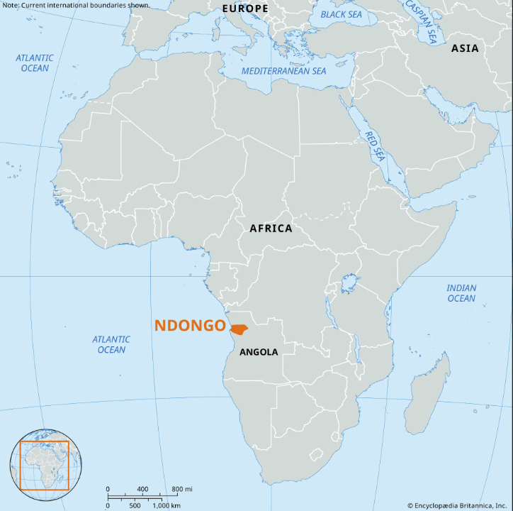
Kingdom of Ndongo
Notes:
This slide is to provide a connection to Ndongo…
Rankine does not mention the queen in her poem….should I take this slide out? I liked this and so did my students it was a great example of a woman and resistance!!

Slide 8
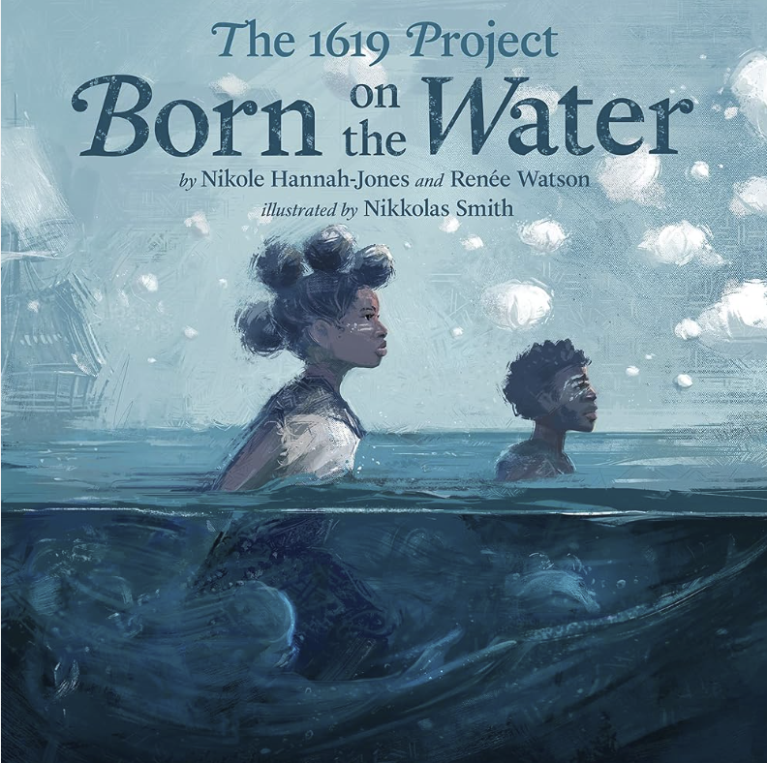
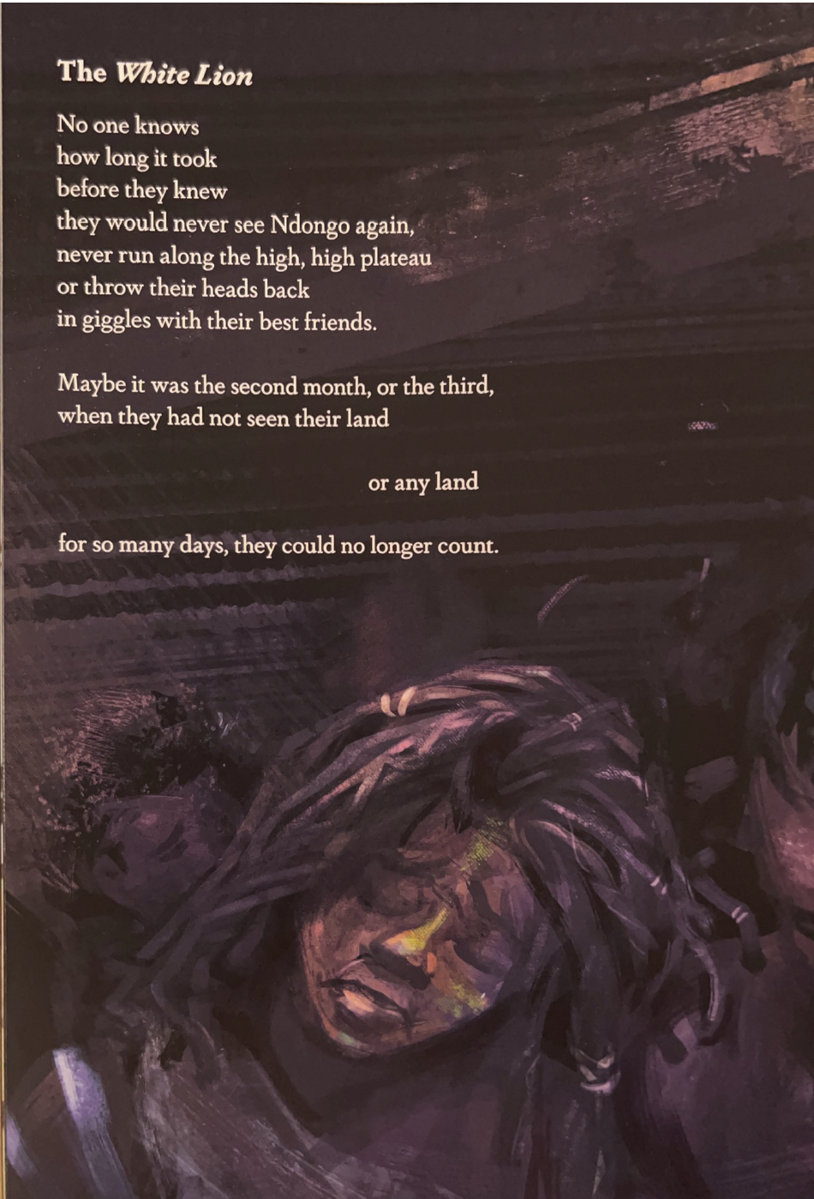
Notes:
Building Background through text
We will be building more background/knowledge using text to build on the slidedeck topic. Students will have printed copies of these slides. Complete a close read of the information spending time for students to highlight their copies and annotate. Another option is having students complete a close read in small groups or partners first and then bringing class together to read through discussing important information. This is also a good time to have students ask any questions about the text.
Key understandings of this text:
To connect back to the anchor text for this section, Born on the Water, the students can either listen or read the section of the White Lion from the book. It will be important in this section to have students discuss the emotions represented through the text as well as making connections to Claudia Rankine’s poem.

Slide 9
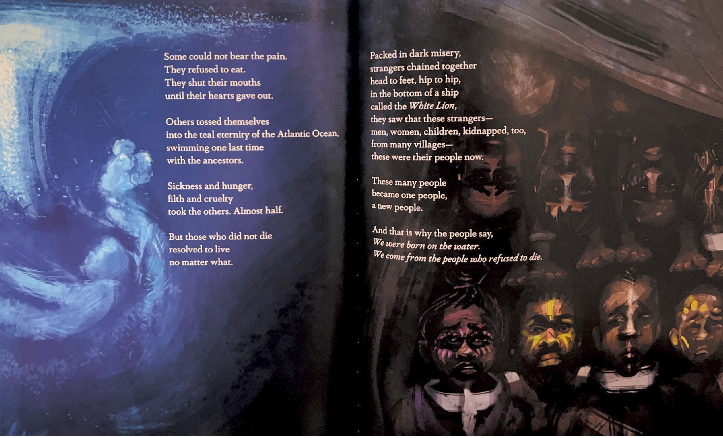
Notes:
Building Background through text
We will be building more background/knowledge using text to build on the slidedeck topic. Students will have printed copies of these slides. Complete a close read of the information spending time for students to highlight their copies and annotate. Another option is having students complete a close read in small groups or partners first and then bringing class together to read through discussing important information. This is also a good time to have students ask any questions about the text.
Key understandings of this text:
It will be important in this section to highlight how resistance to enslavement was immediate for some/many Africans. These examples are ways that some Africans resisted on the ships. Some refused to eat, others jumped into the ocean and for some it was the work it took to stay alive.

Slide 10
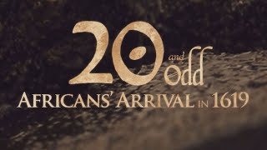
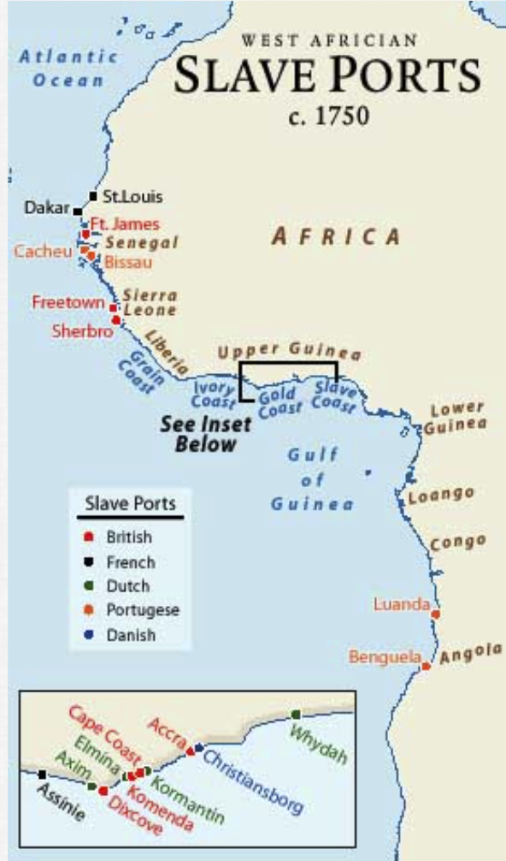
20 and Odd: Africans’ Arrival in 1619
Notes:
In this section, show up to minute 10:55 of the video.
Building background through media
Students will build background knowledge, vocabulary, and build towards a deep understanding of the concept through images and/or multi/media presentations and discussion.Students engage in discussion/turn and talks/ and/or whole class discussion. An optional scaffold to add to the class discussion after viewing is writing important discussion points on a white board or chart paper in order to assist students in their journal writing later.
Key understandings for this background media:
In this documentary, created by the William Tucker Foundation, there is a connection to Rankine’s poem:
“Filing its first property
Ledger with twenty and odd
Of the uprooted twelve million,
Including Anthony and Isabella,
Who, out of the White Lion’s hold,
Step into the whole of history
To give birth to the first child”
This video connects this history to today through ancestry and the importance of learning about and knowing our past.

Slide 11
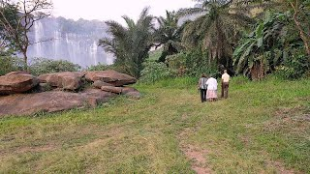
Beauty and Sorrow: Virginia family retraces steps of enslaved Angolan Ancestors
Notes:
Building background through media
Students will build background knowledge, vocabulary, and build towards a deep understanding of the concept through images and/or multi/media presentations and discussion.Students engage in discussion/turn and talks/ and/or whole class discussion. An optional scaffold to add to the class discussion after viewing is writing important discussion points on a white board or chart paper in order to assist students in their journal writing later.
Key understandings for this background media:
This is a short video that follows up to the previous documentary of a family retracing the steps of their ancestors from Angola.

Slide 12
Notes:
Building Background through text
We will be building more background/knowledge using text to build on the slidedeck topic. Students will have printed copies of these slides. Complete a close read of the information spending time for students to highlight their copies and annotate. Another option is having students complete a close read in small groups or partners first and then bringing class together to read through discussing important information. This is also a good time to have students ask any questions about the text.
Key understandings of this text:
Connecting back to the anchor text, Born on the Water, Nikole Hannah-Jones tells the story of Anthony and Isabella, names students will have heard multiple times in this slide deck. It is important to share names of people to bring this history to life and to build understanding that the people stolen from their land had names, had lives, had dreams before being forced onto the ships.

Slide 13
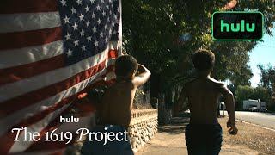
Notes:
This was moved to the intro deck

Slide 14
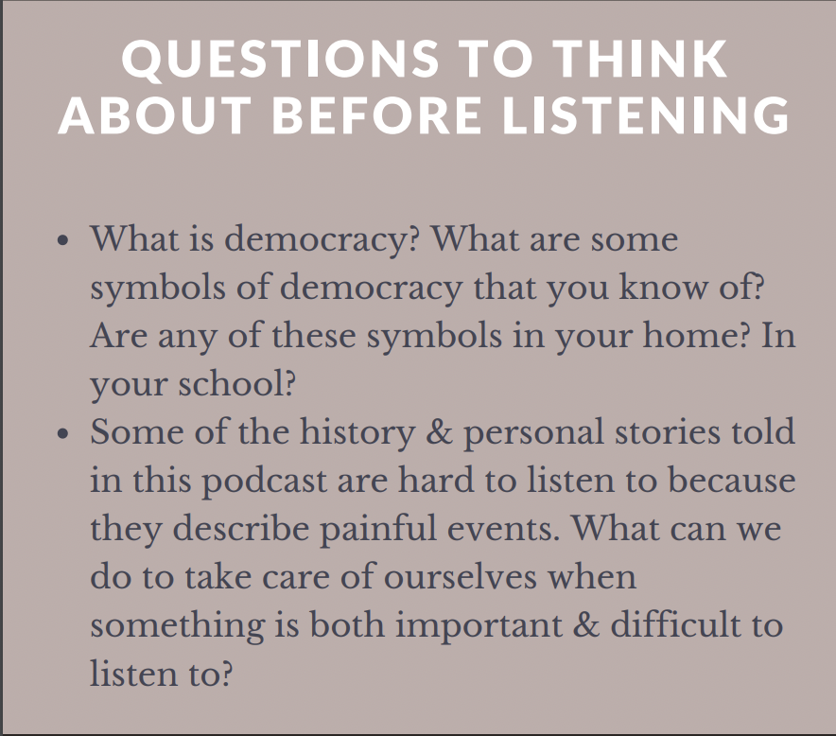
1619 Podcast
Notes:
On the next two slides, the students will listen to and read a section from the first podcast from the 1619 Project: The Fight for a True Democracy. Prior to reading …..
Wondering if this slide is necessary since what we read is so short, or if it should maybe be moved to the beginning of the slide deck?

Slide 15
1. 1619 Podcast: The Fight for a True Democracy
In 1776, the nation was founded on the ideal of democracy. In 1619, when enslaved Africans first arrived in what would become the United States, black people began the fight to make that ideal a reality. Released on Aug. 23, 2019.
Nikole Hannah-Jones
They say our people were born on the water.
When it occurred, no one can say for certain. Perhaps it was in the second week, or the third, but surely by the fourth, when they had not seen their land or any land for so many days that they lost count. It was after the fear had turned to despair and the despair to resignation and the resignation gave way, finally, to resolve.
They knew then that they would not hug their grandmothers again, or share a laugh with a cousin during his nuptials, or sing their baby softly to sleep with the same lullabies that their mothers had once sung to them.
The teal eternity of the Atlantic Ocean had severed them so completely that it was as if nothing had ever existed before, that everything they ever knew had simply vanished from the earth.
Notes:
Click on the picture of 1619 to link to the podcast- listen to the first 5 minutes.
Building Background through text
We will be building more background/knowledge using text to build on the slidedeck topic. Students will have printed copies of these slides. Complete a close read of the information spending time for students to highlight their copies and annotate. Another option is having students complete a close read in small groups or partners first and then bringing class together to read through discussing important information. This is also a good time to have students ask any questions about the text.
Key understandings of this text:
Transcript is linked.
In this section, the students can read and listen to the author, Nikole Hannah-Jones, share about what happened in 1619. They can listen longer or read more, but for this section, I’ve only included the first five minutes.

Slide 16
Some could not bear the realization. They heaved themselves over the walls of wooden ships to swim one last time with their ancestors.
Others refused to eat, mouths clamped shut until their hearts gave out.
But in the suffocating hull of a ship called the White Lion, bound for where they did not know, those who refused to die understood that the men and women chained next to them in the dark were no longer strangers. They had been forged in trauma. They had been made black by those who believed themselves to be white.
And where they were headed, black equaled ‘slave.’ So these were their people now.
Adizah Eghan
What happened here?
Nikole Hannah-Jones
I mean, we really don’t know a lot. A pirate ship by the name of White Lion sails into the bay here, and they needed to trade something of value so that they could get supplies to make the rest of their journey. And what they traded were 20 to 30 Africans, and this would be at this place kind of ironically called Point Comfort, where slavery in the British North American colonies that would go on to become the United States begins.
Notes:
Building Background through text
We will be building more background/knowledge using text to build on the slidedeck topic. Students will have printed copies of these slides. Complete a close read of the information spending time for students to highlight their copies and annotate. Another option is having students complete a close read in small groups or partners first and then bringing class together to read through discussing important information. This is also a good time to have students ask any questions about the text.
Key understandings of this text:
This is the next part of the text for students to listen to/read.

Slide 17
Cloze Passage for Comprehension
weakened, broken, rise, history
You may write me down in _______ With your bitter, twisted lies, You may trod me in the very dirt But still, like dust, I’ll _______.
Does my sassiness upset you? Why are you beset with gloom? ’Cause I walk like I’ve got oil wells Pumping in my living room. Just like moons and like suns, With the certainty of tides, Just like hopes springing high, Still I’ll rise.
Did you want to see me _________? Bowed head and lowered eyes? Shoulders falling down like teardrops, __________ by my soulful cries?
Does my haughtiness offend you? Don’t you take it awful hard ’Cause I laugh like I’ve got gold mines Diggin’ in my own backyard.
Notes:
Cloze Passage: In this section, students read a text from the previous slide deck- in this case it is from the poem, Still I Rise. I have not taken out many words to create the cloze passage, but since this is their first experience with it in this unit, they can use this as an introduction to the idea. This can be done with the whole class or small group, up to you, but the idea will be that the students identify the missing word, in this case it is Rise.
After identifying the word, discussing the importance of the words, Still I Rise, will be the next step. It could be a reminder for them from the previous text, but multiple exposures will support their understanding.
Here is an article about using cloze passages and about fluency, which is the work on slide 19, if you’d like to read more.

Slide 18
Discussion Questions
What is ironic about the name Point Comfort? Does the irony remind you of any other historical names or landmarks?
What is the significance of the title, Born on the Water?
How did Africans resist enslavement from their kidnappers from the beginning? (want to reword this question)
Notes:
Class Discussion:
In this section, students discuss what they have learned in a whole group discussion. Use these questions as a guideline to the discussion, but also feel free to follow what the students have gleaned from the learning so far in this slide deck. This discussion will support them in the writing section, where each student will be expected to write a page about what they learned. This will be very helpful for them to make connections, ask questions and build an understanding of the content.

Slide 19
Fluency Practice Practice reading the text below with a partner. The goal is to read the text with 100% accuracy. The words in red are from the A, E, I, O, U, 1, 2 List.
Legacy from Born on the Water
And the people who were born on the water survived.
Kept living and living.
It was illegal to teach enslaved people how to read,
But they birthed generations of
Teachers and librarians,
Scholars and authors.
They were brokenhearted, beaten and bruised,
But they became healers,
Pastors and activists,
Doctors and counselors.
No one could steal the people’s joy.
They wrote songs,
Created jazz hip-hop,
Rhythm and blues.
They became
Inventors and athletes,
Nurses and cooks,
Pilots and architects,
Farmers and housekeepers,
Singers and artists,
Dancers and poets,
Mathematicians and scientists.
They passed on their stories
Through the stitch of a quilt,
Shared secret messages through songs.
The people survived.
The people fought.
Notes:
Fluency Practice:
Each day, students should be working on fluency. They can either pair up with a partner, or practice by themselves in this first reading. The ultimate goal would be that they have a fluency partner, each reading to the other for one minute. I have the first reader identify themself and place their finger on the first word, and the listener do the same, but be ready to listen. After one minute, I tell them to stop and switch roles.
If you print this text for them, the only change would be that the listener has a pencil ready to make the text with words missed from the reader. That is not to highlight mistakes, but to support one another in building towards fluency.

Slide 20
Writing Tips Use the following tips to complete your writing using the texts and the videos. Remember to include what you learned about the topic. Also, share your thinking about what you learned.
Using the texts and videos, write what you learned about the experiences of the first enslaved people who were stolen from their homes and forced to board ships from European enslavers.
Write what you learned about (topic) from the examples, the reading and the videos.
Write what you will do with what you have learned.
What thoughts or questions do you have after today’s lesson?
Writing Structure- summary sentences
Notes:
Writing:
Each student should be prepared to write an entire page about what they learned today. You can either provide a blank journal or print and copy journal pages for them. The expectation is that they fill a page, and though they might struggle initially, they will get used to the format.
Possible scaffold for writing-To help emergent bilingual students you may pull a small group and give a paragraph frame or complete a guided writing.
For students who need more support, some sentence starters could be:
Today I learned about…
One thing I connected with was …
This helped me understand ….

Slide 21
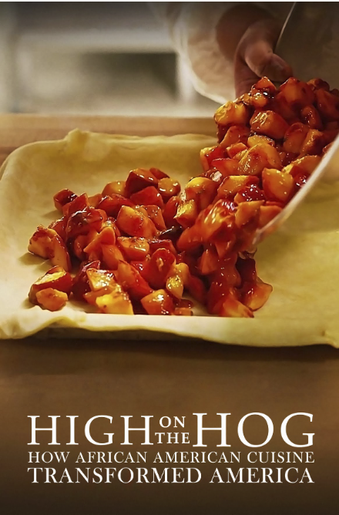
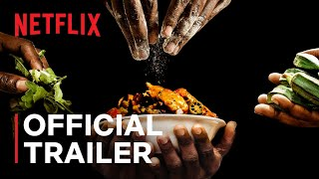
JOY! African Cuisine
Notes:
Joy: How will my instruction advance students’ happiness through the use of beautiful and truthful images, representations, and narratives about themselves and/or others? This portion can be included during the lesson or at a separate time depending on time availability.
Key Understandings:
So many of the foods we eat today came to us from Africans who were forced to come to the United States. High on the Hog is a documentary/show on Netflix that celebrates the roots of this food. The trailer gives an idea of the series, as Stephen Satterfield travels first to Benin to talk with people about the food they make and the ingredients they use. It is a fantastic series
About the first episode:
“The hunt for African American food's roots goes to Benin, where okra and yam rule the market and pre-enslavement fish and corn plates reign at the table.”

Slide 22
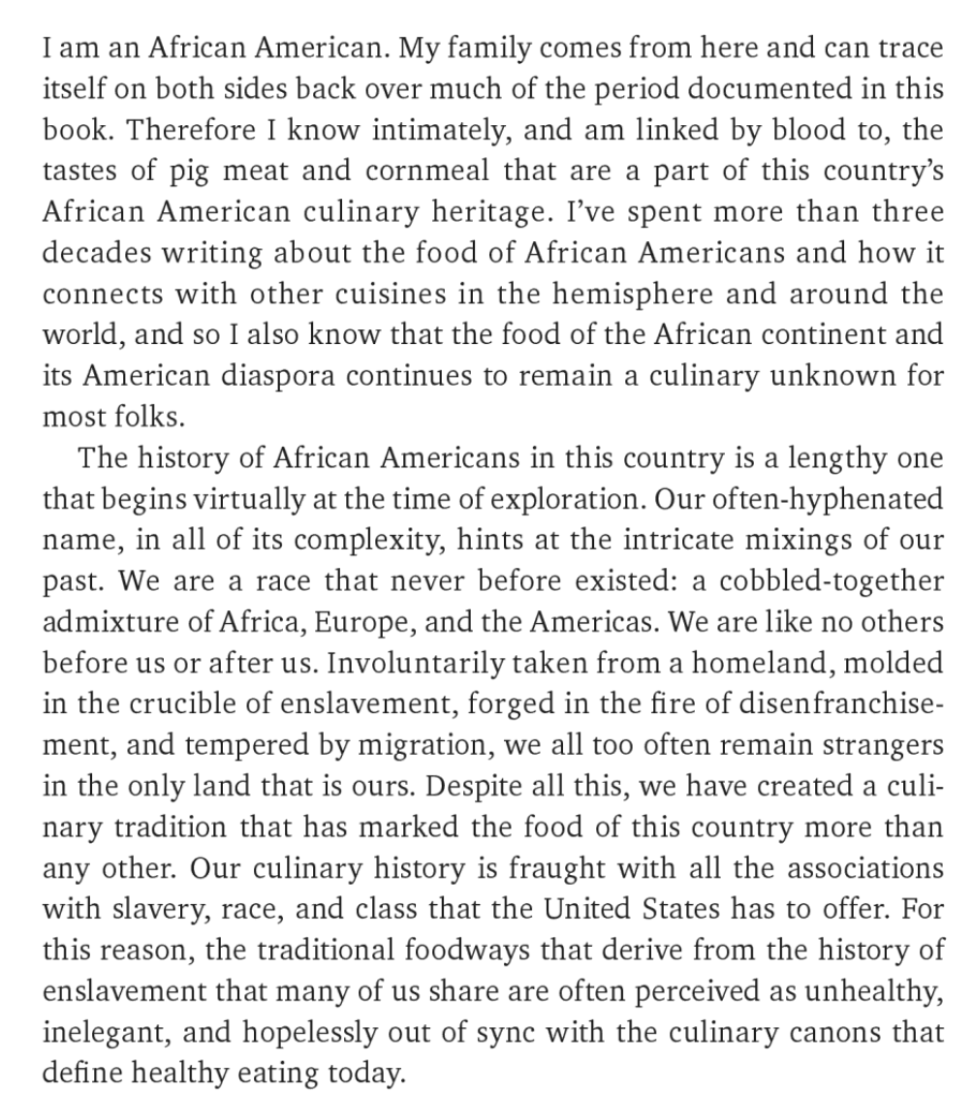
Notes:
Joy: How will my instruction advance students’ happiness through the use of beautiful and truthful images, representations, and narratives about themselves and/or others? This portion can be included during the lesson or at a separate time depending on time availability.
Key Understandings:
This is an excerpt from the book High on the Hog (linked here) by Jessica B. Harris. On this link, you can access a preview of the text.

Slide 23
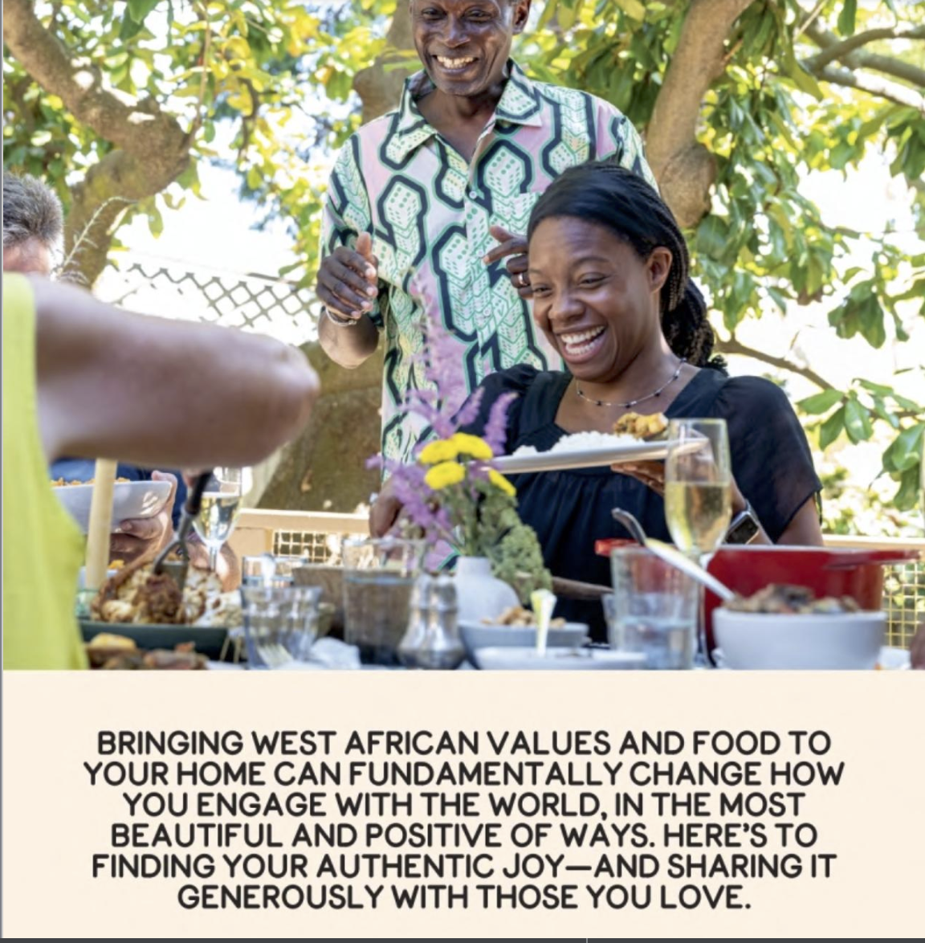
Simply West African
by Pierre Thiam and Lisa Katayama
Notes:
Joy: How will my instruction advance students’ happiness through the use of beautiful and truthful images, representations, and narratives about themselves and/or others? This portion can be included during the lesson or at a separate time depending on time availability.
Key Understandings:
This is another book where the author’s intention is to share the joy in learning about where so much of our food in the United States comes from. The title has a link to a preview of the text again and the introduction is worth a read. The students can either access it individually or you could read it as a group.
Interview with the Author: Pierre Thiam
Slave trade: How African foods influenced modern American cuisine

