Slide 1
African American History 400+ years of Resistance, Resilience, Power, and Pride
Today you will become smarter
about the history of African Americans and the 1619 Project.
Notes:
Introduction:
In this slide deck, students will be introduced to the 1619 project and the history of enslavement in the United States through the lens of resistance, resilience, power and pride. It will be very important to continuously come back to the idea of resistance; that in every time and place, enslave people sought freedom, as stated in the Teaching Hard History standards.
This slide deck is to provide background and build a foundation for the learning that will take place throughout this study. The slides take the students through experiences of viewing images, watching videos and reading text in order to build background knowledge. They will also build foundational skills throughout the slides while learning the content.
Joy is included at the end of every slide deck to celebrate the foundation of food, song, dance, etc, brought to the United States by Africans forced from their homes.
To prepare for this study, the students should be provided with a blank journal or journal pages in a folder, as they will be writing a full page at the end of each slide deck, possibly more. Also, the slide decks were originally designed to be completed in one class period, but I have found that it usually takes two to three class periods. If that is the same for you, you might have the students at least write a sentence or two at the end of each period so they remember what they learned throughout the study.

Slide 2
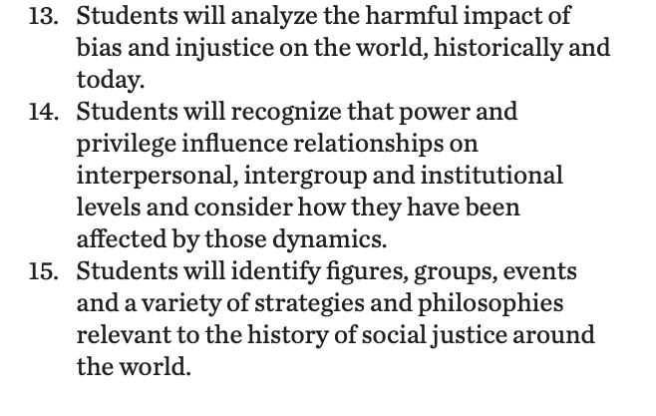
Standards/SJ Standards
Social Justice Standards
History Social Science Standards CA
Teaching Hard History Standards
Notes:
Standards:
Included here are the standards addressed throughout this study. They all in one place so as to keep the study focused on the goals written in the standards. We introduce one standard at a time, starting with the Teaching Hard History Standard, “In every place and time, enslaved people sought freedom”, as this is the main focus of the entire study.

Slide 3
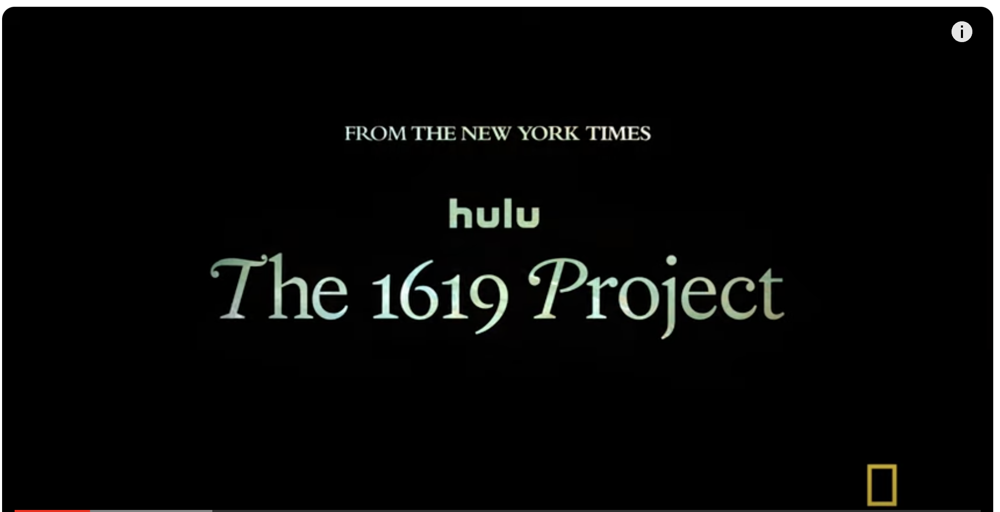
What is the 1619 Project?
The New York Times Articles
Notes:
Building background through media
Students will build background knowledge, vocabulary, and build towards a deep understanding of the concept through images and/or multimedia presentations and discussion.Students engage in discussion/turn and talks/ and/or whole class discussion. An optional scaffold to add to the class discussion after viewing is writing important discussion points on a white board or chart paper in order to assist students in their journal writing later.
Key understandings for this background media: What is the “1619 Project” and why is it important? In introducing it to your students it is important that they understand the importance of the project and that they will be participating in a study of their own related to this project.

Slide 4
How did the 1619 Project begin?
NIKOLE HANNAH-JONES
Notes:
Building Background through text
We will be building more background/knowledge using text to build on the slidedeck topic. Students will have printed copies of these slides. Complete a close read of the information spending time for students to highlight their copies and annotate. Another option is having students complete a close read in small groups or partners first and then bringing class together to read through discussing important information. This is also a good time to have students ask any questions about the text.
Key understandings of this text: Ask students to analyze this text in turn and talks. This talks of confronting truth and students should be evaluating why these truths are important.

Slide 5
Notes:
Building Background through text
We will be building more background/knowledge using text to build on the slidedeck topic. Students will have printed copies of these slides. Complete a close read of the information spending time for students to highlight their copies and annotate. Another option is having students complete a close read in small groups or partners first and then bringing class together to read through discussing important information. This is also a good time to have students ask any questions about the text.
Key understandings of this text: This text gives students more insight into Nikole’s role in the 1619 project and builds more background knowledge.

Slide 6
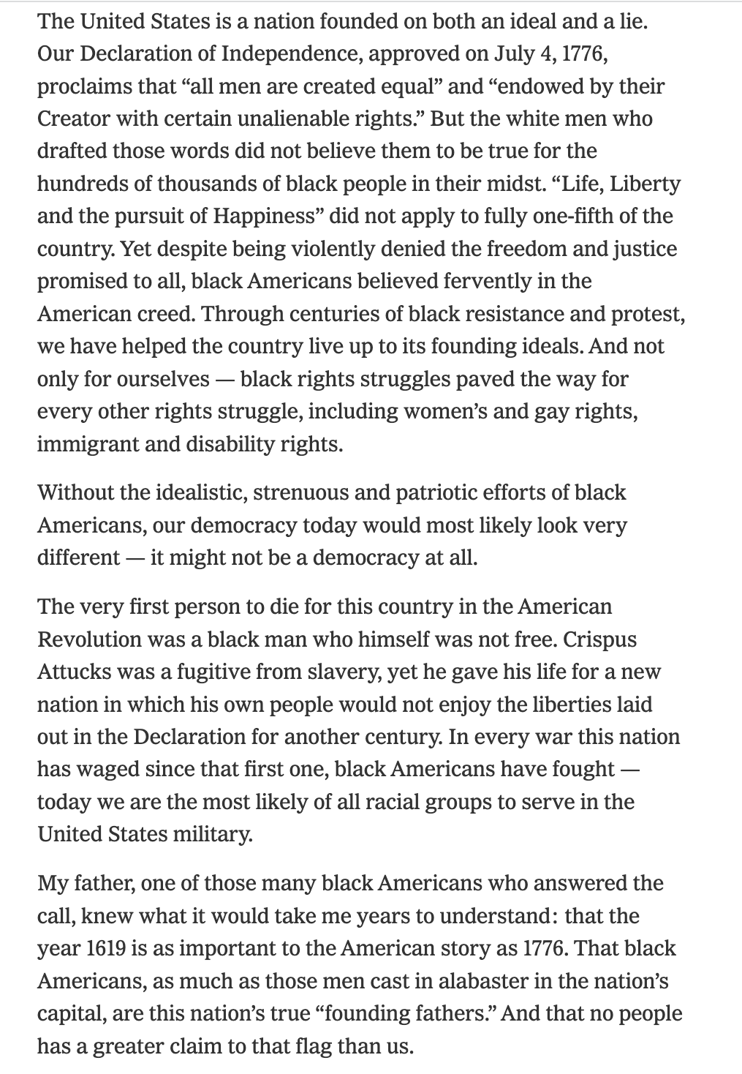
File:US Flag Backlit.jpg - Wikimedia Commons
VisitFile:US Flag Backlit.jpg - Wikimedia Commons
Visit
Get this image on: Wikimedia Commons | License details
Creator: Photographer: Joshua Nathanson
Copyright: Copyright: 2009 Joshua Nathanson
Want to know where this information comes from? Learn more
Get this image on: Wikimedia Commons | License details
Creator: Photographer: Joshua Nathanson
Copyright: Copyright: 2009 Joshua Nathanson
Want to know where this information comes from? Learn more
What you think about when you see the American Flag? What does it make you think about in history? What kinds of people or images do you associate with the American Flag?
Notes:
Building Background through text
We will be building more background/knowledge using text to build on the slidedeck topic. Students will have printed copies of these slides. Complete a close read of the information spending time for students to highlight their copies and annotate. Another option is having students complete a close read in small groups or partners first and then bringing class together to read through discussing important information. This is also a good time to have students ask any questions about the text.
Key understandings of this text: Students should have a physical copy of these slides so they can analyze these readings collaboratively. The reading outlines the foundation of the 1619 project “Democracy.” Hannah discusses how her father always placed a flag at their house and served in the military. The underlying message being that African Americans have ALWAYS upheld democracy. “Without the idealistic, strenuous, and patriotic efforts of black Americans, our democracy would most likely look very different–it might not be a democracy at all.”

Slide 7
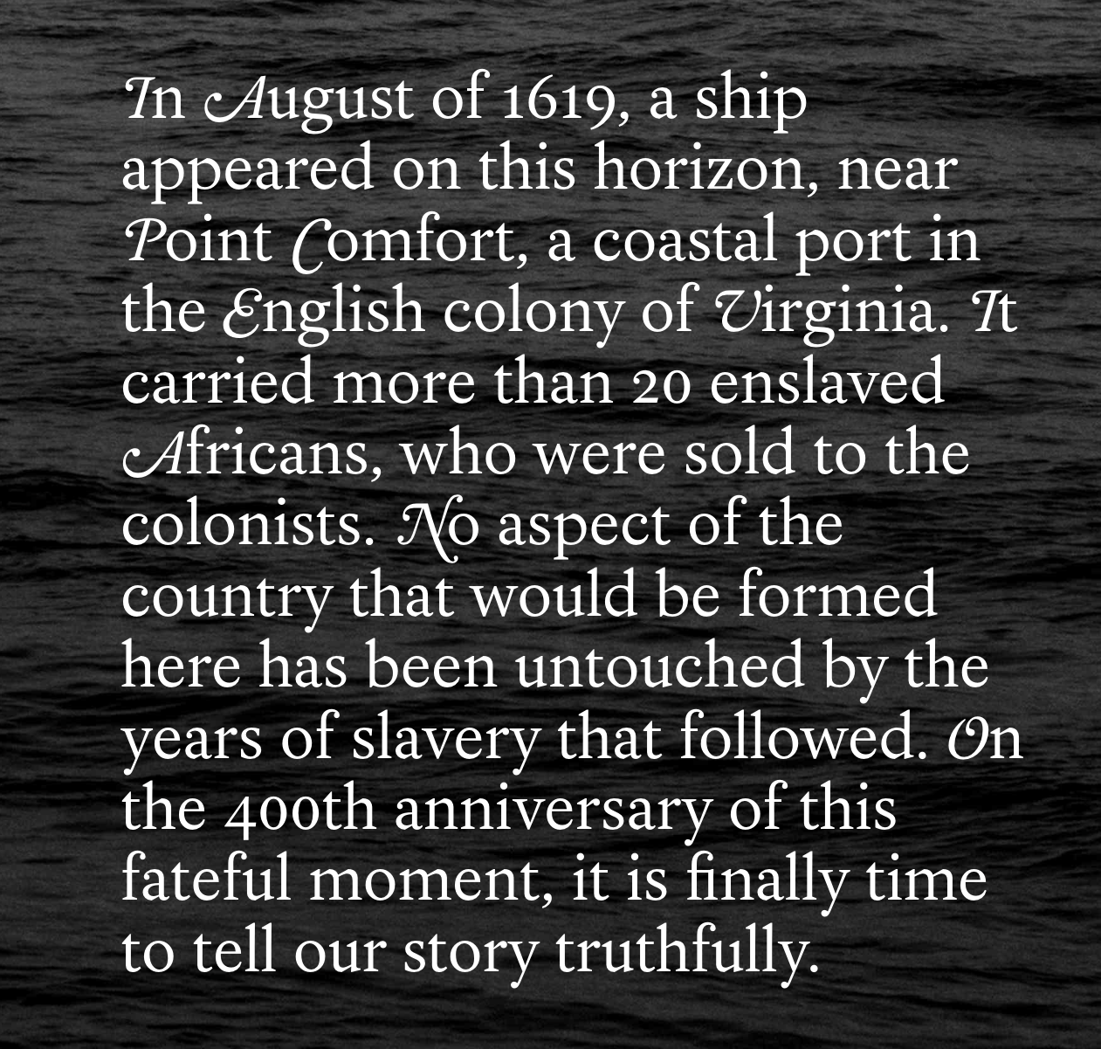
Notes:
Building Background through text
We will be building more background/knowledge using text to build on the slidedeck topic. Students will have printed copies of these slides. Complete a close read of the information spending time for students to highlight their copies and annotate. Another option is having students complete a close read in small groups or partners first and then bringing class together to read through discussing important information. This is also a good time to have students ask any questions about the text.
Key understandings of this text: This piece brings it all together and ties it to 1619 (Born on the Water). Students should again make the connection to 1619 and American history.

Slide 8
Born on the Water Read Aloud
Notes:
Building background through media
Students will build background knowledge, vocabulary, and build towards a deep understanding of the concept through images and/or multimedia presentations and discussion.Students engage in discussion/turn and talks/ and/or whole class discussion. An optional scaffold to add to the class discussion after viewing is writing important discussion points on a white board or chart paper in order to assist students in their journal writing later.
Key understandings for this background media: This will be the initial read through of the “anchor text” Born on the Water, you should have a class discussion about the book either during or after reading.

Slide 9
A,E,I,O,U,1,2 Use this approach to help read words with multiple syllables.
Place an X under each A, E, I, O, U
Count the letters between the X’s
Split between:
(X and X) example: jo/vi/al
(X and 1) example: te/na/cious
(1 and 2) example: bal/lad
Do not separate blends or word groupings that need each other.
ous, qu, bi, cl, dr, pr, cial, tion
Ancestor
haughtiness
democracy
wondrously
Notes:
Cognitive Content Dictionary Glad Strategy
On this slide, students are introduced to four multisyllabic words that they will encounter in the texts below. The strategy is to first place an X under each vowel. Then the students will split the word into syllables and then they blend the syllables to put the word together.
If your students are familiar with syllable types, here is another strategy you can teach your students to decode multisyllabic words.
After decoding the words, you can use the GLAD strategy of Cognitive Content Dictionary (background information linked). These words are key to understanding the text on these slides.

Slide 10
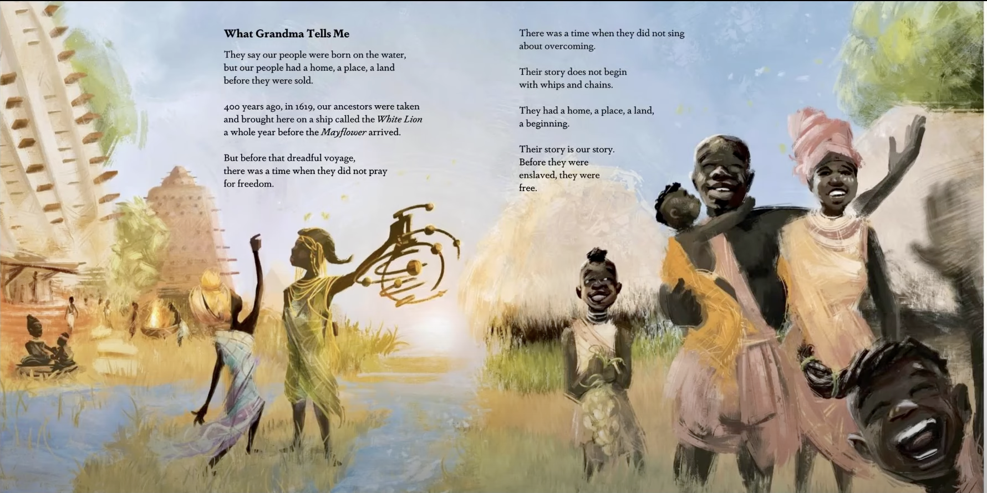
Notes:
Building Background through text
We will be building more background/knowledge using text to build on the slidedeck topic. Students will have printed copies of these slides. Complete a close read of the information spending time for students to highlight their copies and annotate. Another option is having students complete a close read in small groups or partners first and then bringing class together to read through discussing important information. This is also a good time to have students ask any questions about the text.
Key understandings of this text: Use this text as a means for class discussion about the rich culture and community that already existed in Ndongo before enslavement. It is also important that students understand that a consequence of enslavement was being grouped into a single group once they were enslaved rather than the unique cultures (language, traditions etc).

Slide 11
Notes:
Building Background through text
We will be building more background/knowledge using text to build on the slidedeck topic. Students will have printed copies of these slides. Complete a close read of the information spending time for students to highlight their copies and annotate. Another option is having students complete a close read in small groups or partners first and then bringing class together to read through discussing important information. This is also a good time to have students ask any questions about the text.
Key understandings of this text: How can survival and legacy be another form resistance? What other forms of resistance are described in the text?

Slide 12
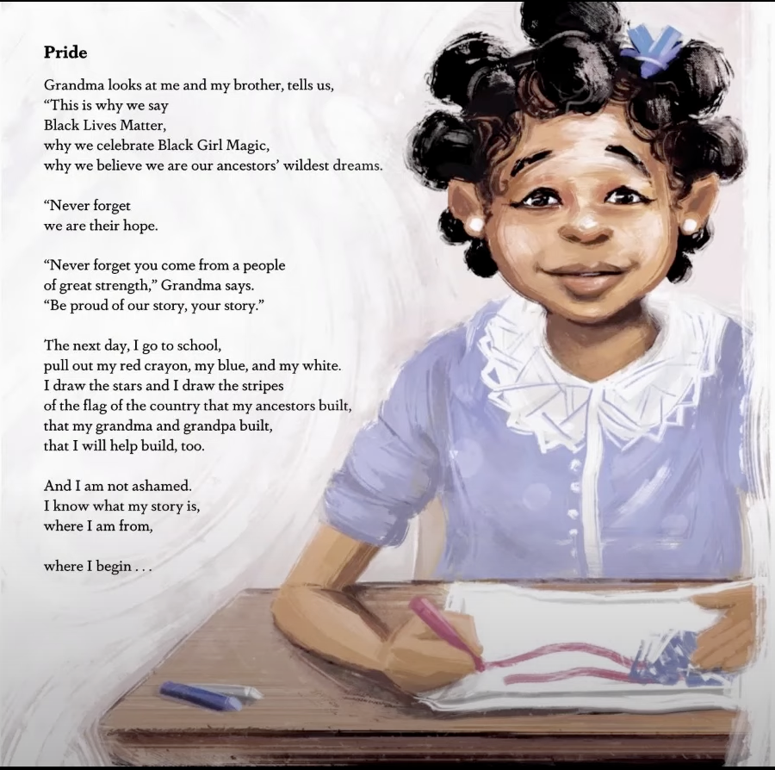
Notes:
Building Background through text
We will be building more background/knowledge using text to build on the slidedeck topic. Students will have printed copies of these slides. Complete a close read of the information spending time for students to highlight their copies and annotate. Another option is having students complete a close read in small groups or partners first and then bringing class together to read through discussing important information. This is also a good time to have students ask any questions about the text.
Key understandings of this text: Why is this work so important? Why is it important to know history?

Slide 13
Exploring 400 years of the African American Experience
4 minutes, 25 seconds
Developed by a group of NPS staff and interns, this film explores the trauma, resilience, and beauty of the African American experience in our country.
The title, “Twenty & Odd,” is taken from a quote from English colonist John Rolfe describing the number of the first enslaved Africans brought to Virginia in 1619. The creative team chose this title to reclaim power of Rolfe’s phrasing and instead celebrate all that Black and African American communities represent and contribute to our collective heritage, through the lens of national parks. The narrative for “Twenty & Odd” is Maya Angelou’s remarkable piece, “Still I Rise.” Through its voice and imagery, the film advances messages of African American empowerment, remembrance, education, inspiration, and engagement in iconic places stewarded by the National Park Service.
https://www.nps.gov/subjects/africanamericanheritage/twenty-and-odd.htm
Or
Notes:
Building Background through text
We will be building more background/knowledge using text to build on the slidedeck topic. Students will have printed copies of these slides. Complete a close read of the information spending time for students to highlight their copies and annotate. Another option is having students complete a close read in small groups or partners first and then bringing class together to read through discussing important information. This is also a good time to have students ask any questions about the text.
Key understandings of this text: In this slide I introduce Maya Angelou and explain briefly her work as a writer and activist. I tell students that we are going to analyze a poem of hers that is used to as an anthem narrative for the empowerment of African American history. Play the video in the link and have student follow along.

Slide 14
Still I Rise Maya Angelou 1928 –2014
You may write me down in history With your bitter, twisted lies, You may trod me in the very dirt But still, like dust, I’ll rise.
Does my sassiness upset you? Why are you beset with gloom? ’Cause I walk like I’ve got oil wells Pumping in my living room. Just like moons and like suns, With the certainty of tides, Just like hopes springing high, Still I’ll rise.
Did you want to see me broken? Bowed head and lowered eyes? Shoulders falling down like teardrops, Weakened by my soulful cries?
Does my haughtiness offend you? Don’t you take it awful hard ’Cause I laugh like I’ve got gold mines Diggin’ in my own backyard.
You may shoot me with your words, You may cut me with your eyes, You may kill me with your hatefulness, But still, like air, I’ll rise.
Does my sexiness upset you? Does it come as a surprise That I dance like I’ve got diamonds At the meeting of my thighs?
Out of the huts of history’s shame I rise Up from a past that’s rooted in pain I rise I’m a black ocean, leaping and wide, Welling and swelling I bear in the tide.
Leaving behind nights of terror and fear I rise Into a daybreak that’s wondrously clear I rise Bringing the gifts that my ancestors gave, I am the dream and the hope of the slave. I rise I rise I rise.
Notes:
Building Background through text
We will be building more background/knowledge using text to build on the slidedeck topic. Students will have printed copies of these slides. Complete a close read of the information spending time for students to highlight their copies and annotate. Another option is having students complete a close read in small groups or partners first and then bringing class together to read through discussing important information. This is also a good time to have students ask any questions about the text.
Key understandings of this text:Next, have students collaboratilevly pick out stanzas or lines that stick out to them and WHY. Connect this back to resistance.

Slide 15
Discussion Questions for Still I Rise
What is the title of the poem? What do you think "Still I Rise" might mean?
Who do you think is talking in the poem? What do you imagine this person might be feeling or experiencing?
Why do you think the poem repeats the line "I rise" so many times? How does that make you feel when you hear it?
If you were to draw a picture of what the poem is about, what would it look like?
Notes:
Class Discussion:
In this section, students discuss what they have learned in a whole group discussion. Use these questions as a guideline to the discussion, but also feel free to follow what the students have gleaned from the learning so far in this slide deck. This discussion will support them in the writing section, where each student will be expected to write a page about what they learned. This will be very helpful for them to make connections, ask questions and build an understanding of the content.

Slide 16
Reading for Fluency
Notes:
Fluency
Each day, students should be working on fluency(article linked to read more about fluency).
They can either pair up with a partner, or practice by themselves in this first reading. The ultimate goal would be that they have a fluency partner, each reading to the other for one minute. I have the first reader identify themself and place their finger on the first word, and the listener does the same, but be ready to listen. After one minute, I tell them to stop and switch roles.
If you print this text for them, the only change would be that the listener has a pencil ready to make the text with words missed from the reader. That is not to highlight mistakes, but to support one another in building towards fluency.

Slide 17
Writing Tips Use the following tips to complete your writing using the texts and the videos. Remember to include what you learned about the topic. Also, share your thinking about what you learned.
Using the texts and videos
Write what you learned about (topic) from the examples, the reading and the videos.
Write what you will do with what you have learned.
What thoughts or questions do you have after today’s lesson?
Sentence starters-
Today I learned about…
One thing I connected with was …
This helped me understand ….
An example of resistance was …..
Notes:
Writing
Each student should be prepared to write an entire page about what they learned today. You can either provide a blank journal or print and copy journal pages for them. The expectation is that they fill a page, and though they might struggle initially, they will get used to the format.
Possible scaffold for writing-To help emergent bilingual students you may pull a small group and give a paragraph frame or complete a guided writing.
For students who need more support, some sentence starters could be:
Today I learned about…
One thing I connected with was …
This helped me understand ….
An example of resistance was …..

Slide 18
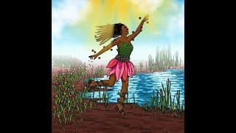
Visualizing Back Joy
Three Artists Explain and Visualize What Black Joy Means to Them
Notes:
Joy: How will my instruction advance students’ happiness through the use of beautiful and truthful images, representations, and narratives about themselves and/or others? This portion can be included during the lesson or at a separate time depending on time availability.
Key understandings of this section: Throughout this Unit of study each slide deck will end with a piece of black JOY. You can explain to students this important component to learning about history. You can engage in class discussion and have them respond in their journals using the same sentence frames as above.

