Slide 1
African American History 400+ years of Resistance, Resilience, Power, and Pride
Today you are going to become smarter about the history of Resistance, Revolt, and Abolition in the United States during the 1800s (Civil War Era).
Notes:
Introduction:
In this slide deck, students will be introduced to different forms of resistance and the role of abolitionism played during the civil era. Students will also learn about how the Fugitive Slave Act was used to combat resistance. It will be very important to continuously come back to the idea of resistance; that in every time and place, enslave people sought freedom, as stated in the Teaching Hard History standards.
This slide deck is to provide background and build a foundation for the learning that will take place throughout this study. The slides take the students through experiences of viewing images, watching videos and reading text in order to build background knowledge. They will also build foundational skills throughout the slides while learning the content.
Joy is included at the end of every slide deck to celebrate the foundation of food, song, dance, etc, brought to the United States by Africans forced from their homes.
To prepare for this study, the students should be provided with a blank journal or journal pages in a folder, as they will be writing a full page at the end of each slide deck, possibly more. Also, the slide decks were originally designed to be completed in one class period, but I have found that it usually takes two to three class periods. If that is the same for you, you might have the students at least write a sentence or two at the end of each period so they remember what they learned throughout the study.

Slide 2
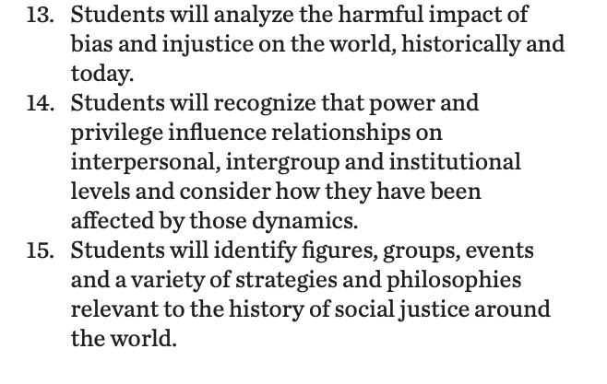
Standards/SJ Standards
Social Justice Standards
History Social Science Standards CA
Teaching Hard History Standards
Notes:
https://www.sutori.com/en/story/understanding-the-historical-perspective--iQg3yRgTSCBGx38JenGm73sK Teacher or Student Resource that connects to the anchor text. It is an optional resource to delve deeper into the the true story behind January’s Sparrow.

Slide 3
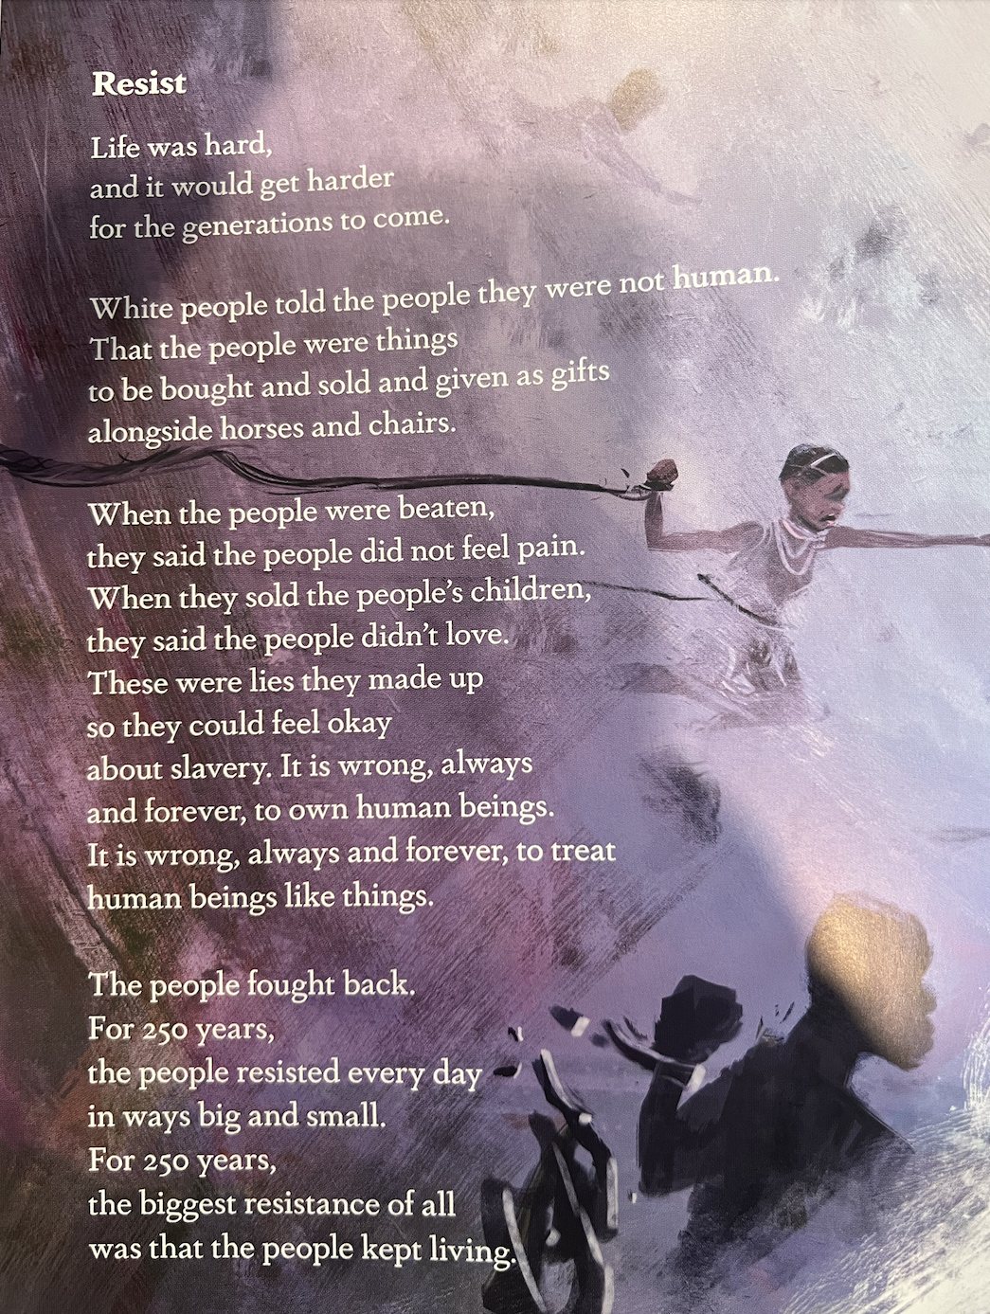
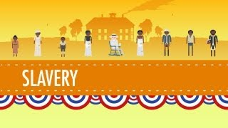
Resistance and Revolts
PBS Video about other ways of resistance
Notes:
Background for evaluating resistance and revolt for enslaved
Slides 3&4 We will begin by watching videos about forms of resistance from enslaved women and men. This will be paired with the “Resist” from Born on the water. Read this passage to students or have students echo/choral read it with you. Watch the video about Abolition (there is also a link for additional PBS video which you can choose to show or share a copy of the slides with students to view later). The focus will be on the methods of resistance and resilience. Every discussion and video will be viewed through this lens. You can tell students to keep track of the different methods of resistance so share after the videos. These could be written on the board after the videos as the students share. This will help students during their journal write later.

Slide 4
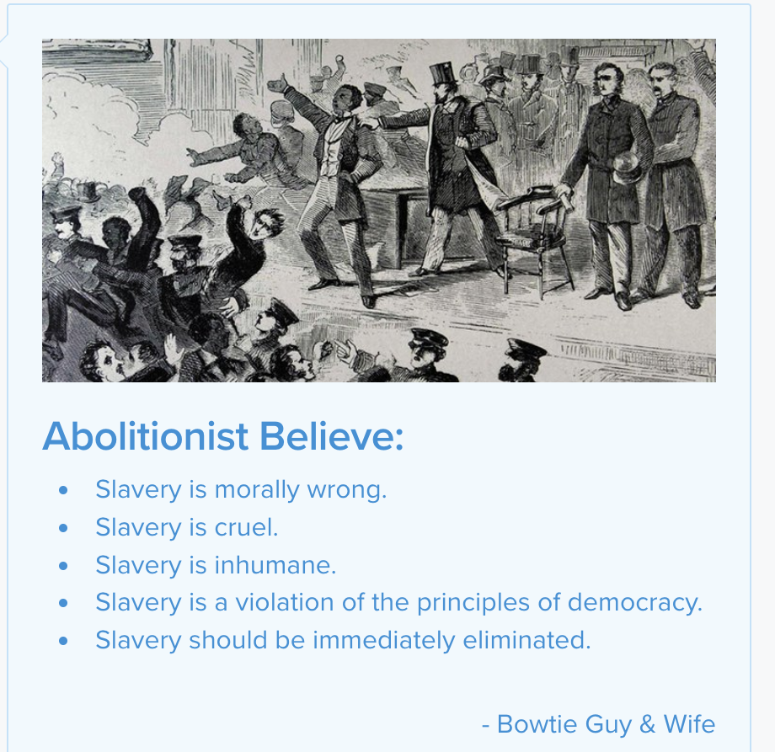
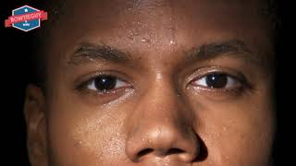
Abolitionist
Notes:
This is a more in depth view of who abolitionists were and what they did. This is meant to add another layer to the history of resistance. The idea that abolitionism rose against enslavement and included different kinds of key figures. In contrast to the horrors of enslavement were those who fought against it. Anyone can be an abolitionist, even students! You might ask if they believe they also believe the same things as abolitionists.

Slide 5
The 1619 Project text, Page 170
“When private property extends to human beings, however, a particularly strong and expansive set of protections is required. Human beings, after all, can run away and revolt. The founders recognized this, and in the Constitution they safe guarded the human property of those who owned enslaved people through a number of provisions. Article I, Section 8 granted Congress the power to summon the militia to “to suppress insurrections,” understood to mean the rebellions of the enslaved. Article I, Section 9 forbade Congress from ending the slave trade untill 1808. Article V, Section 2 prohibited free states from emancipating runaways: human property in the South would remain human property in the North. The framers helped create a doctrine of private property strong enough to justify and enforce human trafficking, so much so that abolitionists publicly burned copies of the Constitution. “
A New Origin Story; The 1619 Project
Notes:
Read an excerpt from the 1619 project, page 170, we will discuss how legislation on slavery/property was written into the fabric of our nation. The purpose of this passage is to analyze the way the enslaved men, women and children were written about into American Legislation. Being referred to as “Human Property” and that slavery was so ingrained in our framers writings that “Abolitionists often publicly burned copies of the Constitution.” Option-students get a printed copy to analyze in small groups first.

Slide 6
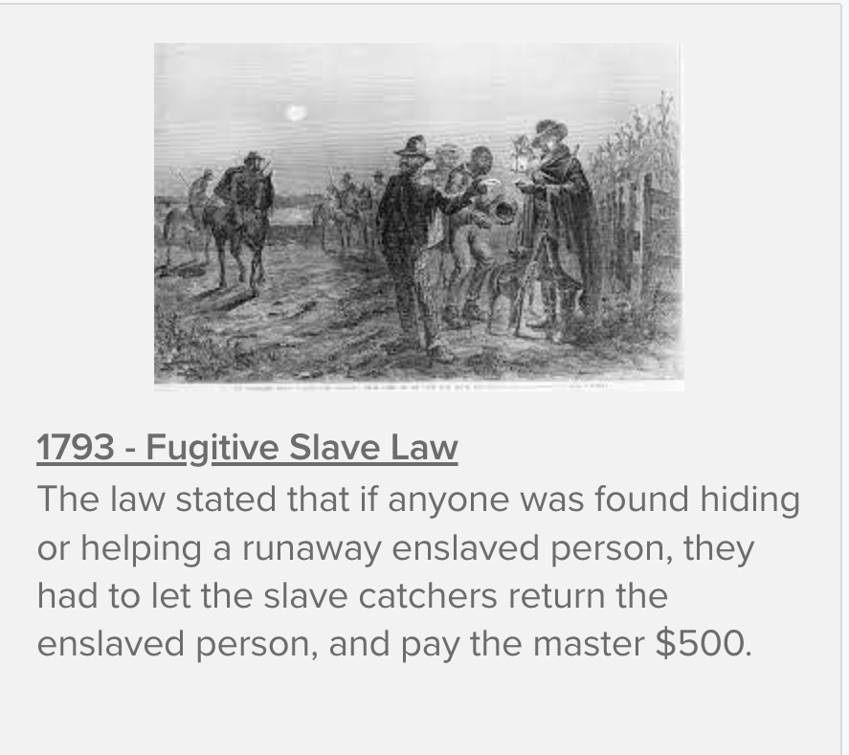
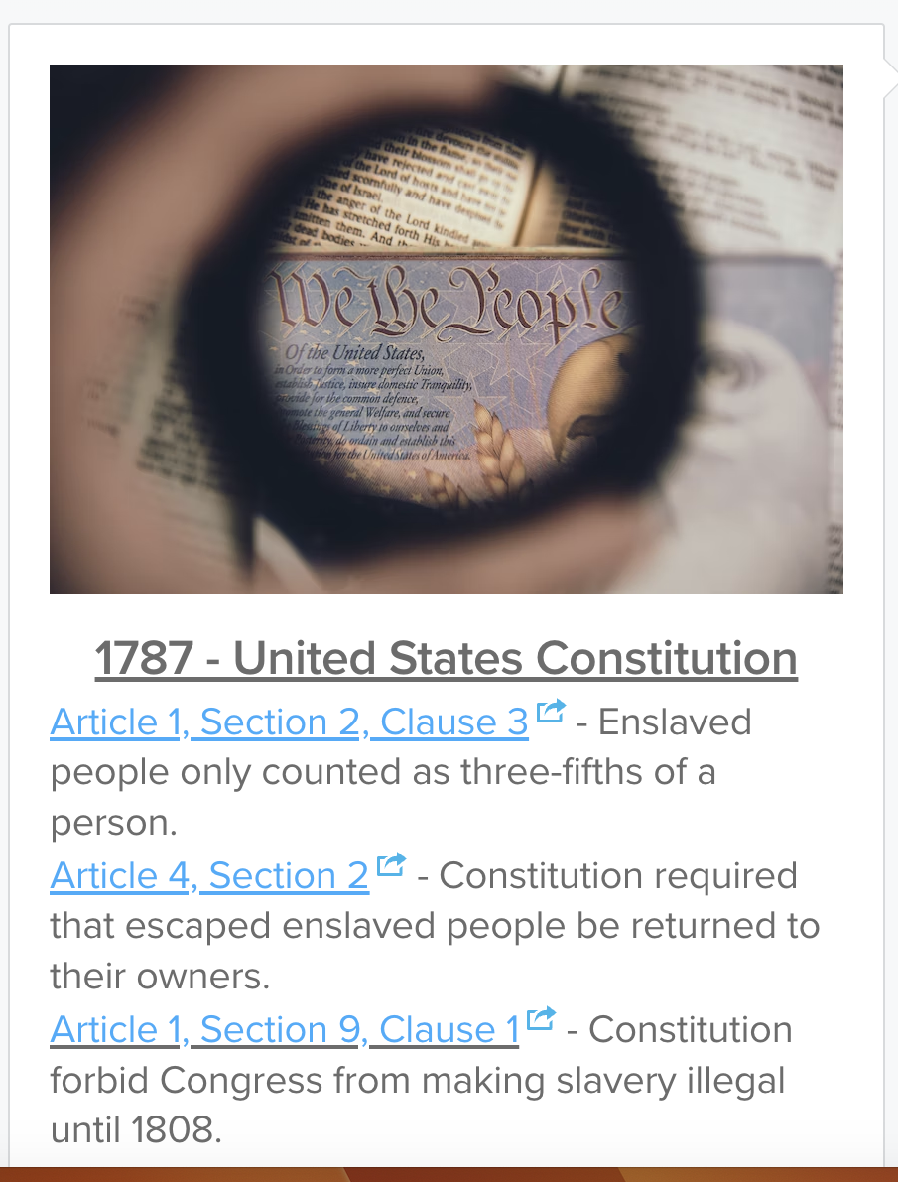
What did the laws look like during this time period? (before 1850)
Notes:
Slide 6 & 7 we will explore this further by watching a video about the Fugitive Slave Act. This act is important for students to understand. This shows how enslaved men, women and children were controlled, overpoliced and subject to being dehumanized by the very laws of our country. You could connect this to the anchor text read aloud, January’s Sparrow. In this text, (based on a true story) the family becomes victims of the Fugitive Slave Law. A town comes to the aid in an act of resistence but this is a perfect example of how the enslavers could take legal action against those who helped.

Slide 7
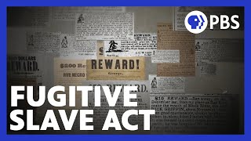
The Fugitive Slave Act
Additional PBS video
Notes:
Continue this learning on the Fugitive Slave Act, by having students watch the videos together. Then connect this to resistance, by telling students this first Fugitive Slave Act was a catalyst for the creation of the Underground Railroad. Keep track of this information in a central location for students to reference, such as whiteboard or anchor chart paper. Have students help contribute by listing the details learned about the act from these videos and information. Students can reference this information when writing in their journals later.

Slide 8
A,E,I,O,U,1,2 Use this approach to help read words with multiple syllables.
Place an X under each A, E, I, O, U
Count the letters between the X’s
Split between:
(X and X) example: jo/vi/al
(X and 1) example: te/na/cious
(1 and 2) example: bal/lad
Do not separate blends or word groupings that need each other.
ous, qu, bi, cl, dr, pr, cial, tion
Resistance
Fugitive
Abolitionist
Enslaved
4 Square Vocabulary Template
Notes:
Word Work
On this slide, students are introduced to four multisyllabic words that they will encounter in the texts below. The strategy is to first place an X under each vowel. Then the students will split the word into syllables and then they blend the syllables to put the word together.
If your students are familiar with syllable types, here is another strategy you can teach your students to decode multisyllabic words.
After decoding the words, you can use the GLAD strategy of Cognitive Content Dictionary (background information linked). These words are key to understanding the text on these slides.

Slide 9
Notes:
Building Background through text:
We will be building more background/knowledge using text to build on the slidedeck topic. Students will have printed copies of these slides. Complete a close read of the information spending time for students to highlight their copies and annotate. Another option is having students complete a close read in small groups or partners first and then bringing class together to read through discussing important information. This is also a good time to have students ask any questions about the text.

Slide 10
Notes:
Slide 9-11- We will be building more background/knowledge using text on the Fugitive Slave Act. students will have printed copies of these slides. During our class read we will complete a close read of the information spending time for students to highlight their copies and annotate.

Slide 11
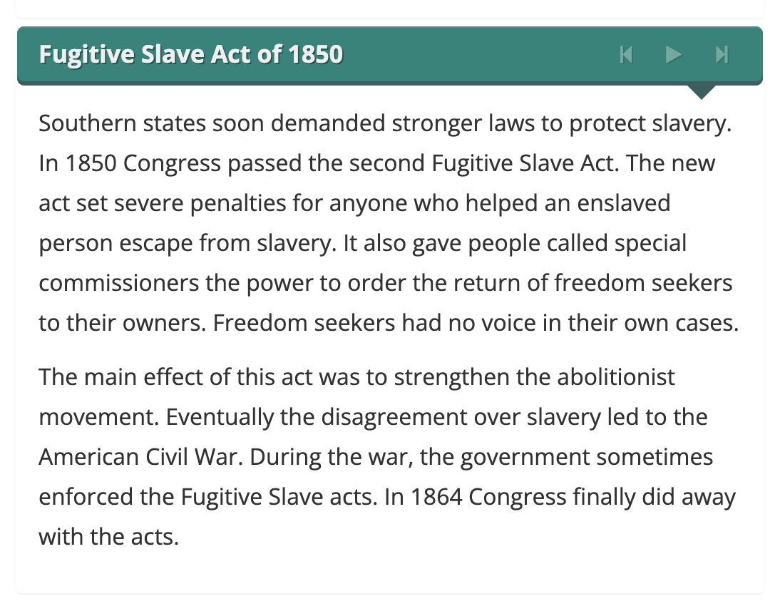
Kiddle article for deeper student research
Notes:
Kids Britannica Article for students (Students can access these extra links through a copy shared on google classroom, and reference this in their journals or through later research/performance task).

Slide 12
Cloze Passage to Build Comprehension
Women Historians Revolt
“When quantitative ________ used statistical analysis to try to determine why slave ________ happened on some ships, and not others, they found one clear pattern: that the more ________ there were aboard a slave ship, the more likely it was that a revolt would happen, although they dismissed the finding as coincidence.
Notes:
Cloze passage
In this section, students read a text from the previous slide deck using “cloze passage” method. The cloze passage is pulled from previous reading and helps build reading fluency. In the previous reading there are key vocabulary words (non sight words) missing. There are a few options with different scaffolds. One way to complete this passage is to read chorally with all students while the vocabulary are listed above the passage. Students choose which words to fill into the passage while reading chorally. Students can also complete this independently or with a partner. After identifying the words, the next step would be talking about the importance and meaning of the words. It could be a reminder for them from the previous text, but multiple exposures will support their understanding.
Here is an article about using cloze passages and about fluency, which is the work on slide 19, if you’d like to read more.

Slide 13
Why was the Fugitive Slave Act put in place?
If it was illegal to help enslaved people runaway, why do you think so many people did?
What are ways that enslaved peoples resisted? Why is this important?
Notes:
Class Discussion
In this section, students discuss what they have learned in a whole group discussion. Use these questions as a guideline to the discussion, but also feel free to follow what the students have gleaned from the learning so far in this slide deck. This discussion will support them in the writing section, where each student will be expected to write a page about what they learned. This will be very helpful for them to make connections, ask questions and build an understanding of the content.

Slide 14
Fluency Practice Practice reading the text below with a partner. The goal is to read the text with 100% accuracy. The words in red are from the A, E, I, O, U, 1, 2 List.
The U.S. Constitution of 1789 stated that freedom seekers had to be returned to their owners. Congress passed the Fugitive Slave Act of 1793 to enforce this part of the Constitution. The act allowed any slaveholder to capture a suspected freedom seeker and bring that person before a judge. They did not get a trial by jury. The judge decided whether the person was escaping slavery or not.
The act angered people who opposed slavery. Northern states voted to give some legal rights to freedom seekers. Abolitionists (people against slavery) formed a secret network called the Underground Railroad to help enslaved people escape to freedom.
Southern states soon demanded stronger laws to protect slavery. In 1850 Congress passed the second Fugitive Slave Act. The new act set severe penalties for anyone who helped an enslaved person escape from slavery. It also gave people called special commissioners the power to order the return of freedom seekers to their owners. Freedom seekers had no voice in their own cases.
The main effect of this act was to strengthen the abolitionist movement. Eventually the disagreement over slavery led to the American Civil War. During the war, the government sometimes enforced the Fugitive Slave acts. In 1864 Congress finally did away with the acts.
Notes:
Fluency
Each day, students should be working on fluency. They can either pair up with a partner, or practice by themselves in this first reading. The ultimate goal would be that they have a fluency partner, each reading to the other for one minute. I have the first reader identify themself and place their finger on the first word, and the listener does the same, but be ready to listen. After one minute, I tell them to stop and switch roles.
If you print this text for them, the only change would be that the listener has a pencil ready to make the text with words missed from the reader. That is not to highlight mistakes, but to support one another in building towards fluency.

Slide 15
Writing Tips Use the following tips to complete your writing using the texts and the videos. Remember to include what you learned about the topic. Also, share your thinking about what you learned.
Using the texts and videos
Write what you learned about (topic) from the examples, the reading and the videos.
Write what you will do with what you have learned.
What thoughts or questions do you have after today’s lesson?
Sentence starters-
Today I learned about…
One thing I connected with was …
This helped me understand ….
An example of resistance was …..
Notes:
Writing
Each student should be prepared to write an entire page about what they learned today. You can either provide a blank journal or print and copy journal pages for them. The expectation is that they fill a page, and though they might struggle initially, they will get used to the format.
Possible scaffold for writing-To help emergent bilingual students you may pull a small group and give a paragraph frame or complete a guided writing.
For students who need more support, some sentence starters could be:
Today I learned about…
One thing I connected with was …
This helped me understand ….
An example of resistance was …..

Slide 16
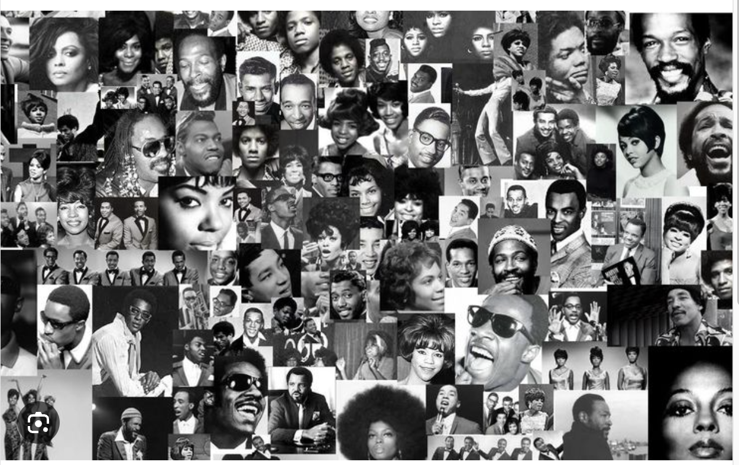
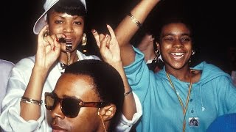
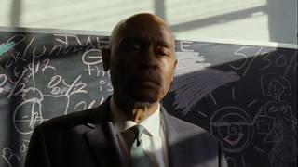
MUSIC history is BLACK HISTORY
Music has been used as a tool for activism, culture, and JOY
Notes:
Joy: How will my instruction advance students’ happiness through the use of beautiful and truthful images, representations, and narratives about themselves and/or others? This portion can be included during the lesson or at a separate time depending on time availability.
In this joy portion students will learn that MUSIC history is BLACK HISTORY
Music has been used as a tool for activism, culture, and JOY
Students will watch a crash course video on the origins of rap and hip hop.
Students will also watch the music video “Fight the Power” while also evaluating the lyrics.

Slide 17
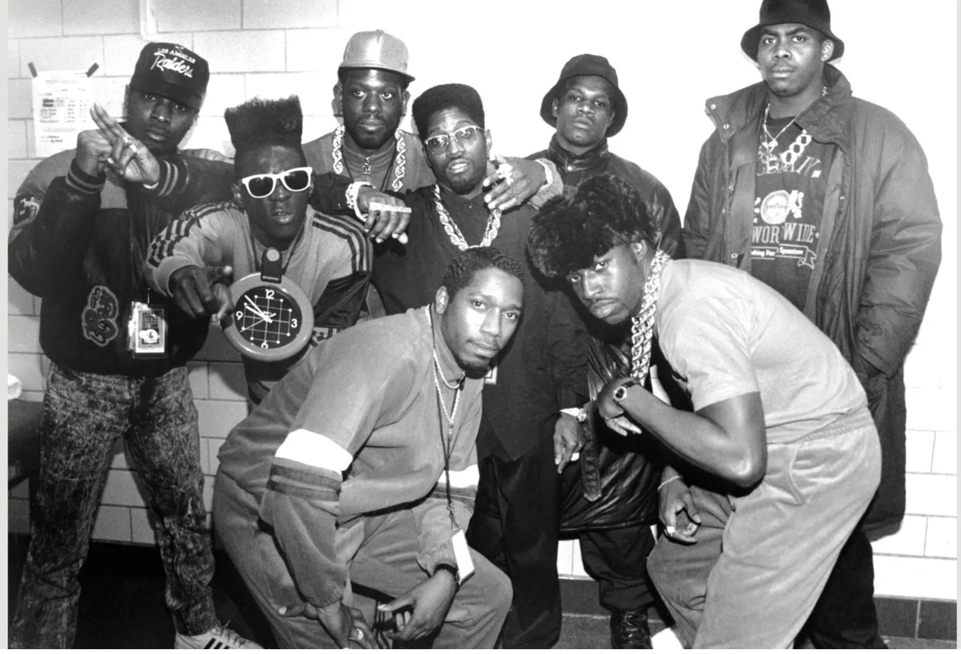
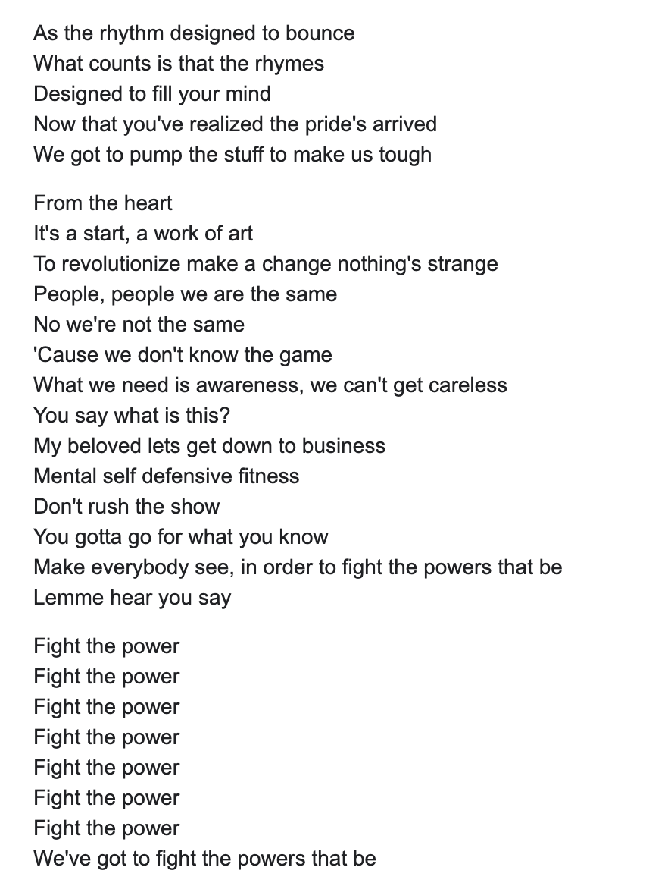
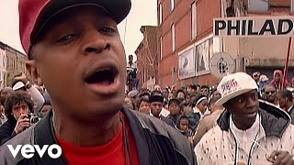
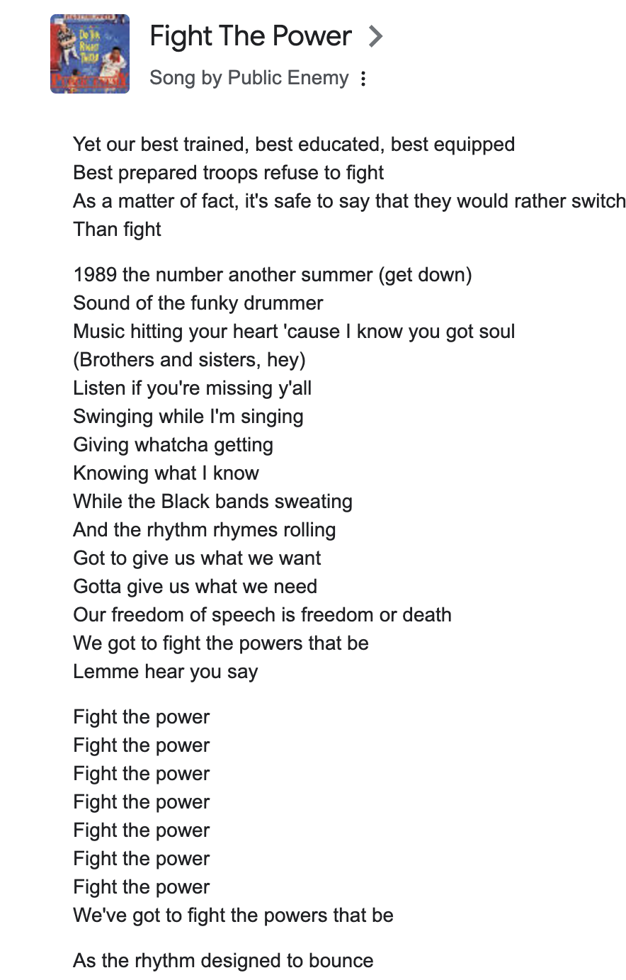
Public Enemy
Notes:
Students discuss lyrics in groups to choose lines from the song that stood out to them, and what they think they mean.
Students can also connect images in the video to activism.

