Slide 1
African American History 400+ years of Resistance, Resilience, Power, and Pride
Today you are going to become smarter about the history of Resistance, Revolt, and Abolition in the United States during the 1800s (Civil War Era) by analyzing the Crosswhite affair and the Underground Railroad.
Notes:
Introduction:
In this slide deck, students will be introduced to the true story from the anchor text, January’s Sparrow. In addition they will learn about the Underground Railroad and its role in the continued resistance. It will be very important to continuously come back to the idea of resistance; that in every time and place, enslave people sought freedom, as stated in the Teaching Hard History standards.
This slide deck is to provide background and build a foundation for the learning that will take place throughout this study. The slides take the students through experiences of viewing images, watching videos and reading text in order to build background knowledge. They will also build foundational skills throughout the slides while learning the content.
Joy is included at the end of every slide deck to celebrate the foundation of food, song, dance, etc, brought to the United States by Africans forced from their homes.
To prepare for this study, the students should be provided with a blank journal or journal pages in a folder, as they will be writing a full page at the end of each slide deck, possibly more. Also, the slide decks were originally designed to be completed in one class period, but I have found that it usually takes two to three class periods. If that is the same for you, you might have the students at least write a sentence or two at the end of each period so they remember what they learned throughout the study.

Slide 2
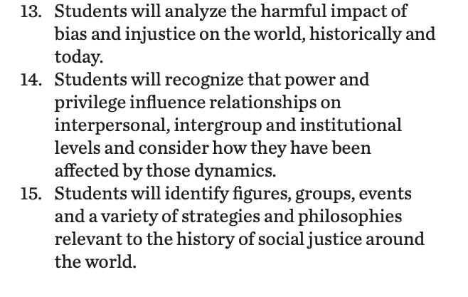
Standards/SJ Standards
Social Justice Standards
History Social Science Standards CA
Teaching Hard History Standards
Notes:
https://www.sutori.com/en/story/understanding-the-historical-perspective--iQg3yRgTSCBGx38JenGm73sK Teacher or Student Resource that connects to the anchor text. It is an optional resource to delve deeper into the the true story behind January’s Sparrow.

Slide 3
The Underground Railroad: A Means of Resistance.
Kiddle Article for student research
Notes:
Building background through media
Students will build background knowledge, vocabulary, and build towards a deep understanding of the concept through images and/or multimedia presentations and discussion.Students engage in discussion/turn and talks/ and/or whole class discussion. An optional scaffold to add to the class discussion after viewing is writing important discussion points on a white board or chart paper in order to assist students in their journal writing later.
Key understandings for this background media: This is introducing another major form of resistance and also connecting back to the anchor text where students learned about the Crosswhite families use of the Underground Railroad to escape enslavement.

Slide 4
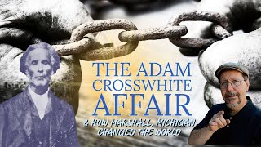
Remember the Crosswhite Family?
Student Research-Kiddle Article on Adam Cross White
Article about the Cross Whites
Notes:
Key understandings for this background media: Students will watch this video about the real life events about the Crosswhite family, this connects to the anchor text, January’s Sparrow. Students can keep an eye out for connections to the read aloud and the real events. These slides could also be shared with students in a “student copy” to allow them to reference the additional information for journal entries and/or their performance task later.

Slide 5
A,E,I,O,U,1,2 Use this approach to help read words with multiple syllables.
Place an X under each A, E, I, O, U
Count the letters between the X’s
Split between:
(X and X) example: jo/vi/al
(X and 1) example: te/na/cious
(1 and 2) example: bal/lad
Do not separate blends or word groupings that need each other.
ous, qu, bi, cl, dr, pr, cial, tion
Network
Route
Conductor
Disguises
Notes:
Word Work
On this slide, students are introduced to four multisyllabic words that they will encounter in the texts below. The strategy is to first place an X under each vowel. Then the students will split the word into syllables and then they blend the syllables to put the word together.
If your students are familiar with syllable types, here is another strategy you can teach your students to decode multisyllabic words.
After decoding the words, you can use the GLAD strategy of Cognitive Content Dictionary (background information linked). These words are key to understanding the text on these slides.

Slide 6
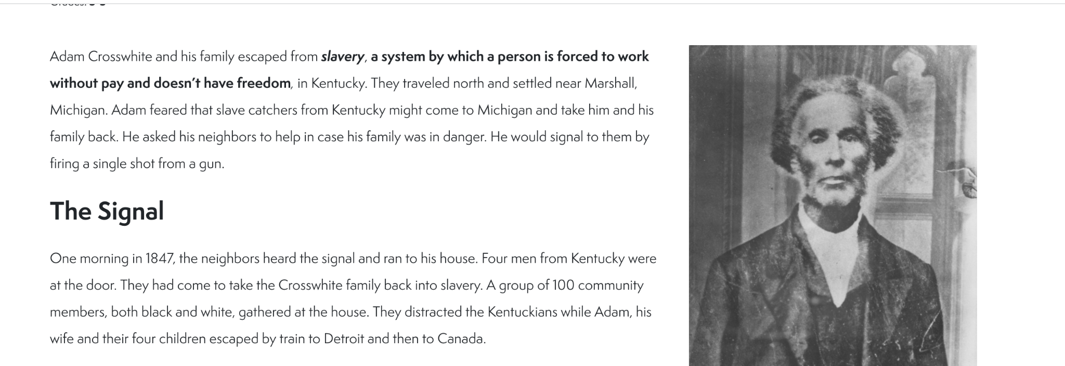
Adam Crosswhite
Notes:
Building Background through text
We will be building more background/knowledge using text to build on the slidedeck topic. Students will have printed copies of these slides. Complete a close read of the information spending time for students to highlight their copies and annotate. Another option is having students complete a close read in small groups or partners first and then bringing class together to read through discussing important information. This is also a good time to have students ask any questions about the text.
Key understandings of this text: Students will get an understanding of the realities of Adam Crosswhite’s resistance and should also connect his story to what they know of abolitionists. They should also connect the use of legislation in this account, equating humans to property through the use of the Fugitive Slave Act.

Slide 7
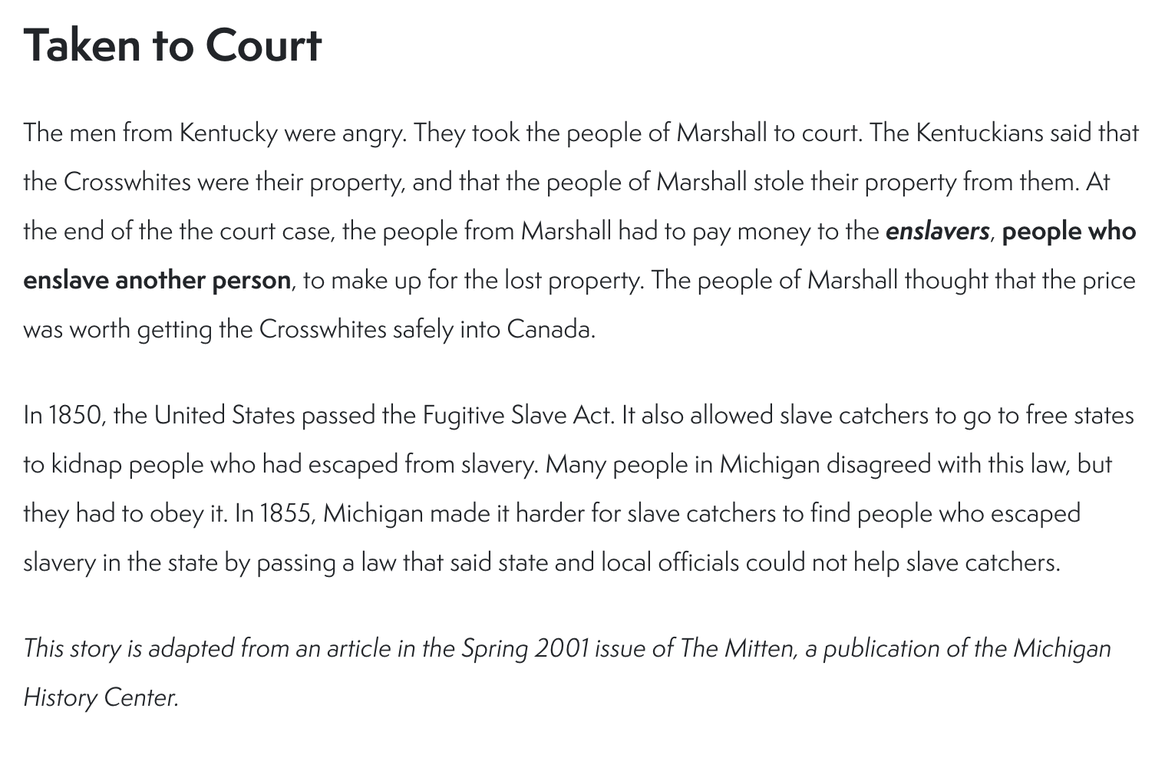

Slide 8
Notes:
https://michiganology.org/stories/the-underground-railroad/

Slide 9
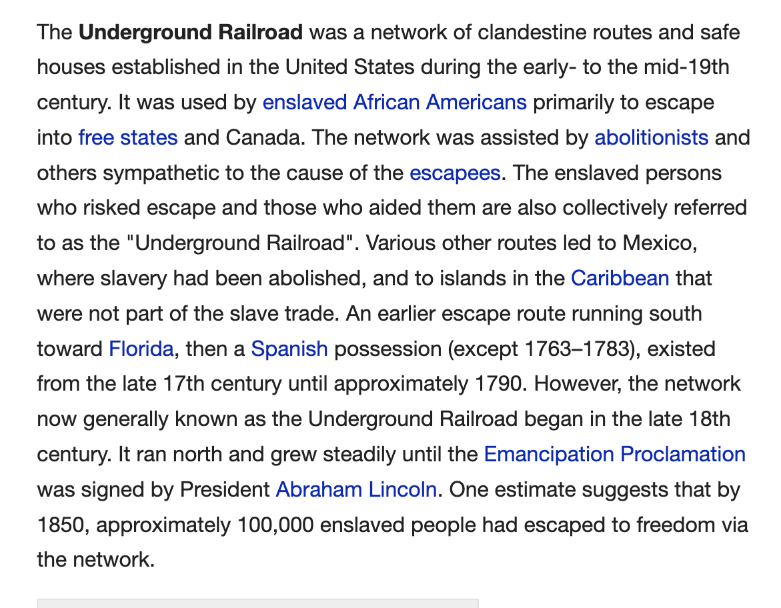
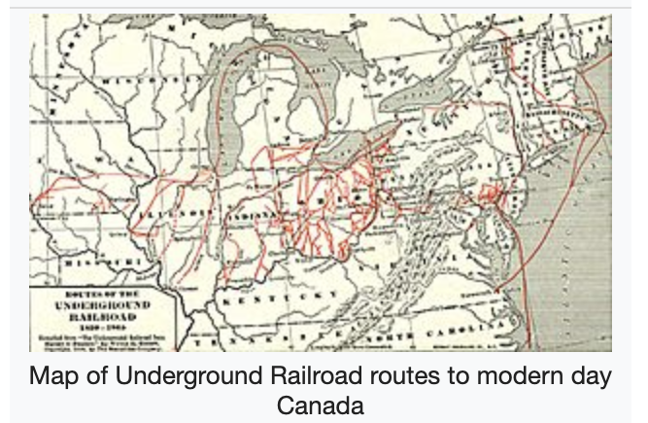
The Underground Railroad
Notes:
Building Background through text
We will be building more background/knowledge using text to build on the slidedeck topic. Students will have printed copies of these slides. Complete a close read of the information spending time for students to highlight their copies and annotate. Another option is having students complete a close read in small groups or partners first and then bringing class together to read through discussing important information. This is also a good time to have students ask any questions about the text.

Slide 10
Cloze Passage to Build Comprehension
Abolitionist/s Enslaved Fugitive
The U.S. Constitution of 1789 stated that freedom seekers had to be returned to their owners. Congress passed the _______ Slave Act of 1793 to enforce this part of the Constitution. The act allowed any slaveholder to capture a suspected freedom seeker and bring that person before a judge. They did not get a trial by jury. The judge decided whether the person was escaping slavery or not.
The act angered people who opposed slavery. Northern states voted to give some legal rights to freedom seekers ___________ (people against slavery) formed a secret network called the Underground Railroad to help enslaved people escape to freedom.
Southern states soon demanded stronger laws to protect slavery. In 1850 Congress passed the second Fugitive Slave Act. The new act set severe penalties for anyone who helped an _________person escape from slavery. It also gave people called special commissioners the power to order the return of freedom seekers to their owners. Freedom seekers had no voice in their own cases.
The main effect of this act was to strengthen the ___________ movement. Eventually the disagreement over slavery led to the American Civil War. During the war, the government sometimes enforced the ___________Slave acts. In 1864 Congress finally did away with the acts.
Notes:
Cloze passage
In this section, students read a text from the previous slide deck using “cloze passage” method. The cloze passage is pulled from previous reading and helps build reading fluency. In the previous reading there are key vocabulary words (non sight words) missing. There are a few options with different scaffolds. One way to complete this passage is to read chorally with all students while the vocabulary are listed above the passage. Students choose which words to fill into the passage while reading chorally. Students can also complete this independently or with a partner. After identifying the words, the next step would be talking about the importance and meaning of the words. It could be a reminder for them from the previous text, but multiple exposures will support their understanding.
Here is an article about using cloze passages and about fluency, which is the work on slide 19, if you’d like to read more.

Slide 11
Why is the Crosswhite’s resistance historically important?
Why do you think they were successful?
If you could ask the Crosswhite family a question what would it be?
How did the Fugitive Slave Act connect to this event?
Notes:
Class Discussion
In this section, students discuss what they have learned in a whole group discussion. Use these questions as a guideline to the discussion, but also feel free to follow what the students have gleaned from the learning so far in this slide deck. This discussion will support them in the writing section, where each student will be expected to write a page about what they learned. This will be very helpful for them to make connections, ask questions and build an understanding of the content.

Slide 12
Fluency Practice Practice reading the text below with a partner. The goal is to read the text with 100% accuracy. The words in red are from the A, E, I, O, U, 1, 2 List.
The U.S. Constitution of 1789 stated that freedom seekers had to be returned to their owners. Congress passed the Fugitive Slave Act of 1793 to enforce this part of the Constitution. The act allowed any slaveholder to capture a suspected freedom seeker and bring that person before a judge. They did not get a trial by jury. The judge decided whether the person was escaping slavery or not.
The act angered people who opposed slavery. Northern states voted to give some legal rights to freedom seekers. Abolitionists (people against slavery) formed a secret network called the Underground Railroad to help enslaved people escape to freedom.
Southern states soon demanded stronger laws to protect slavery. In 1850 Congress passed the second Fugitive Slave Act. The new act set severe penalties for anyone who helped an enslaved person escape from slavery. It also gave people called special commissioners the power to order the return of freedom seekers to their owners. Freedom seekers had no voice in their own cases.
The main effect of this act was to strengthen the abolitionist movement. Eventually the disagreement over slavery led to the American Civil War. During the war, the government sometimes enforced the Fugitive Slave acts. In 1864 Congress finally did away with the acts.
Notes:
Fluency
Each day, students should be working on fluency. They can either pair up with a partner, or practice by themselves in this first reading. The ultimate goal would be that they have a fluency partner, each reading to the other for one minute. I have the first reader identify themself and place their finger on the first word, and the listener does the same, but be ready to listen. After one minute, I tell them to stop and switch roles.
If you print this text for them, the only change would be that the listener has a pencil ready to make the text with words missed from the reader. That is not to highlight mistakes, but to support one another in building towards fluency.

Slide 13
Writing Tips Use the following tips to complete your writing using the texts and the videos. Remember to include what you learned about the topic. Also, share your thinking about what you learned.
Using the texts and videos, write about the Crosswhite family, and/or the Underground Railroad
Write what you learned about (topic) from the examples, the reading and the videos.
Write what you will do with what you have learned.
What thoughts or questions do you have after today’s lesson?
Writing Structure- summary sentences
Sentence starters-
Today I learned about…
One thing I connected with was …
This helped me understand ….
An example of resistance was …..
Notes:
Writing
Each student should be prepared to write an entire page about what they learned today. You can either provide a blank journal or print and copy journal pages for them. The expectation is that they fill a page, and though they might struggle initially, they will get used to the format.
Possible scaffold for writing-To help emergent bilingual students you may pull a small group and give a paragraph frame or complete a guided writing.
For students who need more support, some sentence starters could be:
Today I learned about…
One thing I connected with was …
This helped me understand ….
An example of resistance was …..

Slide 14
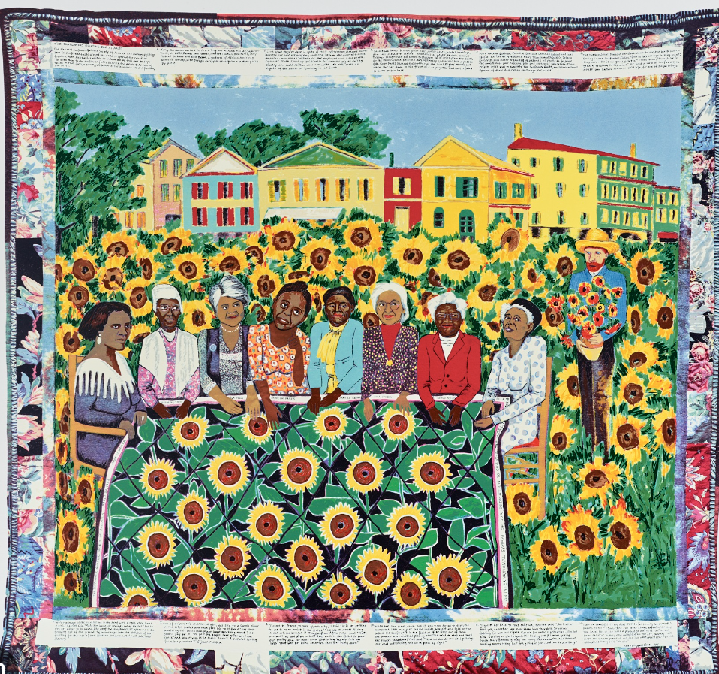
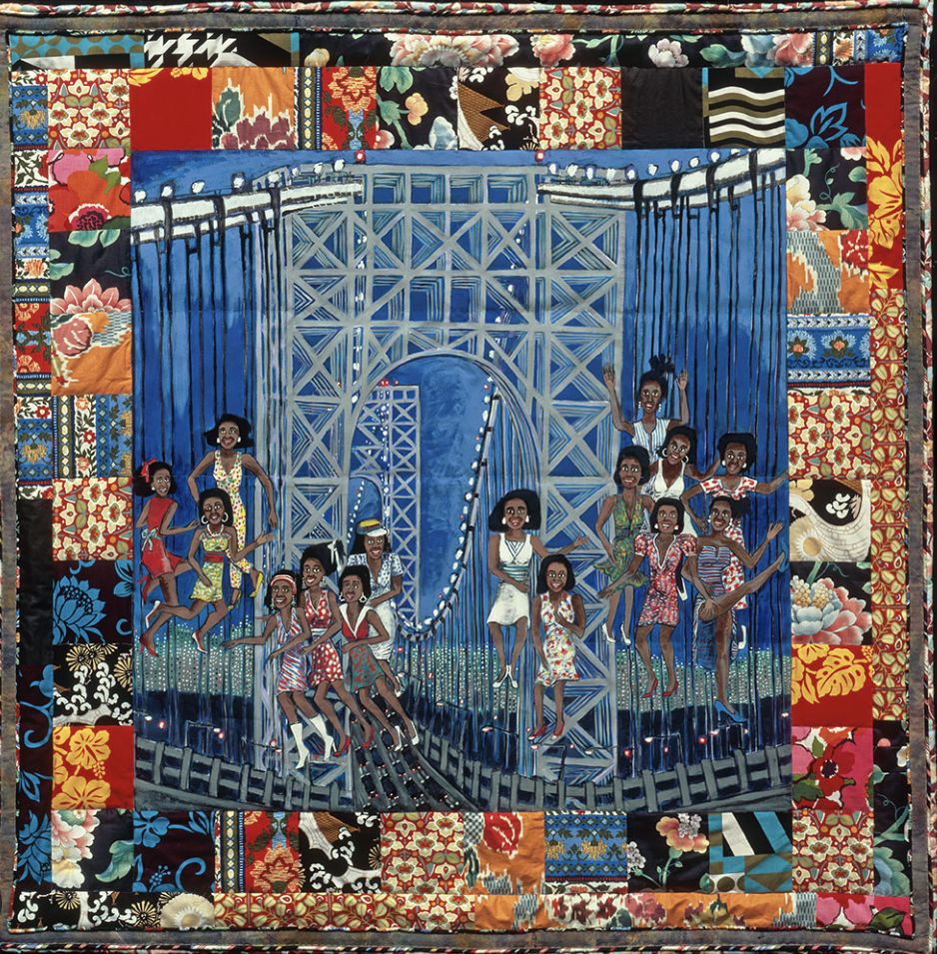
Black Influence in ART
Additional Resources for Faith Ringgold
Notes:
Joy: How will my instruction advance students’ happiness through the use of beautiful and truthful images, representations, and narratives about themselves and/or others? This portion can be included during the lesson or at a separate time depending on time availability.
This Joy section focuses on Faith Ringgold and her contribution to art, and activism. Play both videos for students.
Lesson Extension: Have students include this learning in their journal responses. Additionally, there is a linked art lesson that can be used as well.

Slide 15
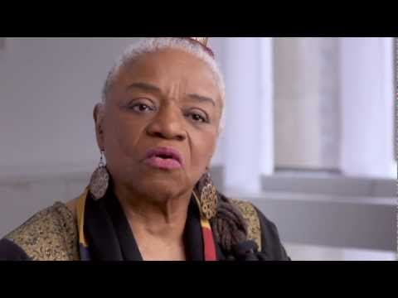
Faith Ringgold
Possible art lesson plan
Teaching resources
Notes:
Joy: How will my instruction advance students’ happiness through the use of beautiful and truthful images, representations, and narratives about themselves and/or others? This portion can be included during the lesson or at a separate time depending on time availability.
This Joy section focuses on Faith Ringgold and her contribution to art, and activism. Play both videos for students.
Lesson Extension: Have students include this learning in their journal responses. Additionally, there is a linked art lesson that can be used as well.

