Slide 1
African American History 400+ years of Resistance, Resilience, Power, and Pride
Today you will become smarter about the role the abolitionist movement played in resistance and revolts by examining the case of Anthony Burns and the Boston Slave Riot.
Notes:
Introduction:
In this slide deck, students will be introduced to the story of the Boston Slave Riot and the case of Anthony Burns. Once again to analyze different forms of resistance and the role of abolitionism played during the civil era. Students will also learn about how the Fugitive Slave Act was used to combat resistance. It will be very important to continuously come back to the idea of resistance; that in every time and place, enslave people sought freedom, as stated in the Teaching Hard History standards.
This slide deck is to provide background and build a foundation for the learning that will take place throughout this study. The slides take the students through experiences of viewing images, watching videos and reading text in order to build background knowledge. They will also build foundational skills throughout the slides while learning the content.
Joy is included at the end of every slide deck to celebrate the foundation of food, song, dance, etc, brought to the United States by Africans forced from their homes.
To prepare for this study, the students should be provided with a blank journal or journal pages in a folder, as they will be writing a full page at the end of each slide deck, possibly more. Also, the slide decks were originally designed to be completed in one class period, but I have found that it usually takes two to three class periods. If that is the same for you, you might have the students at least write a sentence or two at the end of each period so they remember what they learned throughout the study.

Slide 2
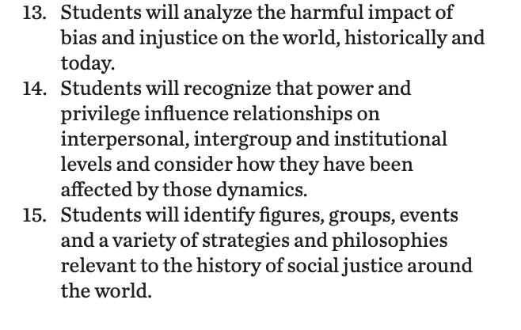
Standards/SJ Standards
Social Justice Standards
History Social Science Standards CA
Teaching Hard History Standards
Notes:
https://www.sutori.com/en/story/understanding-the-historical-perspective--iQg3yRgTSCBGx38JenGm73sK Teacher or Student Resource that connects to the anchor text. It is an optional resource to delve deeper into the the true story behind January’s Sparrow.

Slide 3
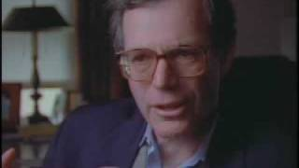
There were other similar cases of Resistance like the Crosswhite affair….Anthony Burns & The Boston Slave Riot
Notes:
Building background through media
Students will build background knowledge, vocabulary, and build towards a deep understanding of the concept through images and/or multi/media presentations and discussion.Students engage in discussion/turn and talks/ and/or whole class discussion. An optional scaffold to add to the class discussion after viewing is writing important discussion points on a white board or chart paper in order to assist students in their journal writing later.
Key understandings for this background media: There are many examples of active resistance, such as Anthony Burns. In this example, Anthony Burns is arrested under the Fugitive Slave Act and it causes a riot. This becomes a bigger fight with abolitionists pushing for his freedom as well. This is a well documented case and connects back to the resistance found in the anchor text. Anthony himself is an Abolitionist activist in this as he champions his own fight against enslavement and a constitution that protects his enslavers.

Slide 4
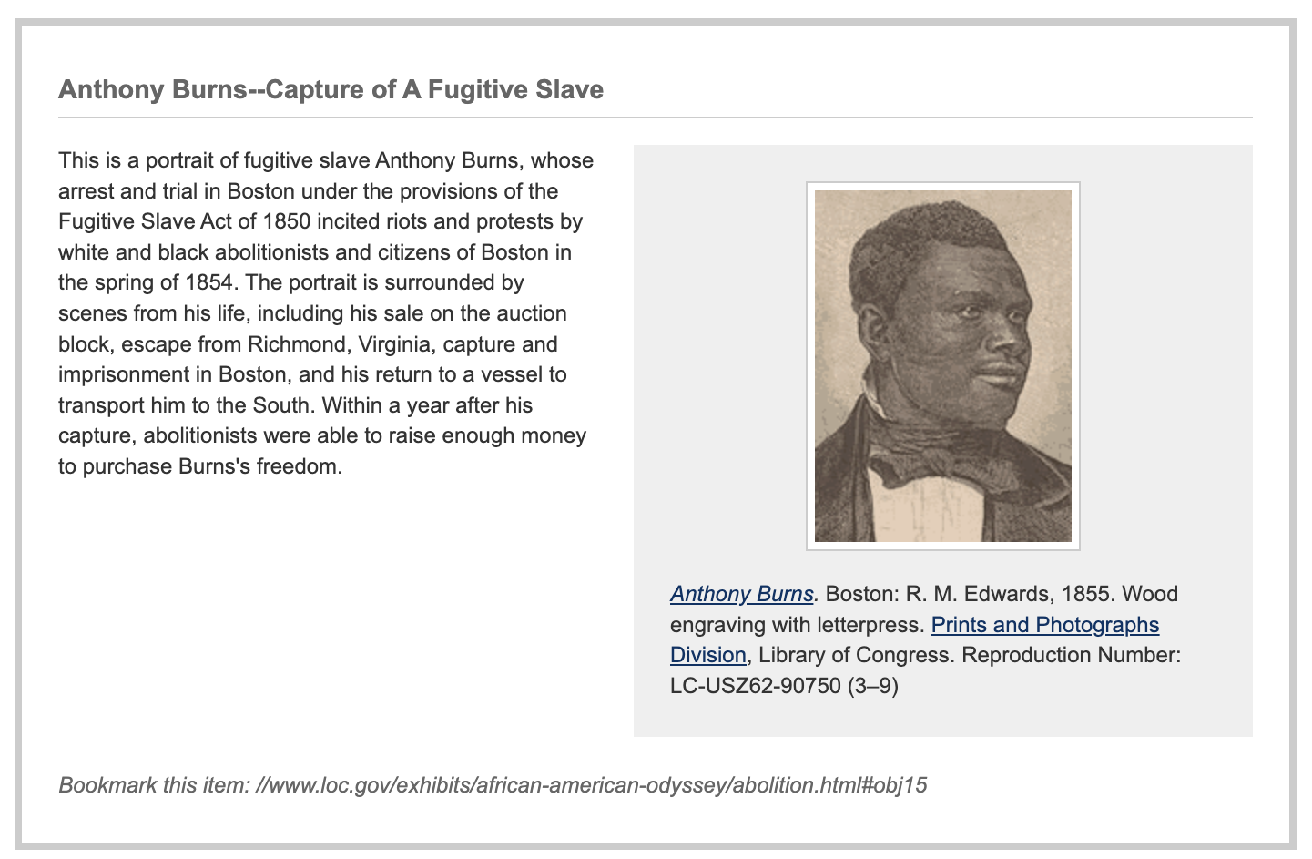
PBS Video of Anthony Burns
Notes:
Building background through media
Students will build background knowledge, vocabulary, and build towards a deep understanding of the concept through images and/or multi/media presentations and discussion.Students engage in discussion/turn and talks/ and/or whole class discussion. An optional scaffold to add to the class discussion after viewing is writing important discussion points on a white board or chart paper in order to assist students in their journal writing later.
Key understandings for this background media:What is unique about this example and what connections can be made to previous learning?

Slide 5
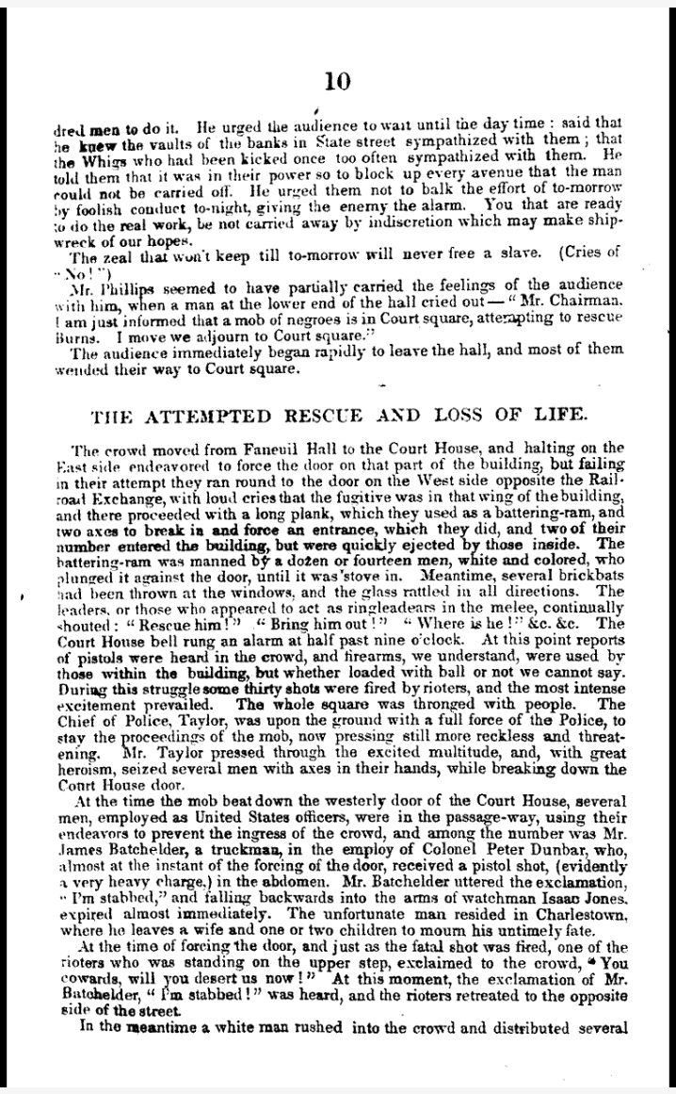
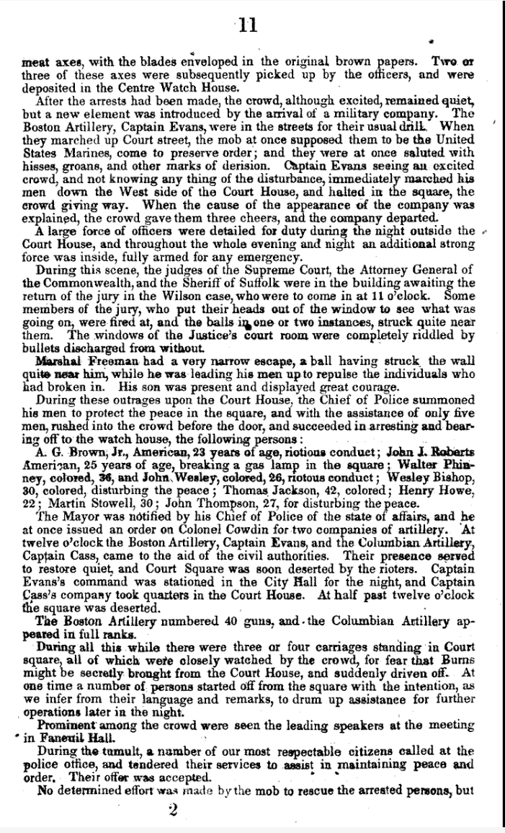
News report from the Library of Congress
Full source from library of congress
Notes:
Building background through media
Students will build background knowledge, vocabulary, and build towards a deep understanding of the concept through images and/or multi/media presentations and discussion.Students engage in discussion/turn and talks/ and/or whole class discussion. An optional scaffold to add to the class discussion after viewing is writing important discussion points on a white board or chart paper in order to assist students in their journal writing later.
Key understandings for this background media: This publication details the events of the riot. Reading excerpts from this document can deepen students understanding of the realities of resistance, resilience and revolt.

Slide 6
A,E,I,O,U,1,2 Use this approach to help read words with multiple syllables.
Place an X under each A, E, I, O, U
Count the letters between the X’s
Split between:
(X and X) example: jo/vi/al
(X and 1) example: te/na/cious
(1 and 2) example: bal/lad
Do not separate blends or word groupings that need each other.
ous, qu, bi, cl, dr, pr, cial, tion
Liberty
Freedom
Compromise
Notes:
Word Work
On this slide, students are introduced to four multisyllabic words that they will encounter in the texts below. The strategy is to first place an X under each vowel. Then the students will split the word into syllables and then they blend the syllables to put the word together.
If your students are familiar with syllable types, here is another strategy you can teach your students to decode multisyllabic words.
After decoding the words, you can use the GLAD strategy of Cognitive Content Dictionary (background information linked). These words are key to understanding the text on these slides.

Slide 7
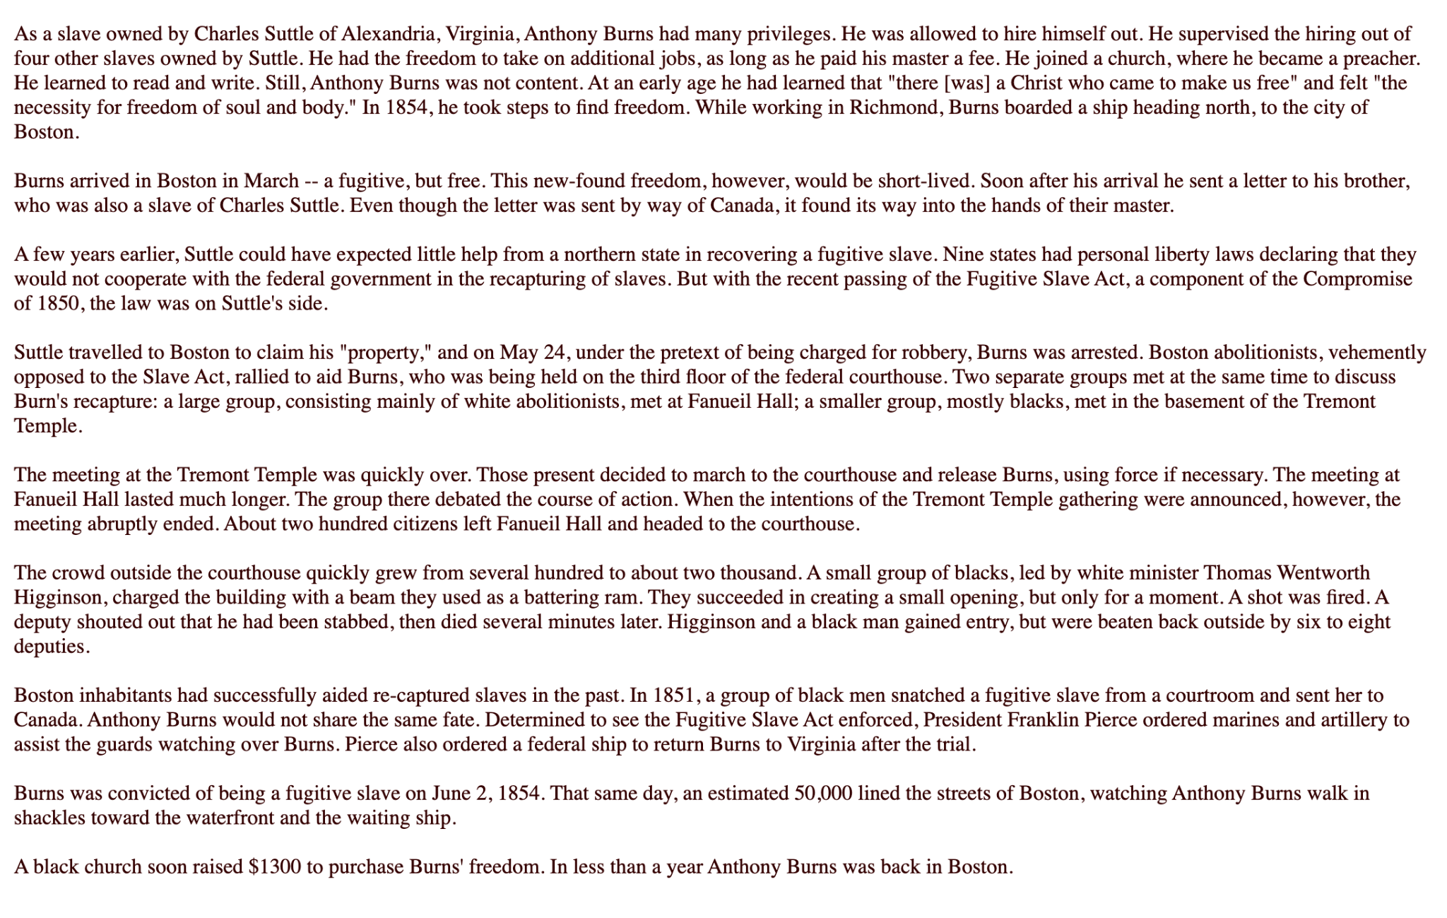
Source:PBS
Notes:
Building Background through text
We will be building more background/knowledge using text to build on the slidedeck topic. Students will have printed copies of these slides. Complete a close read of the information spending time for students to highlight their copies and annotate. Another option is having students complete a close read in small groups or partners first and then bringing class together to read through discussing important information. This is also a good time to have students ask any questions about the text.
Key understandings of this text:Building a deeper understanding of Anthony Burns and the Boston Slave Riot. What was unique about this event and what connections can be made? Even when resistance was did not end in freedom it still helped to shape the progress of emancipation and to show that “IN EVERY PLACE AND TIME ENSLAVED PEOPLE SOUGHT FREEDOM.” Additionally, the events are bringing together communities and groups of abolitionists. It was a MOVEMENT.

Slide 8
Notes:
Building Background through text
We will be building more background/knowledge using text to build on the slidedeck topic. Students will have printed copies of these slides. Complete a close read of the information spending time for students to highlight their copies and annotate. Another option is having students complete a close read in small groups or partners first and then bringing class together to read through discussing important information. This is also a good time to have students ask any questions about the text.

Slide 9
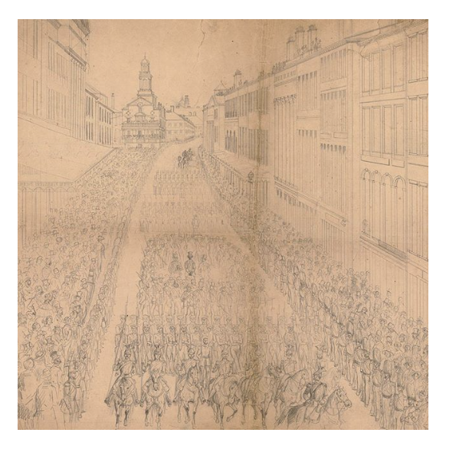
Interactive timeline for Anthony Burns
Notes:
Building Background through text
We will be building more background/knowledge using text to build on the slidedeck topic. Students will have printed copies of these slides. Complete a close read of the information spending time for students to highlight their copies and annotate. Another option is having students complete a close read in small groups or partners first and then bringing class together to read through discussing important information. This is also a good time to have students ask any questions about the text.
Key understandings of this text: In this text students will evaluate the aftermath of this event. What do we see changing socially here?

Slide 10
Notes:
Building Background through text
We will be building more background/knowledge using text to build on the slidedeck topic. Students will have printed copies of these slides. Complete a close read of the information spending time for students to highlight their copies and annotate. Another option is having students complete a close read in small groups or partners first and then bringing class together to read through discussing important information. This is also a good time to have students ask any questions about the text.
Key understandings of this text: In this text we have another example of abolitionists in Leonard Grimes. He not only was an abolitionist he was a conductor in the Underground Railroad. He mobilized the black communities in cases against the Fugitive Slave Act, including Anthony Burns. He is an example of radical resistance and organization from the Black communities during this era.

Slide 11
Cloze Passage to Build Comprehension
Network Conductor Fugitives Railroad
The Underground _________________was not a real railroad. It was a _________________of people, both black and white, who helped enslaved people, people forced to perform labor and services against their will, escape from their enslavers, people who enslave another person. This __________________was called “Underground” because it was top secret, and “Railroad” because terms like “___________” and “depot” were used as codes for helpers and safe places.
People who escape slavery were considered fugitives, because it was against the law to escape. Many _____________went to the northern United States and Canada where they could be free. Many of the fugitives that came to Michigan were enslaved in Kentucky.
Notes:
Cloze passage
In this section, students read a text from the previous slide deck using “cloze passage” method. The cloze passage is pulled from previous reading and helps build reading fluency. In the previous reading there are key vocabulary words (non sight words) missing. There are a few options with different scaffolds. One way to complete this passage is to read chorally with all students while the vocabulary are listed above the passage. Students choose which words to fill into the passage while reading chorally. Students can also complete this independently or with a partner. After identifying the words, the next step would be talking about the importance and meaning of the words. It could be a reminder for them from the previous text, but multiple exposures will support their understanding.
Here is an article about using cloze passages and about fluency, which is the work on slide 19, if you’d like to read more.

Slide 12
Why was the trial of Anthony Burns important historically?
What was the role of Abolitionists in the resistance of the enslaved?
Notes:
Class Discussion
In this section, students discuss what they have learned in a whole group discussion. Use these questions as a guideline to the discussion, but also feel free to follow what the students have gleaned from the learning so far in this slide deck. This discussion will support them in the writing section, where each student will be expected to write a page about what they learned. This will be very helpful for them to make connections, ask questions and build an understanding of the content.

Slide 13
Fluency Practice Practice reading the text below with a partner. The goal is to read the text with 100% accuracy. The words in red are from the A, E, I, O, U, 1, 2 List.
The Underground Railroad was not a real railroad. It was a network of people, both black and white, who helped enslaved people, people forced to perform labor and services against their will, escape from their enslavers, people who enslave another person. This network was called “Underground” because it was top secret, and “Railroad” because terms like “conductor” and “depot” were used as codes for helpers and safe places.People who escape slavery were considered fugitives, because it was against the law to escape. Many fugitives went to the northern United States and Canada where they could be free. Many of the fugitives that came to Michigan were enslaved in Kentucky.Escaping was dangerous. Fugitives were determined, cautious, and courageous. They knew that the punishment was harsh if they were caught. Many fugitives that were caught were whipped, beaten or even made to wear chains.Traveling north was also very dangerous. Fugitives had to be careful not to be noticed, so many wore disguises. They traveled mostly by foot, but sometimes by horse, train or even fancy carriages. Conductors on the Underground Railroad helped them find routes and ways to escape to the north.
Notes:
Fluency
Each day, students should be working on fluency. They can either pair up with a partner, or practice by themselves in this first reading. The ultimate goal would be that they have a fluency partner, each reading to the other for one minute. I have the first reader identify themself and place their finger on the first word, and the listener does the same, but be ready to listen. After one minute, I tell them to stop and switch roles.
If you print this text for them, the only change would be that the listener has a pencil ready to make the text with words missed from the reader. That is not to highlight mistakes, but to support one another in building towards fluency.

Slide 14
Writing Tips Use the following tips to complete your writing using the texts and the videos. Remember to include what you learned about the topic. Also, share your thinking about what you learned.
Using the texts and videos, write about
Write what you learned about (topic) from the examples, the reading and the videos.
Write what you will do with what you have learned.
What thoughts or questions do you have after today’s lesson?
Writing Structure- summary sentences
Sentence starters-
Today I learned about…
One thing I connected with was …
This helped me understand ….
An example of resistance was …..
Notes:
Writing
Each student should be prepared to write an entire page about what they learned today. You can either provide a blank journal or print and copy journal pages for them. The expectation is that they fill a page, and though they might struggle initially, they will get used to the format.
Possible scaffold for writing-To help emergent bilingual students you may pull a small group and give a paragraph frame or complete a guided writing.
For students who need more support, some sentence starters could be:
Today I learned about…
One thing I connected with was …
This helped me understand ….
An example of resistance was …..

Slide 15
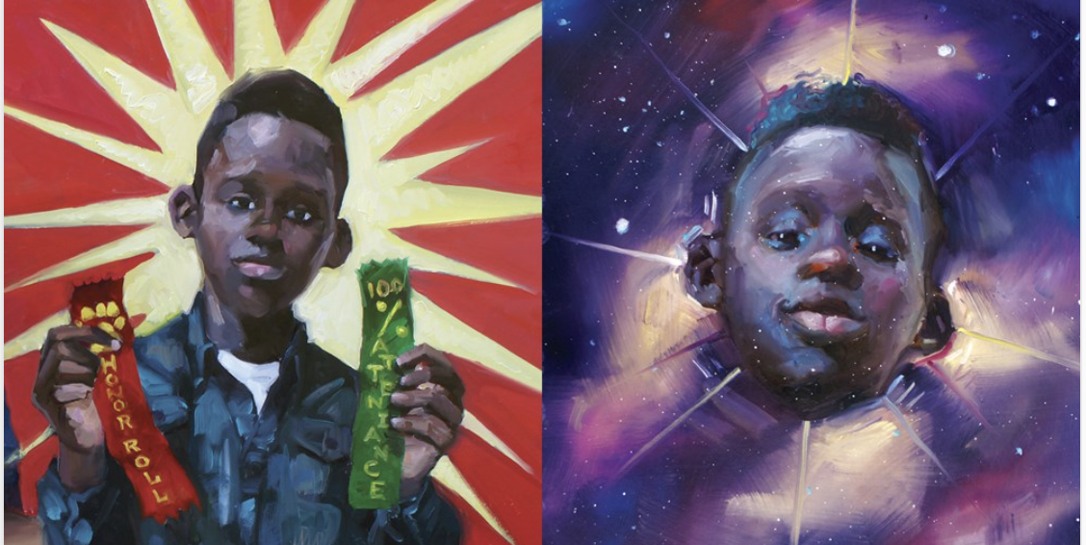
Read Aloud: Crown: An Ode to a Fresh Cut
Did you know that barber shops were safe havens for black liberation activists?
Notes:
Joy: How will my instruction advance students’ happiness through the use of beautiful and truthful images, representations, and narratives about themselves and/or others? This portion can be included during the lesson or at a separate time depending on time availability.
Focuses on the history and joy of black hair. Includes: Crown Read Aloud, Text and videos on the history and importance of black hairstyles, history.

Slide 16
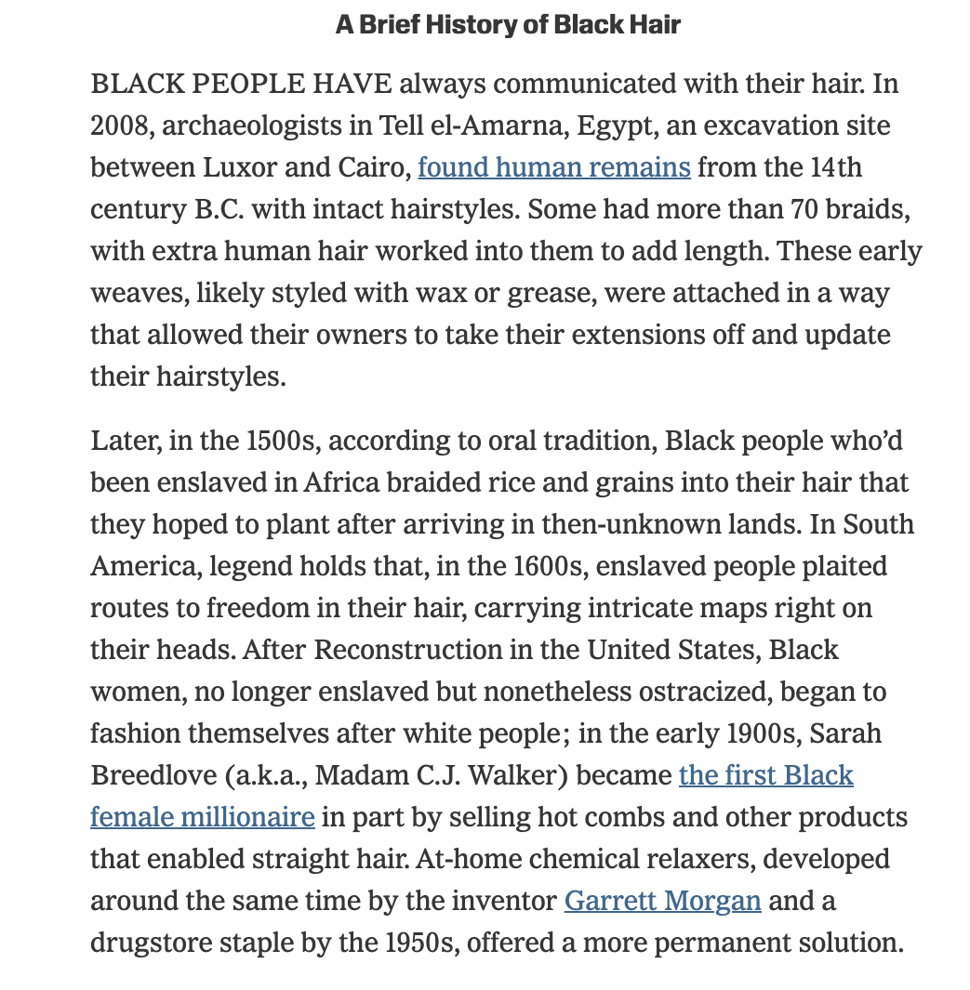
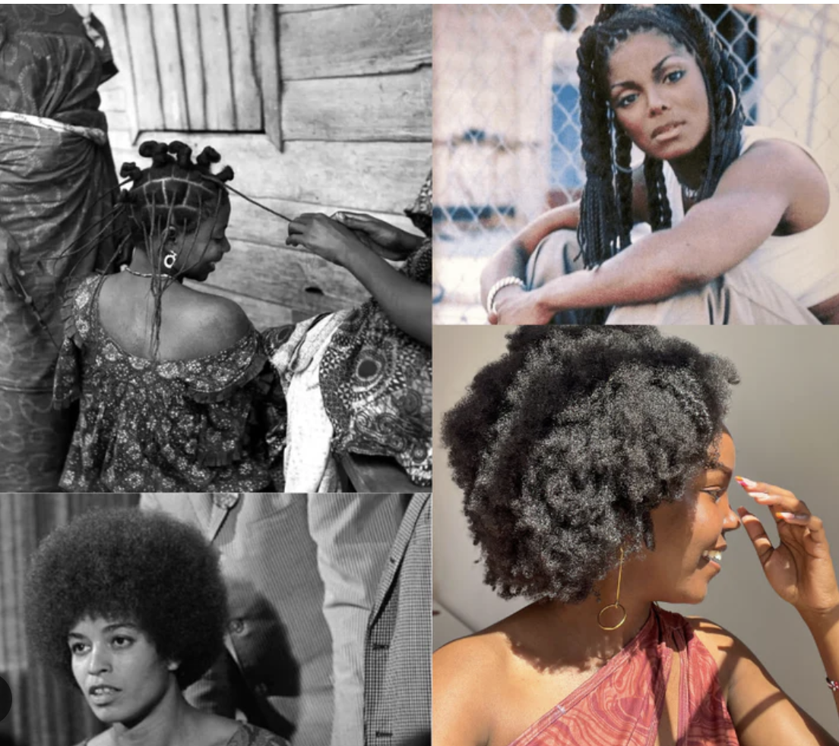
Notes:
Joy: How will my instruction advance students’ happiness through the use of beautiful and truthful images, representations, and narratives about themselves and/or others? This portion can be included during the lesson or at a separate time depending on time availability.
Focuses on the history and joy of black hair. Includes: Crown Read Aloud, Text and videos on the history and importance of black hairstyles, history.

Slide 17
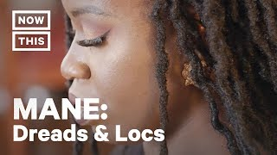
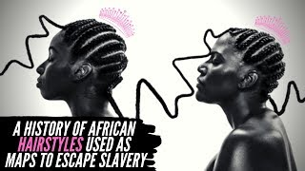
Black HAIR, Braids, Locs and LOVE
Teacher and Student Resource for Additional Research
Notes:
Joy: How will my instruction advance students’ happiness through the use of beautiful and truthful images, representations, and narratives about themselves and/or others? This portion can be included during the lesson or at a separate time depending on time availability.
Focuses on the history and joy of black hair. Includes: Crown Read Aloud, Text and videos on the history and importance of black hairstyles, history.

