Slide 1
African American History 400+ years of Resistance, Resilience, Power, and Pride
Today you will become smarter about the origins and impact of the Black Panther Party and the Black Power Movement.
Notes:
Introduction:
In this slide deck, students will be introduced to the Black Panther Party and the Black Power Movement. It will be very important to continuously come back to the idea of resistance; that in every time and place, enslave people sought freedom, as stated in the Teaching Hard History standards.
This slide deck is to provide background and build a foundation for the learning that will take place throughout this study. The slides take the students through experiences of viewing images, watching videos and reading text in order to build background knowledge. They will also build foundational skills throughout the slides while learning the content.
Joy is included at the end of every slide deck to celebrate the foundation of food, song, dance, etc, brought to the United States by Africans forced from their homes.
To prepare for this study, the students should be provided with a blank journal or journal pages in a folder, as they will be writing a full page at the end of each slide deck, possibly more. Also, the slide decks were originally designed to be completed in one class period, but I have found that it usually takes two to three class periods. If that is the same for you, you might have the students at least write a sentence or two at the end of each period so they remember what they learned throughout the study.

Slide 2
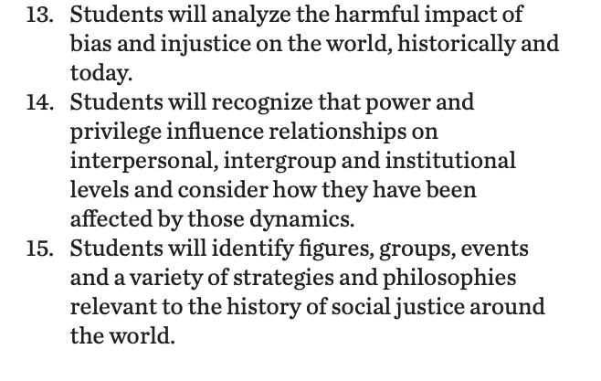
Standards/SJ Standards
Social Justice Standards
History Social Science Standards CA
Teaching Hard History Standards
Notes:
Standards:
Included here are the standards addressed throughout this study. They all in one place so as to keep the study focused on the goals written in the standards. We introduce one standard at a time, starting with the Teaching Hard History Standard, “In every place and time, enslaved people sought freedom”, as this is the main focus of the entire study.

Slide 3
Notes:
Building Background through text
We will be building more background/knowledge using text to build on the slidedeck topic. Students will have printed copies of these slides. Complete a close read of the information spending time for students to highlight their copies and annotate. Another option is having students complete a close read in small groups or partners first and then bringing class together to read through discussing important information. This is also a good time to have students ask any questions about the text.
Key understandings of this text:

Slide 4
The Black Panther Party
The Birth of the Black Panthers
(This 2 min. Video gives an overview of the practical activities of the Black Panther Party as well as the ongong legacy of their community activism).
Notes:
Building background through media
Students will build background knowledge, vocabulary, and build towards a deep understanding of the concept through images and/or multi/media presentations and discussion.Students engage in discussion/turn and talks/ and/or whole class discussion. An optional scaffold to add to the class discussion after viewing is writing important discussion points on a white board or chart paper in order to assist students in their journal writing later.
Key understandings for this background media:

Slide 5
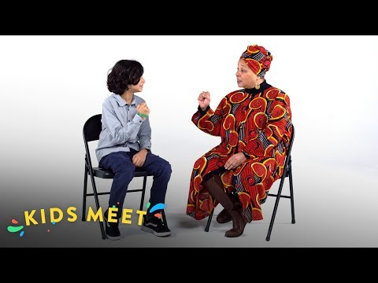
The Black Panther Party
Black Panther Party Members teach young people (6 min. video)
The Birth of the Black Panthers
(This 2 min. Video gives an overview of the practical activities of the Black Panther Party as well as the ongong legacy of their community activism).
Notes:
Building background through media
Students will build background knowledge, vocabulary, and build towards a deep understanding of the concept through images and/or multi/media presentations and discussion.Students engage in discussion/turn and talks/ and/or whole class discussion. An optional scaffold to add to the class discussion after viewing is writing important discussion points on a white board or chart paper in order to assist students in their journal writing later.
Key understandings for this background media: Both of these videos explain the activities and philosophy of the Black Panther Party with an emphasis on self-determination and providing practical support to community members. The ways in which the Black Panther Party was surveilled by the FBI is addressed as is the Black Panthers stance and practice of carrying guns for self-defense.

Slide 6
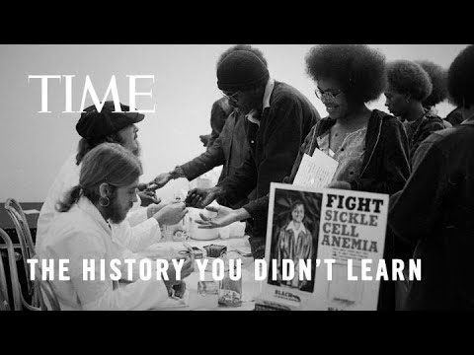
The Health Programs created by the Black Panthers
Notes:
Building background through media
Students will build background knowledge, vocabulary, and build towards a deep understanding of the concept through images and/or multi/media presentations and discussion.Students engage in discussion/turn and talks/ and/or whole class discussion. An optional scaffold to add to the class discussion after viewing is writing important discussion points on a white board or chart paper in order to assist students in their journal writing later.
Key understandings for this background media:

Slide 7
Black Power
“But at a rally in 1966, words were used as armoire to fight against racism. Stokley Carmichael, the bold, new young leader of the Student Nonviolent Coordinating Committee (SNCC), shouted….”Black Power!” These words connected to Blackness not to negativity but to strength. “Black Power” was new language that empowered the Black community and sparked a new movement. Here’s what Carmichael meant by Black Power: Black people owning and controlling their own neighborhoods and futures, free of White supremacy. Here’s what racist White people heard: Black Supremacy! See what was happening? People afraid of antiracist ideas purposely twisted Carmichael’s message of empowerment into racist ideas. “ -Stamped for Kids
Notes:
Building Background through text
We will be building more background/knowledge using text to build on the slidedeck topic. Students will have printed copies of these slides. Complete a close read of the information spending time for students to highlight their copies and annotate. Another option is having students complete a close read in small groups or partners first and then bringing class together to read through discussing important information. This is also a good time to have students ask any questions about the text.
Key understandings of this text: The meaning of “Black Power” as an affirming and empowering call to self-determination. This meant the development of black owned businesses and community services by and for black people.

Slide 8
A,E,I,O,U,1,2 Use this approach to help read words with multiple syllables.
Place an X under each A, E, I, O, U
Count the letters between the X’s
Split between:
(X and X) example: jo/vi/al
(X and 1) example: te/na/cious
(1 and 2) example: bal/lad
Do not separate blends or word groupings that need each other.
ous, qu, bi, cl, dr, pr, cial, tion
Choose 4 words here from the text that students might struggle to decode.
advocacy
disparities
nutritious
initiatives
Notes:
Word Work:
On this slide, students are introduced to four multisyllabic words that they will encounter in the texts below. The strategy is to first place an X under each vowel. Then the students will split the word into syllables and then they blend the syllables to put the word together.
If your students are familiar with syllable types, here is another strategy you can teach your students to decode multisyllabic words.
After decoding the words, you can use the GLAD strategy of Cognitive Content Dictionary (background information linked). These words are key to understanding the text on these slides.

Slide 9
The Black Panther Party (BPP) was a revolutionary social and political organization in the United States during the 1960s and 1970s. In addition to their advocacy for civil rights and self-defense, the BPP also established various health programs to address the healthcare disparities faced by African American communities.
The BPP launched initiatives like the Free Breakfast for Children Program in 1969 to provide nutritious meals to children in impoverished neighborhoods before school. At it peak, the program fed thousands.
The BPP established community health clinics, commonly known as "People's Free Medical Centers," which provided medical services, health screenings, and education to underserved neighborhoods.
The BPP engaged in community outreach and education to empower African American communities with knowledge about healthcare and their rights.
The health programs of the Black Panther Party exemplify their belief in the interconnections between health and social justice. By addressing healthcare disparities, they sought to uplift oppressed communities.
Notes:
Building Background through text
We will be building more background/knowledge using text to build on the slidedeck topic. Students will have printed copies of these slides. Complete a close read of the information spending time for students to highlight their copies and annotate. Another option is having students complete a close read in small groups or partners first and then bringing class together to read through discussing important information. This is also a good time to have students ask any questions about the text.
Key understandings of this text:

Slide 10
What were the goals of the Black Panther Party?
Black Panther Party Text Resource
Notes:
Building Background through text
We will be building more background/knowledge using text to build on the slidedeck topic. Students will have printed copies of these slides. Complete a close read of the information spending time for students to highlight their copies and annotate. Another option is having students complete a close read in small groups or partners first and then bringing class together to read through discussing important information. This is also a good time to have students ask any questions about the text.
Key understandings of this text: This list spells out the freedoms and opportunities that the Black Panther Party sought. Notice the items that are “freedom from” – like police brutality, imprisonment, economic exploitation AND “freedom to” like power to determine their own destiny and to build strong communities with access to housing, education, and other basic needs.

Slide 11
conductor enslaved network fugitives disguises
The Underground Railroad was not a real railroad. It was a __________of people, both black and white, who helped ___________people, people forced to perform labor and services against their will, escape from their enslavers, people who enslave another person. This network was called “Underground” because it was top secret, and “Railroad” because terms like “” and “depot” were used as codes for helpers and safe places.People who escape slavery were considered___________, because it was against the law to escape. Many fugitives went to the northern United States and Canada where they could be free. Many of the fugitives that came to Michigan were ____________________in Kentucky.Escaping was dangerous. Fugitives were determined, cautious, and courageous. They knew that the punishment was harsh if they were caught. Many __________________ that were caught were whipped, beaten or even made to wear chains.Traveling north was also very dangerous. Fugitives had to be careful not to be noticed, so many wore ______________. They traveled mostly by foot, but sometimes by horse, train or even fancy carriages. ________________on the Underground Railroad helped them find routes and ways to escape to the north.
Notes:
Cloze passage
In this section, students read a text from the previous slide deck using “cloze passage” method. The cloze passage is pulled from previous reading and helps build reading fluency. In the previous reading there are key vocabulary words (non sight words) missing. There are a few options with different scaffolds. One way to complete this passage is to read chorally with all students while the vocabulary are listed above the passage. Students choose which words to fill into the passage while reading chorally. Students can also complete this independently or with a partner. After identifying the words, the next step would be talking about the importance and meaning of the words. It could be a reminder for them from the previous text, but multiple exposures will support their understanding.
Here is an article about using cloze passages and about fluency, which is the work on slide 19, if you’d like to read more.

Slide 12
Discussion
Why do you think the Black Panther Party chose to start a breakfast program for children?
How do you think this program impacted the communities it served?
Why do you think access to healthcare was a priority for the Black Panther Party? How does access to healthcare impact the well-being of a community?
How do you see the relationship between health and social justice? How can addressing healthcare disparities contribute to a more equitable society?
Notes:
Class Discussion
In this section, students discuss what they have learned in a whole group discussion. Use these questions as a guideline to the discussion, but also feel free to follow what the students have gleaned from the learning so far in this slide deck. This discussion will support them in the writing section, where each student will be expected to write a page about what they learned. This will be very helpful for them to make connections, ask questions and build an understanding of the content.

Slide 13
disparities advocacy initiatives nutritious
The Black Panther Party (BPP) was a revolutionary social and political organization in the United States during the 1960s and 1970s. In addition to their _______________for civil rights and self-defense, the BPP also established various health programs to address the healthcare _____________ faced by African American communities.
The BPP launched ______________ like the Free Breakfast for Children Program in 1969 to provide ____________meals to children in impoverished neighborhoods before school. At it peak, the program fed thousands.
The BPP established community health clinics, commonly known as "People's Free Medical Centers," which provided medical services, health screenings, and education to underserved neighborhoods.
The BPP engaged in community outreach and education to empower African American communities with knowledge about healthcare and their rights.
The health programs of the Black Panther Party exemplify their belief in the interconnections between health and social justice. By addressing healthcare disparities, they sought to uplift oppressed communities.
Notes:
In this section, students read a text from the previous slide deck- in this case it is from the poem, Still I Rise. I have not taken out many words to create the cloze passage, but since this is their first experience with it in this unit, they can use this as an introduction to the idea. This can be done with the whole class or small group, up to you, but the idea will be that the students identify the missing word, in this case it is Rise.
After identifying the word, discussing the importance of the words, Still I Rise, will be the next step. It could be a reminder for them from the previous text, but multiple exposures will support their understanding.
Here is an article about using cloze passages and about fluency, which is the work on slide 19, if you’d like to read more.

Slide 14
Fluency Practice Practice reading the text below with a partner. The goal is to read the text with 100% accuracy. The words in red are from the A, E, I, O, U, 1, 2 List.
The Black Panther Party (BPP) was a revolutionary social and political organization in the United States during the 1960s and 1970s. In addition to their advocacy for civil rights and self-defense, the BPP also established various health programs to address the healthcare disparities faced by African American communities.
The BPP launched initiatives like the Free Breakfast for Children Program in 1969 to provide nutritious meals to children in impoverished neighborhoods before school. At it peak, the program fed thousands.
The BPP established community health clinics, commonly known as "People's Free Medical Centers," which provided medical services, health screenings, and education to underserved neighborhoods.
The BPP engaged in community outreach and education to empower African American communities with knowledge about healthcare and their rights.
The health programs of the Black Panther Party exemplify their belief in the interconnections between health and social justice. By addressing healthcare disparities, they sought to uplift oppressed communities.
Notes:
Fluency
Each day, students should be working on fluency. They can either pair up with a partner, or practice by themselves in this first reading. The ultimate goal would be that they have a fluency partner, each reading to the other for one minute. I have the first reader identify themself and place their finger on the first word, and the listener does the same, but be ready to listen. After one minute, I tell them to stop and switch roles.
If you print this text for them, the only change would be that the listener has a pencil ready to make the text with words missed from the reader. That is not to highlight mistakes, but to support one another in building towards fluency.

Slide 15
Writing Tips Use the following tips to complete your writing using the texts and the videos. Remember to include what you learned about the topic. Also, share your thinking about what you learned.
Using the texts and videos, write about the Black Panther Party
Write what you learned about (topic) from the examples, the reading and the videos.
Write what you will do with what you have learned.
What thoughts or questions do you have after today’s lesson?
Writing Structure- summary sentences
Notes:
Writing
Each student should be prepared to write an entire page about what they learned today. You can either provide a blank journal or print and copy journal pages for them. The expectation is that they fill a page, and though they might struggle initially, they will get used to the format.
Possible scaffold for writing-To help emergent bilingual students you may pull a small group and give a paragraph frame or complete a guided writing.
For students who need more support, some sentence starters could be:
Today I learned about…
One thing I connected with was …
This helped me understand ….
An example of resistance was …..

Slide 16
Activism and music
Elaine Brown was the only female leader of the Black Panther Party.
She was also a talented musician.
Click the album cover to see her performing seize the time!
Today she is an activist, writer, and singer
https://elainebrown.org/
Notes:
Joy: How will my instruction advance students’ happiness through the use of beautiful and truthful images, representations, and narratives about themselves and/or others? This portion can be included during the lesson or at a separate time depending on time availability.
Key understandings of this section: The Black Panther Party was involved in all aspects of community and cultural life. Women of the Black Panther Party aren’t often celebrated as much as the men. Elaine Brown was a powerful leader and voice of the party and remains active today as an an activist, writer, and singer. What themes of the BPP can hear you hear in this song? What messages does the title “seize the time!” convey

