Slide 1
African American History 400+ years of Resistance, Resilience, Power, and Pride
Today you will become smarter about the origins and impact of the Black Lives Matter movement
Notes:
Introduction
In this slide deck, students will be introduced to the…..
It will be very important to continuously come back to the idea of resistance; that in every time and place, enslave people sought freedom, as stated in the Teaching Hard History standards.
This slide deck is to provide background and build a foundation for the learning that will take place throughout this study. The slides take the students through experiences of viewing images, watching videos and reading text in order to build background knowledge. They will also build foundational skills throughout the slides while learning the content.
Joy is included at the end of every slide deck to celebrate the foundation of food, song, dance, etc, brought to the United States by Africans forced from their homes.
To prepare for this study, the students should be provided with a blank journal or journal pages in a folder, as they will be writing a full page at the end of each slide deck, possibly more. Also, the slide decks were originally designed to be completed in one class period, but I have found that it usually takes two to three class periods. If that is the same for you, you might have the students at least write a sentence or two at the end of each period so they remember what they learned throughout the study.

Slide 2
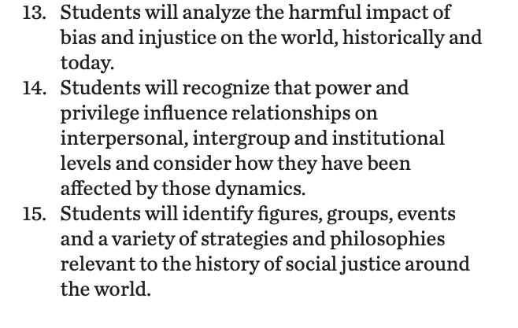
Standards/SJ Standards
Social Justice Standards
History Social Science Standards CA
Teaching Hard History Standards
Notes:
Standards:
Included here are the standards addressed throughout this study. They all in one place so as to keep the study focused on the goals written in the standards. We introduce one standard at a time, starting with the Teaching Hard History Standard, “In every place and time, enslaved people sought freedom”, as this is the main focus of the entire study.

Slide 3
The cry for Black Lives Mattering
President Obama: Trayvon Martin Made America Confront Its Original Sin | NYT Opinion
Or
Origins of Black Lives Matter (7 min) (start at 1:15 to avoid language)
Notes:
Building background through media
Students will build background knowledge, vocabulary, and build towards a deep understanding of the concept through images and/or multi/media presentations and discussion.Students engage in discussion/turn and talks/ and/or whole class discussion. An optional scaffold to add to the class discussion after viewing is writing important discussion points on a white board or chart paper in order to assist students in their journal writing later.
Key understandings for this background media:
In this video the origins of the Black Lives Matter is explained and placed in the context of the ongoing Civil Rights Movement.
Key learnings include the rise of activism stemming from frustration and heartbreak at the loss of live and the lack of justice.

Slide 4
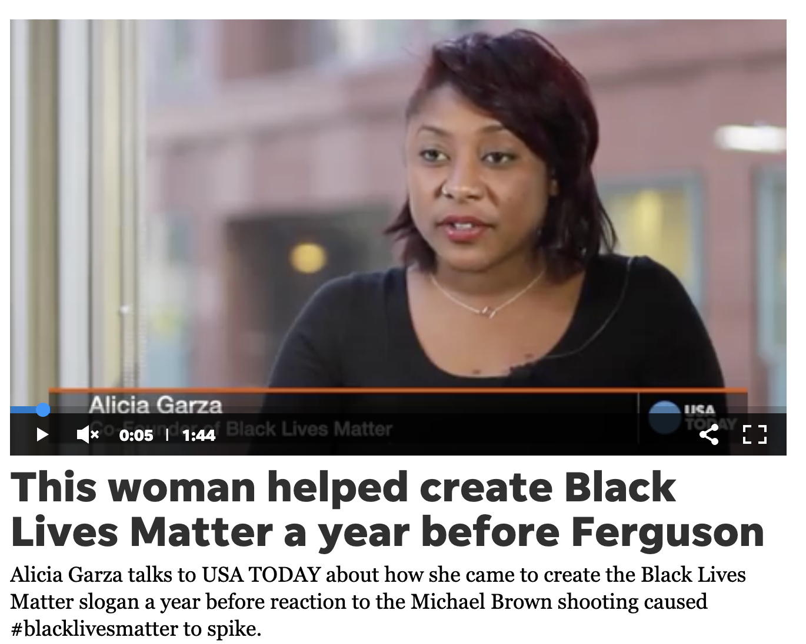
Alicia Garza on her Facebook post that started Black Lives Matter
Notes:
Building background through media
Students will build background knowledge, vocabulary, and build towards a deep understanding of the concept through images and/or multi/media presentations and discussion.Students engage in discussion/turn and talks/ and/or whole class discussion. An optional scaffold to add to the class discussion after viewing is writing important discussion points on a white board or chart paper in order to assist students in their journal writing later.
Key understandings for this background media:
Alicia Garza explains how her lament over the acquittal of Trayvon Martin’s killer (George Zimmerman) led to the #Black Lives Matter and how the message fueled street protests and the growth of a movement.

Slide 5
#BlackLivesMatter
Jessica Guynn
USA TODAY (MArch 4th 2
Alicia Garza was watching television news in an Oakland, Calif., bar with friends when neighborhood watch volunteer George Zimmerman was acquitted of murder in the killing of Trayvon Martin, an unarmed 17-year-old African-American.
"It was as if we had all been punched in the gut," she recalled. She pulled out her phone to check Facebook. "What I saw was really disappointing," Garza said.
Many of the responses "were blaming black people for our own conditions," she said. "It wasn't Trayvon Martin's fault that (Zimmerman) stopped him and murdered him. ... It really has to do with a society that has a really sick disease and that disease is racism."
Martin could just as easily have been her brother, a gentle, 6-foot, 25-year-old with a big Afro "who could never hurt a fly," Garza said.
"I felt not only enraged but a deep sense of grief that I can't protect him. I can't protect him against this cancer," she said.
So she composed a love note to black people on Facebook, urging them to come together to ensure "that black lives matter."
Her friend, Patrisse Cullors, a community organizer from Los Angeles, spotted the Facebook post and put a hashtag in front of those three words. #BlackLivesMatter was born.
The hashtag spread so quickly on social media because it distilled the complexities of police brutality, racial inequality and social justice "into a simple, easy to remember slogan that fits in a Tweet or on a T-shirt
Notes:
Building Background through text
We will be building more background/knowledge using text to build on the slidedeck topic. Students will have printed copies of these slides. Complete a close read of the information spending time for students to highlight their copies and annotate. Another option is having students complete a close read in small groups or partners first and then bringing class together to read through discussing important information. This is also a good time to have students ask any questions about the text.
Key understandings of this text:

Slide 6
Crash Course-Black Lives Matter
Notes:
Building background through media
Students will build background knowledge, vocabulary, and build towards a deep understanding of the concept through images and/or multi/media presentations and discussion.Students engage in discussion/turn and talks/ and/or whole class discussion. An optional scaffold to add to the class discussion after viewing is writing important discussion points on a white board or chart paper in order to assist students in their journal writing later.
Key understandings for this background media:
This video offers additional background

Slide 7
A,E,I,O,U,1,2 Use this approach to help read words with multiple syllables.
Place an X under each A, E, I, O, U
Count the letters between the X’s
Split between:
(X and X) example: jo/vi/al
(X and 1) example: te/na/cious
(1 and 2) example: bal/lad
Do not separate blends or word groupings that need each other.
ous, qu, bi, cl, dr, pr, cial, tion
Intervening
reimagine
Breathable
foundational
Notes:
Word Work
On this slide, students are introduced to four multisyllabic words that they will encounter in the texts below. The strategy is to first place an X under each vowel. Then the students will split the word into syllables and then they blend the syllables to put the word together.
If your students are familiar with syllable types, here is another strategy you can teach your students to decode multisyllabic words.
After decoding the words, you can use the GLAD strategy of Cognitive Content Dictionary (background information linked). These words are key to understanding the text on these slides.

Slide 8
Black Lives Matter has 6 pillars:
POLICY
ARTS
HEALING JUSTICE
FRONTLINE ORGANIZING
RESEARCH & EDUCATION
CULTURE
Here is a statement about what BLM is doing in the area of POLICY
We are intervening on existing and new policies that reimagine
a world without punitive measures and create a world where Black people have all that we need: food, education, housing, health care, clean water, breathable air, and everything that is foundational to personal and community safety.
Notes:
Building Background through text
We will be building more background/knowledge using text to build on the slidedeck topic. Students will have printed copies of these slides. Complete a close read of the information spending time for students to highlight their copies and annotate. Another option is having students complete a close read in small groups or partners first and then bringing class together to read through discussing important information. This is also a good time to have students ask any questions about the text.
Key understandings of this text:

Slide 9
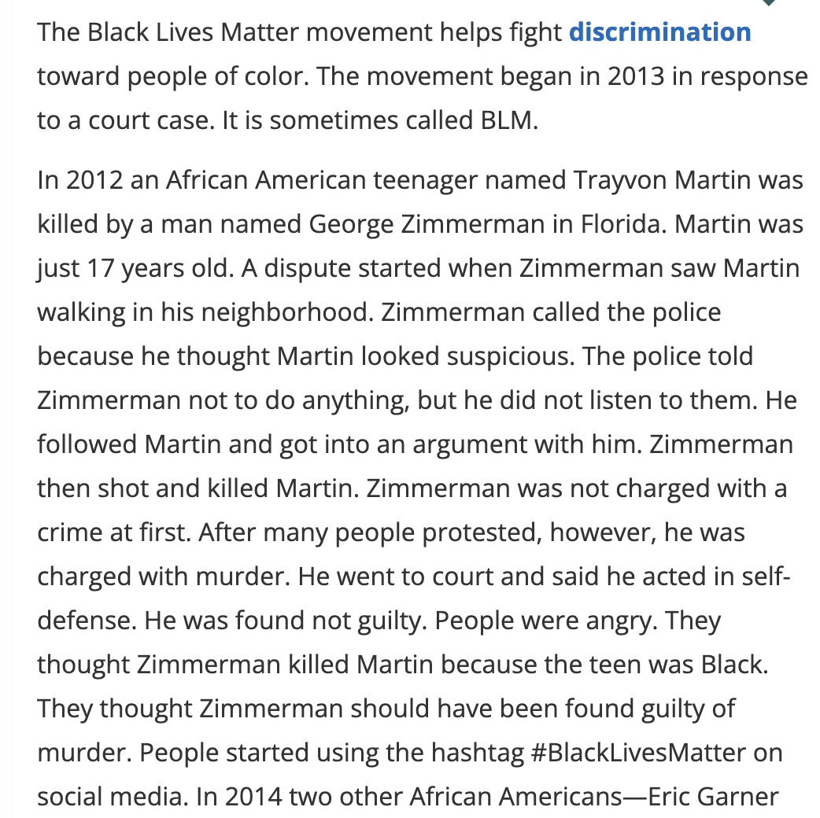
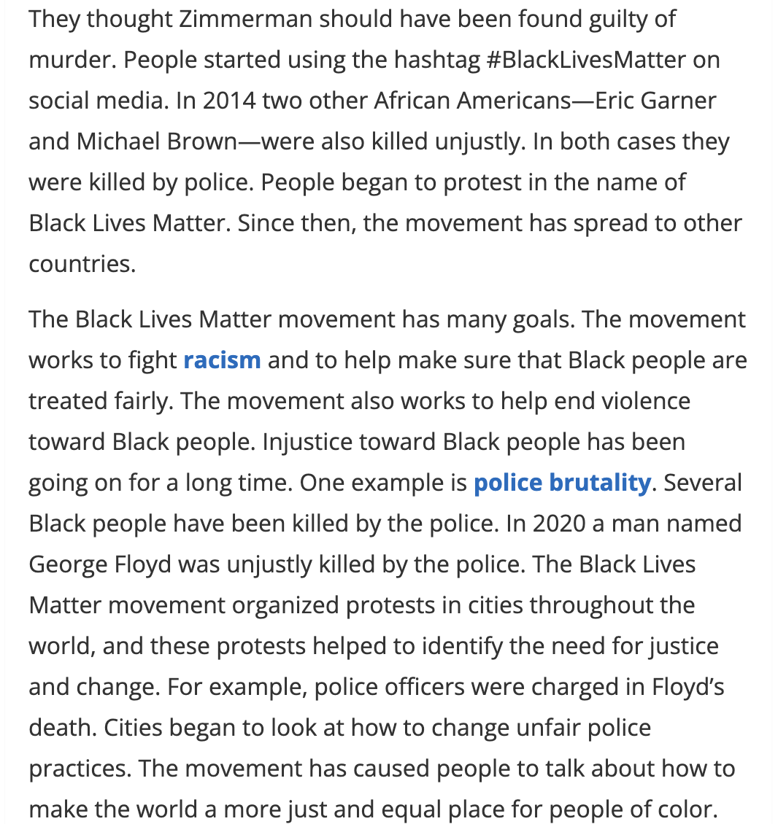
Notes:
Building Background through text
We will be building more background/knowledge using text to build on the slidedeck topic. Students will have printed copies of these slides. Complete a close read of the information spending time for students to highlight their copies and annotate. Another option is having students complete a close read in small groups or partners first and then bringing class together to read through discussing important information. This is also a good time to have students ask any questions about the text.
Key understandings of this text:
https://kids.britannica.com/kids/article/Black-Lives-Matter/632612

Slide 10
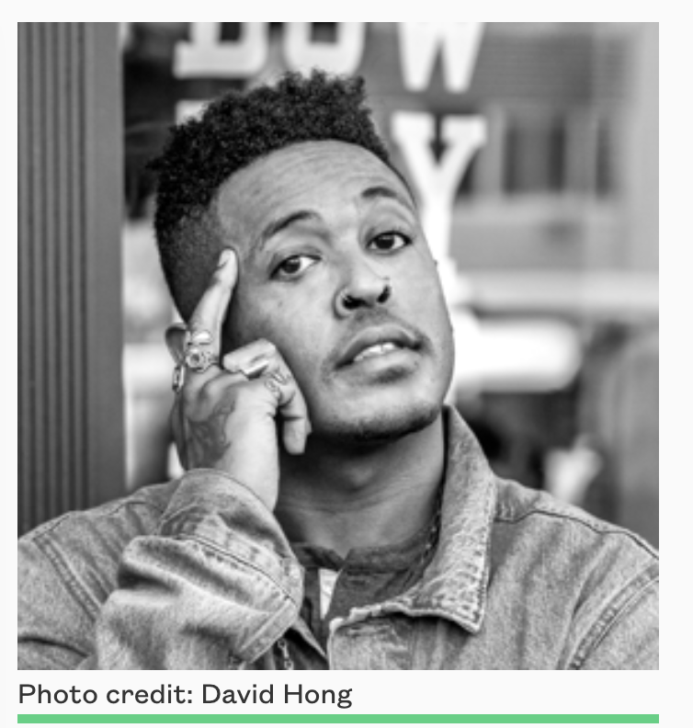
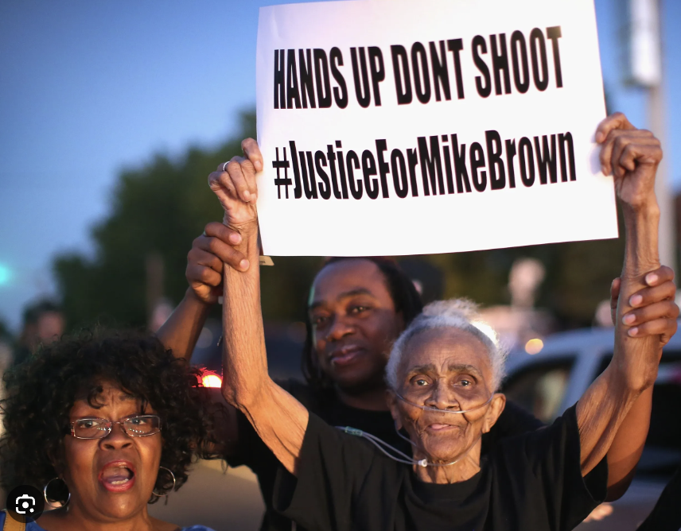
Poetry of the movement
let ruin end here
let him find honey where there was once a slaughter
let him enter the lion’s cage & find a field of lilacs
let this be the healing & if not let it be
‘little prayer’ by Danez Smith (picture below) was published in 2017 in Don’t Call Us Dead. It is an elegy, written in honor of Michael Brown, an 18-year-old Black man who was shot in August 2014. The event birthed the slogan “Hands up, don’t shoot,” which’s still used to this day during protests (also picture below)
Notes:
Building Background through text
We will be building more background/knowledge using text to build on the slidedeck topic. Students will have printed copies of these slides. Complete a close read of the information spending time for students to highlight their copies and annotate. Another option is having students complete a close read in small groups or partners first and then bringing class together to read through discussing important information. This is also a good time to have students ask any questions about the text.
Key understandings of this text:
Danez Smith responds in poetry to the killing of 18 year old Michael Brown

Slide 11
systemic societal solidarity marginalized
In recent years, the world has witnessed the emergence of a powerful movement called Black Lives Matter. This movement emerged as a response to the longstanding racial injustices faced by Black communities. Black Lives Matter is not just a phrase but a resounding call for justice, equality, and human rights.
Through peaceful protests, activism, and social media, people from all walks of life have come together to raise their voices and demand change. The movement aims to shed light on ________ racism, police brutality, and the need for ________ eforms that treat everyone with fairness and respect, regardless of their skin color.
Black Lives Matter stands for unity and________ , empowering voices that have been ________ for far too long. It is a reminder that we must confront America’s hard histories, learn from them, and build a brighter future together.
Notes:
Cloze passage
In this section, students read a text from the previous slide deck using “cloze passage” method. The cloze passage is pulled from previous reading and helps build reading fluency. In the previous reading there are key vocabulary words (non sight words) missing. There are a few options with different scaffolds. One way to complete this passage is to read chorally with all students while the vocabulary are listed above the passage. Students choose which words to fill into the passage while reading chorally. Students can also complete this independently or with a partner. After identifying the words, the next step would be talking about the importance and meaning of the words. It could be a reminder for them from the previous text, but multiple exposures will support their understanding.
Here is an article about using cloze passages and about fluency, which is the work on slide 19, if you’d like to read more.

Slide 12
Fluency Practice Practice reading the text below with a partner. The goal is to read the text with 100% accuracy. The words in red are from the A, E, I, O, U, 1, 2 List.
In recent years, the world has witnessed the emergence of a powerful movement called Black Lives Matter. This movement emerged as a response to the longstanding racial injustices faced by Black communities. Black Lives Matter is not just a phrase but a resounding call for justice, equality, and human rights.
Through peaceful protests, activism, and social media, people from all walks of life have come together to raise their voices and demand change. The movement aims to shed light on systemic racism, police brutality, and the need for societal reforms that treat everyone with fairness and respect, regardless of their skin color.
Black Lives Matter stands for unity and solidarity, empowering voices that have been marginalized for far too long. It is a reminder that we must confront America’s hard histories, learn from them, and build a brighter future together.
Notes:
Fluency
Each day, students should be working on fluency. They can either pair up with a partner, or practice by themselves in this first reading. The ultimate goal would be that they have a fluency partner, each reading to the other for one minute. I have the first reader identify themself and place their finger on the first word, and the listener does the same, but be ready to listen. After one minute, I tell them to stop and switch roles.
If you print this text for them, the only change would be that the listener has a pencil ready to make the text with words missed from the reader. That is not to highlight mistakes, but to support one another in building towards fluency.

Slide 13
Class Discussion
What is the purpose of the Black Lives Matter organization?
Why have so many people participated in protests
related to Black Lives Matter?
How is the Black Lives Matter movement of the 2020s similar to the Civil Rights movement of the 1960s
How is it different?
Notes:
Class Discussion
In this section, students discuss what they have learned in a whole group discussion. Use these questions as a guideline to the discussion, but also feel free to follow what the students have gleaned from the learning so far in this slide deck. This discussion will support them in the writing section, where each student will be expected to write a page about what they learned. This will be very helpful for them to make connections, ask questions and build an understanding of the content.

Slide 14
Writing Tips Use the following tips to complete your writing using the texts and the videos. Remember to include what you learned about the topic. Also, share your thinking about what you learned.
Using the texts and videos, write about Black Lives Matter
Write what you learned about (topic) from the examples, the reading and the videos.
Write what you will do with what you have learned.
What thoughts or questions do you have after today’s lesson?
Writing Structure- summary sentences
Notes:
Writing
Each student should be prepared to write an entire page about what they learned today. You can either provide a blank journal or print and copy journal pages for them. The expectation is that they fill a page, and though they might struggle initially, they will get used to the format.
Possible scaffold for writing-To help emergent bilingual students you may pull a small group and give a paragraph frame or complete a guided writing.
For students who need more support, some sentence starters could be:
Today I learned about…
One thing I connected with was …
This helped me understand ….
An example of resistance was …..

Slide 15
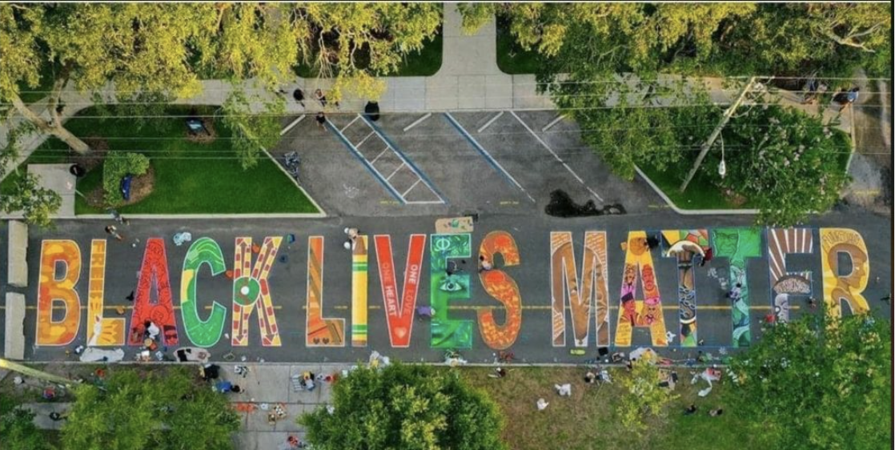
Many places across the world have used art to proclaim support for the Black Lives Matter movement.
This example is from St. Petersburg, Florida
Can you find local examples?
Notes:
Joy: How will my instruction advance students’ happiness through the use of beautiful and truthful images, representations, and narratives about themselves and/or others? This portion can be included during the lesson or at a separate time depending on time availability.
Key understandings of this section:
The three words BLACK LIVES MATTER are making a powerful statement throughout the world. Many communities are proclaiming these words in a variety of public art like the block long street painting you see here. Find and or create other examples of art proclaiming this message. How would you describe the tone of these works of art? What feeling does the art create?

