Slide 1
African American History 400+ years of Resistance, Resilience, Power, and Pride
Today you will become smarter about Angela Davis and the movement to Abolish Prisons
Notes:
Introduction:
In this slide deck, students will be introduced to the abolitionist Angela Davis.
It will be very important to continuously come back to the idea of resistance; that in every time and place, enslave people sought freedom, as stated in the Teaching Hard History standards.
This slide deck is to provide background and build a foundation for the learning that will take place throughout this study. The slides take the students through experiences of viewing images, watching videos and reading text in order to build background knowledge. They will also build foundational skills throughout the slides while learning the content.
Joy is included at the end of every slide deck to celebrate the foundation of food, song, dance, etc, brought to the United States by Africans forced from their homes.
To prepare for this study, the students should be provided with a blank journal or journal pages in a folder, as they will be writing a full page at the end of each slide deck, possibly more. Also, the slide decks were originally designed to be completed in one class period, but I have found that it usually takes two to three class periods. If that is the same for you, you might have the students at least write a sentence or two at the end of each period so they remember what they learned throughout the study.

Slide 2
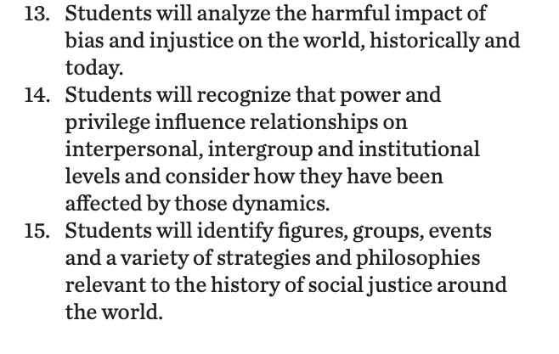
Standards/SJ Standards
Social Justice Standards
History Social Science Standards CA
Teaching Hard History Standards
Notes:
Standards:
Included here are the standards addressed throughout this study. They all in one place so as to keep the study focused on the goals written in the standards. We introduce one standard at a time, starting with the Teaching Hard History Standard, “In every place and time, enslaved people sought freedom”, as this is the main focus of the entire study.

Slide 3
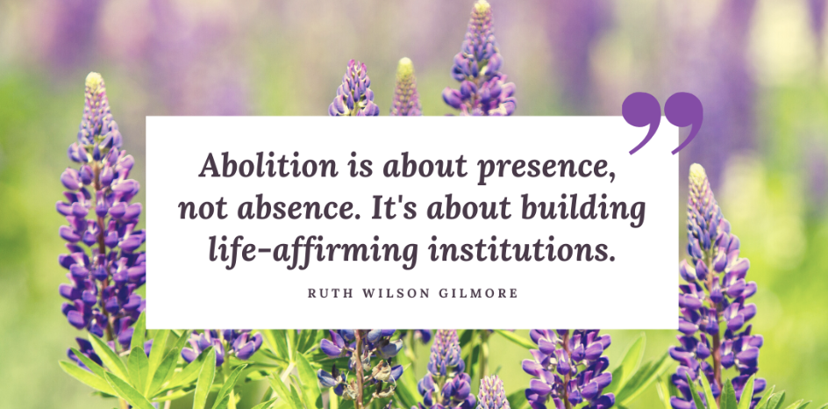
Notes:
Building Background through text
We will be building more background/knowledge using text to build on the slidedeck topic. Students will have printed copies of these slides. Complete a close read of the information spending time for students to highlight their copies and annotate. Another option is having students complete a close read in small groups or partners first and then bringing class together to read through discussing important information. This is also a good time to have students ask any questions about the text.
Key understandings of this text:

Slide 4
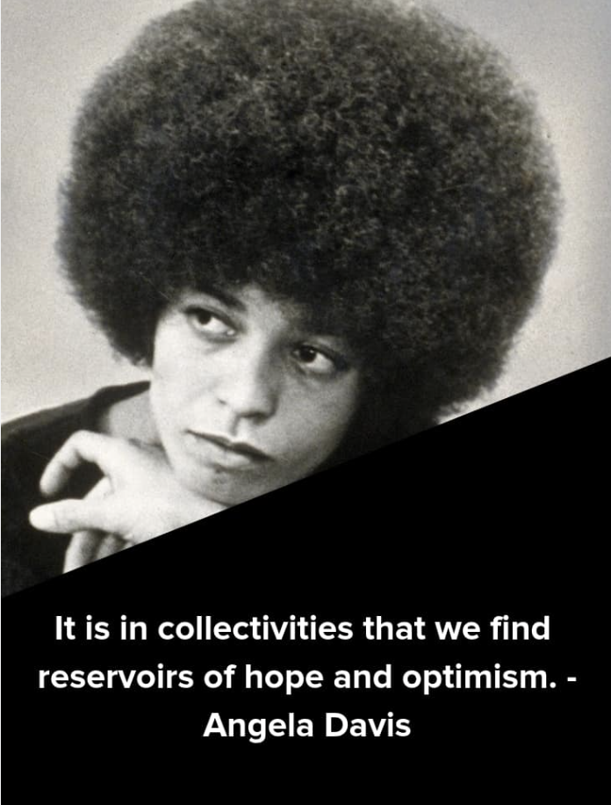
https://womenshistory.si.edu/herstory/activism/video/how-did-angela-davis-inspire-movement-becauseofherstory
Notes:
Building background through media
Students will build background knowledge, vocabulary, and build towards a deep understanding of the concept through images and/or multi/media presentations and discussion.Students engage in discussion/turn and talks/ and/or whole class discussion. An optional scaffold to add to the class discussion after viewing is writing important discussion points on a white board or chart paper in order to assist students in their journal writing later.
Key understandings for this background media:
In this two minute video, Kemi, a student, talks with Kelly Elaine Navies, oral historian at our National Museum of African American History and Culture about how in in 1970, activist Angela Davis was charged with murder. A movement arose to free her, and her time in jail inspired her to work to change the prison system.

Slide 5
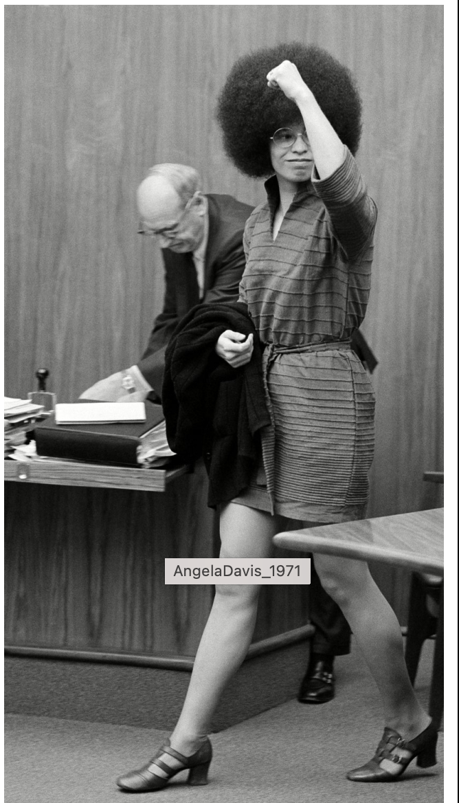
Angela Davis Defended Herself against Unjust Criminal Charges
https://www.youtube.
com/watch?v=W9OnR6wjkTs
Notes:
Building background through media
Students will build background knowledge, vocabulary, and build towards a deep understanding of the concept through images and/or multi/media presentations and discussion.Students engage in discussion/turn and talks/ and/or whole class discussion. An optional scaffold to add to the class discussion after viewing is writing important discussion points on a white board or chart paper in order to assist students in their journal writing later.
Key understandings for this background media:
This 3 min. video provides background to Angela Davis career as an activist and scholar in the academy. It also explains her personal involvement in the criminal justice system (including as a fugitive and prisoner) and her ongoing fight to expose the racial bias within the system.

Slide 6
A,E,I,O,U,1,2 Use this approach to help read words with multiple syllables.
Place an X under each A, E, I, O, U
Count the letters between the X’s
Split between:
(X and X) example: jo/vi/al
(X and 1) example: te/na/cious
(1 and 2) example: bal/lad
Do not separate blends or word groupings that need each other.
ous, qu, bi, cl, dr, pr, cial, tion
Choose 4 words here from the text that students might struggle to decode.
injustice
cultivate
generation
organized
Notes:
Word Work
On this slide, students are introduced to four multisyllabic words that they will encounter in the texts below. The strategy is to first place an X under each vowel. Then the students will split the word into syllables and then they blend the syllables to put the word together.
If your students are familiar with syllable types, here is another strategy you can teach your students to decode multisyllabic words.
After decoding the words, you can use the GLAD strategy of Cognitive Content Dictionary (background information linked). These words are key to understanding the text on these slides.

Slide 7
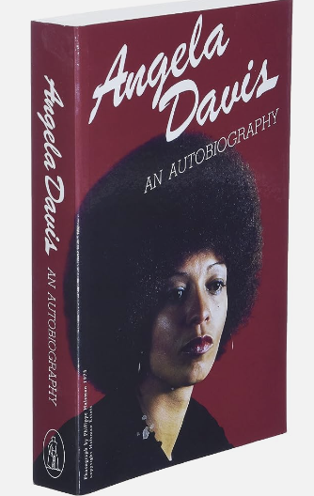
Davis knew early on that she would be a fighter for justice
Davis grew up with a burning sense of justice – and injustice. She received a good education at her segregated school, where she was taught about Black history, and endowed with pride. “The teachers felt the need to cultivate a generation who would be capable of resisting the ideological racism surrounding us.” Her mother told young Angela that the world they were living in was not the world of the future. “She always said: never forget that that world is not organized in the way it should be and that things will change, and that we will be a part of that change.”
Excerpt of interview https://www.theguardian.com/us-news/2022/mar/05/angela-davis-on-the-power-of-protest-we-cant-do-anything-without-optimism
Notes:
Building Background through text
We will be building more background/knowledge using text to build on the slidedeck topic. Students will have printed copies of these slides. Complete a close read of the information spending time for students to highlight their copies and annotate. Another option is having students complete a close read in small groups or partners first and then bringing class together to read through discussing important information. This is also a good time to have students ask any questions about the text.
Key understandings of this text:
This excerpt provides additional background information about Angela’s education and family background and how she was encouraged at home and at school to fight against racism. She also has written about her own life – a book you write about yourself is called an autobiography

Slide 8
Abolishing prisons means transforming the way we handle people who break the law. Instead of locking them away in jails, we would focus on understanding and addressing the root causes of their actions. It involves investing in education, mental health support, job opportunities, and community programs to prevent crime and help individuals reintegrate into society positively. The goal is to create a fair and just system that promotes healing, rehabilitation, and addressing the societal issues that contribute to crime.
Angela Davis, a strong advocate for change, works to abolish prisons. She believes in a world where we help and understand each other instead of punishing. Davis thinks prisons often don't address root problems, like poverty and lack of education. She wants a fair system that focuses on rehabilitation and support. By speaking up, she hopes to create a society where we heal and understand, making a world without mass incarceration possible.
Notes:
Building Background through text
We will be building more background/knowledge using text to build on the slidedeck topic. Students will have printed copies of these slides. Complete a close read of the information spending time for students to highlight their copies and annotate. Another option is having students complete a close read in small groups or partners first and then bringing class together to read through discussing important information. This is also a good time to have students ask any questions about the text.
Key understandings of this text:

Slide 9
Class discussion
Why do you think Angela Davis believes in abolishing prisons?
How did Angela Davis’ life experiences push her to activism?
What connections can you make between prisons and enslavement?
Notes:
Class Discussion:
In this section, students discuss what they have learned in a whole group discussion. Use these questions as a guideline to the discussion, but also feel free to follow what the students have gleaned from the learning so far in this slide deck. This discussion will support them in the writing section, where each student will be expected to write a page about what they learned. This will be very helpful for them to make connections, ask questions and build an understanding of the content.

Slide 10
Injustice cultivate generation organized
Davis grew up with a burning sense of justice – and _________. She received a good education at her segregated school, where she was taught about Black history, and endowed with pride. “The teachers felt the need to _______ a ________ who would be capable of resisting the ideological racism surrounding us.” Her mother told young Angela that the world they were living in was not the world of the future. “She always said: never forget that that world is not _________ in the way it should be and that things will change, and that we will be a part of that change.”
Notes:
Cloze passage
In this section, students read a text from the previous slide deck using “cloze passage” method. The cloze passage is pulled from previous reading and helps build reading fluency. In the previous reading there are key vocabulary words (non sight words) missing. There are a few options with different scaffolds. One way to complete this passage is to read chorally with all students while the vocabulary are listed above the passage. Students choose which words to fill into the passage while reading chorally. Students can also complete this independently or with a partner. After identifying the words, the next step would be talking about the importance and meaning of the words. It could be a reminder for them from the previous text, but multiple exposures will support their understanding.
Here is an article about using cloze passages and about fluency, which is the work on slide 19, if you’d like to read more.

Slide 11
Fluency Practice Practice reading the text below with a partner. The goal is to read the text with 100% accuracy. The words in red are from the A, E, I, O, U, 1, 2 List.
Davis grew up with a burning sense of justice – and injustice. She received a good education at her segregated school, where she was taught about Black history, and endowed with pride. “The teachers felt the need to cultivate a generation who would be capable of resisting the ideological racism surrounding us.” Her mother told young Angela that the world they were living in was not the world of the future. “She always said: never forget that that world is not organized in the way it should be and that things will change, and that we will be a part of that change.”
Notes:
Fluency
Each day, students should be working on fluency. They can either pair up with a partner, or practice by themselves in this first reading. The ultimate goal would be that they have a fluency partner, each reading to the other for one minute. I have the first reader identify themself and place their finger on the first word, and the listener does the same, but be ready to listen. After one minute, I tell them to stop and switch roles.
If you print this text for them, the only change would be that the listener has a pencil ready to make the text with words missed from the reader. That is not to highlight mistakes, but to support one another in building towards fluency.

Slide 12
Writing Tips Use the following tips to complete your writing using the texts and the videos. Remember to include what you learned about the topic. Also, share your thinking about what you learned.
Using the texts and videos, write about Angela Davis and Aboltionism Today
Write what you learned about Aboltionism Today and Angela Davis from the examples, the reading and the videos.
Write what you will do with what you have learned.
What thoughts or questions do you have after today’s lesson?
Writing Structure- summary sentences
Notes:
Writing
Each student should be prepared to write an entire page about what they learned today. You can either provide a blank journal or print and copy journal pages for them. The expectation is that they fill a page, and though they might struggle initially, they will get used to the format.
Possible scaffold for writing-To help emergent bilingual students you may pull a small group and give a paragraph frame or complete a guided writing.
For students who need more support, some sentence starters could be:
Today I learned about…
One thing I connected with was …
This helped me understand ….
An example of resistance was …..

Slide 13
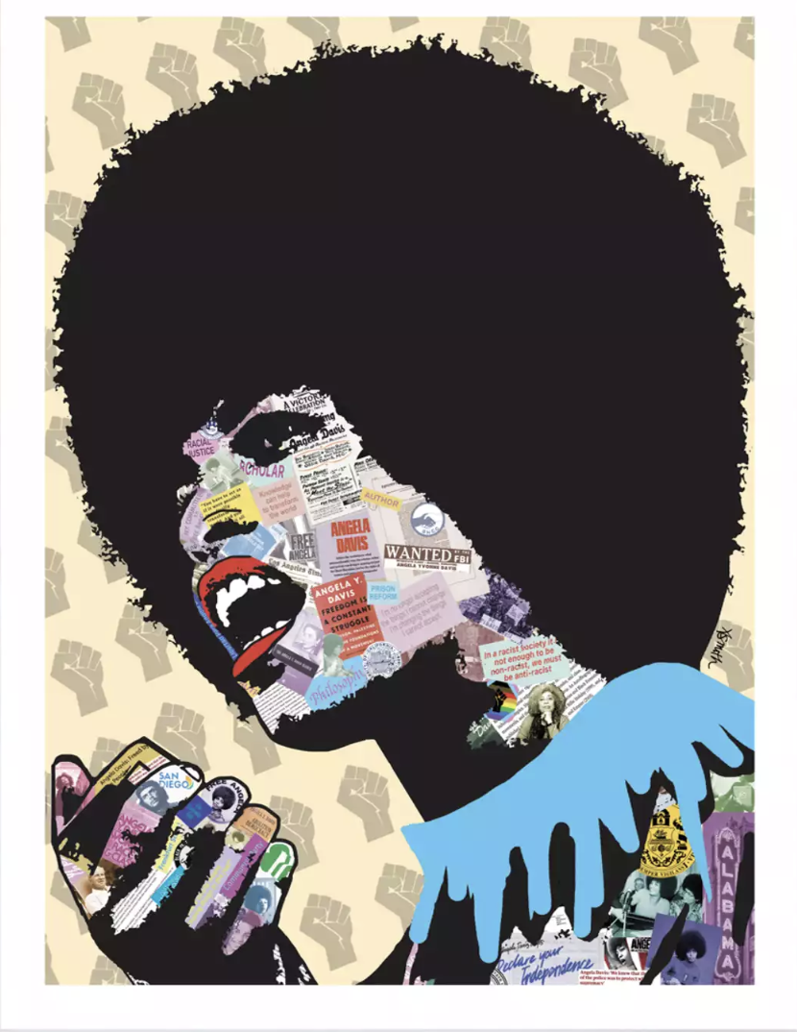
Angela Davis is a
Cultural Icon
Representing
Power and Style
This mixed media piece is by Amy Smith. Can you identify the symbols and images she uses in the collage?
What does messages does this image convey?
Notes:
Joy: How will my instruction advance students’ happiness through the use of beautiful and truthful images, representations, and narratives about themselves and/or others? This portion can be included during the lesson or at a separate time depending on time availability.
Key understandings of this section:
Angela Davis is powerful role model demonstrating what a lifetime of social justice looks like. She remains active today see the recent Netflix release of Stamped from the Beginning https://www.netflix.com/title/81321341

Slide 14
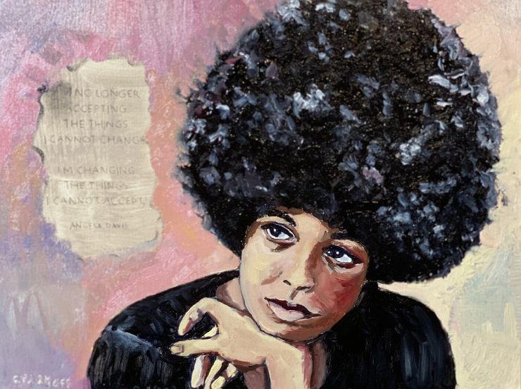
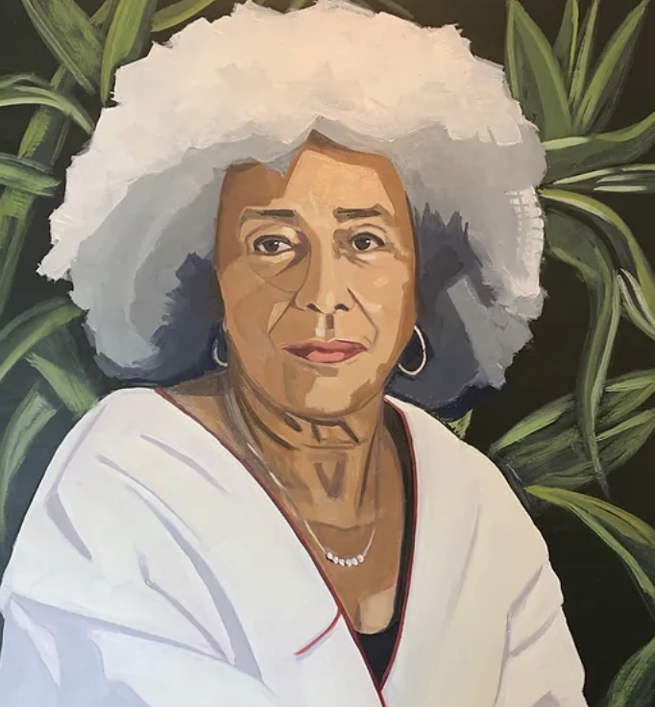
Search the internet for Angela Davis Art and see which images inspire you.
Here are some examples:
Notes:
Joy: How will my instruction advance students’ happiness through the use of beautiful and truthful images, representations, and narratives about themselves and/or others? This portion can be included during the lesson or at a separate time depending on time availability.
Key understandings of this section:
In what ways are the power and influence of Angela Davis’s words and actions captured in images of her?

