Slide 1
Empowering Equity Through Education
Illuminating Affirmative Action’s Legacy
An Oral Interview/Documentary Project

Slide 2
Open Up the Door: To be Young, Gifted, and Black
We are living in the wake of the United State Supreme Court’s ruling to overturn Affirmative Action.
Affirmative action was intended to alleviate under-representation and to promote the opportunities of defined minority groups within society.

Slide 3
Open Up the Door: To be Young, Gifted, and Black
In your writing journal…
What is equality to you?
In what ways can equality be achieved in education without Affirmative Action?

Slide 4
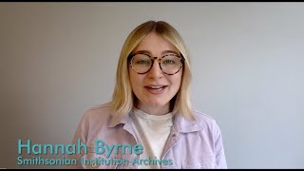
Open Up the Door: To be Young, Gifted, and Black
You will interview someone who was the beneficiary of affirmative action.
Themes to explore: identity, equality, and societal progress

Slide 5
Open Up the Door: To be Young, Gifted, and Black
You will record an interview and create a documentary to be shown during the end-of-unit exhibition.
You will use the step-by-step guide created by the Smithsonian Institution on How to Do Oral History to prepare for and complete your interview.

Slide 6
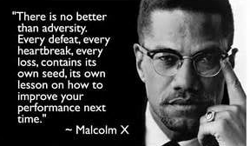
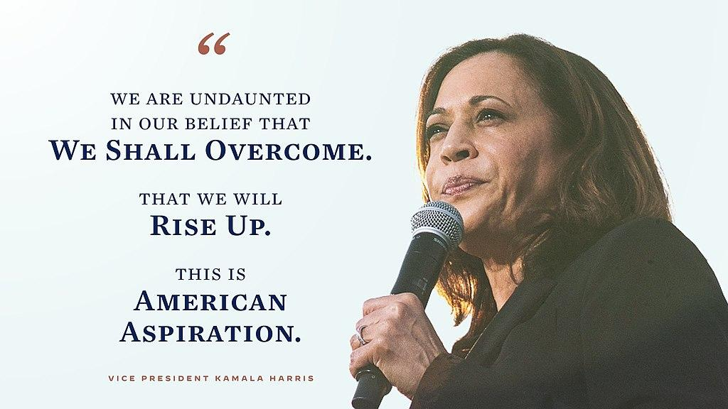
Open Up the Door: To be Young, Gifted, and Black
You will also take a portrait of your interviewee to be displayed at the exhibition with a quote from their interview.

Slide 7
Open Up the Door: To be Young, Gifted, and Black
You’ll be exhibiting all of your work during our culminating Film Festival/Exhibition.
Date: TBD

Slide 8
Open Up the Door: To be Young, Gifted, and Black
In your journal…
What is one thing you are still wondering about when it comes to viewing education through a lens of equity?

