Slide 1
Finding Genius: Past and Present
Amya. W and Maya. T

Slide 2
Table of contents
Introduction and Early Life
Major Life Events and Contributions
01
02
Impact on others & Photos
Our Thoughts & Conclusion
03
04
Notes:
1 min.

Slide 3
Introduction
Today we will be talking about the lives of Melissa Viviane Jefferson (aka Lizzo) and Maya Angelou and how they impacted the world with their existences and contributions.
Notes:
1 min.

Slide 4
Early Life
Maya
Lizzo
Maya Angelou return to her mothers house. She got r-word from her moms boyfriend and he was put in jail. Then he was Murdered when released from jail.
Melissa viviane Jefferson (aka lizzo) was born on 04-27-88 in Detroit Michigan. In high school in 2006 she started rapping at 14 and she formed a musical group called the Cornrow Clique with her friends.
Notes:
2 min.

Slide 5
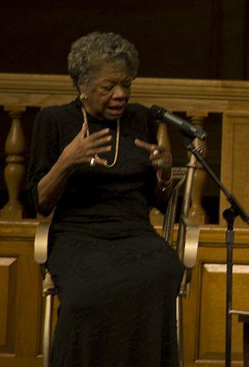
Major Life Events - Historical Figure
Maya
Angelou was a famous author. She wrote books about herself which is a autobiography. She also she was a dancer, singer, and a poet.
Notes:
1 min.

Slide 6
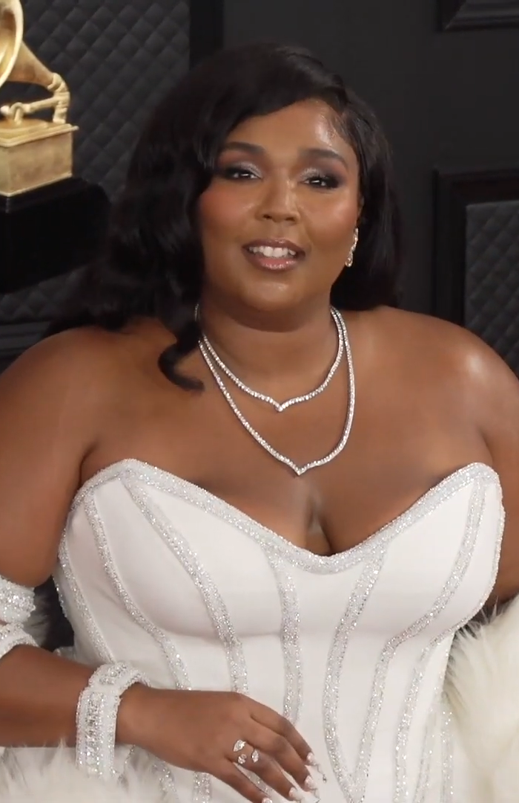
Major Life Events - Lizzo
In college Lizzo studied classical music concentrated on flute at the University of Houston. At age 21 after the death of her father she lived out in her car for a year as she tried to break out into the music industry.
Notes:
1 min.

Slide 7
Important Contributions
Past Figure - Maya.A
Current Figure - lizzo.J
Maya Angelou was a, poet, dancer, singer, activist, and Maya angelou was a world-famous author she was best known for her writing.
Lizzo both says and shows how being big doesn’t mean you can’t be beautiful and successful. Also she was in 33 films and won 4 grammys, 1 emmy,2 soul train music awards, a billboard award, bet award and a guinness world record.
Notes:
2 min.

Slide 8
Impact on Others - Maya
Community
Education
Society
Maya Angelou was a African American,poet, dancer, singer, activist.
She was best known for her unique writing.
Maya Angelou legendary poet and civil rights activist.
Notes:
1 min.

Slide 9
Impact on Others - Lizzo
Community
Education
Society
She shows how you can succeed no matter what you look like.
She shows that you don’t have to complete your education to succeed.
She’s showing society that you can succeed in anything no matter you back story.
Notes:
1 min.

Slide 10
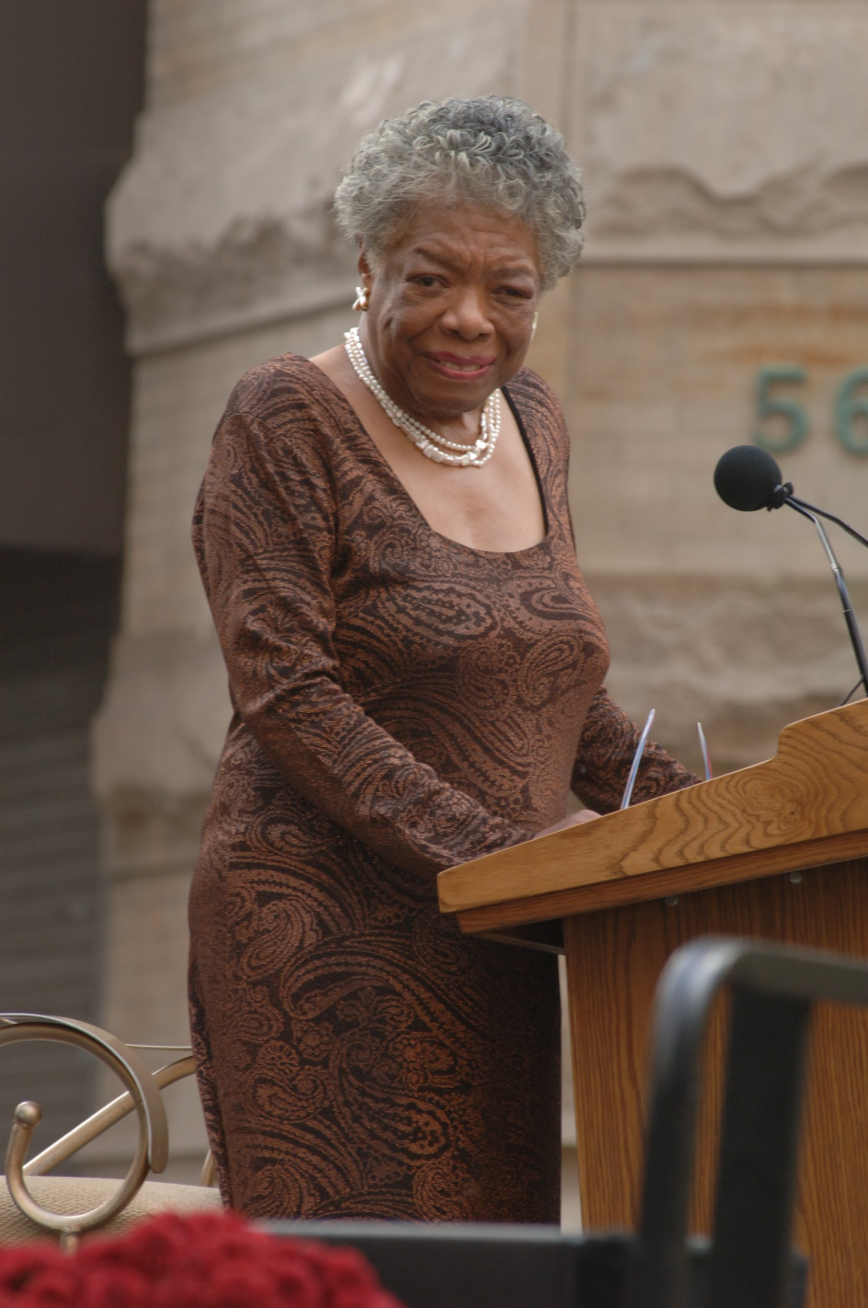
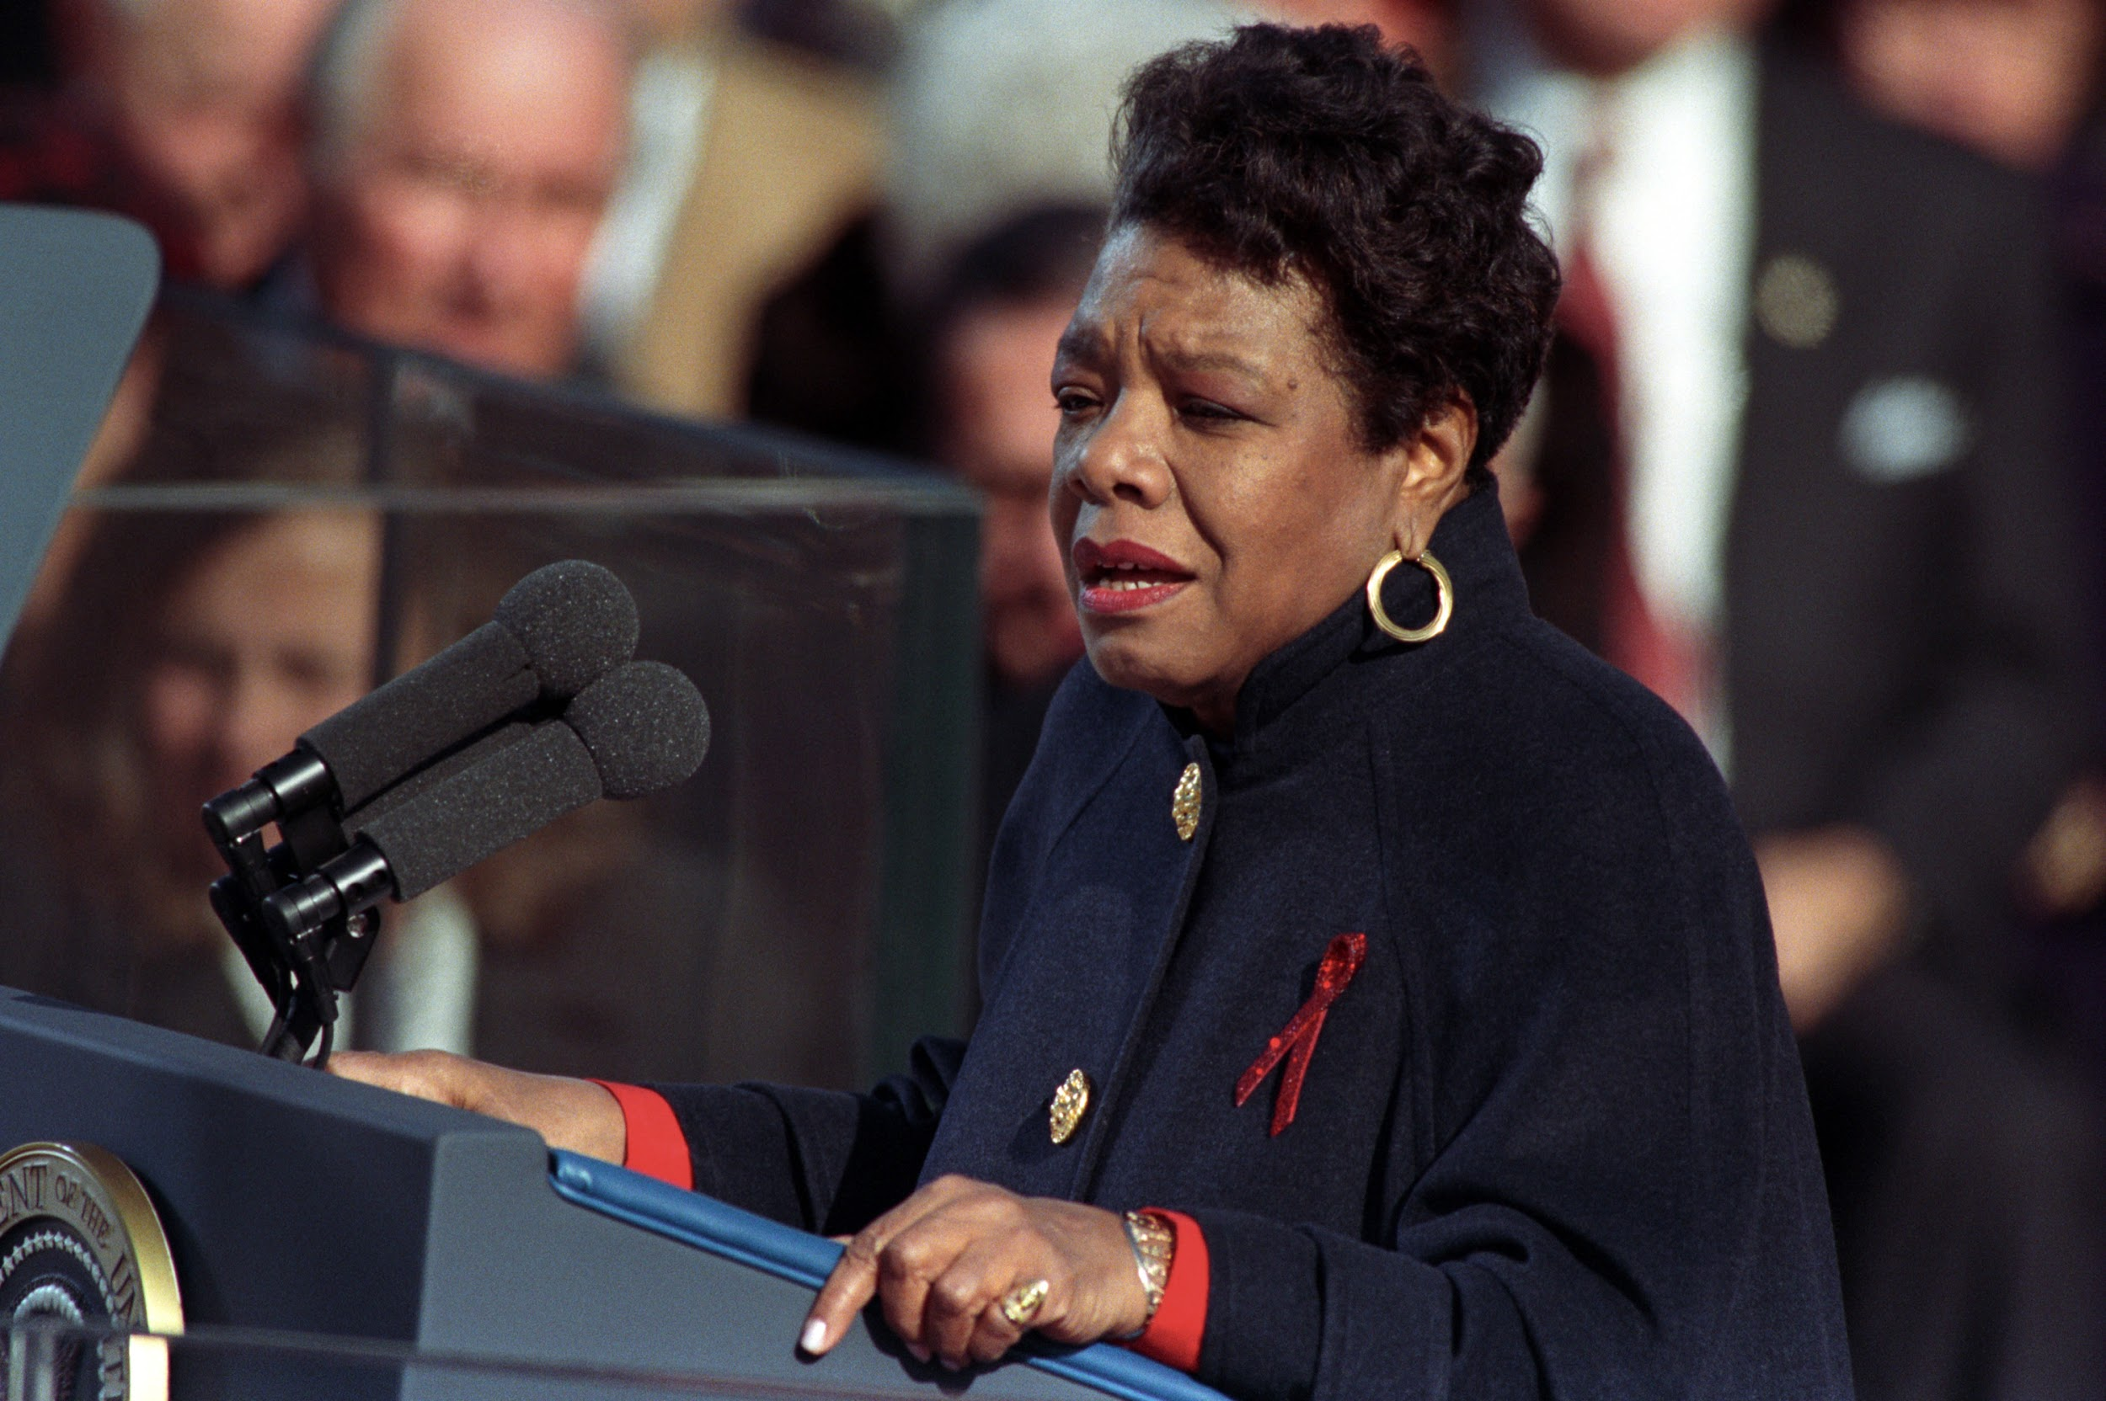
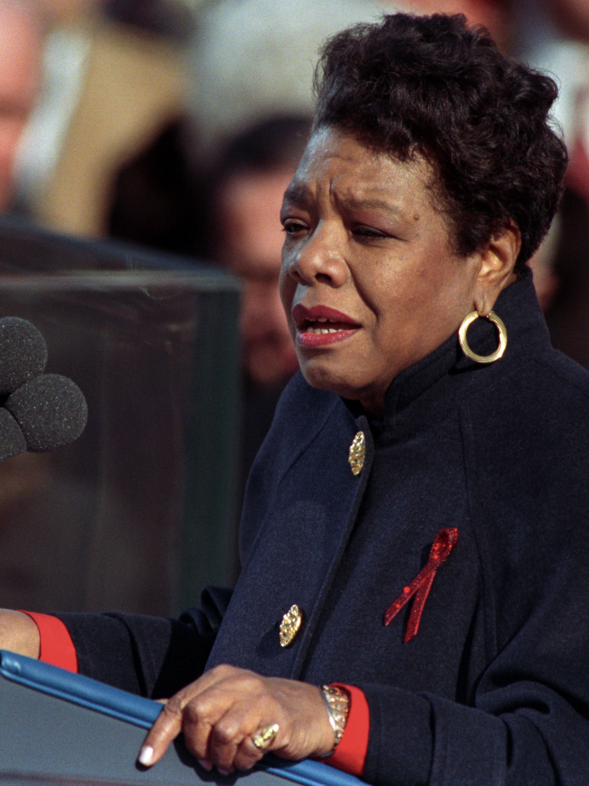
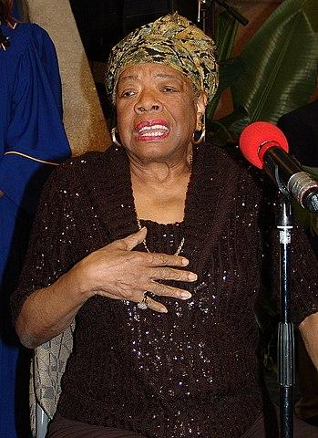
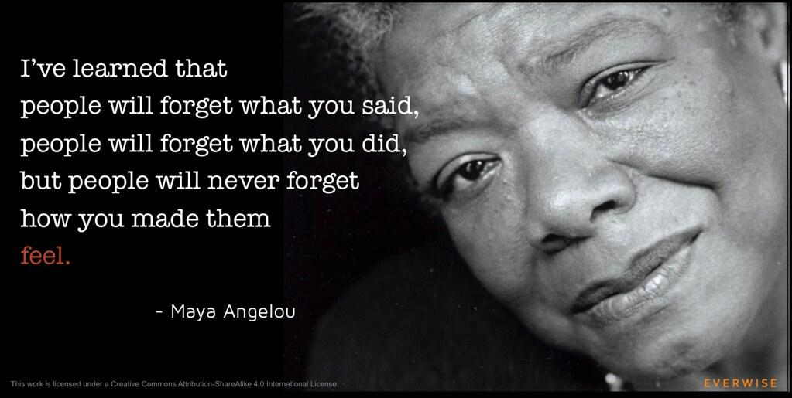
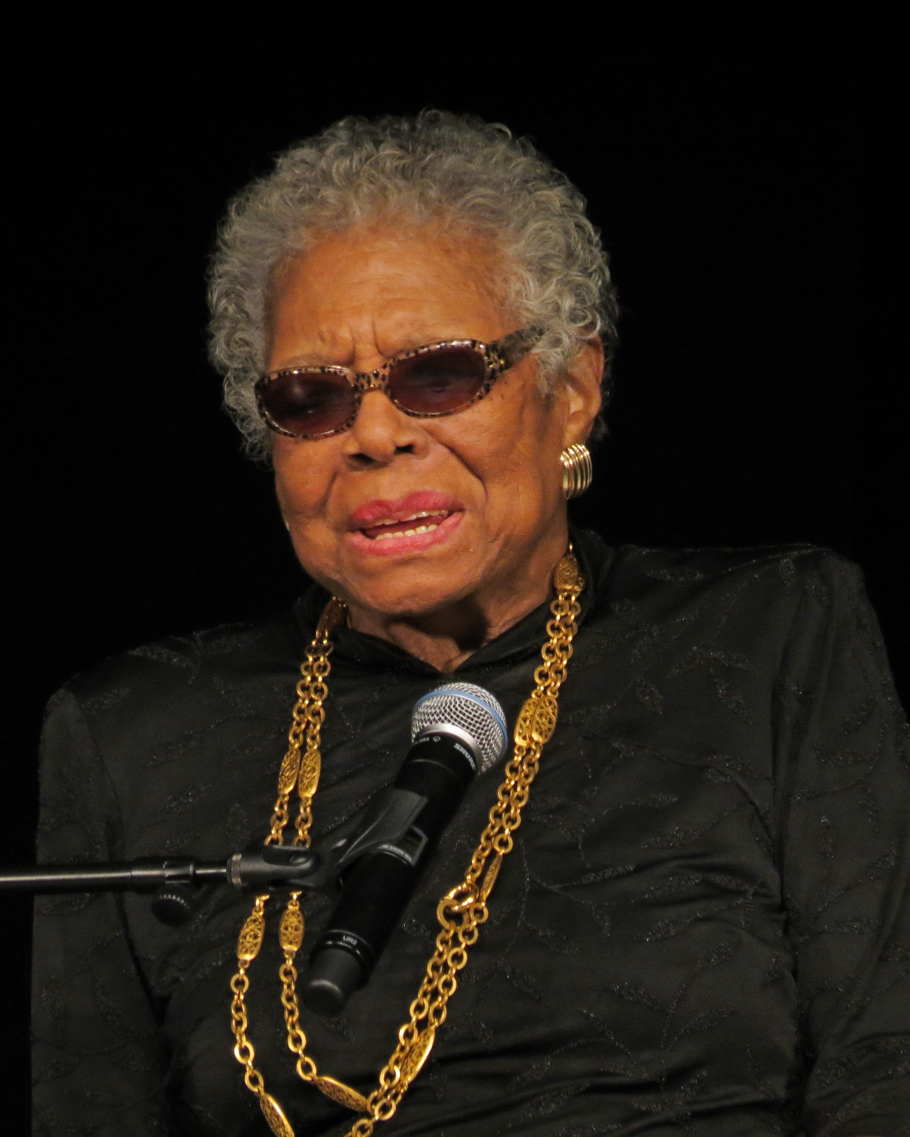
Pictures
tell the story
Notes:
30 sec.

Slide 11
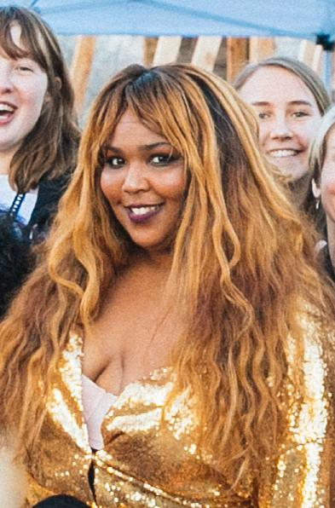
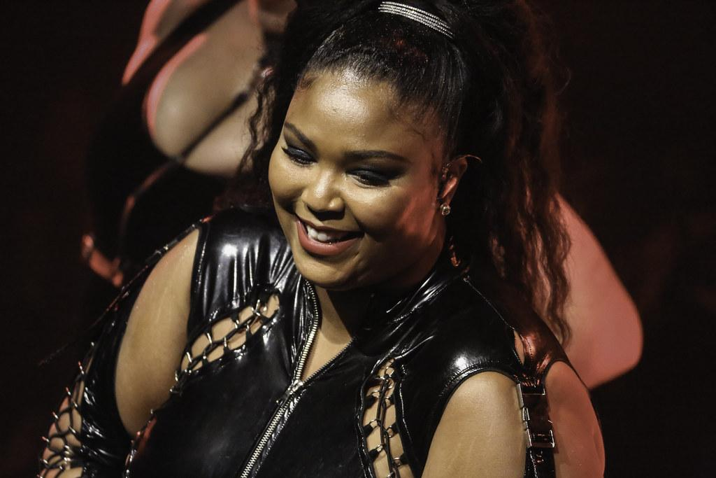
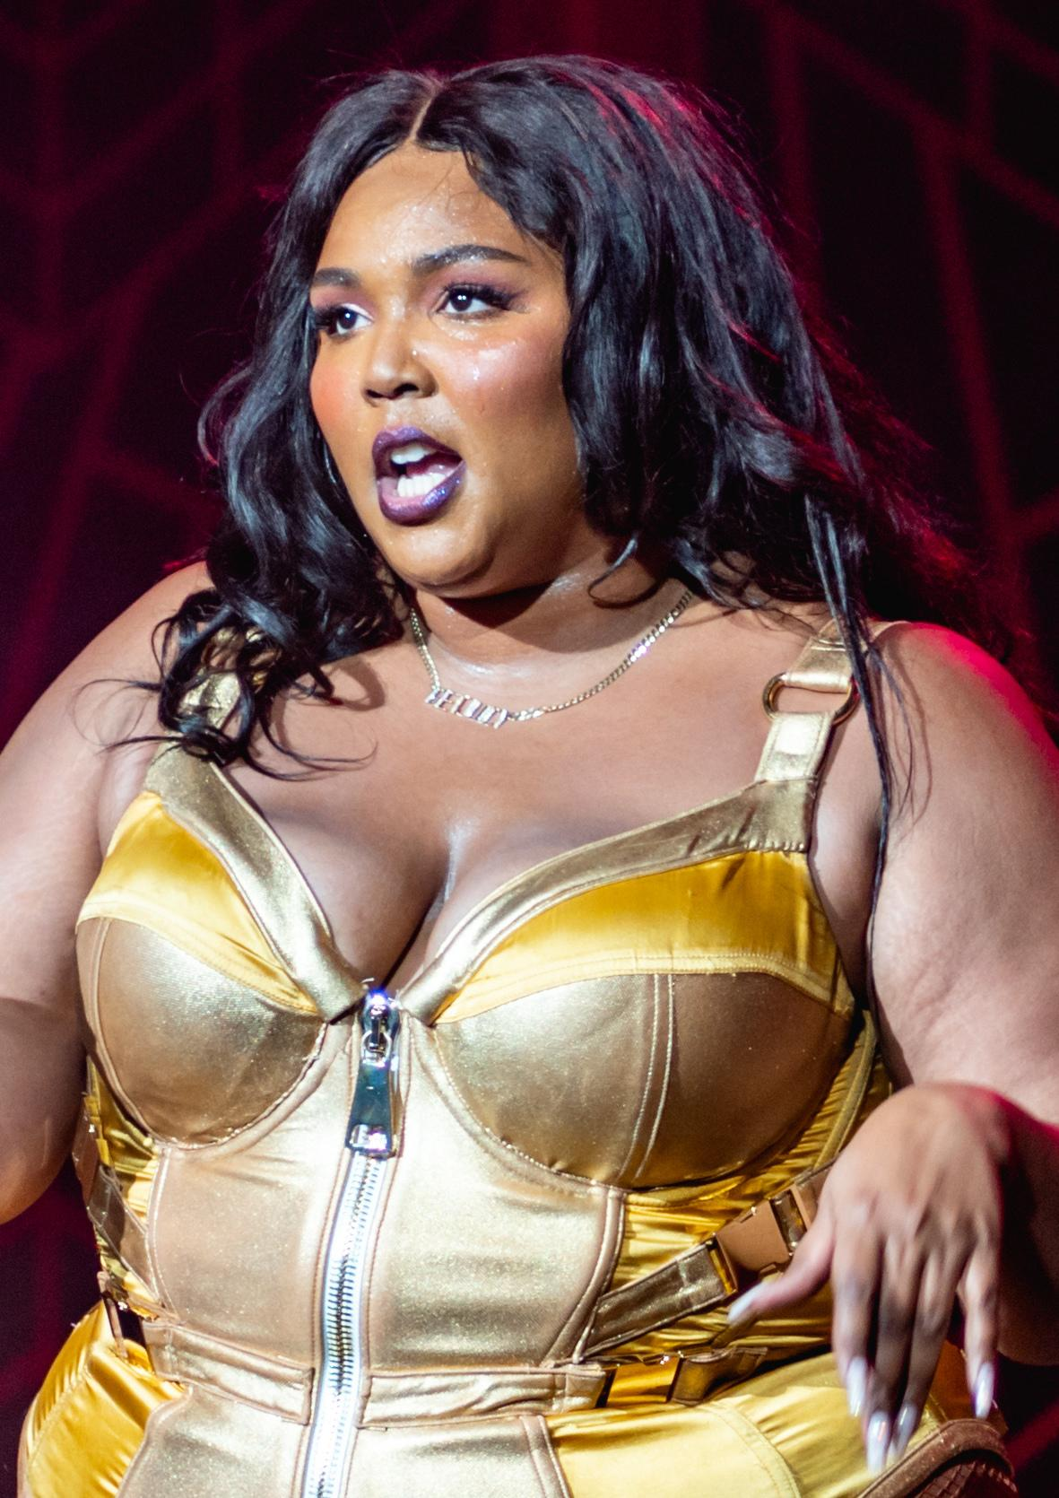
Pictures
tell the story
Notes:
30 sec.

Slide 12
Their Genius
Maya
Lizzo
Hoping for the best, prepared for the unsurprised by anything in between.
She decided that she wasn’t gonna wait for someone to motivate her to succeed she was gonna motivate herself to succeed.
Notes:
2 min.

Slide 13
Our Genius Connection
We have Mayas genius because try our best and we hope for the best.We have Lizzos genius because we don’t wait for someone to pick us up we stand up. And like both of them we are skilled individuals who think beyond the box.
Notes:
2 min.

Slide 14
Our Conclusion
Famous Quote
Reflection
“Im my own inspiration” - lizzo
.
She inspires herself to succeed and you can too.
Famous Quote
Reflection
“Never make someone a priority when all you are to them is an option” - Maya Angelou
Never treat someone better then they treat you .
Notes:
2 min.

Slide 15
How can you contribute to the world?
Notes:
30 sec.

