Slide 1
The Consequences of Standing Up
What are you willing to risk?

Slide 2
Your Topic/Video
Add additional text or an image here
Type group member names here

Slide 3
RISKS
What did the people engaging in these fights risk?

Slide 4
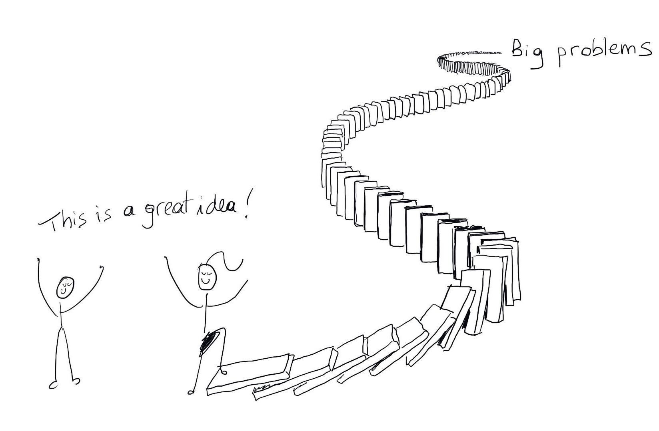
CONSEQUENCES
What consequences did they face?

Slide 5
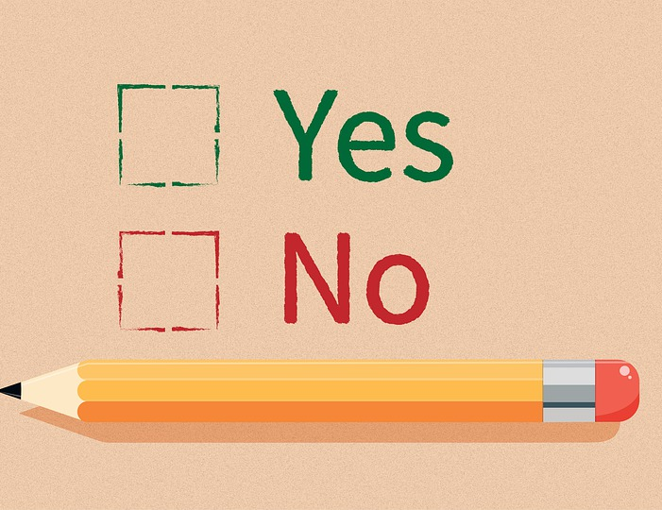
REFLECTION
Would you have made the same decisions as them? Why or why not?

