Slide 2
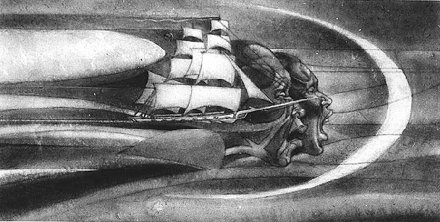
Is the artwork black & white or in color?
Is there a caption? If so what does it tell you
Why do you think the artwork was created?
Who is the artist and what is their relationship to the topic”
How does this artwork compare to modern times?
Where do you think we could find out more information about the people or objects in the artwork?

Slide 3
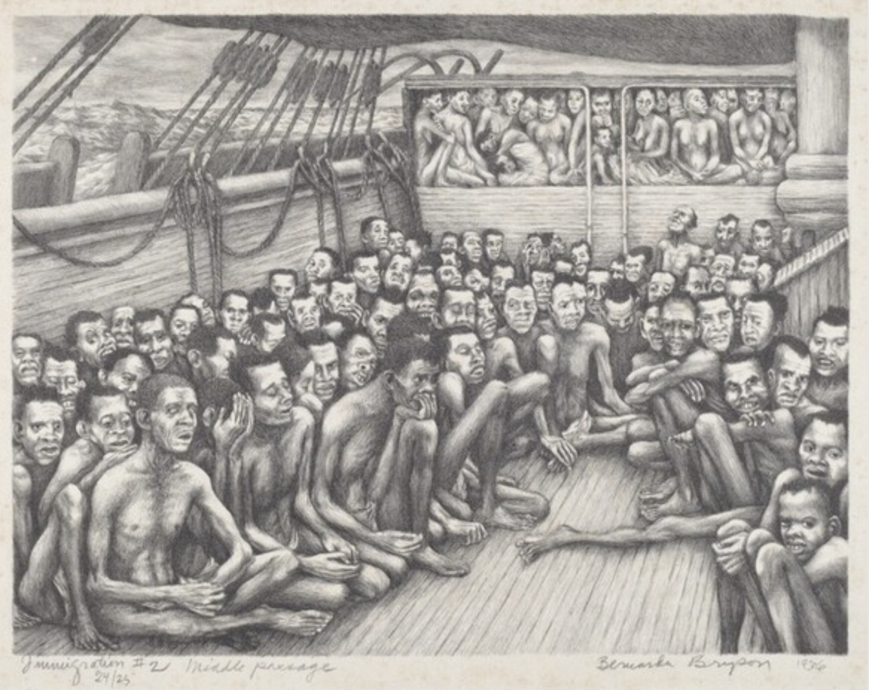
Is the artwork black & white or in color?
Is there a caption? If so what does it tell you
Why do you think the artwork was created?
Who is the artist and what is their relationship to the topic”
How does this artwork compare to modern times?
Where do you think we could find out more information about the people or objects in the artwork?

Slide 4
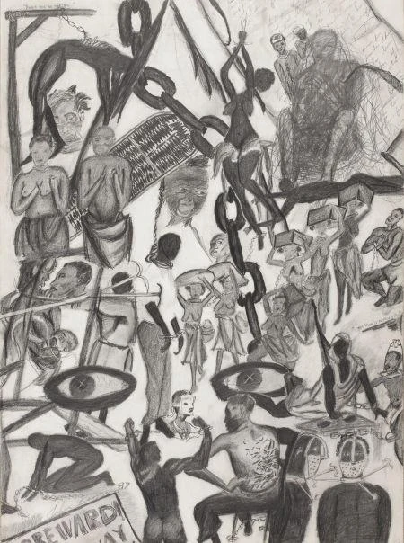
Is the artwork black & white or in color?
Is there a caption? If so what does it tell you?
Why do you think the artwork was created?
Who is the artist and what is their relationship to the topic”
How does this artwork compare to modern times?
Where do you think we could find out more information about the people or objects in the artwork?

Slide 5
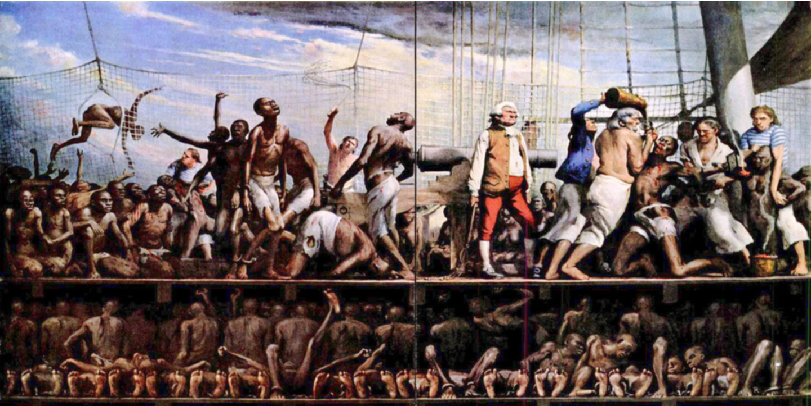
Is the artwork black & white or in color?
Is there a caption? If so what does it tell you?
Why do you think the artwork was created?
Who is the artist and what is their relationship to the topic”
How does this artwork compare to modern times?
Where do you think we could find out more information about the people or objects in the artwork?

Slide 6
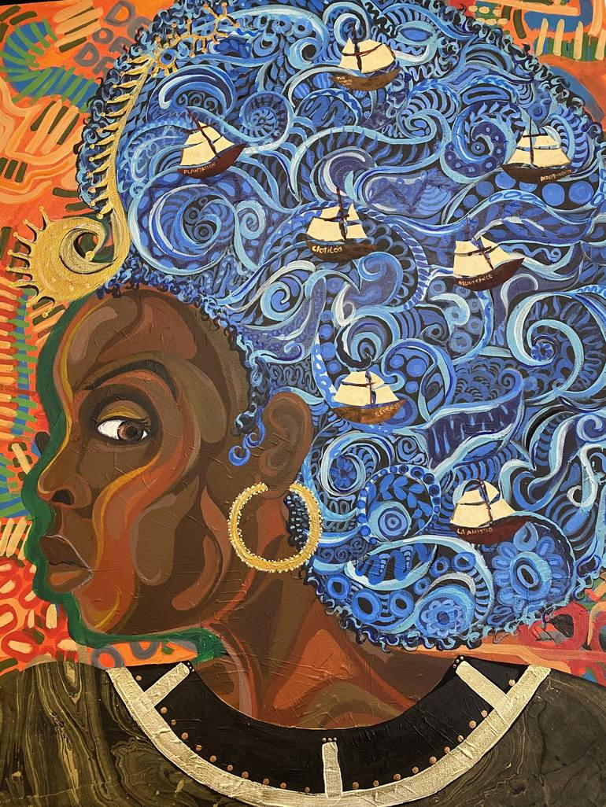
Is the artwork black & white or in color?
Is there a caption? If so what does it tell you
Why do you think the artwork was created?
Who is the artist and what is their relationship to the topic”
How does this artwork compare to modern times?
Where do you think we could find out more information about the people or objects in the artwork?

Slide 7
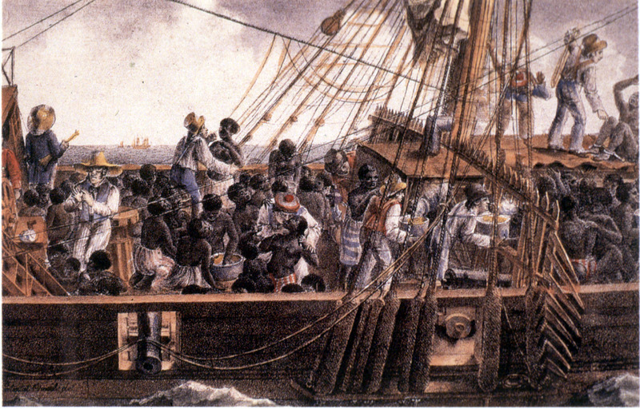
Is the artwork black & white or in color?
Is there a caption? If so what does it tell you
Why do you think the artwork was created?
Who is the artist and what is their relationship to the topic”
How does this artwork compare to modern times?
Where do you think we could find out more information about the people or objects in the artwork?

