Slide 1
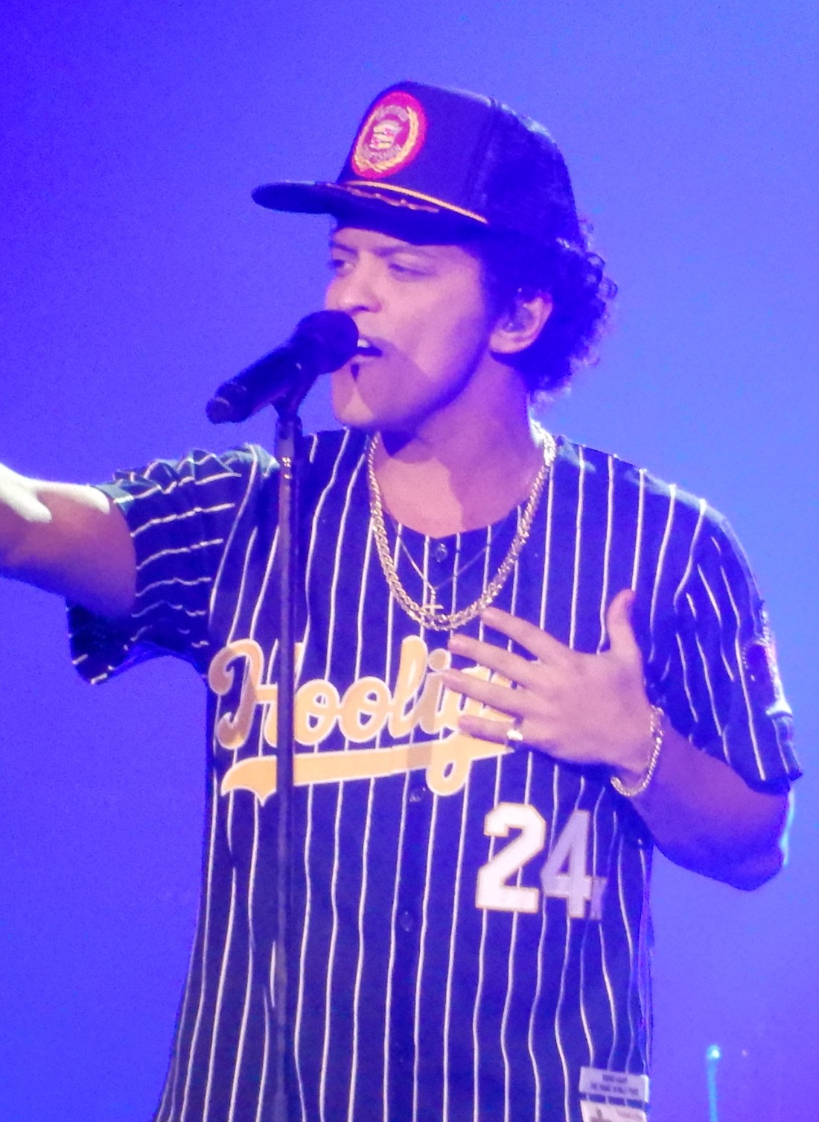
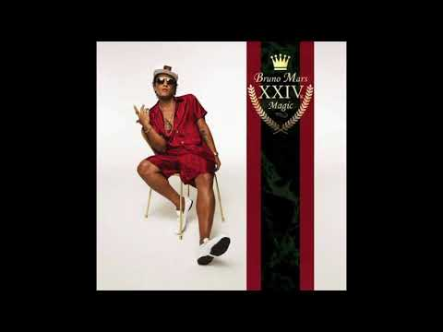
Bruno Mars
Bruno Mars is an artist that has been influenced by the musical traditions of enslaved people. His music is R&B and Soul music, which comes from Blues music. In his songs, we can hear call-and-response, chants, and drumming which are all traditions that enslaved people developed from Africa.

